Slide 1
OSP Organizational Changes
December MRAM
Carol Rhodes
Office of Sponsored Programs

Slide 2
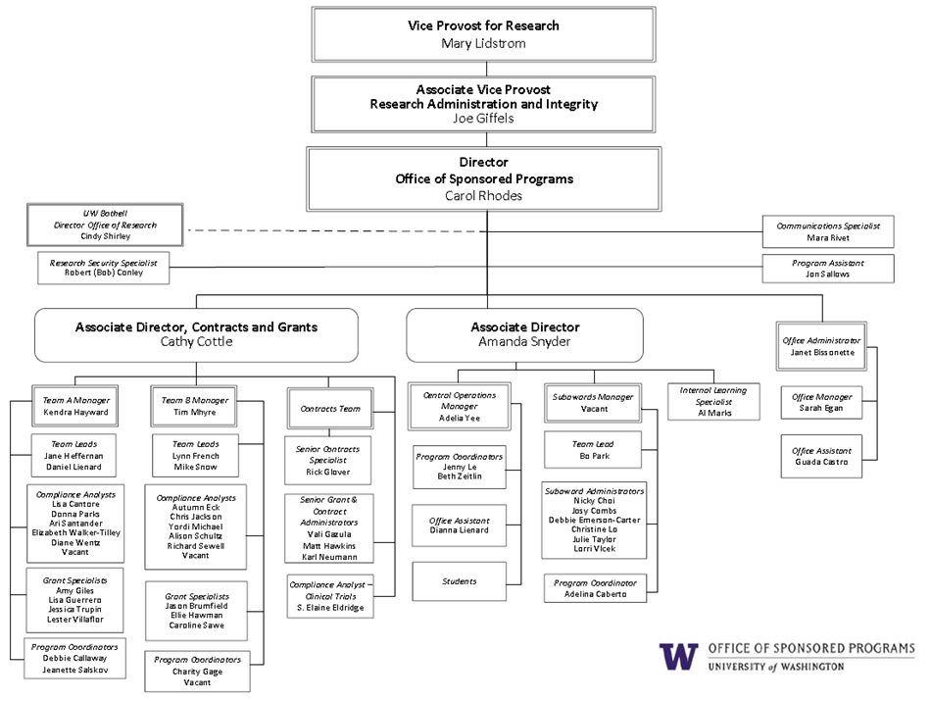
JLKJDKJ
asjdklajska
Notes:
OSP Organizational Chart

Slide 3
Questions

