Slide 1
Institutional Allowance Budgets
MRAM
December, 2017
Matt Gardner
Post Award Fiscal Compliance

Slide 2
Current IA Treatment
Currently, IA funds are transferred to a 67-budget upon receipt of the Fellowship (80-budget) using transfer coding (9481/9480).
We have noticed in some instances that 67-budget funds remain unexpended for years after the original fellowship budget closed.
MRAM – Matt Gardner – Post Award Fiscal Compliance

Slide 3
Simplification Proposal
In an effort to simplify this process, we propose establishing sub budgets moving forward.
These new sub budgets will carry the same end date as their related parent (80-budget).
MRAM – Matt Gardner – Post Award Fiscal Compliance

Slide 4
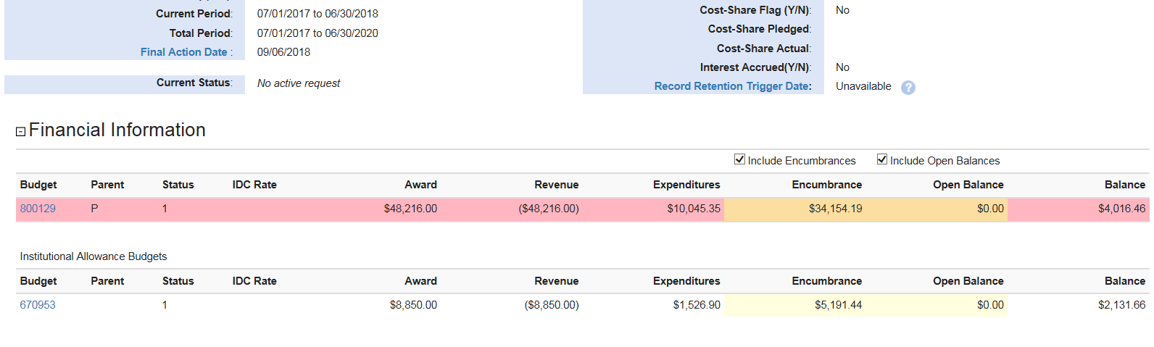
IA Visual “Before”
IA 67-budget related, but not a sub budget. Can carry a different end date then linked 80-budget.
MRAM – Matt Gardner – Post Award Fiscal Compliance

Slide 5
IA Visual “After”
IA will function as a standard sub budget, with the benefit of a view that clearly displays the award as one unit (rather than spread across two or more distinct standalone budgets).
MRAM – Matt Gardner – Post Award Fiscal Compliance

Slide 6
Questions?
gcahelp@uw.edu
206-616-9995

