Slide 1
MRAM | Monthly Research Administration Meeting
MARCH 15, 2018 9:00 AM – 10:00 AM UW TOWER AUDITORIUM
TOPIC | PRESENTER | EMAIL | MIN
Welcome | Kirsten DeFries Research Compliance & Operations | kirsten5@uw.edu | 2
Compliance Tools | Andra Sawyer & Matt Gardner Post Award Financial Compliance | gcafco@uw.edu | 25
Fringe Benefit Rates for Proposals | Carol Rhodes Office of Sponsored Programs | carhodes@uw.edu | 5
SAGE: eGC1 Compliance Updates | Chris Carlson ORIS | carlsc@uw.edu | 15
New VPN Security Requirement | Rebekah Skiver Thompson Chief Information Security Office | bskiver@uw.edu | 10
Salary Cap Cost Sharing & eFECS | Michael Anthony Management Accounting & Analysis | mda1213@uw.edu | 3
NEXT MEETING APRIL 12, 2018 UW TOWER AUDITORIUM

Slide 2
COMPLIANCE CORNER
MRAM
March, 2018
Andra Sawyer & Matt Gardner
Post Award Fiscal Compliance

Slide 3
New PAFC/GCA Tools
Cost Share Addendum
http://finance.uw.edu/gca/cost-share
Internal Controls – Purchasing eLearning
http://finance.uw.edu/pafc/trainings-and-outreach
Fiscal Compliance Dashboard
https://bitools.uw.edu/#/projects/228/workbooks

Slide 4
New Cost Share Addendum
What’s New?
Cost Share Calculators are linked to the Addendum
Addendum displays the benefits and/or F&A for each Cost Share item
F&A Rate only entered one time on the Addendum
Why is this better?
Reduction in the amount of information entered
Less chance for error
Easier to review the benefits and F&A costs
Easier to reconcile to eFECS Summary
MRAM – Post Award Fiscal Compliance

Slide 5
New Cost Share Addendum
Four different Excel files
Calendar Percent-based
Calendar Dollar-based
Academic Percent-based
Academic Dollar-based
Drop-down menus to prevent using the wrong form (Academic vs. Calendar)
Updated Cost Share content on the GCA webpage
http://finance.uw.edu/gca/cost-share
MRAM – Post Award Fiscal Compliance

Slide 6
New Cost Share Addendum
Want to see the New Addendum yourself?
Training for Campus!
Date: April 24th, 2018
Time: 9:30am – 11:00am
Room: Foege N130A
Sign up at CORE
https://uwresearch.gosignmeup.com/Public/Course/Browse
MRAM – Post Award Fiscal Compliance

Slide 7
New Cost Share Addendum
Questions?
Andra Sawyer
andra2@uw.edu
206-685-8902
Matt Gardner
mgard4@uw.edu
206-543-2610
Matt & Andra
gcafco@uw.edu
GCA
gcahelp@uw.edu
206-616-9995
MRAM – Post Award Fiscal Compliance

Slide 8
UPCOMING COURSES
IN RESEARCH ADMINISTRATION
 | Mar 28 | MAA 210 | Modifying an FEC, Change Outside eFECS and Recertifications
 | Apr 3 | OSP 101 | Introduction to Research Administration
 | Apr 11 | MAA 220 | Managing Faculty Effort
 | Apr 17 | GCA 203 | Preparing for Audit
New! | Apr 18 | OR Special Topics | Handling Research Administration Data
New! | Apr 24 | RAA 100 | Cost Share Essentials: Filling out the Addendum
New! | Online Class | RAA 203 | Internal Controls: Basic Concepts
Register: https://uwresearch.gosignmeup.com/public/course/browse
CORE home: https://www.washington.edu/research/training/about-core/

Slide 9
Internal Controls eLearning
Notes:
Only small part of Internal Controls, just around purchasing and purchase documentation – here is a screen shot of what the introduction looks like, you can see the content covered on the left menu bar. As with all of our eLearnings, set up so that users can either use as a reference tool and just enter the sections of interest or can take the entire course. If want credit then need to pass the Quiz at the end

Slide 10
Goals & Objectives

Slide 11
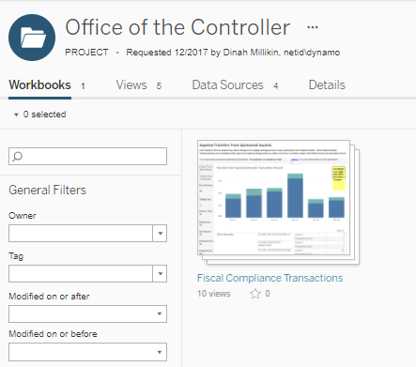
Office of the Controller Dashboard
Aged Receivables & high risk transactions on Sponsored Awards
Options for Open and Controlled Access
Program will expand
Uses Tableau which is:
Really cool
Frustrating
Notes:
When open it will see this view, click on the pic and you will see….

Slide 12
Office of the Controller Dashboard:
Aged Receivables has Open Access
Notes:
Cover what the A/R viz includes, updated daily

Slide 13
Visualizations with Controlled Access
Cost Transfers (To/From)
Equipment > 90 days Award End
Food
High risk transactions should be reviewed for:
Trends
Corrective actions
Training opportunities
Gaps in Internal Controls
Access > School/College Admin>email gcafco@uw.edu

Slide 14
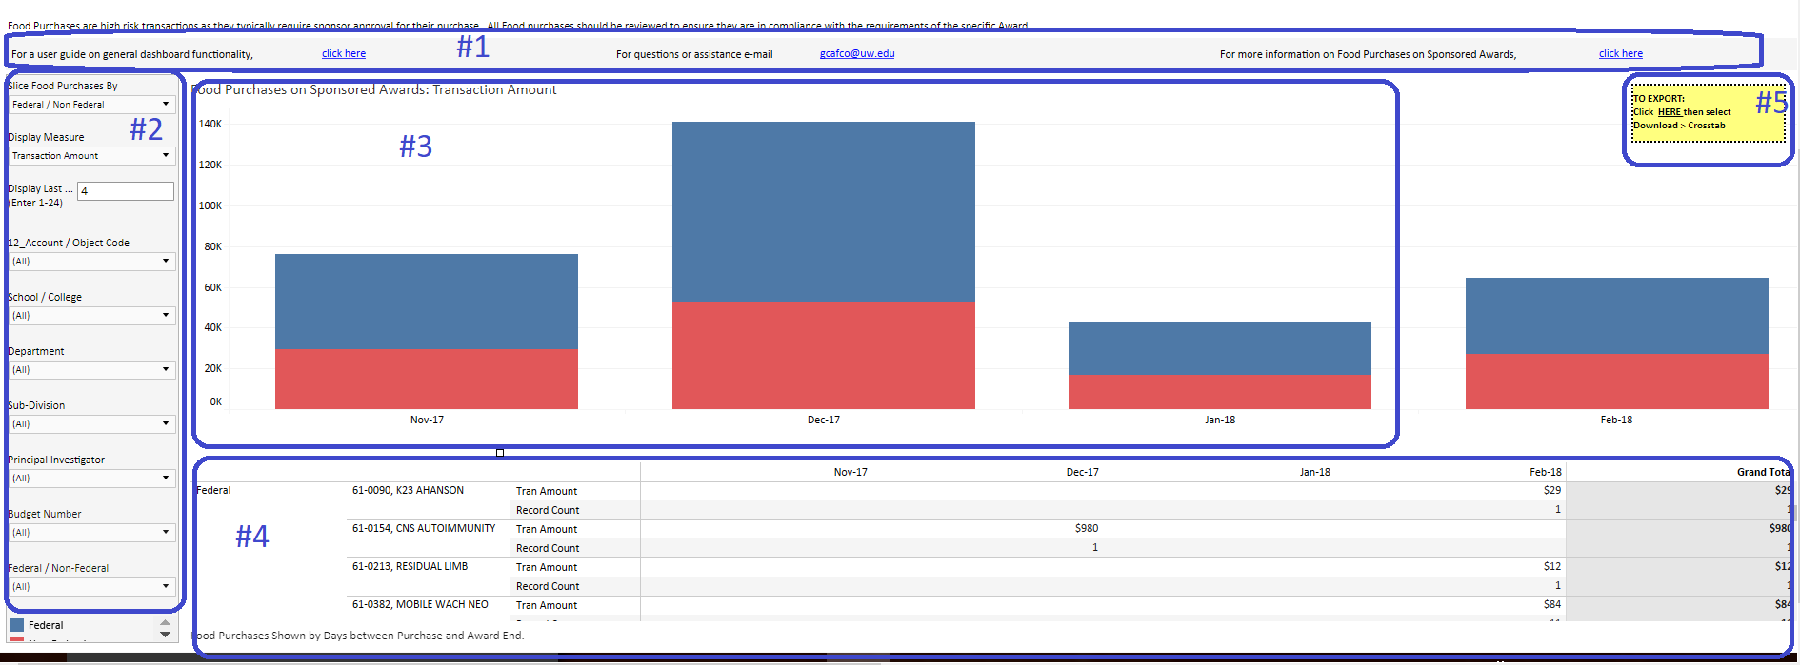
5 Parts to the Visualization
Help
Filter
Chart
Table
Export

Slide 15
Equipment Example: 1 department, Transaction Count, PI by Color

Slide 16
Food Example: 1 School, Transaction Amount, Colors by Department
Notes:
Highlight hover functionality; and Export

Slide 17
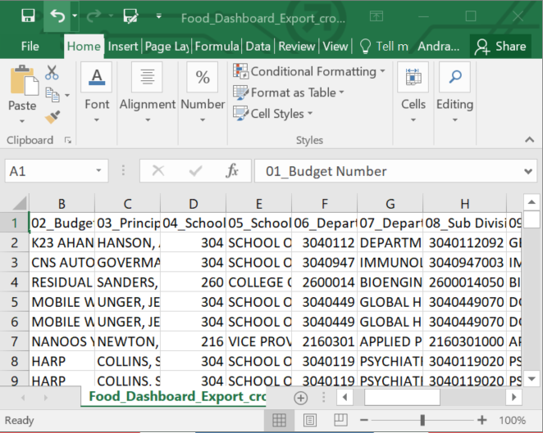
Filtered Data Exported into Excel
Budget Number & Name
Org Code (broken down into 3 segments)
PI Name
Revenue Class (Sponsor)
Federal/Non-Federal
Account Code
Posting Date
Amount
Notes:
Export functionality in Tableau, its terrible

Slide 18
Cost Transfers, includes information from MyFD
Notes:
Bonus section

Slide 19
Cost Transfers - Additional Exported Data
Name of Preparer
Name of Submitter
Number of days from Original Posting to Transfer Date
Responses to 3 Questions in MyFD:
Reason for Transfer
Benefit to Award
Reason for Delay (if > 120 days from original posting)

Slide 20
Office of Controller Dashboard - Key Points
Aged Receivables – open access
Controlled access
School/College Admin email gcafco@uw.edu for access
Help information on Dashboard
PAFC Outreach
Contact PAFC for School/College/Department customized presentation

Slide 21
Fringe
Benefit Rates for
Proposals
March 2018 MRAM
Carol Rhodes
Office of Sponsored Programs

Slide 22
Sample Benefit Rate Approval Timeline for Proposal Submissions
in Benefit Rate Table
& SAGE Budget
DHHS approval may
not happen until next FY
Preliminary Rates
proposed to DHHS
Available rates active 1st FY payroll (July 1- July 15), even if not yet approved by Department of Health & Human Services (DHHS).
Jan Feb Mar Apr May June
July Aug Sept Oct Nov Dec Jan
FY End June 30
FY Begin
July 1
Next Fiscal Year Rates
Estimates available
DHHS
approves rates
Proposal Submission:
Use preliminary rates for future FY budgets
Proposal Submission:
approved rates for current FY budgets & preliminary for future FY
Notes:
Fringe Benefit Rate Fiscal Year Timeline approval process and proposal preparation. It also provides scenarios for proposal preparation throughout a fiscal year illustrating what rates to use.
In the beginning of the year Financial Reporting calculates the next fiscal year (FY) rate forecast estimates.
These estimated rates are published as a downloadable pdf on the Fringe Benefit Load Rate page (http://finance.uw.edu/fr/fringe-benefit-load-rate)
In the following months, those preliminary rates are proposed to the Department of Health & Human Services (DHHS).
After rates proposed to DHHS, our Financial System, the Fringe Benefit Rate table and SAGE Budget are updated to reflect new proposed rates.
Sponsored Program proposals should use available estimated or preliminary proposed rates to most accurately reflect future estimated FY rates.
DHHS reviews and approves or requests changes to proposed rates.
This process can take a long time. Sometimes rates are not approved until well after a FY has begun.
Rates are active the first FY payroll (July1-July15), even if not yet approved by DHHS.

Slide 23
Fringe Benefit Rate
Notes & Resources
UW Finance system charges active rates regardless of what’s in proposal.
Most sponsors allow preliminary rate estimates in proposals.
Some sponsors ONLY allow current approved rates from rate agreement, even if budget includes later years.
Contact OSP to work with these sponsors.
Budget years that cross the current fiscal year and future fiscal year?
Use current approved rate & preliminary rate, prorate accordingly.
Resources:
Fringe Benefit Load Rate page: preliminary estimates posted
Preliminary rates in Rate Table & SAGE Budget after proposal submitted to DHHS
Fringe Benefit Rate table and SAGE Budget have current active rates.
Notes:
http://finance.uw.edu/fr/fringe-benefit-load-rate
https://www.washington.edu/research/institutional-facts-and-rates/#employee-benefits

Slide 24
Questions?

Slide 25
SAGE Compliance Improvements Release 2
MRAM
March 15th, 2018
Chris Carlson - Technology Project Manager
ORIS
carlsc@uw.edu

Slide 26
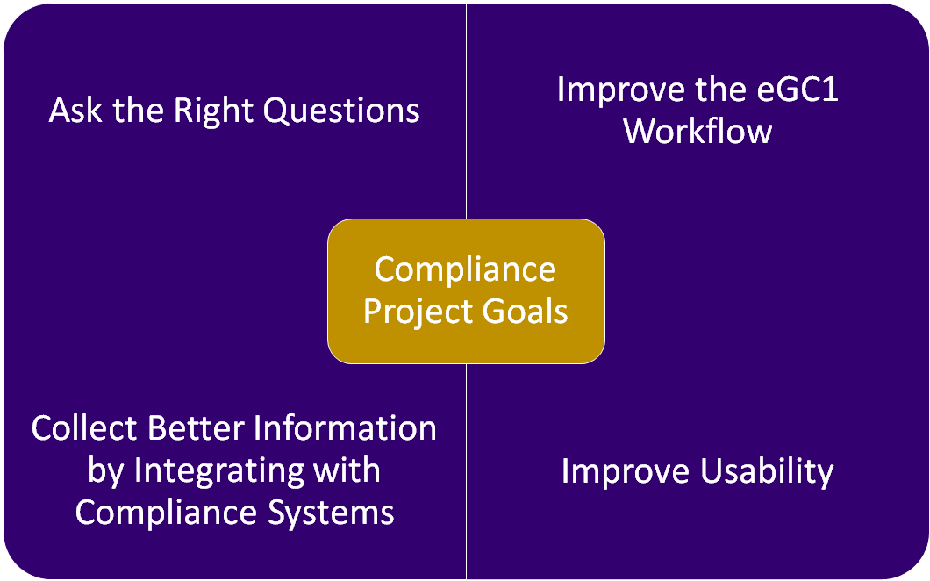
MRAM - Chris Carlson - ORIS

Slide 27
Multi-Phased Feature Delivery
Release 1 (10/17/17) | Release 2 (04/19/18)
Goal: Ask the Right Questions
Eliminate unnecessary questions Reword fiscal and admin questions to better clarify purpose/intent | Revise compliance questions for improved clarity
Goal: Improve Workflow
Move fiscal & administrative questions off Compliance page Add new Activity Locations page | Provide PIs with direct access to Non-Fiscal Compliance page via URL
Goal: Integrate with other Systems
Use GeoSIMS for location lookups | Link Zipline and Hoverboard to Human Subjects and Animal Use sections of eGC1
Goal: Improve Usability
Updated design on Activity Locations | Improved design for Non-Fiscal Compliance page Activity Locations design updated based on subsequent feedback
MRAM - Chris Carlson - ORIS

Slide 28
How We Got Here
Project prioritized due to campus feedback
Stakeholder-driven design
Campus input:
Compliance working group
Research Administration Process Improvement Team (RAPIT)
Sub-group of college/school-level reviewers
OSP partnership
Input from compliance reviewers in HSD, OAW, EH&S, CoMotion, and OR/Export Control
Two rounds of User Acceptance Testing with eGC1 preparers
Sign up to participate in our user research community
MRAM - Chris Carlson - ORIS

Slide 29
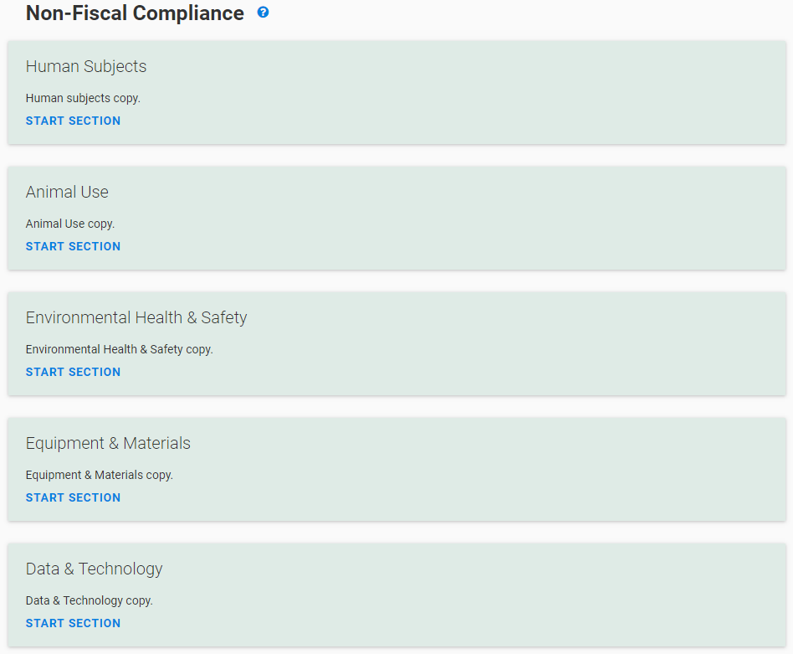
Release 2 Feature Overview
Started fresh, asking:
“What questions need to be asked at time of proposal and why?”
Questions re-worded and re-organized for improved clarity
Obsolete questions removed
Summary page gives transparency to progress, and guidance on how each section is reviewed

Slide 30
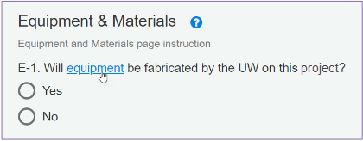
Release 2 Feature Overview
Improved system help documentation
Why asked? What’s it used for?
Links to definitions, guidance

Slide 31
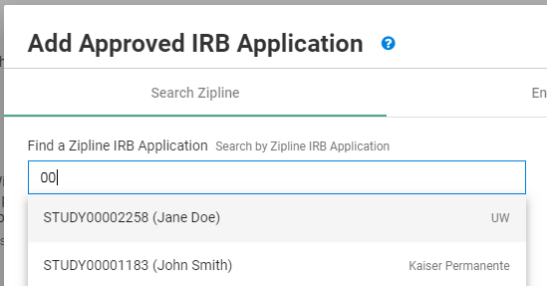
Release 2 Feature Overview
Connect SAGE to Zipline and Hoverboard
Search Zipline and Hoverboard for protocols
Once selected, real-time changes/updates will display in SAGE
(no info from SAGE currently flows to ZL/HB)
MRAM - Chris Carlson - ORIS

Slide 32
Release 2 Feature Overview
Improved collaboration with PI
Send the PI a URL to NFC page for a specific eGC1
The PI can complete the NFC page while you work on other parts of the eGC1
Additional benefits
Direct URLs available to all standard eGC1 pages (not Grant Runner forms)
MRAM - Chris Carlson - ORIS

Slide 33
Summary of Release 2 Benefits
Streamlining:
Removed obsolete questions
Pulls in details from Zipline + Hoverboard
Expedited reviews enabled by more detailed and accurate protocol information
Usability:
Revised, reworded questions for clarity & relevance
Improved design and user experience
Enhanced Collaboration:
Send URL to PIs for direct edit, collaboration
MRAM - Chris Carlson - ORIS

Slide 34
Resources and Feedback
Resources
SNEAK PEEK: View the questions before they go live
eGC1 Compliance Question FAQs (TBD)
SAGE Help Documentation
Non-Fiscal Compliance Guidance
Have questions or suggestions?
Contact sagehelp@uw.edu
MRAM - Chris Carlson - ORIS

Slide 35
New VPN Security Requirement
MRAM
March 2018
Rebekah Skiver Thompson
Incident Response & Threat Intelligence Manager
Office of the Chief Information Security Officer
bskiver@uw.edu

Slide 36
Current network state
Campus network:
Allow all inbound traffic from any location
Block subset of traffic triggering “signatures” in IPS.
UW is a known target of threat actors targeting intellectual property, personal information, credentials, etc.

Slide 37
Network changes: April 24, 2018
Block all inbound traffic over certain ports using phased approach.
April 24: Block inbound RDP- and SMB-related ports
Future phases (dates TBD) will add additional ports
Includes UW Medicine network
Require use of Husky OnNet (or other departmental VPNs) in order to use those ports.

Slide 38
What is RDP and SMB?
Remote Desktop Protocol (RDP)
Including Virtual Network Computing (VNC)
Ports 3389, 5900
Remote desktop, desktop sharing
Server Message Block (SMB)
Including NetBios (largely legacy protocol)
Ports 445, 135, 137, 138, 139
Network file sharing

Slide 40
What is RDP and SMB?
Remote Desktop Protocol (RDP)
Including Virtual Network Computing (VNC)
Ports 3389, 5900
Remote desktop, desktop sharing
Server Message Block (SMB)
Including NetBios (largely legacy protocol)
Ports 445, 135, 137, 138, 139
Network file sharing
Notes:
SMB: port 445
NetBios: ports 135, 137, 138, 139 (largely legacy protocol)

Slide 41
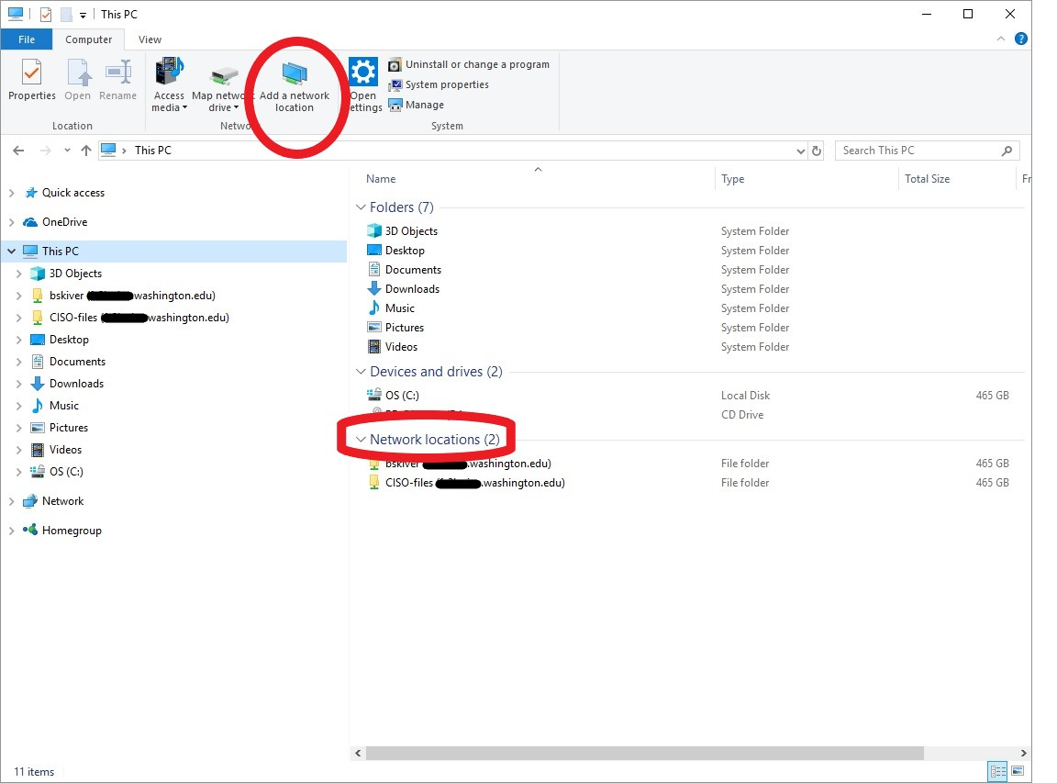

Slide 42
What do users need to do?
Connections from on campus will not be affected
“Campus” includes Seattle/Tacoma/Bothell campuses, UW Medicine (and associated hospitals/clinics), some remote research sites
Connections from off campus:
Use a campus Virtual Private Network (VPN)
E.g., Husky OnNet, Pulse Secure, departmental VPN
Not sure of network location?
Check the Networks Portal tool
https://networks.uw.edu/networks/

Slide 43
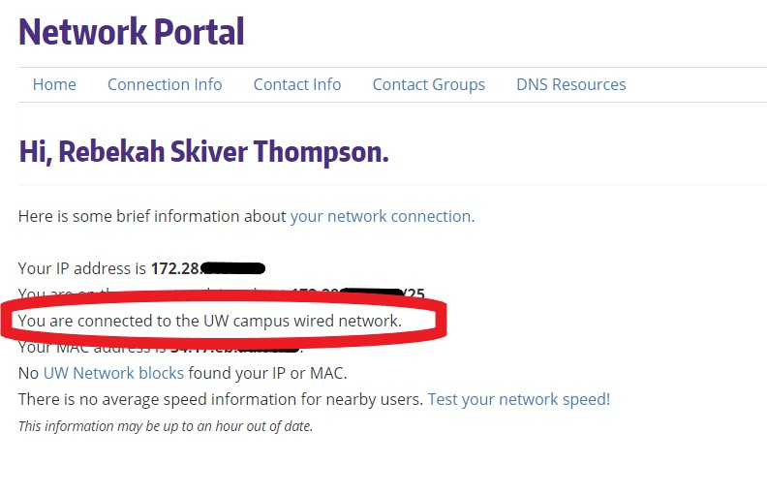
https://networks.uw.edu/networks/

Slide 44
Husky OnNet VPN
Who is eligible
Current UW students, staff, faculty
Sponsored NetIDs with “Assign Computing Service Packages”
Where to get it
Search IT Connect for “Husky OnNet”
https://itconnect.uw.edu/connect/uw-networks/about-husky-onnet/
Husky OnNet-Department Service also available
For-fee service
Department can control the list of eligible NetIDs

Slide 45
What is NOT affected?
Email
Library resources
Web browsing
Canvas
UW Google Suite, Office365
Etc.

Slide 46
Questions?
Contact help@uw.edu with “Network port blocking” in the subject line.

Slide 47
Salary Cap Cost Sharing and eFECS Application
MRAM - March 15, 2018
Michael Anthony
Executive Director
Research & Student Accounting
University of Washington

Slide 48
Status of Salary Cap Threshold
NIH announced new threshold March 7 (NOT-OD-18-137)
Have not as yet provided funding at the new level
PIs must re-budget to accommodate additional salary
Suspect agencies will not fund at new level until formal FY2018 federal budget approved (i.e., agencies operating under continuing resolution)
As a result we anticipate not many departments have started charging grants at the new threshold
University of Washington Management Accounting & Analysis

Slide 49
Planning for eFECS
Prior years eFECS averaged salary CAP for 9/16 -3/15 cycle
Considering leaving 9/16/17 – 3/15/18 at the old threshold
Departments who have started charging at the new threshold would need to adjust salary cap cost sharing
Prior years eFECS implemented full CAP amount for the 1/1 - 6/30 cycle
Considering averaging salary cap for 1/1 – 6/30/18 cycle
Would like input from Schools of Dentistry, Medicine, Pharmacy & Public Health as to preference (efecs@uw)
University of Washington Management Accounting & Analysis
Notes:
Need your input by the end of the month

Slide 50
NEW COURSE!
 | Handling Research Administration Data (Apr 18, 1:00-2:30 pm) Join us for a hands-on workshop to learn or improve how you source, organize, analyze and use research application, award and expenditure data. The Enterprise Data Warehouse (EDW) is the official source of UW data. The Business Intelligence (BI) Portal uses the EDW to allow you to review and analyze data to help inform business decisions. What are you going to learn? In this workshop, you will: Take a deeper dive into data available in the Office of Research FY 2017 Annual Report Access and select the Research Administration Data most relevant to you Perform analysis using the Research Administration Data Cube and PivotTables to answer questions Who should attend? Research team members who are responsible for understanding or providing insights and trends related to the application, award and expenditures managed by your research team or your department. Already managing your own spreadsheets with data you’ve gathered from various locations? This workshop will be helpful for you, too. You will learn why the data in the EDW is the official source for research data and also learn skills to eliminate extra tools you have to manage, reducing your workload. Take control of your data and gain real business insights that help you and your teams make data-driven decisions.
Register: https://uwresearch.gosignmeup.com/public/course/browse
CORE home: https://www.washington.edu/research/training/about-core/
Notes:
Office of Research is offering a new course on Handling Research Administration Data. Key data from SAGE is available in the BI portal in three forms, Visualizations, Reports and Data cube. This workshop will help you learn or get better at analyzing data. April 18 will be the first session and additional courses will be added later in the year. You will receive a registration link via email after MRAM. Registration link: https://uwresearch.gosignmeup.com/public/Course/browse?courseid=2949

