Slide 1
New VPN Security Requirement
MRAM
March 2018
Rebekah Skiver Thompson
Incident Response & Threat Intelligence Manager
Office of the Chief Information Security Officer
bskiver@uw.edu

Slide 2
Current network state
Campus network:
Allow all inbound traffic from any location
Block subset of traffic triggering “signatures” in IPS.
UW is a known target of threat actors targeting intellectual property, personal information, credentials, etc.

Slide 3
Network changes: April 24, 2018
Block all inbound traffic over certain ports using phased approach.
April 24: Block inbound RDP- and SMB-related ports
Future phases (dates TBD) will add additional ports
Includes UW Medicine network
Require use of Husky OnNet (or other departmental VPNs) in order to use those ports.

Slide 4
What is RDP and SMB?
Remote Desktop Protocol (RDP)
Including Virtual Network Computing (VNC)
Ports 3389, 5900
Remote desktop, desktop sharing
Server Message Block (SMB)
Including NetBios (largely legacy protocol)
Ports 445, 135, 137, 138, 139
Network file sharing

Slide 6
What is RDP and SMB?
Remote Desktop Protocol (RDP)
Including Virtual Network Computing (VNC)
Ports 3389, 5900
Remote desktop, desktop sharing
Server Message Block (SMB)
Including NetBios (largely legacy protocol)
Ports 445, 135, 137, 138, 139
Network file sharing
Notes:
SMB: port 445
NetBios: ports 135, 137, 138, 139 (largely legacy protocol)

Slide 7
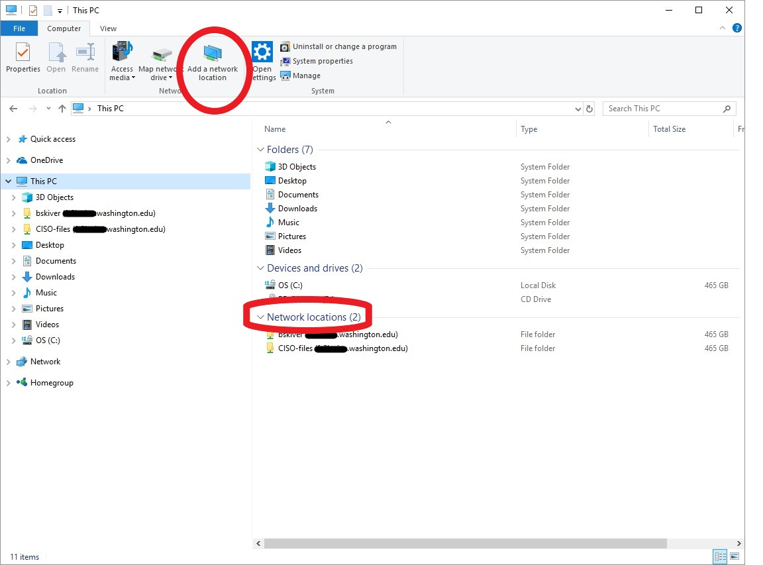

Slide 8
What do users need to do?
Connections from on campus will not be affected
“Campus” includes Seattle/Tacoma/Bothell campuses, UW Medicine (and associated hospitals/clinics), some remote research sites
Connections from off campus:
Use a campus Virtual Private Network (VPN)
E.g., Husky OnNet, Pulse Secure, departmental VPN
Not sure of network location?
Check the Networks Portal tool
https://networks.uw.edu/networks/

Slide 9
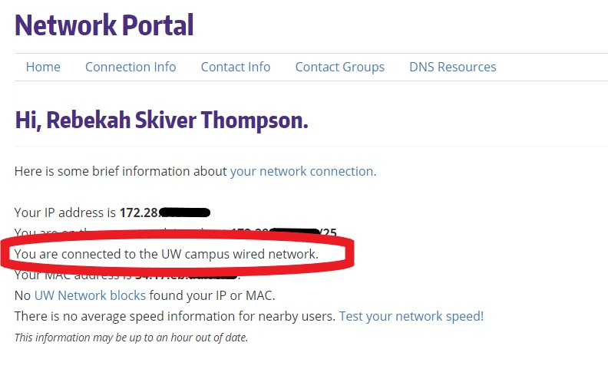
https://networks.uw.edu/networks/

Slide 10
Husky OnNet VPN
Who is eligible
Current UW students, staff, faculty
Sponsored NetIDs with “Assign Computing Service Packages”
Where to get it
Search IT Connect for “Husky OnNet”
https://itconnect.uw.edu/connect/uw-networks/about-husky-onnet/
Husky OnNet-Department Service also available
For-fee service
Department can control the list of eligible NetIDs

Slide 11
What is NOT affected?
Email
Library resources
Web browsing
Canvas
UW Google Suite, Office365
Etc.

Slide 12
Questions?
Contact help@uw.edu with “Network port blocking” in the subject line.

