Slide 1
NSF Article X
Office of Research

Slide 2
Article X
Purpose
To make certain that recipients of NSF grants and cooperative agreements respond promptly and appropriately to instances of sexual harassment, other forms of harassment, or sexual assault
Office of Research

Slide 3
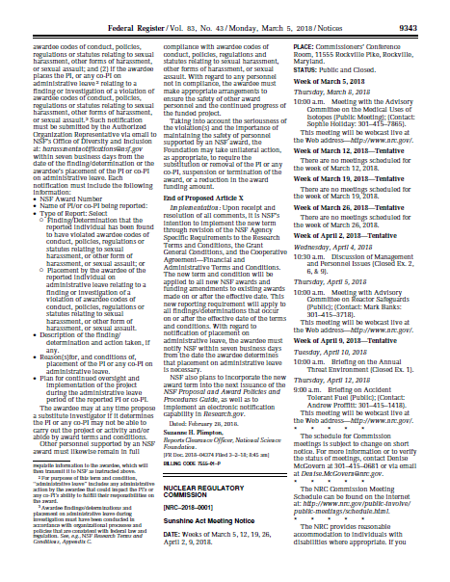
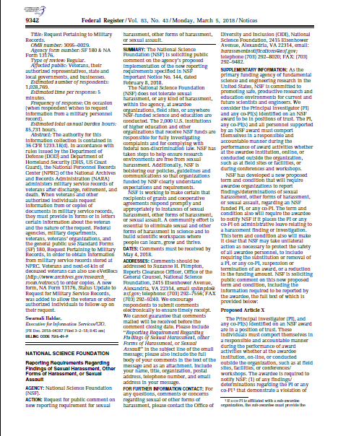
Federal Register Publication
March 5
NEW TERM AND CONDITION
Office of Research

Slide 4
Term and Condition – Reporting to NSF
Report findings or determinations of PI or co-PIs that demonstrate violation of institutional codes of conduct, policies, regulations, or statutes on sexual or other harassment or sexual assault
Report if awardee places PI or co-PIs on administrative leave relating to finding or investigation of PI or co-PIs for violating compliance with institutional codes of conduct, policies, regulations, or statutes on sexual or other harassment or sexual assault

Slide 5
Details
Applies to
new funding
determinations made after effective date
Report
within 7 days
to an NSF email
by Authorized Organization Representative

Slide 6
60 Day Comment Period
Comments due May 4
What does “during the performance of award activities” mean?
How will reports be processed?
Confidentiality
What does “other forms of harassment” include?
Subrecipients (Prime vs Sub responsibilities)
In the case of conflicting regulation, such as FERPA, which takes precedence?
Extend 7 day reporting requirement to 30 days
PI reputation

Slide 7
Current vs Future State
Policies and investigative processes
Obligation to replace PI who can’t direct the research
Reporting
Other agencies to follow suit

