Slide 1
MRAM | Monthly Research Administration Meeting
MAY 10, 2018 9:00 AM – 10:00 AM UW TOWER AUDITORIUM
TOPIC | PRESENTER | EMAIL | MIN
Welcome | Kirsten DeFries Research Compliance & Operations | kirsten5@uw.edu | 2
Federal Budget: Possible Impacts to Funding Opportunities | Carol Rhodes Office of Sponsored Programs | carhodes@uw.edu | 5
SAGE Updates | Chris Carlson Office of research Information Services (ORIS) | carlsc@uw.edu | 10
EH&S Updated Website | Karen Crow Environmental Health & Safety (EH&S) | karenlc@uw.edu | 10
M&E Tax Exemption | Kyle Richard Tax Office | krich1@uw.edu | 15
Compliance Corner | Matt Gardner Post Award Financial Compliance | mgard4@uw.edu | 10
CORE Update | Matt Gardner Collaborative On Research Education (CORE) | corehelp@uw.ed | 2
NEXT MEETING JUNE 14, 2018 UW TOWER AUDITORIUM

Slide 2
Possible Impact of Federal Research Budgets
Carol Rhodes
Director
Office of Sponsored Programs
MRAM – May 2018

Slide 3
Possible Impact of Federal Research Budgets on Proposals and Awards
FY2018 & 2019
UW needs to be ready for an influx of proposals and awards over the next several months
Notes:
Federal Budget Deal covered federal FY2018 and 2019
FY2018 = Oct 1, 2017 – Sep 30, 2018
FY2019 = Oct 1, 2018 – Sep 30, 2019
That deal called for a 5-10% increase in federal funding for research for FY2018 (compressed into a few short months) and another small (2% or less) increase in FY2019
We have no reason to suspect UW researchers won’t be successful in competing for their fair share
PIs should be on the lookout for FOAs – with short turnaround times because funds need to be obligated by federal agencies by Sep 30
FOAs could be for supplements, new projects, equipment -- almost anything
We need to be ready for an influx of proposals and then for an influx of awards (this is good news)

Slide 4
GIM 19 exceptions include . . .
When documented notification of
funding opportunity was made
less than two ( 2) weeks prior
to deadline.
Use waiver request process.

Slide 5
Unknown Variable
Rescission is a request to Congress from Administration to revoke portions of the budget.
Congress can:
Vote to pass with majority in each chamber
No action
If no action after 45 days of the rescission request to Congress, budget remains as-is.
In meantime, there is a “hold” on the funding that is subject to rescission request.
Notes:
As of Monday, the request is to rescind $15 billion, mostly related to the Children’s Health Insurance Program (CHIP).

Slide 6
SAGE Compliance Improvements Release 2 Update
MRAM
May 10th, 2018
Chris Carlson - Technology Project Manager
ORIS
carlsc@uw.edu
Notes:
Good morning, my name is Chris Carlson, I’m from the Office of Research Information Services. I’m here this morning to give you a preview changes coming to the compliance sections of the eGC1 in SAGE.

Slide 7
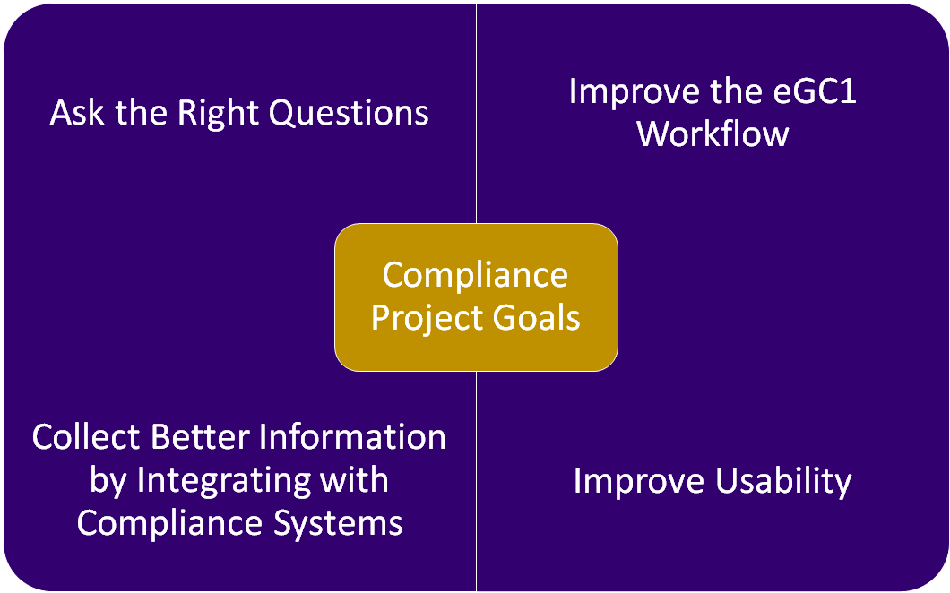
MRAM - Chris Carlson - ORIS
Notes:
The SAGE Compliance Improvements Project aims to redesign how compliance information is collected on the eGC1 to ensure the questions asked are relevant, that they’re asked in a way that facilitates a smooth workflow, leverages information already collected in other compliance systems, and utilizes modern design and accessibility standards.

Slide 8
May 17th Release
Goal: Ask the Right Questions
Revise compliance questions for improved clarity
Goal: Improve Workflow
Provide PIs with direct access to Non-Fiscal Compliance page via URL
Goal: Integrate with other Systems
Link Zipline and Hoverboard to Human Subjects and Animal Use sections of eGC1
Goal: Improve Usability
Improved design for Non-Fiscal Compliance page Activity Locations design updated based on subsequent feedback
MRAM - Chris Carlson - ORIS
Notes:
Our upcoming release is scheduled for next Thursday May 17th. This upcoming release will replace the existing Compliance Questions and Explanations sections with a new Non-Fiscal Compliance section with revised questions for improved clarity. We’ll also introduce the ability to copy/paste links to the specific page of a specific eGC1 so that preparers can provide PI’s with a more streamlined method of navigating to the Non-Fiscal Compliance questions. We’re leveraging the information collected in Zipline and Hoverboard, allowing you to link your IRB and IACUC protocols to the eGC1. And lastly, we’ve received your feedback on the new look and feel introduced in Activity Locations, and are applying those improvements to both Non-Fiscal Compliance and Activity Locations.

Slide 9
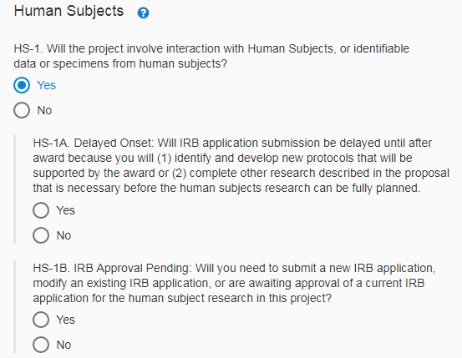
Release 2 Feature Overview
New and improved compliance questions
Questions re-worded and re-organized for improved clarity
Obsolete questions removed
Preview the questions before they go live
Notes:
In redesigning the compliance sections, we started fresh asking stakeholders “What questions need to be asked at the time of proposal, and why?” This was intended to ensure the questions being asked were relevant, necessary, and wording in a way that made their purpose clear. Obsolete questions were removed.

Slide 10
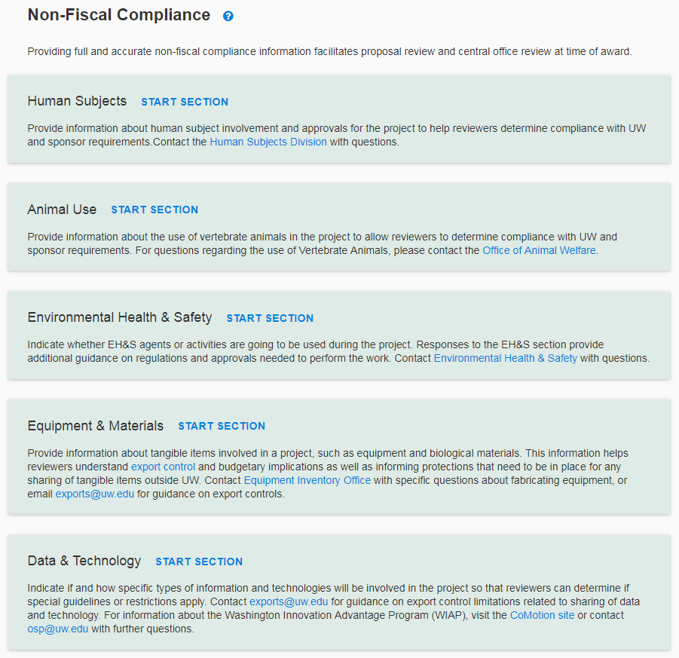
Release 2 Feature Overview
Improved Design
More modern look and feel, based on Activity Locations page feedback
Improved scannability and progress tracking
Supporting guidance embedded throughout with links and support documentation
Notes:
The design lessons learned from introduction of the Activity Locations page have been applied to the new Non-Fiscal Compliance page. You’ll be able to more easily can to see which sections have been started. The new Non-Fiscal Compliance summary page will provide you with a brief description of each section so you know why the information is being collected and who reviews it so that you know who to contact with questions.

Slide 11
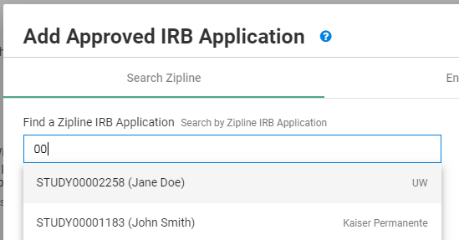
Release 2 Feature Overview
Connect SAGE to Zipline and Hoverboard
Search Zipline and Hoverboard for protocols
Once selected, real-time changes/updates will display in SAGE
(no info from SAGE currently flows to ZL/HB)
MRAM - Chris Carlson - ORIS
Notes:
With the recent introduction of new systems for IRB and IACUC submissions, SAGE will now allow you to search for protocols by the ID, and once linked pull real-time details into the eGC1. Each time you visit the page, you’ll see the latest information available from Zipline and Hoverboard. Note however that it’s currently a one-way link, so no SAGE information will flow to Zipline or Hoverboard.

Slide 12
Release 2 Feature Overview
Improved collaboration with PI
Send the PI a URL to NFC page for a specific eGC1
The PI can complete the NFC page while you work on other parts of the eGC1
Additional benefits
Direct URLs available to all standard eGC1 pages (not Grant Runner forms)
MRAM - Chris Carlson - ORIS
Notes:
We’re also introducing some features to improve the collaboration between preparers and PI’s on completing the Non-Fiscal Compliance section. When you’re on the Non-Fiscal Compliance page of a specific eGC1, you’ll now be able to copy the URL from the address bar, and share it with the PI (or other collaborators). If they have access to that eGC1, that link will take them directly to the page. PI’s can also complete the Non-Fiscal Compliance page even while you work on other parts of the eGC1. So no need to worry that the PI could try to enter and be locked out. Note that the feature allowing you to send direct URLs to eGC1 pages will work on ALL pages except Grant Runner forms. So this will hopefully streamline your ability to collaborate.

Slide 13
Summary of Release 2 Benefits
Streamline:
Removed obsolete questions
Pulls in details from Zipline + Hoverboard
Expedited reviews enabled by more detailed and accurate protocol information
Usability:
Revised, reworded questions for clarity & relevance
Improved design and user experience
Enhanced Collaboration:
Send URL to PIs for direct edit, collaboration
MRAM - Chris Carlson - ORIS
Notes:
So in summary, our next release will be aimed at streamlining by removing obsolete questions, integrating with Zipline and Hoverboard to reduce back-and-forth, and hopefully expedite reviews by providing more detailed and accurate protocol information. We’ll be improving usability to revising questions for clarity and relevance, while also building on the improved design standards from our October release. And lastly, improving collaboration between preparers and PI’s on the Non-Fiscal Compliance questions with shareable URLs and simultaneous editing.

Slide 14
What happens with eGC1s in Progress on 5/17?
If Composing status….
New questions apply, eGC1s will be updated
If in Read-Only state (Routing, In OSP, Approved, Denied.. status)
Questions in effect at time of “completion” apply and will not be changed, unless….
If Returned or Withdrawn
New questions apply
Notes:
How will this affect existing eGC1s? New eGC1s and those in Composing upon release will update to use the new questions. Those that are read-only, and in statuses like Routing, In OSP, Approved, Awarded, will retain their existing questions and responses. However if an eGC1 is returned or withdrawn after release, the new questions will be applied, and you’ll be required to answer them prior to re-completing your eGC1.

Slide 15
What happens with eGC1s in Progress on 5/17?
Tips if you have an eGC1 that could be returned or withdrawn after release:
Preview the new questions before release, and prepare your responses in advance.
Withdraw your eGC1 on 5/18 (right after release), and proactively answer the new questions to avoid last second scrambling.
MRAM - Chris Carlson - ORIS
Notes:
If you have an eGC1 that you think could be returned or withdrawn (for instance because it’s currently marked as ‘ready to submit’ NO) then a few strategies you could employ to avoid surprises at the last minute before a deadline: Preview the questions in advance so you know how they should be answered, and potentially withdraw your eGC1 the day after release to proactively update. We will also be sending out emails to SAGE users who have eGC1s in Routing or In OSP status prior to release to get the word out in advance of the release.

Slide 16
Resources and Feedback
Resources
SNEAK PEEK: Preview the questions before they go live
SAGE Help Documentation
Non-Fiscal Compliance Guidance on Research website
Have questions or suggestions?
Contact sagehelp@uw.edu
MRAM - Chris Carlson - ORIS
Notes:
Existing compliance guidance on the Research website will also be updated in conjunction with the release. If you have any other questions or suggestions, please email sagehelp@uw.edu as we love to hear from you. I’ll also be back for next month’s MRAM to give you an update and reminder. Does anyone have any questions?

Slide 17
WEBSITE REDESIGN
Karen Crow, Outreach & Health Education Analyst
MRAM Meeting
May 10, 2018

Slide 18
BACKGROUND
ABOUT EH&S
60+ safety programs serving multiple client groups
WEBSITE PROJECT GOALS
Replace a static HTML website with CMS website
More professional and consistent with the UW Brand
Easier for content owners to update pages
Easier for users to navigate and locate safety information
DESIRED FEATURES
Training course wizard
Online forms with authentication
Strong search feature
Easy access to popular items and news posts
Notes:
Karen Talking Points:
ABOUT EH&S
--EH&S offers more than 60 programs and services to promote health and safety on the UW campus
--Programs are mainly focused on reducing the risk of job-related accidents and injuries when faculty, staff and students are using hazardous materials or hazardous equipment.
--Many programs have safety training requirements and require users to take online safety training courses.
--Many programs help faculty and staff to comply with state and federal regulations by offering online resources, such as safety manuals, standard operating procedures and safety inspection checklists.

Slide 19
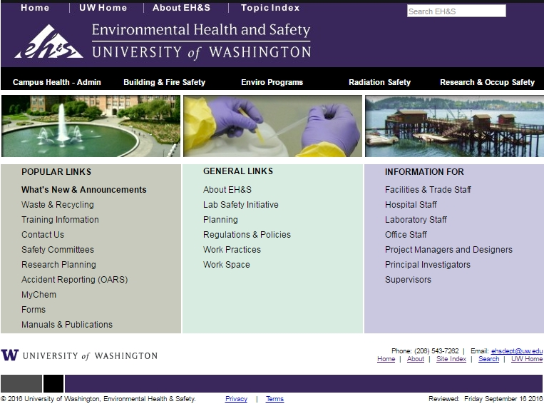
OLD EH&S WEBSITE
Notes:
Karen’s Talking Points
OLD WEBSITE
--Old EH&S logo
--Not UW Brand style
--Home page content static, does not direct users to new content
--Must dig for content, down rabbit holes
--Content organized by department structure, not user-oriented

Slide 20
WEBSITE REDESIGN PROJECT
2 years from contract signing to launch on Feb 2, 2018
From 1,200 HTML pages to about 300 pages
New features:
Organized by topic
Better search functionality
Report a Concern form
Training Course Selection Guides (in progress)
www.ehs.washington.edu (link)
Notes:
Karen’s Talking Points
View redesigned website at www.ehs.washington.edu
Features to highlight:
--Report a Concern form
--Training course guides
--Main Menu options
--Review organization by topic
--Based on user feedback

Slide 21
M&E Tax Exemption

Slide 22
What does the M&E Exemption Apply to?
Machinery and equipment (M&E), which:
Has a useful life of one year or more (as well as repair, maintenance, and installation services)
Is used for more than 50% of its life (measured by time) to discover new scientific information and to translate that scientific information into technological innovations
What is M&E
No definition in state law
Tangible personal property with a useful life of one year or more used in research to accomplish research objectives

Slide 23
What does the M&E Exemption Not Apply to?
M&E must be used in the research itself
equipment used to build other equipment that is later used in the research;
computers used to buy research equipment; and
building fixtures that merely hold or support equipment do not qualify
The purchase must not be:
consumable supplies;
hand-powered tools;
repair and replacement parts that are anticipated to last for less than one year; or
warranty protection

Slide 24
COMPLIANCE CORNER
MRAM
May, 2018
Matt Gardner
Post Award Fiscal Compliance

Slide 25
Effort Reporting Update
Department Administrator Unmet Cost Share Report is available again!
log in: https://depts.washington.edu/maaweb/maa/csapp/index.php
Need access to the Unmet CS report? E-mail efecs@uw.edu
FECs for academic cycle 9/16/2017 – 3/15/2018 were released in April
process all OSETs and cost share adjustments before the faculty certify. Certification deadline – 6/8/2018
In July 2018, the eFECS Effort Reporting application will purge electronic FECs for these reporting periods:
7/1/2011 – 12/31/2011
9/16/2011 – 3/15/2012
1/1/2012 – 6/30/2012
Welcome Liana Ksaibati

Slide 26
Tuition and Stipends
Sparse coverage in the Uniform Guidance
Federal rules require adherence to the UW’s institutional policies
Requirement of consistency and equitable treatment
Terminology can be inconsistent between Federal and non-Federal sponsors
MRAM – Matt Gardner - PAFC

Slide 27
Tuition
Allowable on a Federal award in two situations:
1. Covered by the University (or sponsor) under a Graduate Student Appointment. [2 CFR 200.431 and UW’s Executive Order 28]
2. Allowed by the sponsor on an award when the purpose of the award is to provide training to selected participants. [200.466]
MRAM – Matt Gardner - PAFC

Slide 28
Tuition - Unallowable In Lieu of Wages
Can a graduate student on an award be paid Tuition (08-05) in lieu of compensation (01-XX)?
No.
Uniform Guidance lists requirements to charge tuition in lieu of wages [§ 200.466] but..
Subject to the compensation reporting requirements [§ 200.466], which means producing a GCCRs but…
Tuition has no associated effort so..
UW cannot meet federal requirements.
MRAM – Matt Gardner - PAFC

Slide 29
Stipends
Stipends are not compensation for work performed
No effort requirements associated with stipends
Included with fellowship and training awards
The nature of the payment, not the name, controls
Sponsor may call the payment a “stipend”, but if it’s in exchange for effort and represents compensation, it’s wages
Read funding announcements and awards carefully
MRAM – Matt Gardner - PAFC

Slide 30
Stipends Unallowable In Lieu of Wages
Can a graduate student on a federal award be paid a stipend instead of wages?
No; same issues as with Tuition in lieu of wages
The UW must comply with the Uniform Guidance requirements for documenting compensation
Stipends are not captured on the GCCRs
No method at the UW to document and certify that the stipend payments are reasonable given the level of effort
MRAM – Matt Gardner - PAFC

Slide 31
References
Tuition: http://finance.uw.edu/pafc/tuition
Stipends: http://finance.uw.edu/pafc/stipends
Graduate Student Appointments:
http://finance.uw.edu/pafc/graduate-student-appointments-gsa
UW Executive Order #28
Uniform Guidance
200.430 Compensation
200.431 Fringe Benefits
200.466 Scholarships and Student Aid
MRAM – Matt Gardner - PAFC

Slide 32
Questions?
Matt Gardner
mgard4@uw.edu
206-543-2610
Andra Sawyer
andra2@uw.edu
206-685-8902
PAFC: gcafco@uw.edu
MRAM – Matt Gardner - PAFC

Slide 33
UPCOMING COURSES
IN RESEARCH ADMINISTRATION
May 16 | MAA 102 | Electronic Faculty Effort Certification (eFECS) for FEC Coordinators
May 22 | ORIS 103 | SAGE Budget
May 23 | OSP 146 | Subawards in SAGE
May 30 | MAA 225 | Using the Tools: Calculators, Worksheets and Reports
June 6 | MAA 231 | Salary Limitations: Salary Cap
June 6 | OSP 145 | Subaward Fundamentals
June 12 | MAA 230 | Salary Limitations: K Awards
New Online | RAA 203 | Internal Controls In Purchasing: Basic Concepts
Register: https://uwresearch.gosignmeup.com/public/course/browse
CORE home: https://www.washington.edu/research/training/about-core/

