Slide 1
SAGE Compliance Improvements Release 2 Update
MRAM
May 10th, 2018
Chris Carlson - Technology Project Manager
ORIS
carlsc@uw.edu
Notes:
Good morning, my name is Chris Carlson, I’m from the Office of Research Information Services. I’m here this morning to give you a preview changes coming to the compliance sections of the eGC1 in SAGE.

Slide 2
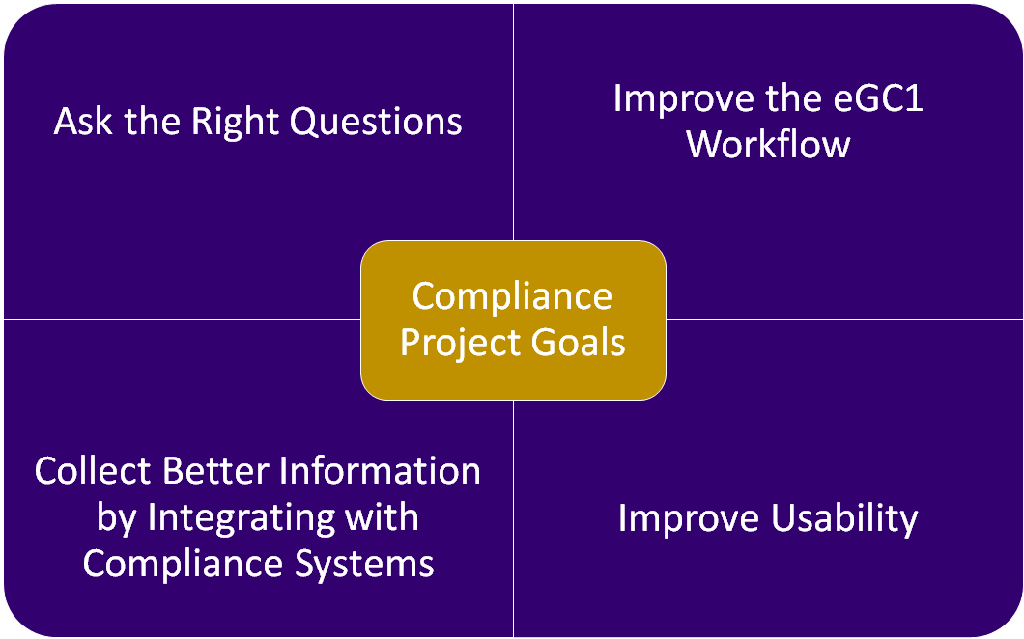
MRAM - Chris Carlson - ORIS
Notes:
The SAGE Compliance Improvements Project aims to redesign how compliance information is collected on the eGC1 to ensure the questions asked are relevant, that they’re asked in a way that facilitates a smooth workflow, leverages information already collected in other compliance systems, and utilizes modern design and accessibility standards.

Slide 3
May 17th Release
Goal: Ask the Right Questions
Revise compliance questions for improved clarity
Goal: Improve Workflow
Provide PIs with direct access to Non-Fiscal Compliance page via URL
Goal: Integrate with other Systems
Link Zipline and Hoverboard to Human Subjects and Animal Use sections of eGC1
Goal: Improve Usability
Improved design for Non-Fiscal Compliance page Activity Locations design updated based on subsequent feedback
MRAM - Chris Carlson - ORIS
Notes:
Our upcoming release is scheduled for next Thursday May 17th. This upcoming release will replace the existing Compliance Questions and Explanations sections with a new Non-Fiscal Compliance section with revised questions for improved clarity. We’ll also introduce the ability to copy/past links to the specific page of a specific eGC1 so that preparers can provide PI’s with a more streamlined method of navigating to the Non-Fiscal Compliance questions. We’re leveraging the information collected in Zipline and Hoverboard, allowing you to link your IRB and IACUC protocols to the eGC1. And lastly, we’ve received your feedback on the new look and feel introduced in Activity Locations, and are applying those improvements to both Non-Fiscal Compliance and Activity Locations.

Slide 4
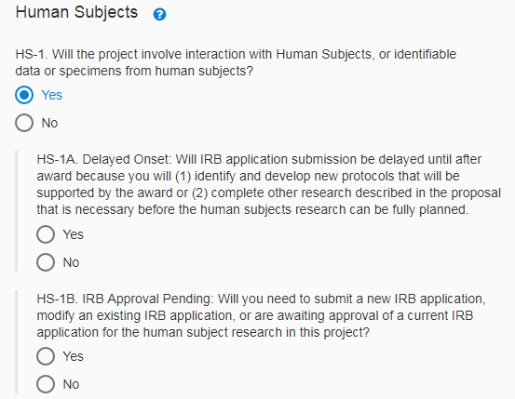
Release 2 Feature Overview
New and improved compliance questions
Questions re-worded and re-organized for improved clarity
Obsolete questions removed
Preview the questions before they go live
Notes:
In redesigning the compliance sections, we started fresh asking stakeholders “What questions need to be asked at the time of proposal, and why?” This was intended to ensure the questions being asked were relevant, necessary, and wording in a way that made their purpose clear. Obsolete questions were removed.

Slide 5
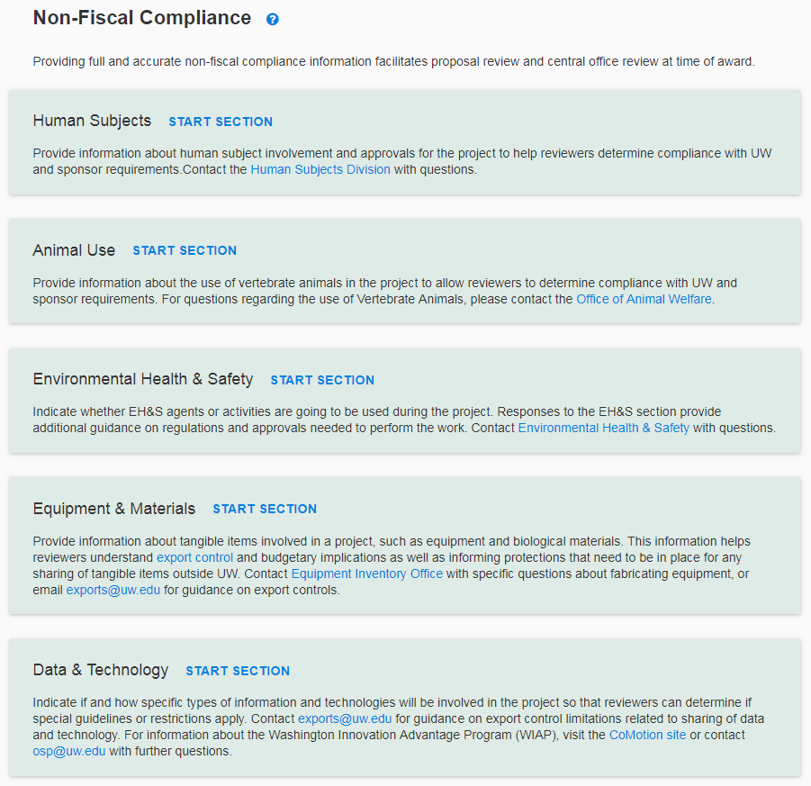
Release 2 Feature Overview
Improved Design
More modern look and feel, based on Activity Locations page feedback
Improved scannability and progress tracking
Supporting guidance embedded throughout with links and support documentation
Notes:
The design lessons learned from introduction of the Activity Locations page have been applied to the new Non-Fiscal Compliance page. You’ll be able to more easily can to see which sections have been started. The new Non-Fiscal Compliance summary page will provide you with a brief description of each section so you know why the information is being collected and who reviews it so that you know who to contact with questions.

Slide 6
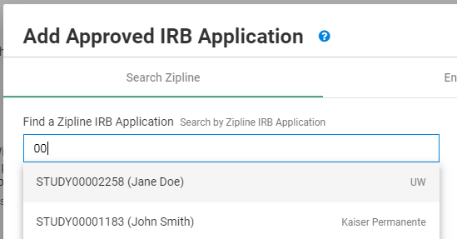
Release 2 Feature Overview
Connect SAGE to Zipline and Hoverboard
Search Zipline and Hoverboard for protocols
Once selected, real-time changes/updates will display in SAGE
(no info from SAGE currently flows to ZL/HB)
MRAM - Chris Carlson - ORIS
Notes:
With the recent introduction of new systems for IRB and IACUC submissions, SAGE will now allow you to search for protocols by the ID, and once linked pull real-time details into the eGC1. Each time you visit the page, you’ll see the latest information available from Zipline and Hoverboard. Note however that it’s currently a one-way link, so no SAGE information will flow to Zipline or Hoverboard.

Slide 7
Release 2 Feature Overview
Improved collaboration with PI
Send the PI a URL to NFC page for a specific eGC1
The PI can complete the NFC page while you work on other parts of the eGC1
Additional benefits
Direct URLs available to all standard eGC1 pages (not Grant Runner forms)
MRAM - Chris Carlson - ORIS
Notes:
We’re also introducing some features to improve the collaboration between preparers and PI’s on completing the Non-Fiscal Compliance section. When you’re on the Non-Fiscal Compliance page of a specific eGC1, you’ll now be able to copy the URL from the address bar, and share it with the PI (or other collaborators). If they have access to that eGC1, that link will take them directly to the page. PI’s can also complete the Non-Fiscal Compliance page even while you work on other parts of the eGC1. So no need to worry that the PI could try to enter and be locked out. Note that the feature allowing you to send direct URLs to eGC1 pages will work on ALL pages except Grant Runner forms. So this will hopefully streamline your ability to collaborate.

Slide 8
Summary of Release 2 Benefits
Streamline:
Removed obsolete questions
Pulls in details from Zipline + Hoverboard
Expedited reviews enabled by more detailed and accurate protocol information
Usability:
Revised, reworded questions for clarity & relevance
Improved design and user experience
Enhanced Collaboration:
Send URL to PIs for direct edit, collaboration
MRAM - Chris Carlson - ORIS
Notes:
So in summary, our next release will be aimed at streamlining by removing obsolete questions, integrating with Zipline and Hoverboard to reduce back-and-forth, and hopefully expedite reviews by providing more detailed and accurate protocol information. We’ll be improving usability to revising questions for clarity and relevance, while also building on the improved design standards from our October release. And lastly, improving collaboration between preparers and PI’s on the Non-Fiscal Compliance questions with shareable URLs and simultaneous editing.

Slide 9
What happens with eGC1s in Progress on 5/17?
If Composing status….
New questions apply, eGC1s will be updated
If in Read-Only state (Routing, In OSP, Approved, Denied.. status)
Questions in effect at time of “completion” apply and will not be changed, unless….
If Returned or Withdrawn
New questions apply
Notes:
How will this affect existing eGC1s? New eGC1s and those in Composing upon release will update to use the new questions. Those that are read-only, and in statuses like Routing, In OSP, Approved, Awarded, will retain their existing questions and responses. However if an eGC1 is returned or withdrawn after release, the new questions will be applied, and you’ll be required to answer them prior to re-completing your eGC1.

Slide 10
What happens with eGC1s in Progress on 5/17?
Tips if you have an eGC1 that could be returned or withdrawn after release:
Preview the new questions before release, and prepare your responses in advance.
Withdraw your eGC1 on 5/18 (right after release), and proactively answer the new questions to avoid last second scrambling.
MRAM - Chris Carlson - ORIS
Notes:
If you have an eGC1 that you think could be returned or withdrawn (for instance because it’s currently marked as ‘ready to submit’ NO) then a few strategies you could employ to avoid surprises at the last minute before a deadline: Preview the questions in advance so you know how they should be answered, and potentially withdraw your eGC1 the day after release to proactively update. We will also be sending out emails to SAGE users who have eGC1s in Routing or In OSP status prior to release to get the word out in advance of the release.

Slide 11
Resources and Feedback
Resources
SNEAK PEEK: Preview the questions before they go live
SAGE Help Documentation
Non-Fiscal Compliance Guidance on Research website
Have questions or suggestions?
Contact sagehelp@uw.edu
MRAM - Chris Carlson - ORIS
Notes:
Existing compliance guidance on the Research website will also be updated in conjunction with the release. If you have any other questions or suggestions, please email sagehelp@uw.edu as we love to hear from you. I’ll also be back for next month’s MRAM to give you and update and reminder. Does anyone have any questions?

