Slide 1
MRAM | Monthly Research Administration Meeting
JULY 12, 2018 9:00 AM – 10:00 AM UW TOWER AUDITORIUM
TOPIC | PRESENTER | EMAIL | MIN
Welcome | Kirsten DeFries Research Compliance & Operations | kirsten5@uw.edu | 2
RPPR Pilot: Status Report and Next Steps | Carol Rhodes Office of Sponsored Programs | carhodes@uw.edu | 10
NIH: Update | Amanda Snyder Office of Sponsored Programs | acs229@uw.edu | 5
NIH RePORT Tool | Melissa Petersen Office of Research | petermm@uw.edu | 8
Business Diversity Program | Claudia Frere-Anderson Business Diversity Program | frerec@uw.edu | 10
Gift Assessment Facts | Tobin Eckholt & Mike Visaya Gift Services or Advancement Services | teckholt@uw.edu visaya@uw.edu | 10
Compliance Corner | Andra Sawyer & Matt Gardner Post Award Financial Compliance | andra2@uw.edu mgard@uw.edu | 10
CORE Update | CORE Team Collaborative On Research Education (CORE) | corehelp@uw.ed | 2
NEXT MEETING AUGUST 9, 2018 UW TOWER AUDITORIUM

Slide 2
Direct RPPR Submission Pilot Update
July 2018 MRAM
Carol Rhodes, Director
Office of Sponsored Programs

Slide 3
What is an RPPR?
How to Identify SNAP eligible RPPR
An RPPR is a uniform progress report format used by federal agencies, that PIs fill out
NIH Streamlined Noncompeting Award Process (SNAP) eligible awards allow automatic carryover of balances into next budget year, typically “R” and “K” series.
GrantTracker indicates “SNAP” eligible awards

Slide 4
Pilot Status
Pilot April 1-July 31, 2018
49 PIs across 6 Colleges volunteered to participate
Most participants have submitted
Remaining 10% of participating PIs will submit RPPRs this month.
Notes:
OSP@U will email an invitation with a link to complete a survey to gather feedback from:
Participating PIs
eGC1 Administrative Contacts
Administrative contact survey includes copy of questions PIs will receive for reference.

Slide 5
Lessons & Questions
Distinguishing SNAP eligible RPPRs
Significant Financial Disclosure Questions
Update some specific Institutional instructions
As always, general questions on due dates.
Notes:
OSP@U will email an invitation with a link to complete a survey to gather feedback from:
Participating PIs
eGC1 Administrative Contacts
Administrative contact survey includes copy of questions PIs will receive for reference.

Slide 6
Feedback
Participating PIs will receive an email invitation to complete a quick online survey:
eGC1 Administrative Contacts & anyone CC’d on Pilot confirmation from PI for eligible awards:
designed for administrators experience in support of their PIs & will include copy of questions PIs receive
Notes:
Shared Service teams supporting PIs will be included in survey as well

Slide 7
Next Steps
After July 31, Participating PIs delegated authority expires and they will no longer be able to directly submit.
OSP will analyze feedback and lessons learned.
We’ll come back in the Fall with more information.
Notes:
OSP@U will email an invitation with a link to complete a survey to gather feedback from:
Participating PIs
eGC1 Administrative Contacts
Administrative contact survey includes copy of questions PIs will receive for reference.

Slide 8
Questions?

Slide 9
NIH Update
July 2018 MRAM
Amanda Snyder, Assistant Director
Office of Sponsored Programs

Slide 10
RPPR Updates
PIs can delegate initiation of ALL types of RPPR (Annual, Final & Interim) to departmental administrators in eRA Commons.
Decimal Points are now allowed for effort reporting on an RPPR.
NIH Announcement: NOT-OD-18-202

Slide 11
Reminder: Appendix Requirements
NIH has become increasingly strict on Appendix & Formatting Requirements
PIs must follow requirements exactly
NIH is rejecting applications that do not comply
NIH Appendix Policy FAQ,
Font & Margin Guidelines

Slide 12
Updating Human Subjects Data
New Human Subjects System (HSS)
NIH’s Human Subjects/Clinical Trials Form post-proposal submission
Annual enrollment at RPPR submission
Updates at JIT or during project but outside annual update
NIH will release new functionality as it’s developed
OSP is checking HSS for forms that are Ready to Submit
Thanks for everyone’s patience as the new system continues to evolve

Slide 13
Questions?

Slide 14
NIH RePORT Research Portfolio Online Reporting Tools
MRAM - July 12, 2018
Melissa Petersen
Office of Research
University of Washington

Slide 15
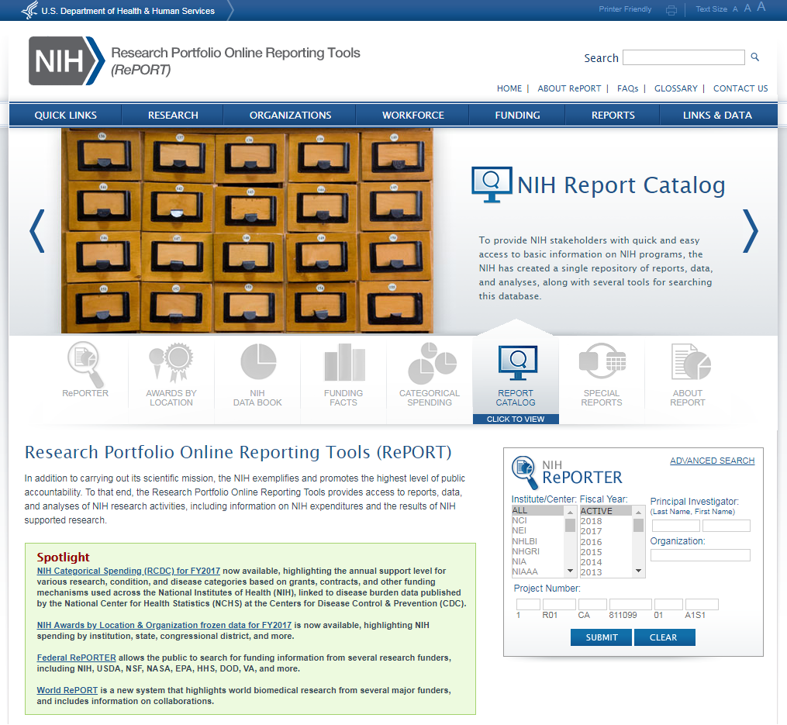
Demo
University of Washington Office of Research

Slide 16
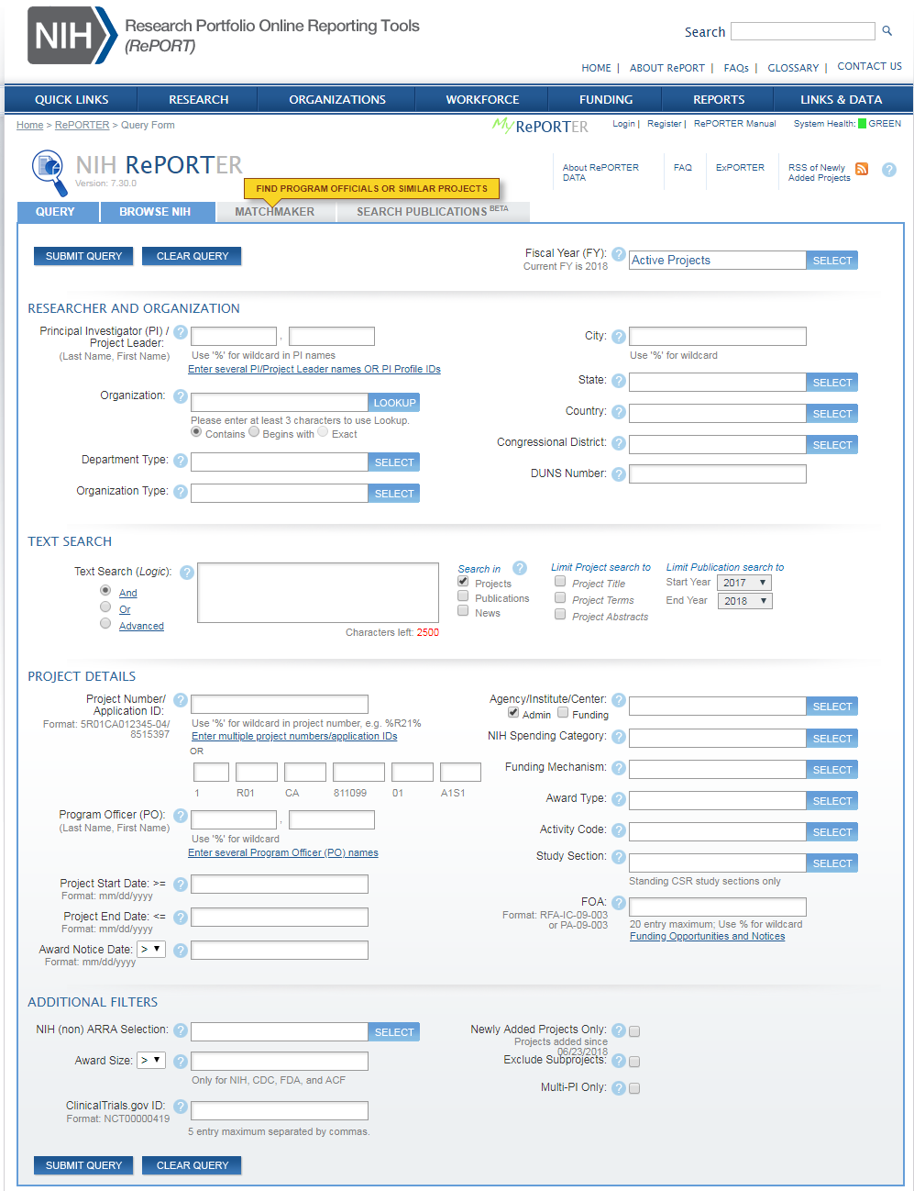
Demo
University of Washington Office of Research

Slide 17
Contact
Contact Information:
research@uw.edu
206.616.0804
Melissa Petersen
petermm@uw.edu
University of Washington Office of Research

Slide 18
UW Business Diversity Program
Diverse Spend Initiative
MRAM
July 12th, 2018

Slide 19
UW Business Diversity Program
Business diversity is about creating avenues of opportunity for minority, women, and veteran owned; small, and other diverse businesses. It’s about keeping UW dollars in Washington state to fund job creation and spur growth of the local economy.
BENEFITS OF BUSINESS DIVERSITY
Demonstrate the University's commitment to the economic growth of all communities
Emphasizes the University's commitment to doing business, beyond consumerism, in diverse markets
Promotes innovation through the entrance of new products, services, and solutions
Provides multiple channels from which to procure goods and services
Drives competition on price and service levels between existing and potential vendors

Slide 20
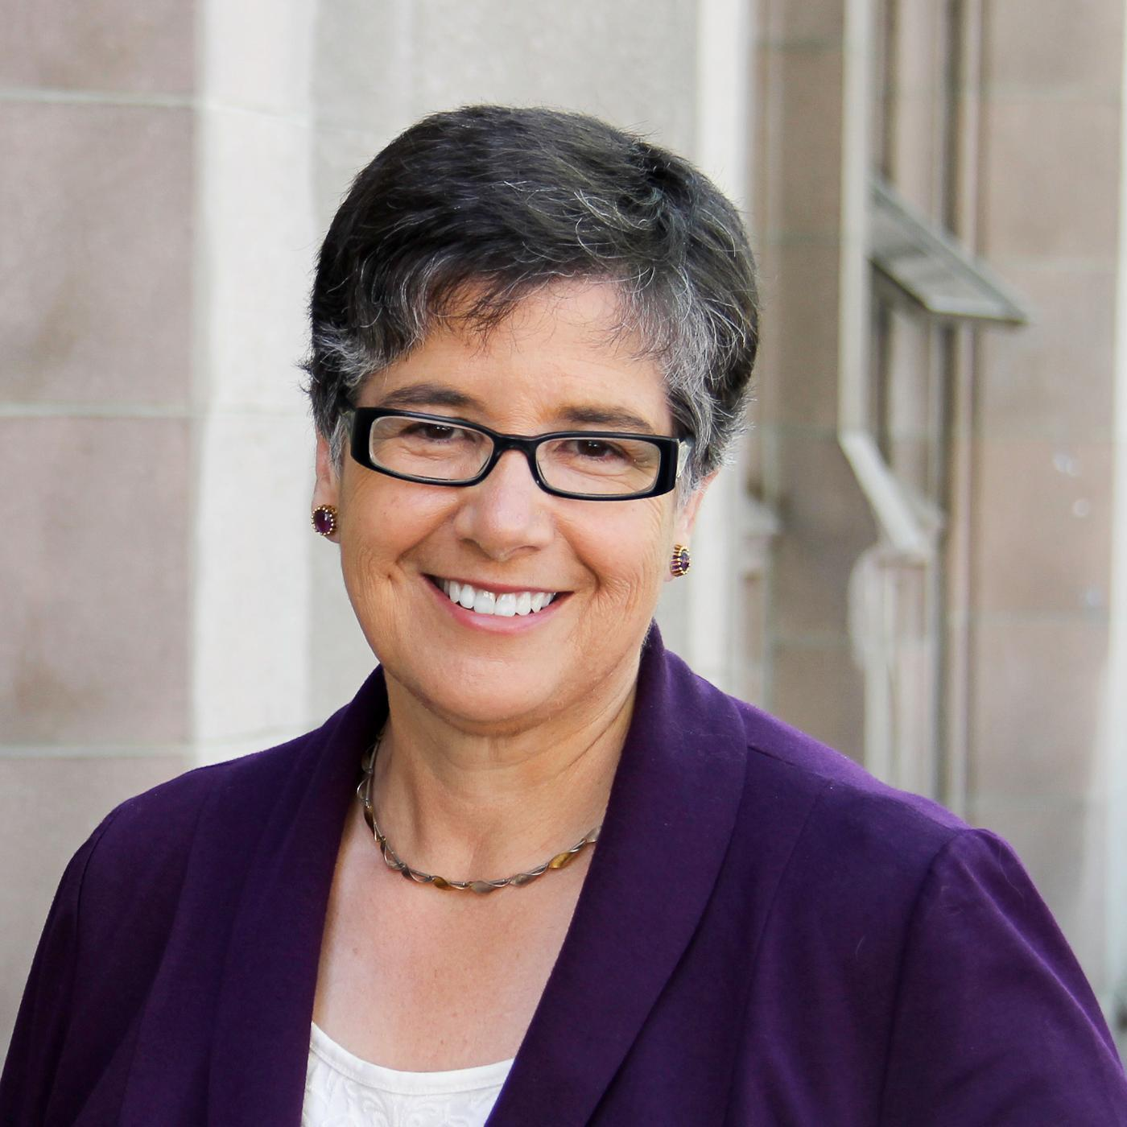
Statement of Business Equity
Approved by the Board of Regents on September 10th, 2015, the Policy No. 16 reinforces the values of inclusion, equity and justice at UW, making it clear that business practices will be guided by inclusion and equity.
“I want to commend the work of the Business Diversity Steering Committee in crafting this Statement of Business Equity, as well as the Business Diversity Program for helping build connections between business and the University. We’re a better university because of the connections they’ve built already, and will be even stronger through those they’ll create as a result of this university–wide focus,” said President Ana Mari Cauce.

Slide 21
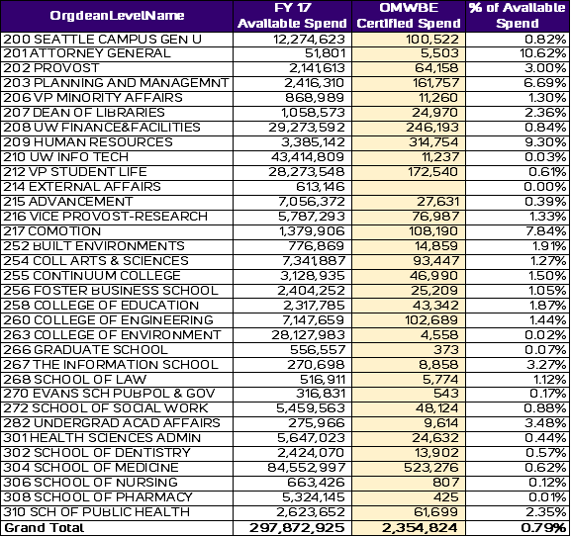
Diverse Spend Data on Ariba
Seattle Campus – FY 2017

Slide 22
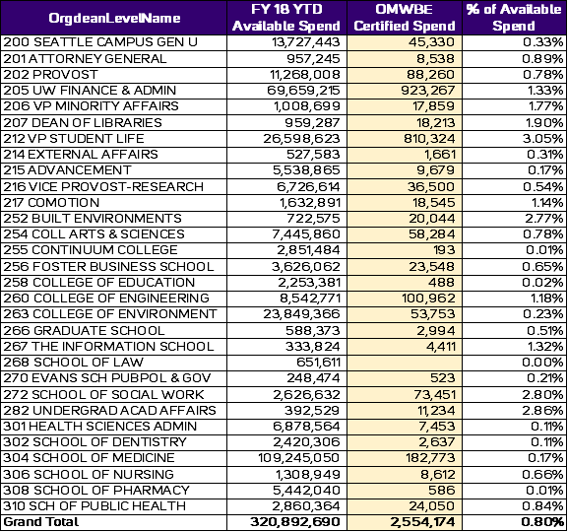
Diverse Spend Data on Ariba – Cont.
Seattle Campus – FY 2018 YTD

Slide 23
Diverse Spend Recommendations
We are asking every UW unit to more than double their diverse spend and number of diverse suppliers utilized over the next year.
Spend Areas | Potential Opportunity
Office Supplies | Consider 10%-20% of qualified office supplies purchases to Keeney’s Office Plus or Pacific Office Solutions
Catering | Consider using caterers from the UW list of Small and Diverse Caterers
Technology | Consider 10%-20% of qualified IT purchases to JR Microsystems or General Microsystems Inc
Notes:
JEFF

Slide 24
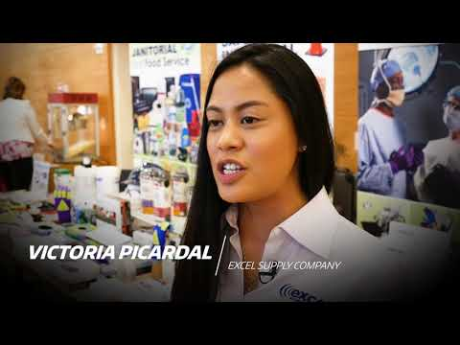
When UW Supports Diverse Businesses
https://youtu.be/bBNHUQcKaZk

Slide 25
Questions
Contact the BDP Team
Claudia Frere-Anderson
Director
frerec@uw.edu / 206.221.0391
Katherine Wu
Program Specialist
yabonunu@uw.edu / 206.616.3741
Christina VanMiddlesworth
Program Specialist
cvanmid@uw.edu /206.543.9214

Slide 26
Gift Assessment

Slide 27
GIFT ASSESSMENT BASICS
Administrative Policy Statement 36.2
The Gift Assessment is applied to select current use gifts upon their receipt, providing essential support to the University of Washington’s advancement efforts and institutional priorities. The assessment is 5 percent and applies only to contributions over $1,000 and under $5 million.
https://www.washington.edu/admin/rules/policies/APS/36.02.html

Slide 28
GIFT ASSESSMENT DECONSTRUCTED
Applies to gifts and pledges as of July 1, 2018
Current-Use Gift Budgets:
Primarily 64-####, 65-####, 68-####
Upon Receipt
Once entered into Advance, scripts run to complete the assessment, the funds are FAS’d and if eligible, 5% is moved to the Provost budget.
Advancement Efforts and Institutional Priorities
Provides UW support for fundraising efforts and supports Provost initiatives.
By donor, amount, budget, cumulative giving by fiscal year
A one-time gift over $1,000 or multiple gifts to the same current use budget that cumulatively exceed $1,000.
Marginally assessed: $249,950 on $5M is the most we could assess on a single gift or payment; the least would be $0.01 on $1000.20

Slide 29
GIFT ASSESSMENT PROCEDURES
Responsible Office: | Frequency | Action:
Advancement Operations | Daily | Enters gift into Advance system
 | Daily | Applies rules to determine if gift is eligible for assessment
 | Daily | Calculates assessment amount for eligible gifts
 | Daily | Prepares 1) cash transmittal to post full gift amount to gift budget and 2) journal voucher to transfer assessment from gift budget to central gift assessment revenue budget
 | Quarterly | Sends gift report to OPB for regular audit and reconciliation
OPB | Quarterly | Receives gift assessment report from Advancement
 | Quarterly | Compares report to actual revenue to verify assessment revenue is accurate
 | Quarterly | Prepares assessment revenue report for Provost
 | As needed | Prepares and processes journal voucher if an individual unit requests to pay the assessment from an alternate fund source
 | As approved | Transfers allocation from central gift assessment revenue budget to unit budget number
Provost and/or | Quarterly | Reviews revenue report from OPB
President | Quarterly | Allocates available funds to units
Unit | As needed | Requests a new budget number for new allocation

Slide 30
GIFT ASSESSMENT
QUESTIONS?
Michael Visaya
Senior Director, Information Management
visaya@uw.edu
221-6712
Tobin Eckholt
Director, Gift Services
teckholt@uw.edu
685-9860

Slide 31
COMPLIANCE CORNER
MRAM
July, 2018
Andra Sawyer & Matt Gardner
Post Award Fiscal Compliance

Slide 32
How to Read the Cost Share Summary Report
GCA web: http://finance.uw.edu/gca/ cost-share

Slide 33
Cost Share Classes
Offered via CORE:
Sept 11: Introduction (& How to Avoid Voluntary)
Sept 20: Managing
Sign up:
https://uwresearch.gosignmeup.com/Public/Course/Browse

Slide 34
Value Added Tax (VAT)
Outside of the US, VAT is the equivalent of a Sales Tax.
Only an Allowable cost if there is NOT an exemption between the US and the country where the tax is being incurred.
Due diligence required where the UW has an office or established location outside of the US.
For more information:
https://finance.uw.edu/pafc/VAT

Slide 35
ALCOHOL
Alcohol, and any costs associated with the provision of alcohol, are unallowable.
PAFC website FAQ:
http://finance.uw.edu/pafc/faq?term_node_tid_depth=Food/Meals

Slide 36
Why do I get a new budget number for some awards and not others?
Maintaining the same budget number throughout the life of a project depends on the terms and conditions of the award
Relevant factors:
Carryover Authority
Frequency of Financial Reporting
Federal Document Number (DHHS awards)
SNAP or Non-SNAP mechanism (NIH)
MRAM – Matt Gardner - PAFC

Slide 37
A new budget number is required if…
Carryover Authority
If carryover requires sponsor approval before spending funds
Frequency of Financial Report(s)
If a final report is required to close out a budget period
Federal Document Number (Any DHHS award)
If the Fed Doc Number has changed from the prior budget period
SNAP or Non-SNAP? (NIH awards)
If the award was issued under the NIH Non-SNAP mechanism
MRAM – Matt Gardner - PAFC
Notes:
Carryover: When carryover is restricted and requires sponsor approval before spending, those funds must be separated from the non-restricted funds.
Federal Document Number: A change in the Fed Doc Number indicates that UW must draw funds from a new, separate pool of money than from prior years. In order to account for the different pools of money, a new budget number must be set up to maintain separate accountability.
Financial Reports: A sponsor requiring a “final” financial report between budget years indicates separate year accountability and will require a new budget number for each year.
NIH SNAP or non-SNAP: Non-SNAP awards restrict carryover from one year to the next and require annual reporting; GCA sets up a new budget number for each year of a non-SNAP award. A SNAP award will receive the same budget number for the entire competitive segment.

Slide 38
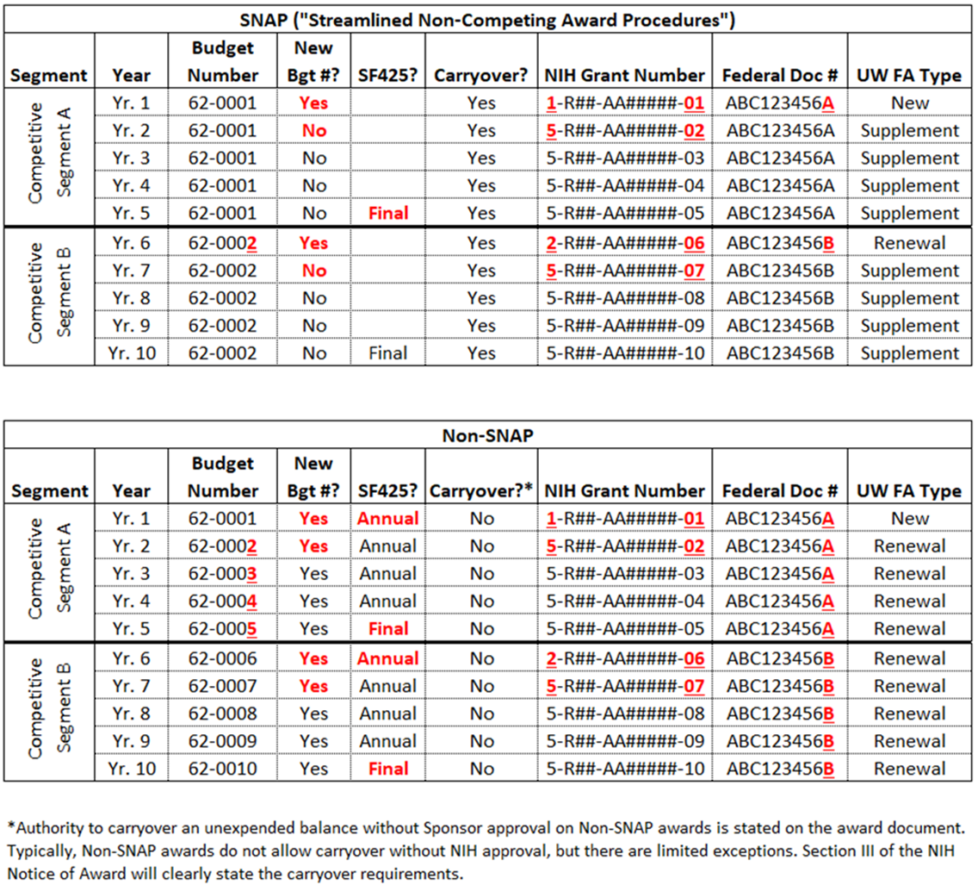
Guide for NIH SNAP & Non-SNAP Awards
MRAM – Matt Gardner - PAFC
Notes:
Illustration of when new budget numbers are required on NIH SNAP and non-SNAP awards.

Slide 39
References
GCA Website > Renewals vs. Supplement/Extensions
http://finance.uw.edu/gca/award-lifecycle/budget-setup/renewals-vs-supplement-extensions
Questions
gcahelp@uw.edu
206-616-9995

Slide 40
Uniform Guidance Procurement Standards
OMB implementation of the Uniform Guidance Procurement Standards has been on hold since UG release in December 2014
OMG guidance sets the thresholds for Micro-Purchases and for Simplified Acquisitions
Effective date of OMB Memo is December 23, 2016

Slide 41
UW’s Application of Procurement Thresholds
Threshold | Requirements | Amount
Micro-Purchase | No quote requirement but must be “reasonable” | Less than $10,000
Simplified Acquisition | Quotes required from “adequate” number of sources | $10,000 to $99,999
Everything else | Formal competition | $100,000 and above
For more information:
OMB Memo 18-18: https://www.whitehouse.gov/wp-content/uploads/2018/06/M-18-18.pdf
UW Procurement: http://finance.uw.edu/ps/how-to-buy
2 CFR 200.320 – Methods of Procurement to be followed

Slide 42
Participant Support (NSF)
NSF has proposed new language regarding “Participant Support” in the Proposal and Award Policies and Procedures Guide (PAPPG)
Highlights
Speakers and trainers are not considered “Participants”
Participant Support funds may not be used to cover “Catering Costs”
NSF hasn’t defined “Catering Costs”
The final PAPPG is expected late Fall 2018
MRAM – Matt Gardner - PAFC

Slide 43
Participant Support (NSF)
Meals for Participants are allowable
Subsistence Allowance or Per Diem
Meals for Participants cannot exceed the per diem allowance
Meals for non-Participants (speakers, trainers, and employees) are not allowable as Participant Support
Other costs associated with hosting a conference or training project are not allowable as Participant Support costs
Speaker, trainer or facilitator fees
Room rental fees
Supplies
MRAM – Matt Gardner - PAFC

Slide 44
Participant Support (NSF)
NSF has focused on Participant Support costs during recent audits
Recommendations:
If there are meal costs at the conference, obtain an itemized receipt from the vendor
Document the number Participants, the costs of the meal(s), and adjustments to the per diem allowance
Costs for non-Participants are unallowable as Participant Support - make sure those costs are excluded from the Participant Support sub budget
MRAM – Matt Gardner - PAFC

Slide 45
References
PAFC Website > Participant Support
http://finance.uw.edu/pafc/participant-support
PAFC: gcafco@uw.edu
Matt Gardner:
mgard4@uw.edu
206-543-2610
Andra Sawyer:
andra2@uw.edu
206-685-8902
MRAM – Matt Gardner - PAFC

Slide 46
UPCOMING COURSES
IN RESEARCH ADMINISTRATION
8/01/2018 MAA 100 Introduction to Grant and Contract Certification (GCCR)
8/15/2018 MAA 101 Introduction to Faculty Effort Certification
8/22/2018 MAA 102 Electronic Faculty Effort Certification (eFECS) for FEC Coordinators
9/11/2018 RAA 205 Introduction to Cost Share at the UW
9/12/2018 SP 101 Introduction to Research Administration
9/12/2018 MAA 205 Modifying an FEC Using Comments and Adjusting Cost Sharing
9/20/2018 RAA 206 Managing Cost Share at the UW
9/26/2018 MAA 210 Modifying an FEC, Change Outside eFECS and Re-certifications
Online Classes
GCA 201 Salary and Cost Transfers
RAA 201 Post Award Food Purchases and Compliance
GCA 202 Direct Billing of F&A Type Costs
RAA 202 Timing of Expenditures & Benefit to Award
Register: https://uwresearch.gosignmeup.com/public/course/browse
CORE home: https://www.washington.edu/research/training/about-core/

