Slide 1
NIH RePORT Research Portfolio Online Reporting Tools
MRAM - July 12, 2018
Melissa Petersen
Office of Research
University of Washington

Slide 2
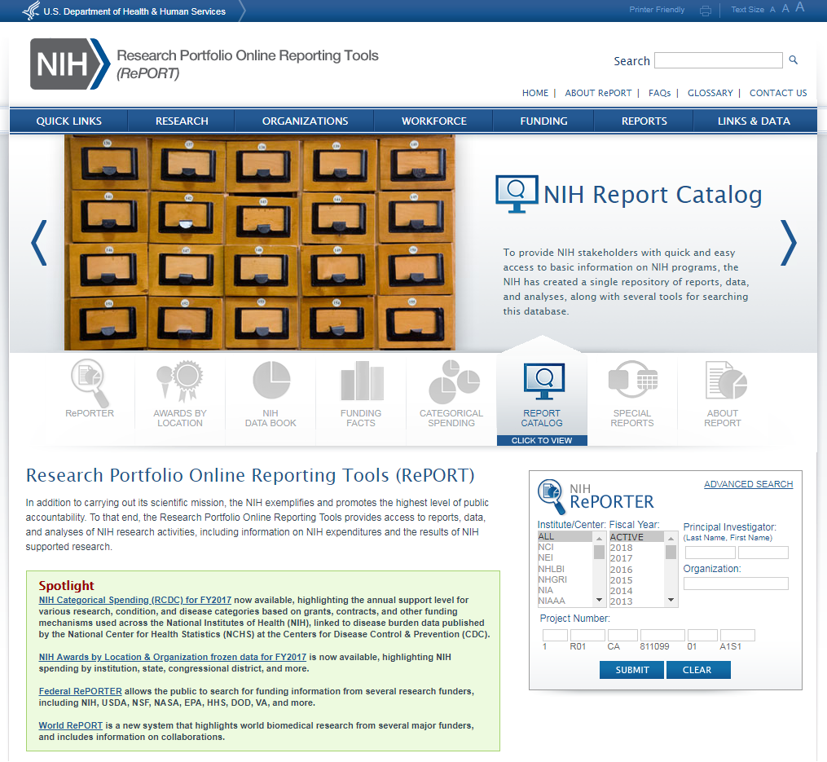
Demo
University of Washington Office of Research

Slide 3
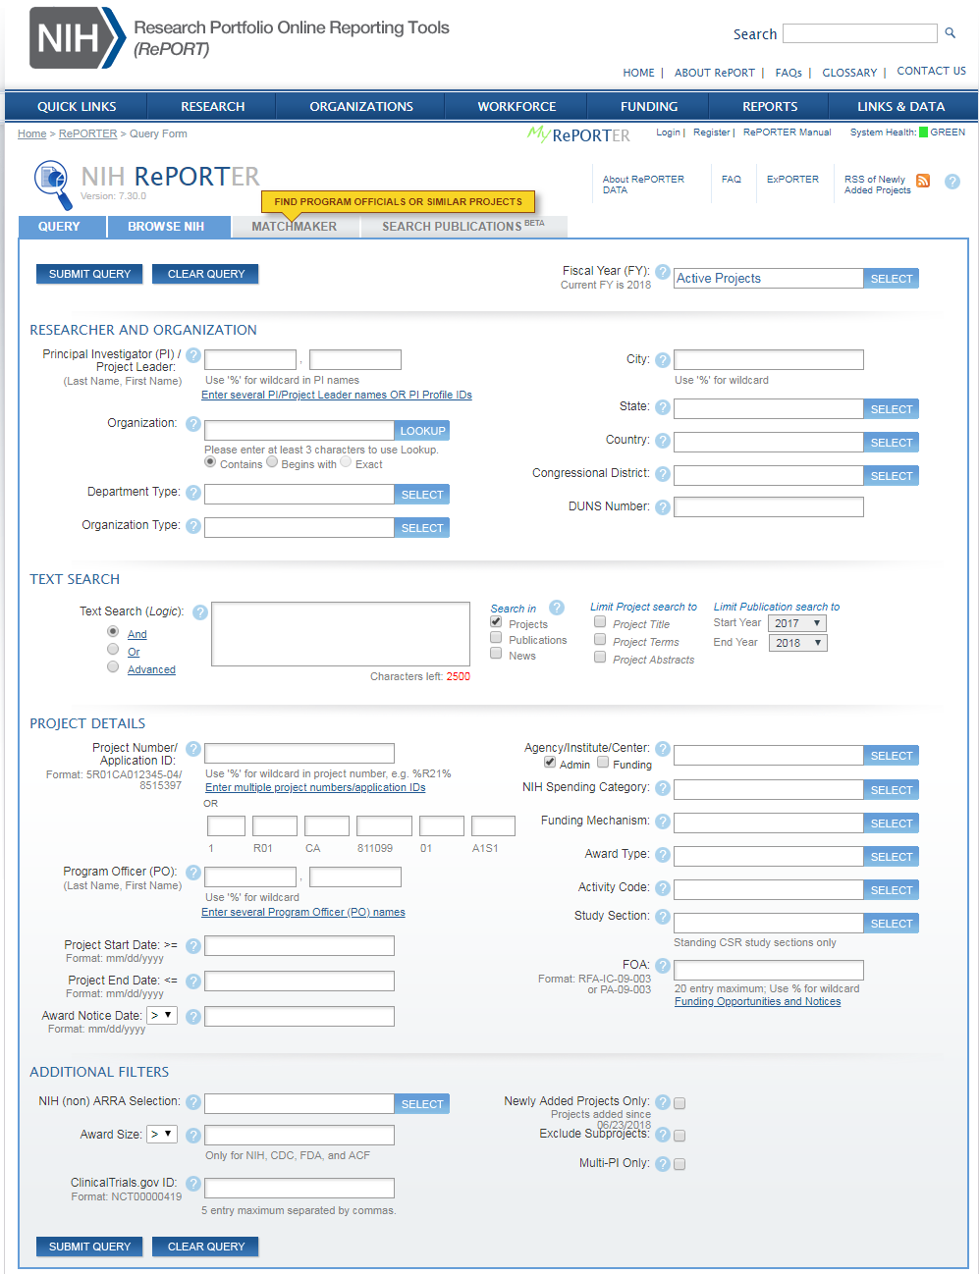
Demo
University of Washington Office of Research

Slide 4
Contact
Contact Information:
research@uw.edu
206.616.0804
Melissa Petersen
petermm@uw.edu
University of Washington Office of Research

