Slide 1
UW Business Diversity Program
Diverse Spend Initiative
MRAM
July 12th, 2018

Slide 2
UW Business Diversity Program
Business diversity is about creating avenues of opportunity for minority, women, and veteran owned; small, and other diverse businesses. It’s about keeping UW dollars in Washington state to fund job creation and spur growth of the local economy.
BENEFITS OF BUSINESS DIVERSITY
Demonstrate the University's commitment to the economic growth of all communities
Emphasizes the University's commitment to doing business, beyond consumerism, in diverse markets
Promotes innovation through the entrance of new products, services, and solutions
Provides multiple channels from which to procure goods and services
Drives competition on price and service levels between existing and potential vendors
2

Slide 3
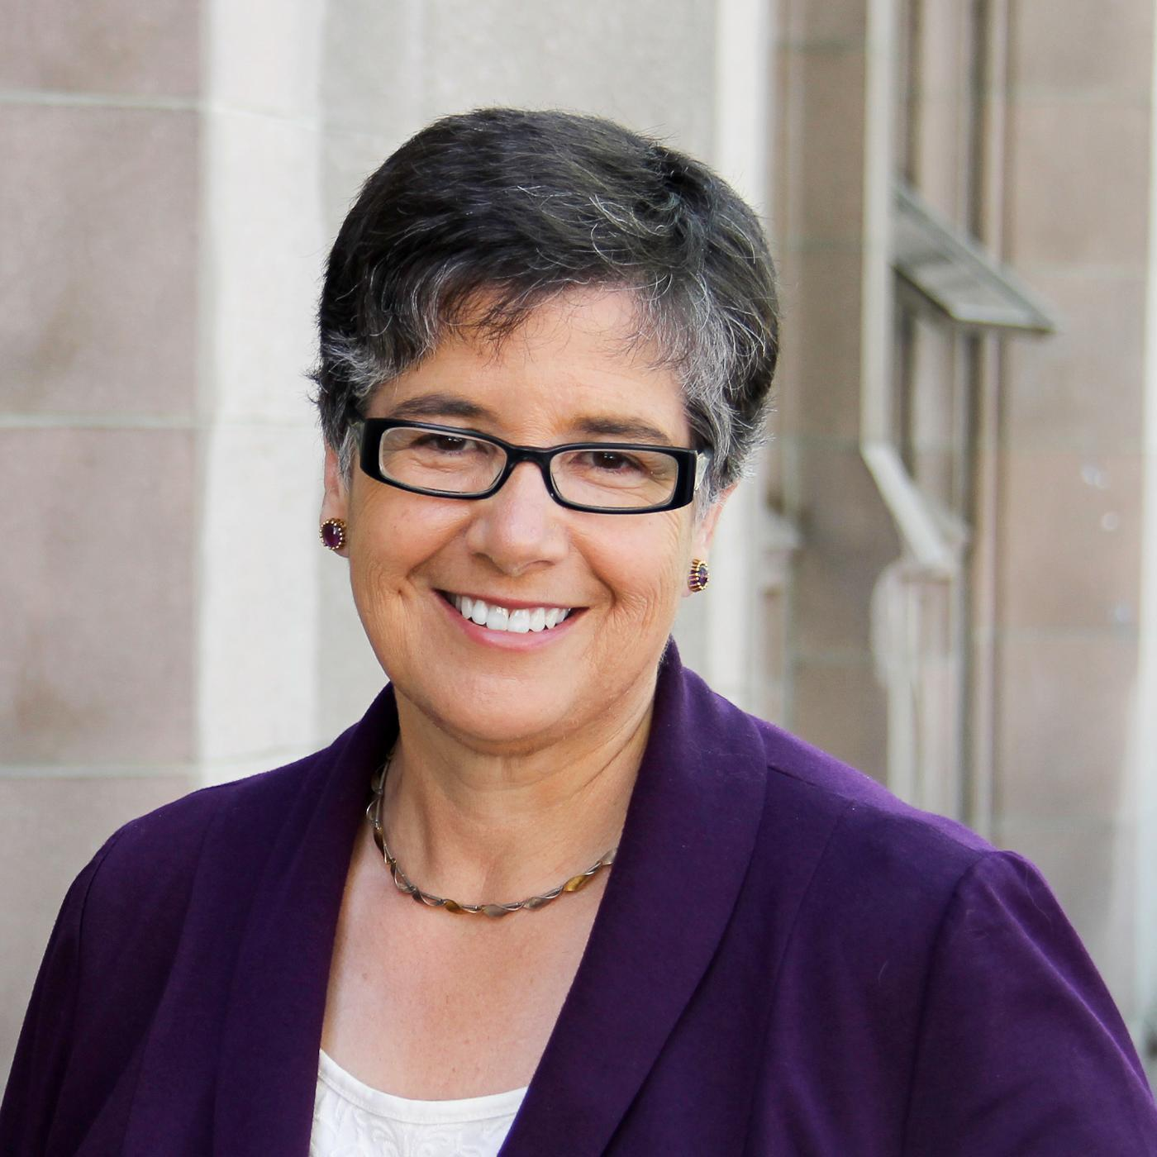
Statement of Business Equity
Approved by the Board of Regents on September 10th, 2015, the Policy No. 16 reinforces the values of inclusion, equity and justice at UW, making it clear that business practices will be guided by inclusion and equity.
“I want to commend the work of the Business Diversity Steering Committee in crafting this Statement of Business Equity, as well as the Business Diversity Program for helping build connections between business and the University. We’re a better university because of the connections they’ve built already, and will be even stronger through those they’ll create as a result of this university–wide focus,” said President Ana Mari Cauce.

Slide 4
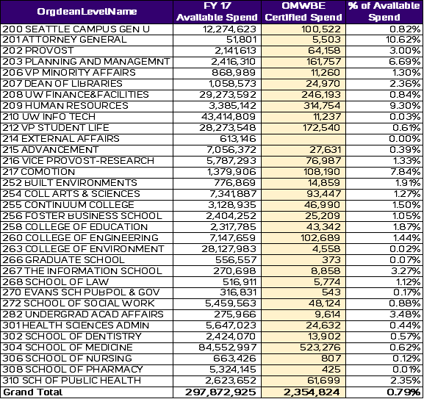
Diverse Spend Data on Ariba
Seattle Campus – FY 2017

Slide 5
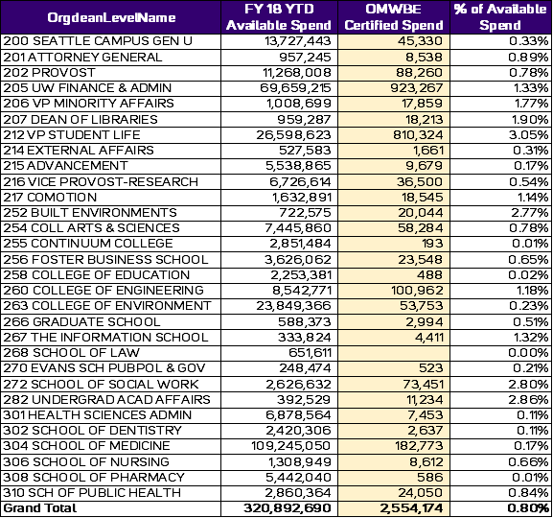
Diverse Spend Data on Ariba – Cont.
Seattle Campus – FY 2018 YTD

Slide 6
Diverse Spend Recommendations
We are asking every UW unit to more than double their diverse spend and number of diverse suppliers utilized over the next year.
Spend Areas | Potential Opportunity
Office Supplies | Consider 10%-20% of qualified office supplies purchases to Keeney’s Office Plus or Pacific Office Solutions
Catering | Consider using caterers from the UW list of Small and Diverse Caterers
Technology | Consider 10%-20% of qualified IT purchases to JR Microsystems or General Microsystems Inc
6
Notes:
JEFF

Slide 7
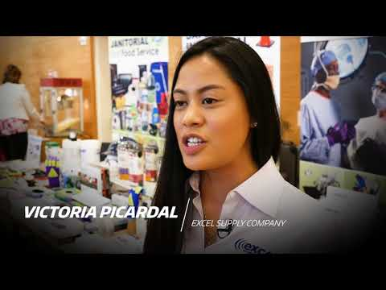
When UW Supports Diverse Businesses
https://youtu.be/bBNHUQcKaZk

Slide 8
Questions
Contact the BDP Team
Claudia Frere-Anderson
Director
frerec@uw.edu / 206.221.0391
Katherine Wu
Program Specialist
yabonunu@uw.edu / 206.616.3741
Christina VanMiddlesworth
Program Specialist
cvanmid@uw.edu /206.543.9214

