Slide 1
COMPLIANCE CORNER
MRAM
July, 2018
Andra Sawyer & Matt Gardner
Post Award Fiscal Compliance

Slide 2
How to Read the Cost Share Summary Report
GCA web: http://finance.uw.edu/gca/ cost-share

Slide 3
Cost Share Classes
Offered via CORE:
Sept 11: Introduction (& How to Avoid Voluntary)
Sept 20: Managing
Sign up:
https://uwresearch.gosignmeup.com/Public/Course/Browse

Slide 4
Value Added Tax (VAT)
Outside of the US, VAT is the equivalent of a Sales Tax.
Only an Allowable cost if there is NOT an exemption between the US and the country where the tax is being incurred.
Due diligence required where the UW has an office or established location outside of the US.
For more information:
https://finance.uw.edu/pafc/VAT

Slide 5
ALCOHOL
Alcohol, and any costs associated with the provision of alcohol, are unallowable.
PAFC website FAQ:
http://finance.uw.edu/pafc/faq?term_node_tid_depth=Food/Meals

Slide 6
Why do I get a new budget number for some awards and not others?
Maintaining the same budget number throughout the life of a project depends on the terms and conditions of the award
Relevant factors:
Carryover Authority
Frequency of Financial Reporting
Federal Document Number (DHHS awards)
SNAP or Non-SNAP mechanism (NIH)
MRAM – Matt Gardner - PAFC

Slide 7
A new budget number is required if…
Carryover Authority
If carryover requires sponsor approval before spending funds
Frequency of Financial Report(s)
If a final report is required to close out a budget period
Federal Document Number (Any DHHS award)
If the Fed Doc Number has changed from the prior budget period
SNAP or Non-SNAP? (NIH awards)
If the award was issued under the NIH Non-SNAP mechanism
MRAM – Matt Gardner - PAFC
Notes:
Carryover: When carryover is restricted and requires sponsor approval before spending, those funds must be separated from the non-restricted funds.
Federal Document Number: A change in the Fed Doc Number indicates that UW must draw funds from a new, separate pool of money than from prior years. In order to account for the different pools of money, a new budget number must be set up to maintain separate accountability.
Financial Reports: A sponsor requiring a “final” financial report between budget years indicates separate year accountability and will require a new budget number for each year.
NIH SNAP or non-SNAP: Non-SNAP awards restrict carryover from one year to the next and require annual reporting; GCA sets up a new budget number for each year of a non-SNAP award. A SNAP award will receive the same budget number for the entire competitive segment.

Slide 8
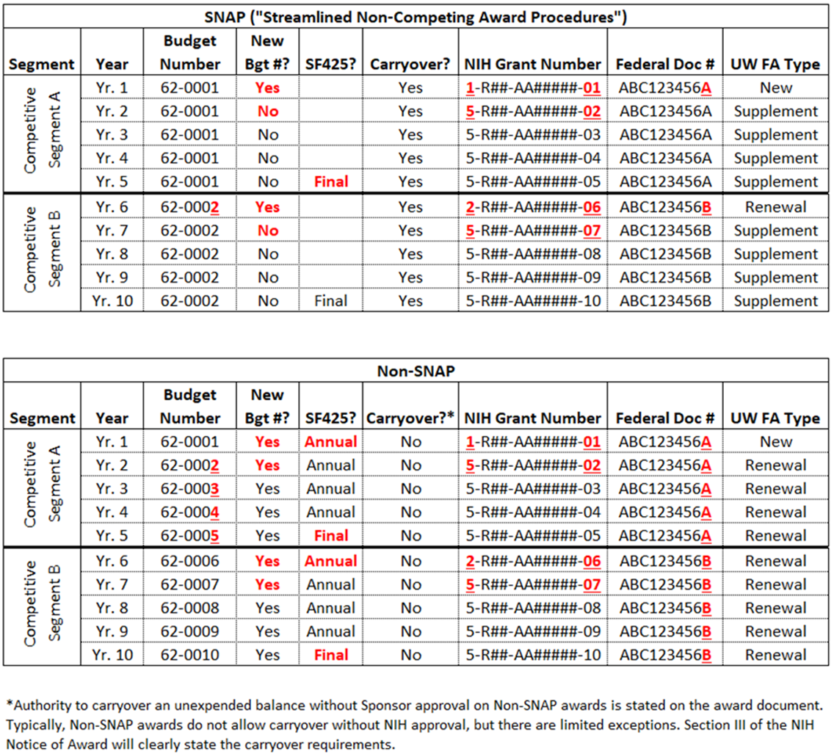
Guide for NIH SNAP & Non-SNAP Awards
MRAM – Matt Gardner - PAFC
Notes:
Illustration of when new budget numbers are required on NIH SNAP and non-SNAP awards.

Slide 9
References
GCA Website > Renewals vs. Supplement/Extensions
http://finance.uw.edu/gca/award-lifecycle/budget-setup/renewals-vs-supplement-extensions
Questions
gcahelp@uw.edu
206-616-9995

Slide 10
Uniform Guidance Procurement Standards
OMB implementation of the Uniform Guidance Procurement Standards has been on hold since UG release in December 2014
OMG guidance sets the thresholds for Micro-Purchases and for Simplified Acquisitions
Effective date of OMB Memo is December 23, 2016

Slide 11
UW’s Application of Procurement Thresholds
Threshold | Requirements | Amount
Micro-Purchase | No quote requirement but must be “reasonable” | Less than $10,000
Simplified Acquisition | Quotes required from “adequate” number of sources | $10,000 to $99,999
Everything else | Formal competition | $100,000 and above
For more information:
OMB Memo 18-18: https://www.whitehouse.gov/wp-content/uploads/2018/06/M-18-18.pdf
UW Procurement: http://finance.uw.edu/ps/how-to-buy
2 CFR 200.320 – Methods of Procurement to be followed

Slide 12
Participant Support (NSF)
NSF has proposed new language regarding “Participant Support” in the Proposal and Award Policies and Procedures Guide (PAPPG)
Highlights
Speakers and trainers are not considered “Participants”
Participant Support funds may not be used to cover “Catering Costs”
NSF hasn’t defined “Catering Costs”
The final PAPPG is expected late Fall 2018
MRAM – Matt Gardner - PAFC

Slide 13
Participant Support (NSF)
Meals for Participants are allowable
Subsistence Allowance or Per Diem
Meals for Participants cannot exceed the per diem allowance
Meals for non-Participants (speakers, trainers, and employees) are not allowable as Participant Support
Other costs associated with hosting a conference or training project are not allowable as Participant Support costs
Speaker, trainer or facilitator fees
Room rental fees
Supplies
MRAM – Matt Gardner - PAFC

Slide 14
Participant Support (NSF)
NSF has focused on Participant Support costs during recent audits
Recommendations:
If there are meal costs at the conference, obtain an itemized receipt from the vendor
Document the number Participants, the costs of the meal(s), and adjustments to the per diem allowance
Costs for non-Participants are unallowable as Participant Support - make sure those costs are excluded from the Participant Support sub budget
MRAM – Matt Gardner - PAFC

Slide 15
References
PAFC Website > Participant Support
http://finance.uw.edu/pafc/participant-support
PAFC: gcafco@uw.edu
Matt Gardner:
mgard4@uw.edu
206-543-2610
Andra Sawyer:
andra2@uw.edu
206-685-8902
MRAM – Matt Gardner - PAFC

