Slide 1
MRAM | Monthly Research Administration Meeting
SEPTEMBER 13, 2018 9:00 AM – 10:30 AM UW TOWER AUDITORIUM
TOPIC | PRESENTER | EMAIL | MIN
Welcome | Kirsten DeFries Research Compliance & Operations | kirsten5@uw.edu | 2
NSF - Updates | Carol Rhodes and Ari Santander OSP | carhodes@uw.edu filimus@uw.edu | 15
New Improved GIM 13: Facilities and Administrative (F&A) Rates | Carol Rhodes OSP | carhodes@uw.edu | 10
NIH updates | Carol Rhodes OSP | carhodes@uw.edu | 5
Schedule I Affinity Group | Joe Giffels Office of Research | jgiffels@uw.edu | 5
RAD Data | Dave Smith Office of Research Information Systems | dsmith17@uw.edu | 10
Award Transparency in SAGE | Amanda Snyder, Judy Chung, Aron Knapp OSP & ORIS | acs229@uw.edu jachung@uw.edu aronk@uw.edu | 10
Compliance Corner | Andra Sawyer and Matt Gardner Post Award Financial Compliance | gcafco@uw.edu | 15
CORE Update | Laurie Stephan Collaborative On Research Education (CORE) | corehelp@uw.ed | 2
NEXT MEETING OCTOBER 11, 2018 UW TOWER AUDITORIUM

Slide 2
NSF:
Senior Personnel
2 Months Rule
Sept. 2018 MRAM
Carol Rhodes, Office of Sponsored Programs

Slide 3
Proposal Preparation & the 2 Months Rule
NSF’s Proposal and Awards Proposals and Procedures Guide (PAPPG) has always had some form of a “2 months rule”.
The current limitation is:
“As a general policy, NSF limits the salary compensation requested in the proposal budget for senior personnel to no more than two months of their regular salary in any one year”
This has been NSF’s way to limit the amount of NSF funding supporting any one individual. Originally, this only applied to summer months compensation for faculty on a 9-month appointment.

Slide 4
Interpretation
As of the 2017 version of the PAPPG, NSF clarified it is the organization’s responsibility to define and consistently apply the term “year”.
UW is defining “year” for this purpose as the UW fiscal year (FY) which runs July 1st - June 30th.

Slide 5
What this means for NSF proposals at UW
Senior personnel may not be paid more than 2 months of their Institutional Base Salary (IBS) from NSF awards in a UW Fiscal Year, unless justified.
At proposal stage, identify senior personnel and be aware of their current and pending NSF support.
Senior Personnel includes:
Principal Investigator/Project Director (PI/PD)
Co-PI/PD
Anyone listed under “Total Senior Personnel” on budget page of a proposal
Notes:
More on justification on slide 6

Slide 6
Proposals and 2 months rule, cont’d.
Identify max 2 months salary amount per UW FY that can be charged.
Confirm committed and pending salary do not exceed max amount per FY.
Calculate salary amount that can be requested on proposal during fiscal year(s).
Compensation fluctuates, use anticipated IBS from proposal budget to calculate

Slide 7
When Senior Personnel will exceed
2 months rule
Proposals:
Provide justification in budget justification section.
Current Awards:
If senior personnel effort levels change during the award, prior approval from NSF is NOT necessary as long as objectives or scope will not change.
Document reason necessary to exceed 2 months salary compensation from NSF awards for individual and maintain in department file.

Slide 8
Need tools? Examples?
Multi-year (crossing more than one UW fiscal year) NSF proposal example on OSP website.
Future dashboard will be developed by PAFC and MAA to help with look-up and calculations.

Slide 9
Other NSF Updates
Sept. 2018
Ariadna Santander
Office of Sponsored Programs

Slide 10
NSF Current/Pending Support
Emphasis: up to date and complete current and pending support.
Must include:
Support for ongoing projects and proposals (including current proposed project) from whatever source, including internal funds and private funding
Even if they receive no salary support from project(s), all other projects or activities requiring a portion of time of PI and any senior personnel must be included.
The total award amount for entire award period covered (including indirect costs) as well as number of person-months per year to be devoted regardless of source of support.

Slide 11
Common formatting/content mistakes
Project Summary: After Overview, label section headings “Intellectual Merit” and “Broader Impacts” and do not exceed one page
Project Description:
Do not use URLs within body of Project Description
In References, use full scholarly citation (e.g. no “et. al.”) ; URLs are helpful here (although not required)
Use acceptable NSF fonts:
Computer Modern family of fonts at a font size of 11 points or larger
Times New Roman at a font size of 11 points or larger
Arial 11, Courier New, or Palatino Linotype at a font size of 10 points or larger
Biosketches include all required sections and DO NOT exceed 2 pages:
Synergistic Activities cannot exceed five listings
In “Products” section, use full citation
https://www.nsf.gov/pubs/policydocs/pappg18_1/pappg_2.jsp#IIB
Notes:
See Chapter II.B for specific formatting instructions
There are other reminders from Jean Feldman’s August NCURA youtube video

Slide 12
New Improved
GIM 13: Facilities and Administrative Rates
Sept. 2018 MRAM
Carol Rhodes, Office of Sponsored Programs

Slide 13
Why Update GIM 13?
Locations Guidance Confusing
Outdated Citations & References
Better align campus partner practices and policy
Clarify infrequently used rates
Provide more clarity on provisional rate usage
When?
End of September!

Slide 14
Notable Updates (1 of 2)
Revised Section Titles for Clarity
Circumstance “exceptions” moved to policy section
Leased Space clarification:
“If rent is covered by an external entity and neither the sponsor nor the UW are paying rent, charge the Off Campus rate.”
APL Rate example and details
Applying F&A Rate and Rate Changes Section
Revised Title
Content redesigned for research lifecycle
New examples

Slide 15
Notable Updates (2 of 2)
Provisional Rates more clearly defined
Multiple Locations (aka Split Rates): Examples
F&A Waiver: Moved to policy section
Section Removed: Projects with Washington State Governmental Agencies
F&A Base: New section title & examples
Associated guidance on Facts & Rates page also reflects updates to GIM 13.

Slide 16
Who was involved?
Post Award Fiscal Compliance
Grant & Contract Accounting
Management Accounting & Analysis
Research Administration Process Improvement Team
OSP’s Sponsored Program Compliance Committee

Slide 17
Questions

Slide 18
NIH Updates
Sept. 2018
Carol Rhodes
OSP

Slide 19
NIH: Prospective Basic Science Studies Involving Human Participants
Delayed Enforcement & Short-Term Flexibility
for Some Requirements
Clinicaltrial.gov registration & reporting delayed thru 9/24/19
Leniency if incorrect FOA used; applications will be reviewed based on criteria for which they are submitted
FOAs that specify CT optional; reviewed based on designation specified by applicant.
Good Clinical Practice (GCP) training still expected for all personnel involved in conduct, oversight or management of these prospective basic science studies involving human participants.

Slide 20
Foreign Influence in Research
In recent letter from Dr. Frances Collins, NIH has voiced serious concern about threats to integrity of US biomedical research.
Diversion of intellectual property (IP) to other entities, including other countries
Sharing of confidential information on grant applications by NIH peer reviewers with others, including foreign entities, or otherwise attempting to influence funding decisions.
Failure by some researchers working at NIH-funded institutions in the U.S. to disclose substantial resources from other organizations, including foreign governments.

Slide 21
Reminders in light of letter
Keep NIH Other Support updated
Progress reports: Indicate change in support that occurred over last budget year
Disclose SFI at proposal stage and annually thereafter, and whenever SFI changes
Report inventions promptly to CoMotion and in final invention statements
Researchers on peer review panels treat all information as confidential
Researchers entering into outside work relationships: Use the Outside Professional Work form (Form 1460) and seek approval

Slide 22
Resources
NIH letter on foreign influence
NIH: Other Support
NIH: Biosketch Format, Instructions and Samples
PHS: Promoting Objectivity in Research
GIM 10: Financial Conflict of Interest Policy
GIM 40: UW Intellectual Property Disposition in Sponsored Program Agreements
Executive Order 36: Patent, Invention and Copyright Policy
Executive Order 57: Outside Professional Work for Compensation

Slide 23
MRAM
UW Schedule I Affinity Group
Office of Research

Slide 24
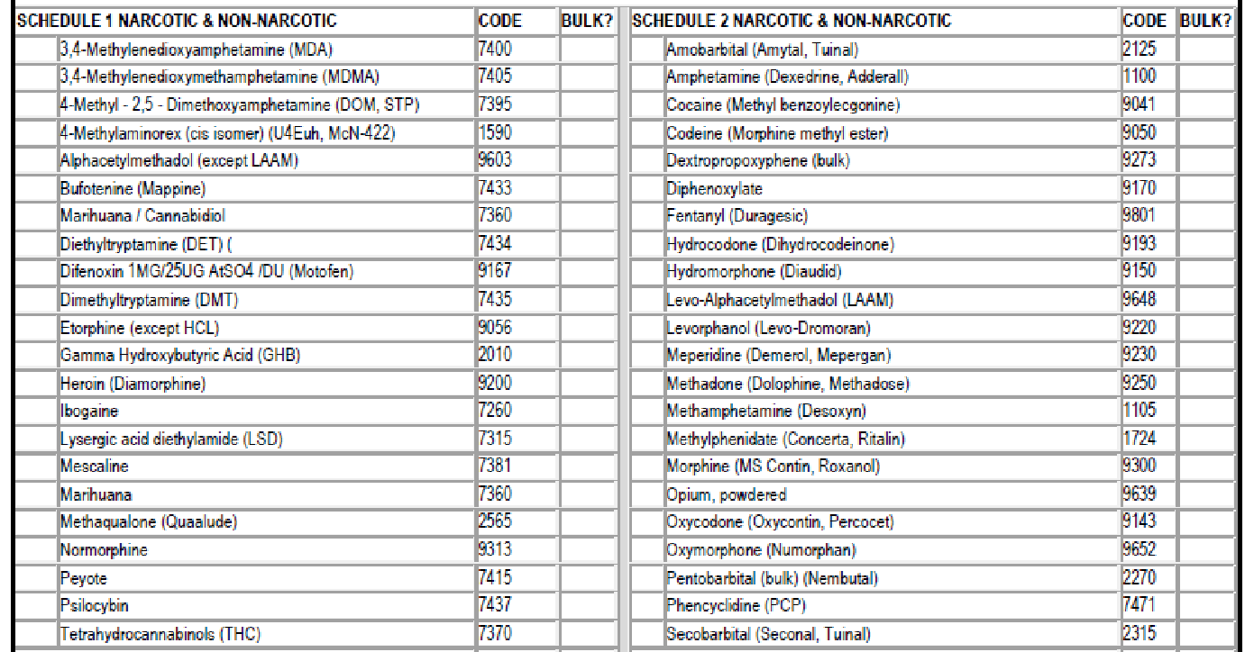
What are Schedule I Substances?
Examples
Cannabis (marijuana)
Lysergic Acid Diethylamide (LSD)
Heroin
Methaqualone (Quaaludes)
3,4-methylenedioxymethamphetamine (Ecstasy)
An updated and complete list of the schedules is published annually at Title 21 Code of Federal Regulations (C.F.R.) §§ 1308.11 through 1308.15.

Slide 25
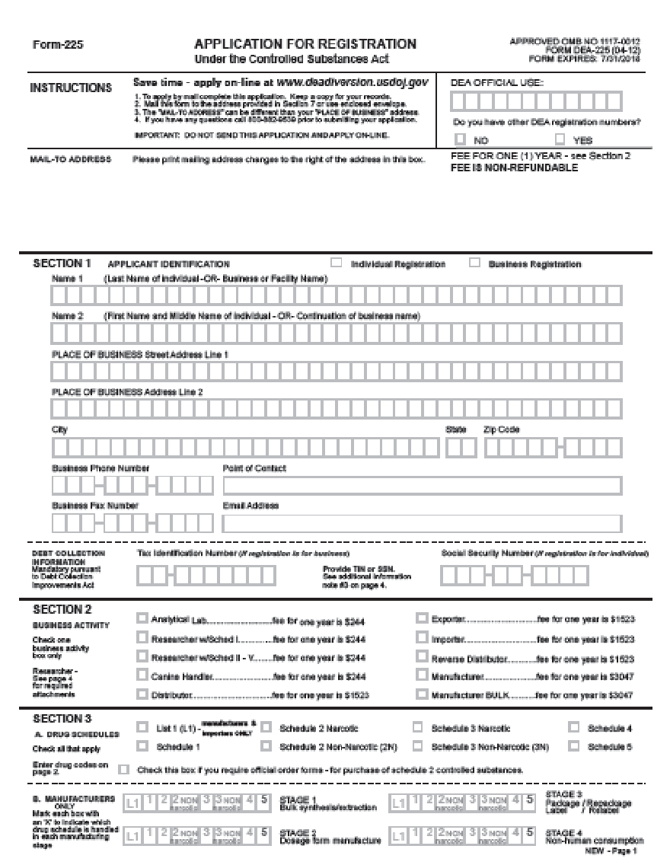
What is the Problem?
Research using Schedule I substances can’t be conducted legally without a federal license

Slide 26
What is the Solution?
(or what is a first step toward a solution?)
UW Schedule I Affinity Group
Facilitator:Nephi Stella, PhD
Professor Department of Pharmacology Director, UW Center for Cannabis Research
Share best practices
Develop information resources

Slide 27
What Can You Do?
Let your research faculty know about the UW Schedule I Affinity Group
Invite them to contact Nephi Stella --
nstella@uw.edu

Slide 28
For more information…
Nephi Stella nstella@uw.edu
Schedule I Registration (license) FAQs https://www.deadiversion.usdoj.gov/drugreg/faq.htm
UW Guidance on Research Involving Marijuana https://www.washington.edu/research/policies/guidance-on-research-involving-marijuana/

Slide 29
Research Administration Data Consolidation (RADC)
Data Solutions Update - ORIS/DSS
MRAM
Sept 13, 2018
David Smith, DSS/ORIS

Slide 30
Agenda
Intro
Research Data Products Overview
Demos!
Looking Ahead
Training

Slide 31
Intro
ORIS/DSS
ORIS: Office of Research Information Systems
DSS: Decision Support Services
Team
Richard Fenger: Assistant Director, ORIS DSS
Dave Smith (presenter): Data Analyst Lead, ORIS DSS
Grzegorz Grabowski: Data Analyst
Craig Friesen: Data Analyst
“We support data-driven decision making through unlocking, simplifying, and sharing information hidden in Research Administration Data (RAD). We conduct analyses of the RAD to identify inefficiencies and reduce burden to research administrators.”

Slide 32
“Data is an Asset”
Notes:
Our Mantra:
Data is an asset, not just a byproduct of the work we do at the UW.

Slide 33
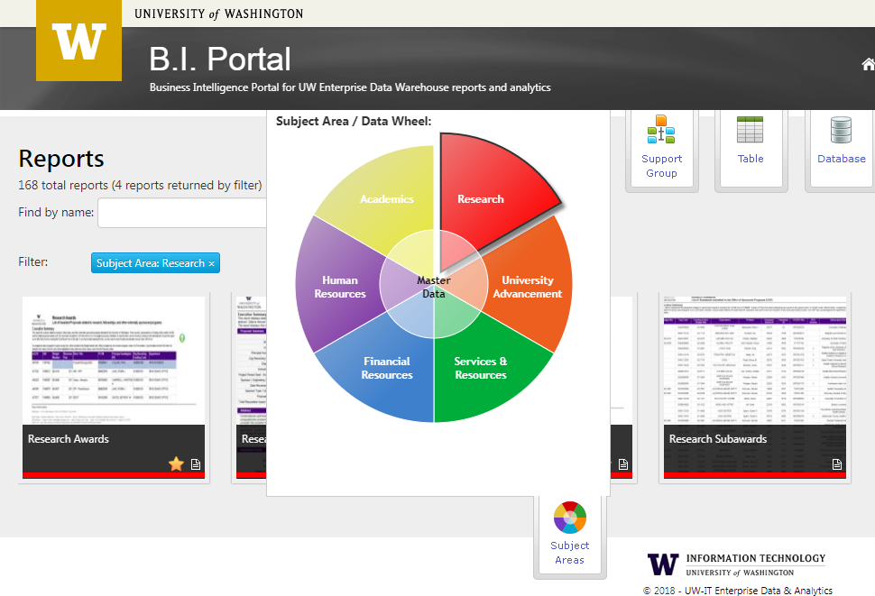
BI Portal: Research Data Tools
Business Intelligence (BI) Portal
The central resource to access institutional data housed in the Enterprise Data Warehouse (EDW)
Categories
Proposals
Awards & Subawards
Expenditures (NEW!)
Sponsored Research Highlights (NEW!)
Tools to access the data
Visualizations
Reports
Research Administration Data Cube
http://www.uw.edu/research/tools/research-administration-data-rad/

Slide 34
BI Portal: Research Data Tools
Visualizations:
High-level, summarized data at-a-glance
Filter the data to capture the information you need and quickly generate a visual report.
Reports:
Detailed Proposal/Award/Expenditures info, including PI information.
Create customized lists for summaries, then download to perform additional analysis.
Research Admin Data Cube:
Deep-dive, drag and drop analysis for more complex questions.
Analyze/explore using Excel or Tableau Desktop

Slide 35
Demo Time!
Notes:
Touch Points:
Bi Portal Overview (very brief)
Visualizations (Live Demo)
Highlights! (hub)
Proposals
Awards
Total Expenditures Summary
Reports (as time allows, show Exps Report)
Mention Cube (not full demo, show info page & screenshot?)

Slide 36
Looking Ahead
Further development of RADC Subject Areas:
Space
Finance
People
Compliance
Master data
Clear the backlog
Analysis and Insights
Know our business
Metrics & KPIs
Forecasting

Slide 37
BI Portal: Training and Outreach
Goals
Provide awareness and education about research funding to enable a range of analytical capabilities using the university’s central source of valid data.
Reduce barriers for departments to use the Enterprise Data Warehouse.
Promote data-driven decision making.
Reduce the amount of systems in use with inaccurate or non-enterprise data. (“Single source of truth”.)

Slide 38
BI Portal: Training and Outreach
Activities
New RAD courses available now! Additional sessions will be added. Refer to CORE schedule for updates. | Throughout 2018 and 2019 Academic Year
ORIS 110: Intro to Research Administration Data | 9/27/18 (Waitlist)
ORIS 210: Research Administration Cube | 10/4/18 (Waitlist)
Departmental engagements - email us to schedule! | Fall 2018 & beyond
Resources
BI Portal | http://itconnect.uw.edu/work/data/use-data/bi-portal/
UW Profiles | https://uwprofiles.uw.edu/
Grantrpt@uw.edu | Ad-hoc requests: analysis, reports, & support
Website | Information and access to tools
Factsheet | Download and share the factsheet with your colleagues

Slide 39
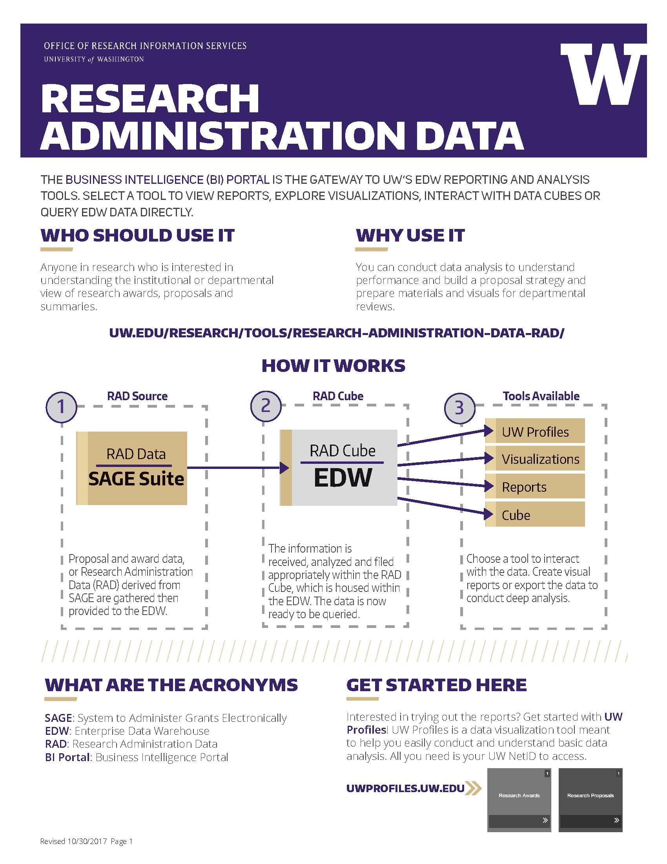
Thank you!
More information/assistance:
email: grantrpt@uw.edu
http://uw.edu/research/tools/research-administration-data-rad/
Materials available to take with you
TIP: Get access to EDW to explore and use BI Portal!
http://itconnect.uw.edu/work/data/use-data/get-access/request-access/
Deans, Chairs and Administrators can all benefit from using the data within BI Portal.

Slide 40
Appendix
Notes:
Data is an asset, not just a byproduct of the work we do at the UW.

Slide 41
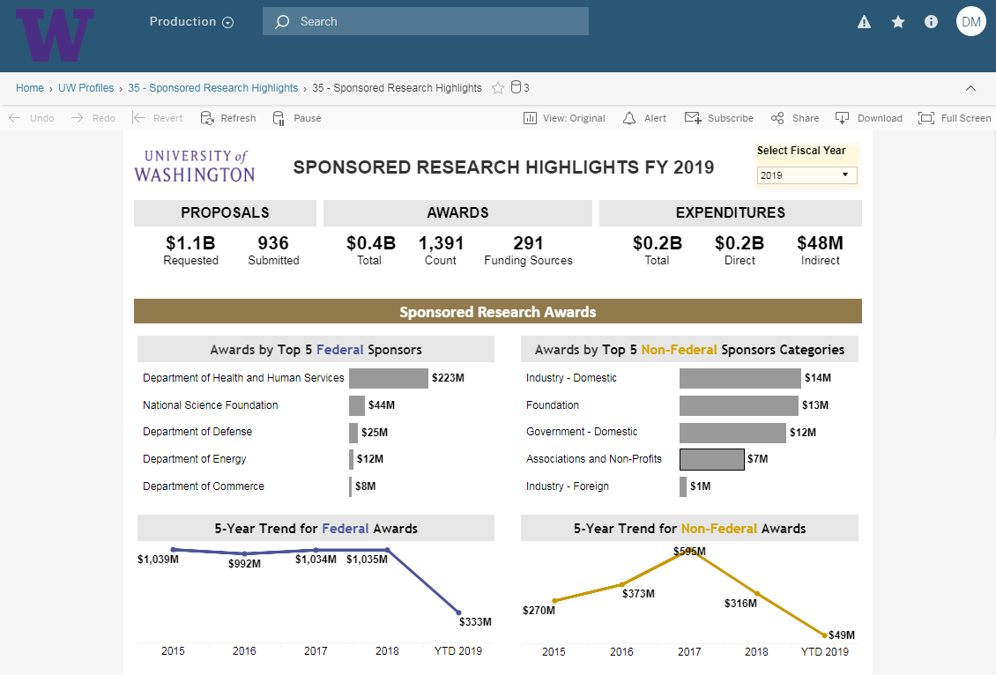
Screenshot: Sponsored Research Highlights

Slide 42
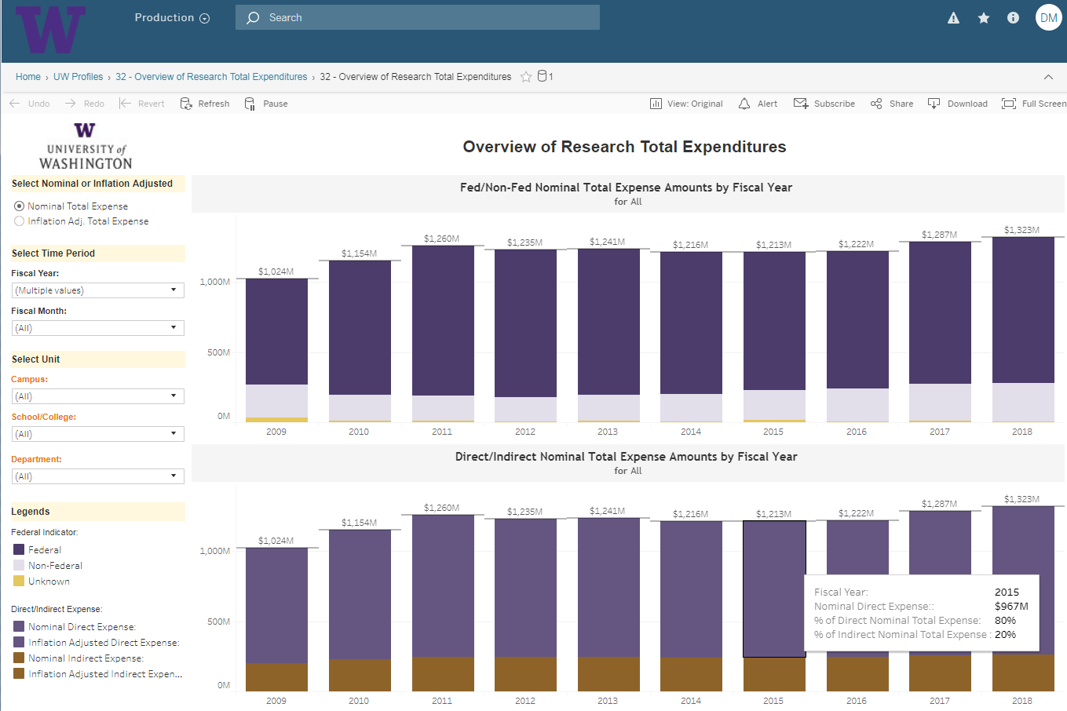
Screenshot: Overview of Research Total Expenditures

Slide 43
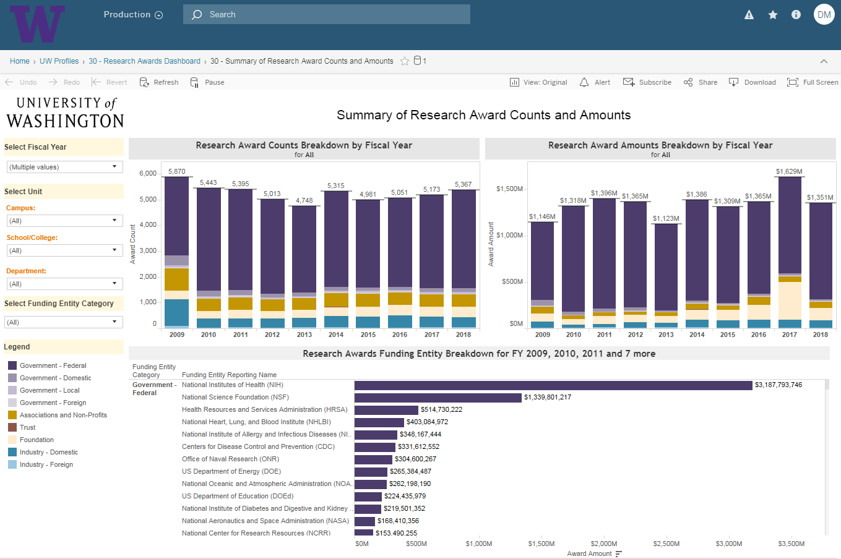
Screenshot: Summary of Research Awards

Slide 44
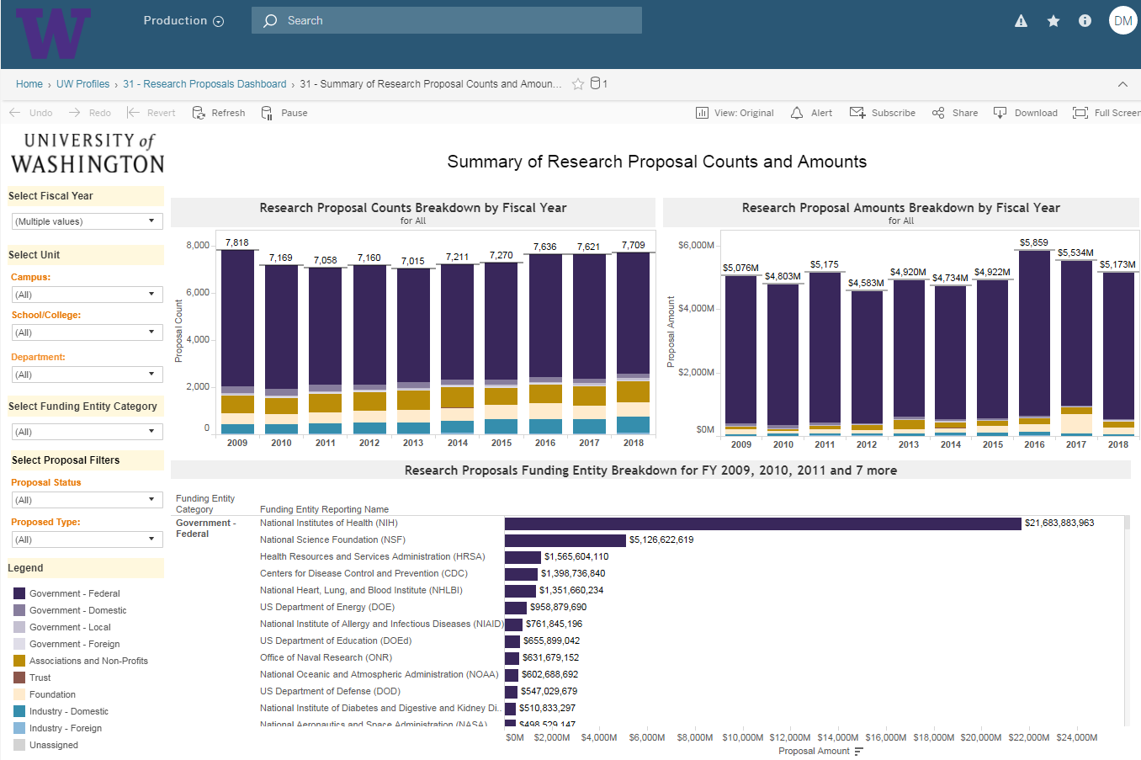
Screenshot: Summary of Research Awards

Slide 45
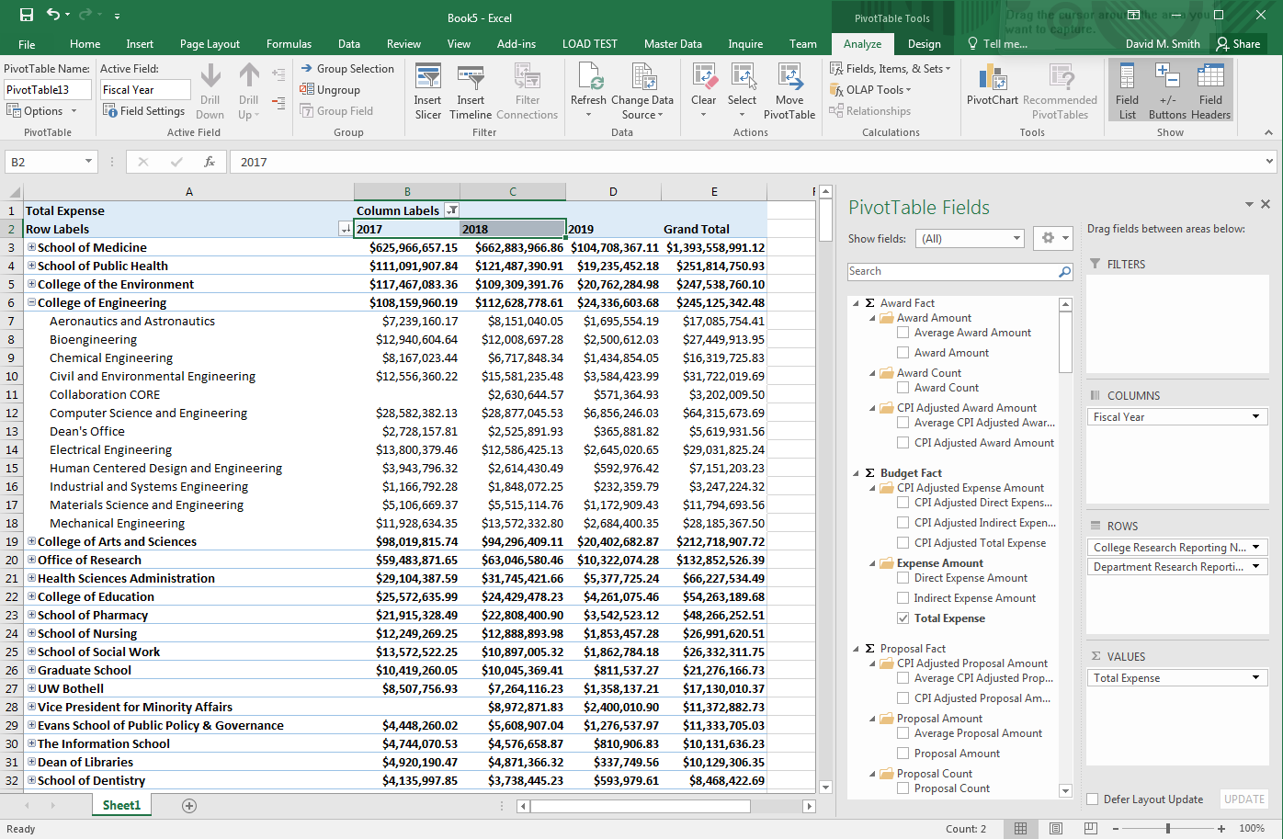
Screenshot: Research Admin Data Cube

Slide 46
SAGE Maintenance Updates
Release: 9/26/2018
MRAM
September 13, 2018
Judy Chung, SAGE Product Manager
ORIS
jachung@uw.edu

Slide 47
Sept 26 Maintenance Release Highlights
Goal: Improve Award Data Quality & Transparency
Features to be Delivered:
Add new Funding Action fields to clarify terms & conditions, and improve business processes
Update Funding Action Receipt (Notification pdf) for campus clarity
Link to MyResearch funding status from SAGE for improved status transparency

Slide 48
Funding Action Changes
New fields added:
Award modification number (allows easier roll-up of award data)
Originating sponsor award number
Non-monetary award amount
Carryover Terms, with sponsor limits explanation
Disposition of Balance Terms, with sponsor limits explanation
New Terms & Conditions Section:
Replaces “GCA Flags” section
Includes new carryover & disposition of balance fields
Consolidates other terms & conditions together
Misc. Existing fields added to FA Notification:
F&A Explanation
Subject to e-Verify
Intellectual Property Provisions

Slide 49
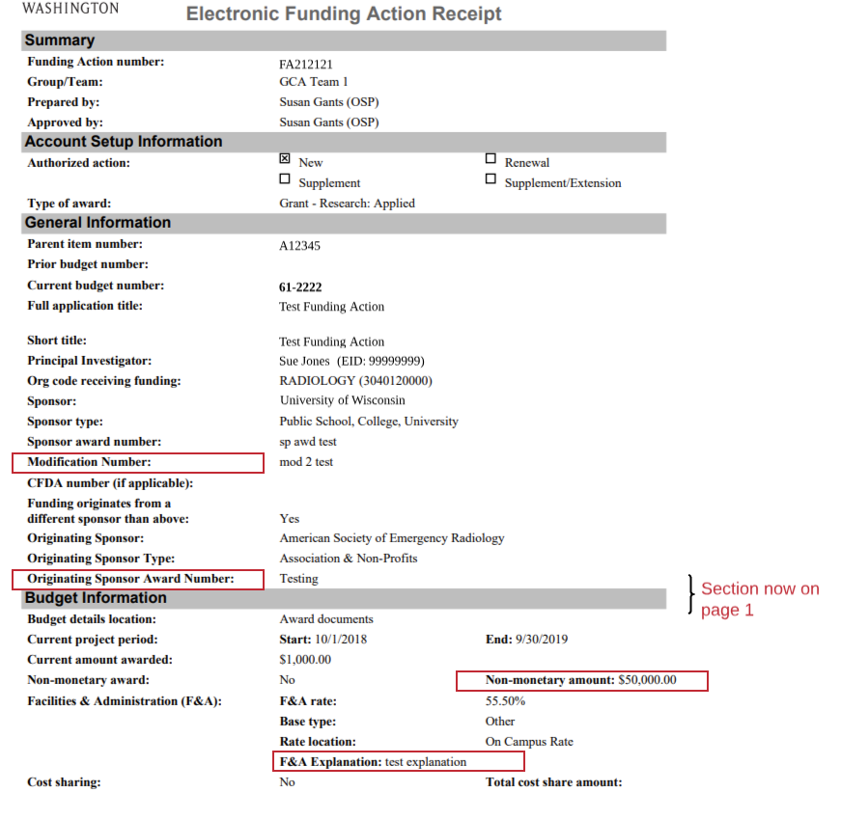
FA Receipt Notification Changes
Page 1 - New fields, changes

Slide 50
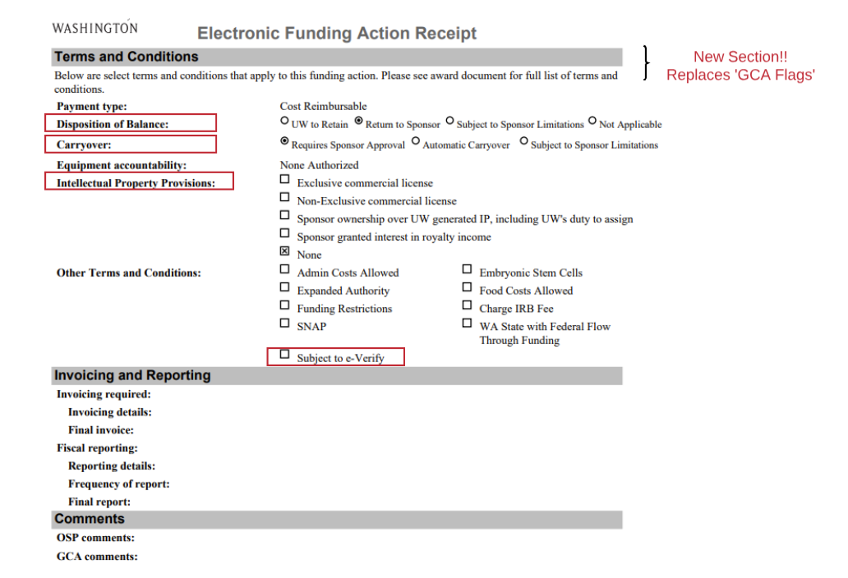
FA Receipt Notification Changes
Page 2 - New fields, section

Slide 51
Link to MyResearch Funding Status from SAGE
Link from My eGC1s list to MyResearch Funding Status, when eGC1 status is:
Approved
Awarded
Denied by Sponsor

Slide 52
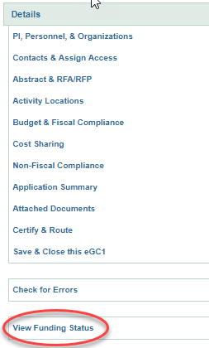
Can also link from eGC1 Left Navigation
Open an eGC1 in Approved, Awarded, or Denied by Sponsor Status
View Funding Status link in left navigation, launches to MyResearch Funding Status Details page

Slide 53
Why Would I Want to Go to MyResearch?
Find answers related to award status:
Where in the setup process is my award?
Why is the award on hold?
Has OSP completed their review yet?
Is my budget number ready yet?
View important OSP & GCA comments during award setup
See the same view as your PI’s in the MyResearch Portal, without leaving SAGE!
Will include PANs & PACs in upcoming releases

Slide 54
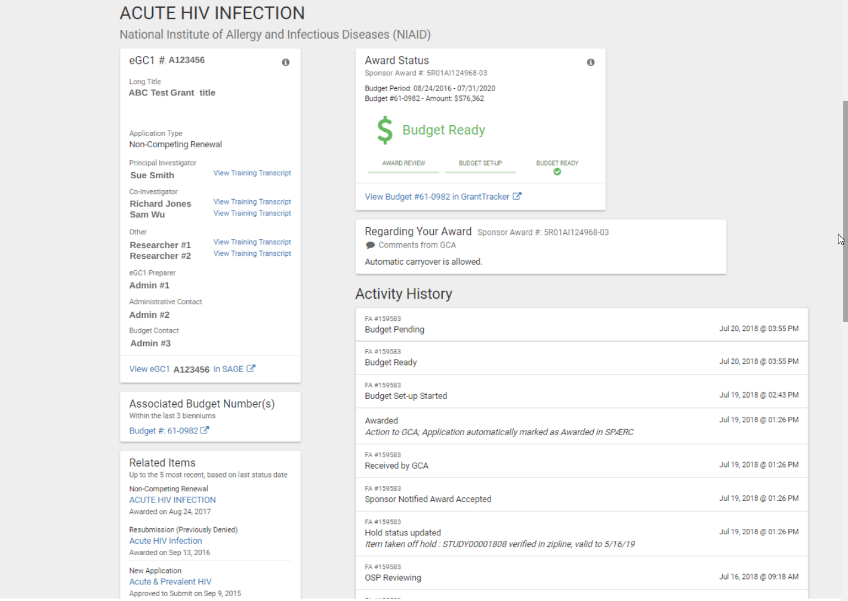
MR Funding Status Details: What you’ll see
eGC1 details
status during entire process; composing through budget ready
easy access to GT
important notes from OSP/GCA
transparency to the review and set up process; including holds

Slide 55
Desired Outcomes
Find award status answers you need without OSP or GCA help.
Facilitate quicker turn-around on award setup (less back and forth between OSP & GCA)
Improved reporting and analytics capabilities for award roll-ups

Slide 56
On its way to your desktop soon
Release Date:
September 26, 2018

Slide 57
Questions or Suggestions?
Systems help or suggestions:
sagehelp@uw.edu
myresearch@uw.edu

Slide 58
COMPLIANCE CORNER
Matt Gardner, Office of Controller
Andra Sawyer, Office of Controller
Laurie Stephan, Office of Research

Slide 59
Participant Support – NSF 2 CFR 200.75; PAPPG Chapter II. 2(a)(v)
What does Participant Support include?
Stipends and subsistence allowances
Travel allowances
Registration fees
Additional categories which must be itemized and justified in the proposal budget or must have prior written approval from sponsor
Who can receive Participant Support?
Trainees, but not employees
Notes:
Additional categories includes incentives, gifts, souvenirs, t-shirts, memorabilia, etc. These must be in the proposal budget or have prior written approval from the sponsor if rebudgeting

Slide 60
Participant Support - NSF
Travel and per diem for University employees to attend a conference are NOT Participant Support costs… even if included in the proposal budget
NSF requires prior written approval to rebudget funds from Participant Support to other cost categories (Prior Approval Matrix)

Slide 61
Participant Support – Recent Audit Findings (NSF)
$12,000 in employee travel to an NSF-supported workshop
PI received “verbal” approval from the NSF program officer
Auditors disallowed the travel costs because:
Employee travel is not considered Participant Support
PI did not obtain written approval to rebudget from Participant Support to other cost categories
Notes:
Take note: the PI travel was probably an allowable cost if it had been properly rebudgeted. But because it was classified as Participant Support and the PI never received written approval to rebudget to other cost categories, it was deemed unallowable.

Slide 62
Participant Support – Recent Audit Findings (NSF)
$4,000 spent for social media and marketing costs
University stated the costs were used by the participants and contributed to their learning experience
Auditors disallowed the costs as they are not Participant Support and the University did not receive approval to rebudget to non-Participant Support cost categories
Notes:
Take note: The social media and marketing costs MAY have been allowable as non-participant support, but since the PI never received prior written approval to rebudget out of participant support to use those funds for other purposes, they were disallowed.

Slide 63
Participant Support – Recent Audit Findings (NSF)
Other costs deemed unallowable as Participant Support:
$9,500 in travel for university employees to attend a symposium
$18,500 in costs to an independent contractor for server configuration
$14,000 in F&A costs incorrectly charged to Participant Support cost

Slide 64
Participant Support – NSF
Resources:
Uniform Guidance
2 CFR 200.75
National Science Foundation
PAPPG - Chapter II, 2(a)(v)
Research Terms & Conditions
https://www.nsf.gov/awards/managing/rtc.jsp
PAFC website
https://finance.uw.edu/pafc/participant-support

Slide 65
Participant Support - NSF
Questions on a specific NSF award?
Post Award Fiscal Compliance:
Email: gcafco@uw.edu
Matt: 543-2610; mgard4@uw.edu
Andra: 685-8902; andra2@uw.edu

Slide 66
COST SHARE!

Slide 67
Cost Share by the Numbers
400 Awards in Status 1, 2 or 3 with a Cost Share Commitment
$88m Total Value of the Cost Share
Commitments
$56m Total value Outstanding Cost Share
Commitments

Slide 68
Cost Share Anecdotally
Cost Share is a big Post-Award headache.
Random sampling of 100 Awards with Cost Share Commitments showed:
10% did not have to be or should not have been a Cost Share Commitment; and
10% had an error in calculation, set up or implementation.

Slide 69
Cost Share Myth
Unclear Sponsor requirements and lack of training & support in Cost Share lead to uncertainty; the “safe” thing to do is create a Cost Share Commitment.

Slide 70
Office of Controller Cost Share Goals
Allow PI’s to leverage use of UW resources without, if possible, creating a Cost Share Commitment.
Reduce number of Awards with an erroneous or unnecessary Cost Share Commitment.
Train and provide support to central and department staff to think strategically about Cost Share.

Slide 71
Office of Controller Current Activities
Updated Cost Share Addendum (March 2018)
Two new CORE classes
Is it Really Cost Share? (Sept 11, Nov 7)
Managing Cost Share (Sept 20)
Ongoing updates on the GCA webpage
GCA’s Revised Guidelines to determine if Cost Share has been met
Access to Cost Share Data leading to:
GCA and PAFC more proactive with issues
Dashboard

Slide 72
CORE!

Slide 73
A Quick Word from CORE
CORE offers training responsive to your needs
Cost Share training need identified through:
CORE customer survey (2014)
Facilitated discussions with department research administration staff
Transaction and process data in central units
Advisory group for the Research Administration certificate
Curriculum vetted by department SMEs
Continuous improvement through feedback
Notes:
CORE offers research administration training based on identified need. Cost Share courses are an example of this.
Needs identified through:
CORE customer survey (2014) –cost share rose to the top as an area where training/information was needed
Facilitated groups with department research administration staff—when asked where more training/information could be offered cost share was a top area
Transaction and process data in central units—as shared by Andra recent data analysis shows there is a need for better information and skills dissemination in this area
Advisory group for the Research Administration certificate—representatives from the schools and colleges identified cost share as a significant need
Curriculum vetted by department SMEs so we know it’s targeted to the right audience with the most helpful lens on the information. We rely on our SMEs in the departments heavily and here is a shout to all of you who spend your valuable time to share your expertise with us. You know who you are! Thank you!!
The cost share classes are full but look for more coming up soon. Speaking of upcoming training… NEXT SLIDE
Continuous improvement through feedback gathered from student evaluations, observation and ongoing process changes at the central units to ease burdens in the departments

Slide 74
UPCOMING COURSES IN
RESEARCH ADMINISTRATION
 | Sep 19 | ORIS 101 | SAGE: Creating and Submitting eGC1s
 | Sep 20 | RAA 206 | Managing Cost Share at the UW
 | Sep 26 | MAA 210 | Modifying an FEC, Change Outside eFECS and Recertifications
 | Sep 27 | OSP 110 | Introduction to Research Administration Data
 | Oct 4 | ORIS 210 | Research Administration Data Cube
 | Oct 24 | MAA 100 | Introduction to Grant and Contract Certification (GCCR)
 | ONLINE | RAA 201 | Post Award Food Purchases and Compliance
 | ONLINE | GCA 202 | Direct Billing of F&A Type Costs Online Class
 | ONLINE | RAA 202 | Timing of Expenditures & Benefit to Award
 | ONLINE | RAA 203 | Internal Controls
Register: https://uwresearch.gosignmeup.com/public/course/browse
CORE Home: https://www.washington.edu/research/training/about-core/

