Slide 1
SAGE Maintenance Updates
Release: 9/26/2018
MRAM
September 13, 2018
Judy Chung, SAGE Product Manager
ORIS
jachung@uw.edu

Slide 2
Sept 26 Maintenance Release Highlights
Goal: Improve Award Data Quality & Transparency
Features to be Delivered:
Add new Funding Action fields to clarify terms & conditions, and improve business processes
Update Funding Action Receipt (Notification pdf) for campus clarity
Link to MyResearch funding status from SAGE for improved status transparency

Slide 3
Funding Action Changes
New fields added:
Award modification number (allows easier roll-up of award data)
Originating sponsor award number
Non-monetary award amount
Carryover Terms, with sponsor limits explanation
Disposition of Balance Terms, with sponsor limits explanation
New Terms & Conditions Section:
Replaces “GCA Flags” section
Includes new carryover & disposition of balance fields
Consolidates other terms & conditions together
Misc. Existing fields added to FA Notification:
F&A Explanation
Subject to e-Verify
Intellectual Property Provisions

Slide 4
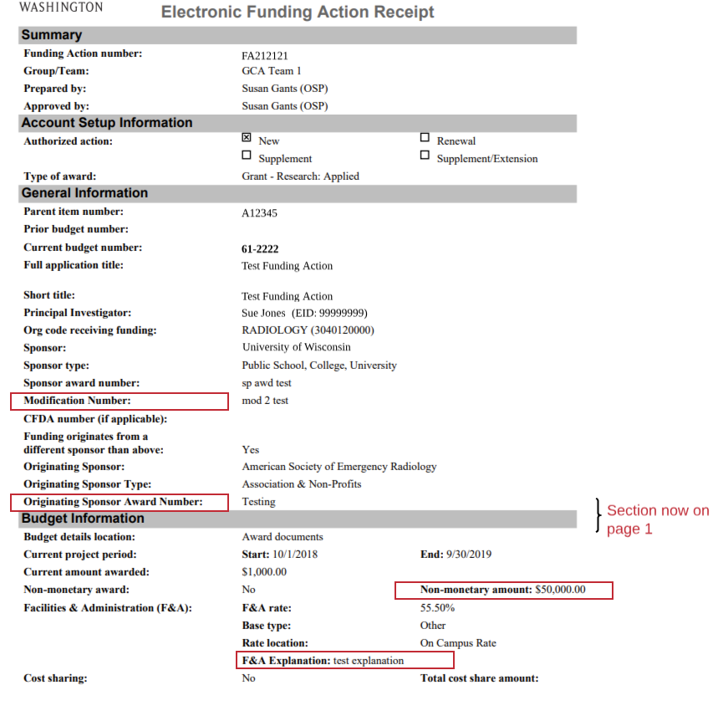
FA Receipt Notification Changes
Page 1 - New fields, changes

Slide 5
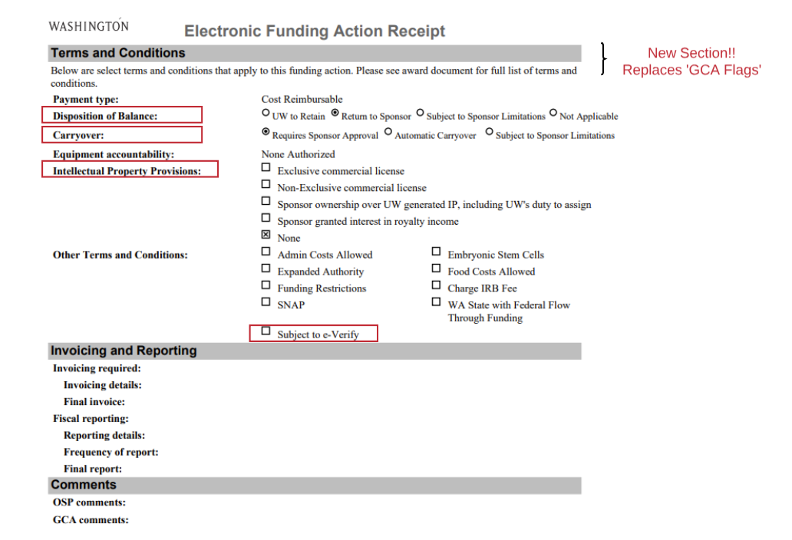
FA Receipt Notification Changes
Page 2 - New fields, section

Slide 6
Link to MyResearch Funding Status from SAGE
Link from My eGC1s list to MyResearch Funding Status, when eGC1 status is:
Approved
Awarded
Denied by Sponsor

Slide 7
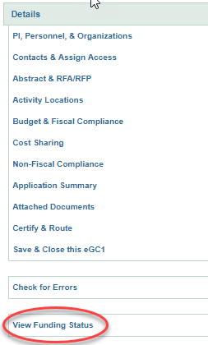
Can also link from eGC1 Left Navigation
Open an eGC1 in Approved, Awarded, or Denied by Sponsor Status
View Funding Status link in left navigation, launches to MyResearch Funding Status Details page

Slide 8
Why Would I Want to Go to MyResearch?
Find answers related to award status:
Where in the setup process is my award?
Why is the award on hold?
Has OSP completed their review yet?
Is my budget number ready yet?
View important OSP & GCA comments during award setup
See the same view as your PI’s in the MyResearch Portal, without leaving SAGE!
Will include PANs & PACs in upcoming releases

Slide 9
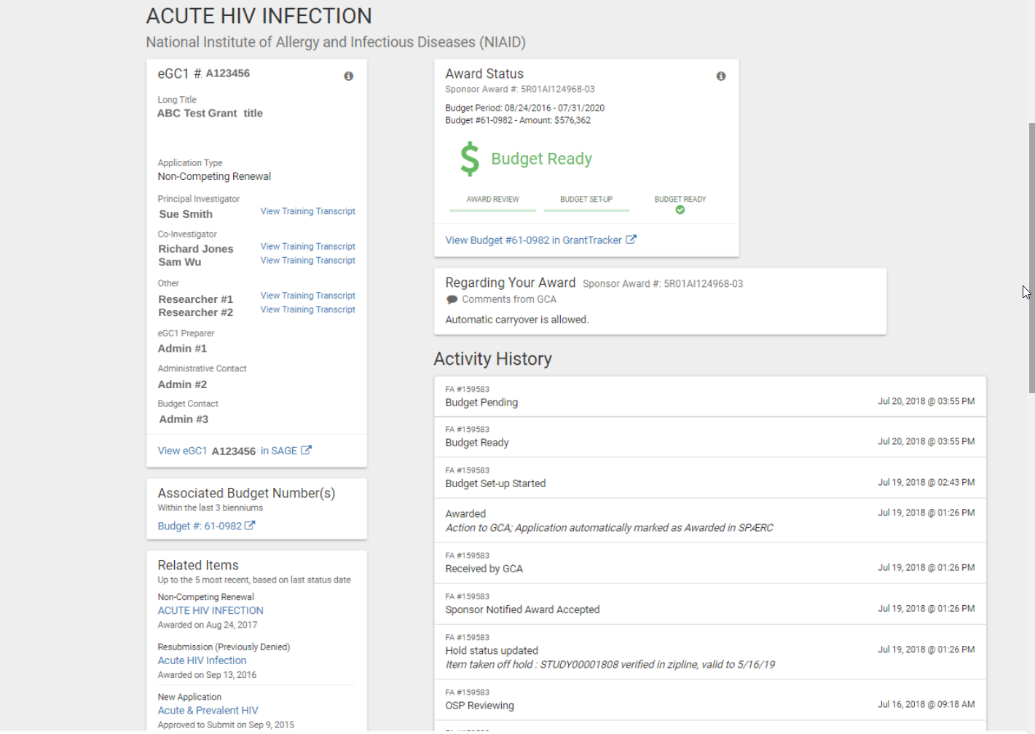
MR Funding Status Details: What you’ll see
eGC1 details
status during entire process; composing through budget ready
easy access to GT
important notes from OSP/GCA
transparency to the review and set up process; including holds

Slide 10
Desired Outcomes
Find award status answers you need without OSP or GCA help.
Facilitate quicker turn-around on award setup (less back and forth between OSP & GCA)
Improved reporting and analytics capabilities for award roll-ups

Slide 11
On its way to your desktop soon
Release Date: September 26, 2018

Slide 12
Questions or Suggestions?
Systems help or suggestions:
sagehelp@uw.edu
myresearch@uw.edu

