Slide 1
NIH: SNAP Eligible
RPPR Delegation Pilot -
Report Out
Research Advisory Board
October 2018
Carol Rhodes
Office of Sponsored Programs

Slide 2
NIH RPPR Direct submission Pilot: Scope and Goal
Scope:
Delegated direct submission of NIH SNAP eligible RPPRs to PIs across campus
April - July 2018
Goal:
To assess if delegation would reduce administrative burden.

Slide 3
Pilot Facts
49 PIs participated
Schools: SOM, SPH, A&S, COE, SON, SSW, (and APL)
Feedback/questions during Pilot, catalogued & saved
Post Pilot Survey sent to participating PI and their department administrator:
PI response rate: 42%
Administrator response rate: 40%

Slide 4
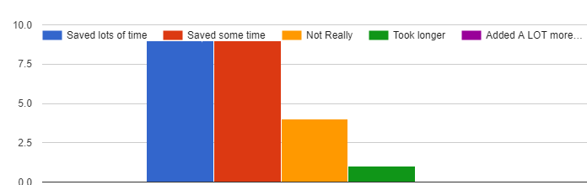
PI Survey Response:
Did submitting report directly save you time?
Saved Time

Slide 5
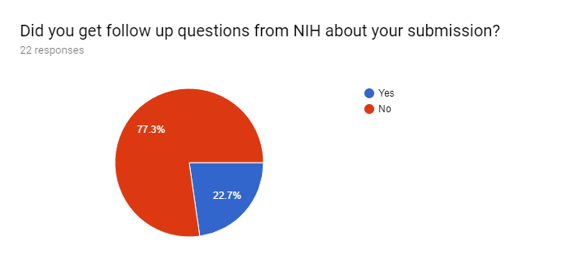
PI Survey Response:
Did you get follow up questions from NIH about your submission?

Slide 6
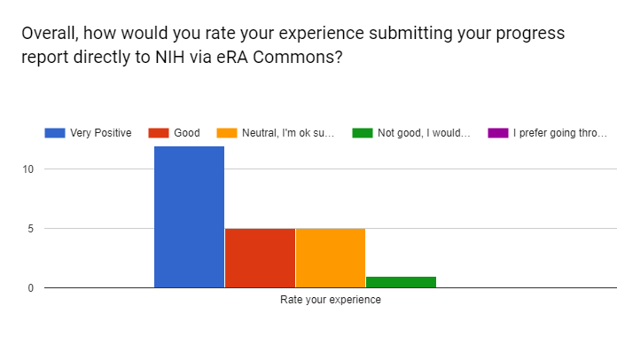
PI Survey Response:
Overall, how would you rate your experience submitting your progress report directly to NIH via eRA Commons?

Slide 7
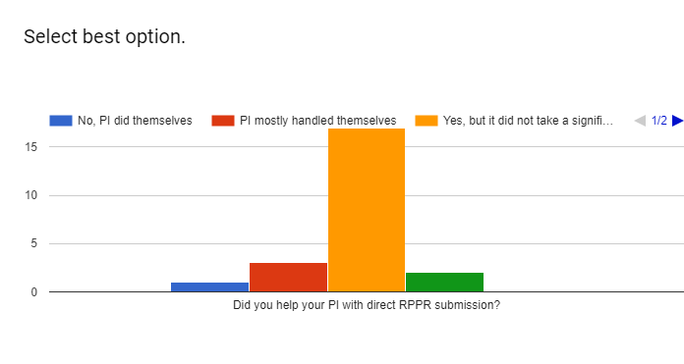
Admins Survey Response:
Did you help your PI with direct submission?

Slide 8
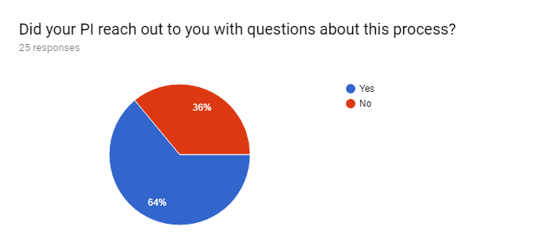
Admins Survey Response:
Did your PI reach out to you with questions about this process?

Slide 9
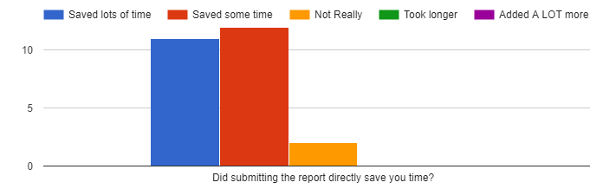
Admins Survey Response:
Did submitting the report directly save you time?

Slide 10
Next Steps:
Delegation & eGC1 Requirements
OSP will delegate submission authority to PIs for SNAP eligible awards.
eGC1s will NO Longer be required for SNAP eligible RPPR Submission
Implementation: November 1st, 2018

