Slide 1
Financial Interest Reporting
MRAM - October 11, 2018
Melissa Petersen
Office of Research
University of Washington
Notes:
Good morning, I am Melissa Petersen from the Office of Research and am here today to talk to you about Financial Interest Reporting.
And with that in mind, let me start with a disclosure of my own: I have a Significant Financial Interest in GIM 10 and Executive Order No 57 in that more compliance with these policies means more work for me, and thus (hopefully) greater job security.

Slide 2
UW Policies & Information
Policies
Financial Conflict of Interest policy (Research & Technology Transfer), Grants Information Memorandum (GIM) 10
Outside Professional Work (Faculty, Librarians, other Academic Personnel), Executive Order No. 57
Outside Consulting Activities and Part-Time Employment by Professional or Classified Staff Employees, Administrative Policy Statement 47.3
UW School of Medicine Policy on Potential Financial Conflicts of Interest for Commercial and Nonprofit Entities
Information
Office of Research – Outside Work
Office of Research – Financial Conflicts of Interest (FCOI)
Notes:
So, policies and information – the two I mentioned GIM 10, the Financial Conflict of Interest policy, and Executive Order No. 57, the Outside Professional Work policy for Faculty, Librarians, and Other Academic Personnel are listed here as well as other related policies such as the Outside Work policy for Staff and the School of Medicine’s policy on Financial Conflicts of Interest.
Also linked here are informational pages provided by the Office of Research covering process and frequently asked questions.

Slide 3
UW Policy & Best Practice
Conflict management plans issued by the UW Office of Research start with:
You are required to make appropriate disclosures of your financial interest(s) in connection with any publication (written, electronic, oral, or otherwise) of the results of the research, as well as to collaborators and trainees (students and postdoctoral fellows) involved in the research.
The American Association for the Advancement of Science (AAAS) says:
“…AAAS has reaffirmed its commitment to robust, independent peer review as well as the sharing of research results through publications and public discourse, in accordance with well-crafted transparency policies and procedures.”
Notes:
This presentation is more than just UW policy, though that is where I’ll start.
Any Investigators on research at the UW who have received a Conflict Management Plan from the Office of Research will be required (it’s the very first condition) to disclose their financial interests in connection with any publications, results, presentations, or collaborators.
Without a conflict management including this condition, we would continue to recommend such disclosure, consistent with the guidance of Triple-A-S, the American Association for the Advancement of Science who says that they are committed to robust, independent peer review as well as the sharing of research results through publications and public disclosure.
So, what happens when researchers do not disclose? This could range from further restrictions or conditions on their UW research activities or external consulting approvals, to, public commenting via media and reporting… such as was the case with…

Slide 4
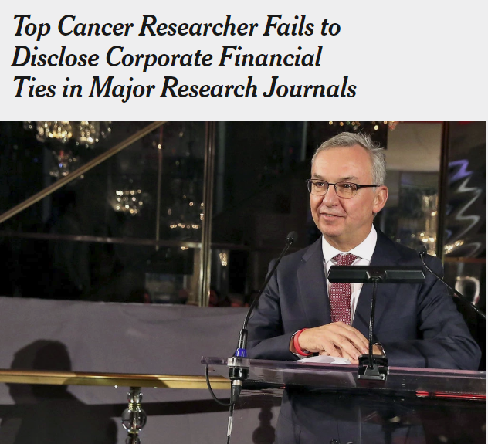
Dr. José Baselga, the chief medical officer at Memorial Sloan Kettering Cancer Center, in 2015.
Cindy Ord Getty Images
By Charles Ornstein and Katie Thomas
Sept. 8, 2018
Notes:
Dr. Jose Baselga – some of you may have seen this article already.
This article only speaks briefly about his institutional compliance where it says Memorial Sloan Kettering was aware of the relationships. This doesn’t necessarily mean he was compliant, however, reporting of financial interests at the UW, for example, doesn’t end with FIDS – especially if there is a conflict management plan, or other conditions, in place for research or outside work.
To continue my shock and awe presentation…

Slide 5
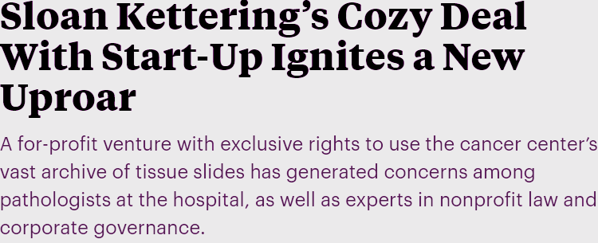
By Charles Ornstein, ProPublica, and Katie Thomas, The New York Times, Sept. 20, 4:10 p.m. EDT
Notes:
Shortly after the previous story, ProPublica and the New York Times worked together to reveal questionable relationships between Sloan Kettering and a Start-Up. At the UW we put restrictions on sharing of intuitional resources (including researchers) in technology transfer management plans that are issued around the time of license execution performed by CoMotion.

Slide 6
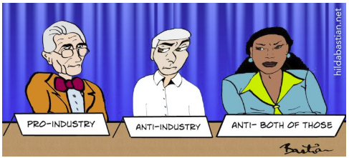
Posted September 24, 2018 by Hilda Bastian in Bias
Notes:
Just one of two more headlines I pulled from recent activity to convey the current level of interest in financial relationships between researchers and industry – these exist by way of consulting and collaboration activities.

Slide 7
Notes:
And the last of my shock and awe headlines, this one was from September 14, 2018. So the theme is: disclose, disclose, disclose – and I don’t intend just to be repetitive – researchers should disclose to their institution, to their study teams, and to their audience.
And “how do I disclose” is not an uncommon question, so we have some sample disclosures available

Slide 8
Simple Disclosures
AUTHOR is employed by COMPANY
AUTHOR is a paid part-time consultant for COMPANY
AUTHOR holds COMPANY stock
One or more embodiments of one or more patents and patent applications filed by the University of Washington and COMPANY may encompass methods, reagents, and the data disclosed in this manuscript. Some work in this study is related to technology described in patent applications.
AUTHOR is a co-founder and equity holder in COMPANY, which has licensed this technology to REACTION via BIOLOGICAL PROCESS in CELL TYPE from the University of Washington
The authors declare the following competing financial interest(s): AUTHOR 1, AND AUTHOR 2 have a financial interest in COMPANY, which has licensed the described technology from the University of Washington
These and additional Sample Disclosures available HERE
Notes:
First, some simple disclosures that should help get any Investigator started, with a link to these and more comprehensive templates.
And if you can't wait until this presentation is posted, don’t hesitate to contact me!

Slide 9
Contact
Contact Information:
research@uw.edu
206.616.0804
Melissa Petersen
petermm@uw.edu
Office of Research, University of Washington
Notes:
My contact information, here.
Questions? Thank you!

