Slide 1
2018 NATIONAL BIOSAFETY MONTH
Zara Llewellyn, PhD, RBP
Biological Safety Manager
Environmental Health and Safety Department
MRAM meeting
October 2018
Notes:
Thank you for inviting me to attend and talk about biosafety month

Slide 2
WHAT IS BIOSAFETY?
The containment of biological hazards
Requires the use of safe practices, training, facilities, and equipment
Provides protection for people, animals, and the environment

Slide 3
BIOLOGICAL RESEARCH AT UW
1,813 of 4,100 total (44%) of lab spaces are biohazard labs
640 projects registered with the Institutional Biosafety Committee (IBC)
368 IBC applications reviewed in 2017
5.6 (FTE) Biological Safety Officers
1.0 (FTE) IBC/Research Coordinator
Notes:
DO you want to show the chart that has projects over time?

Slide 4
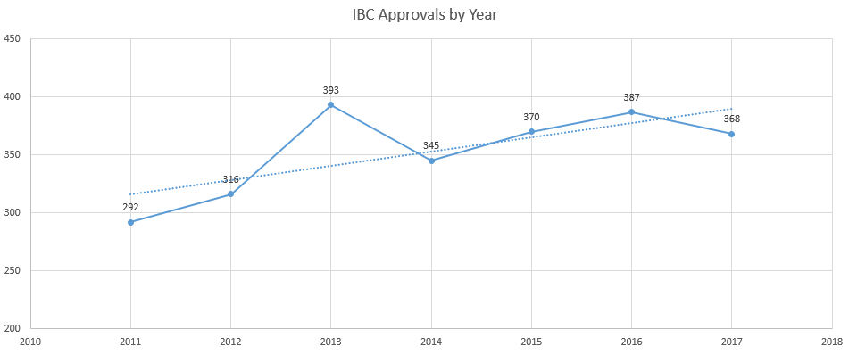
IBC APPROVALS BY YEAR
2011-2017

Slide 5
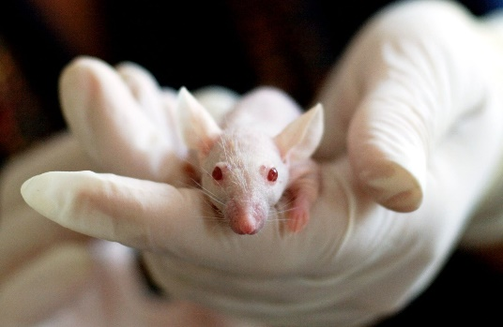
ACTIVE PROJECTS WITH BUAS
610 Currently Approved Projects
37% Involving Viral Vectors (n=222)
37% With Associated Animal Protocol (n=229)
4% Involving Human Subjects (n=24)
15% Involving Recombinant Bacteria or Viruses (n=94)
4% Involving Non-Exempt Transgenic Animals (n=26)
9 plant projects

Slide 6
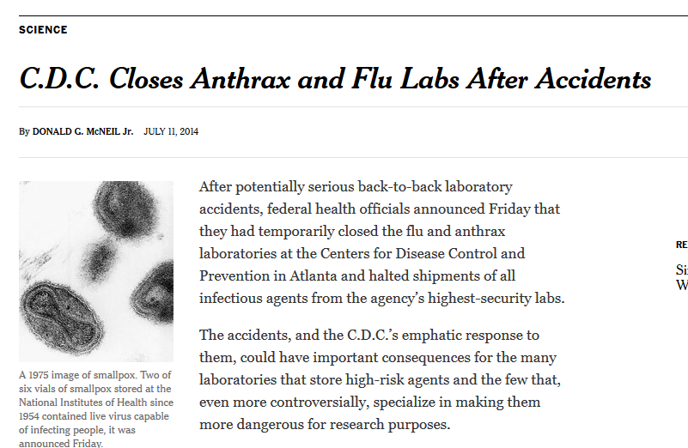
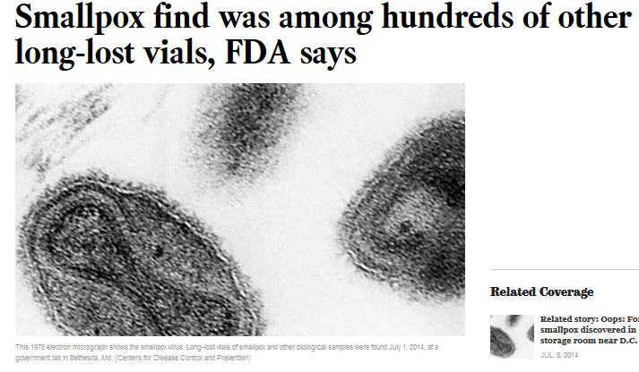
NATIONAL BIOSAFETY MONTH
Started in 2014 by the NIH Office of Science Policy
A time to focus attention to biosafety policies, practices, and procedures

Slide 7
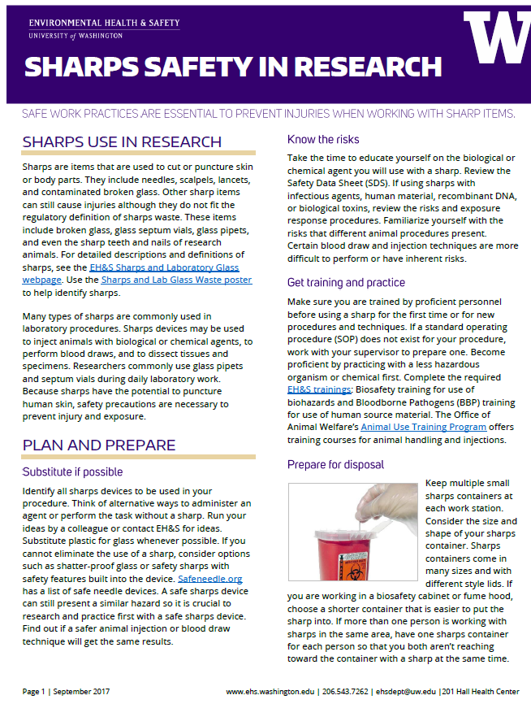
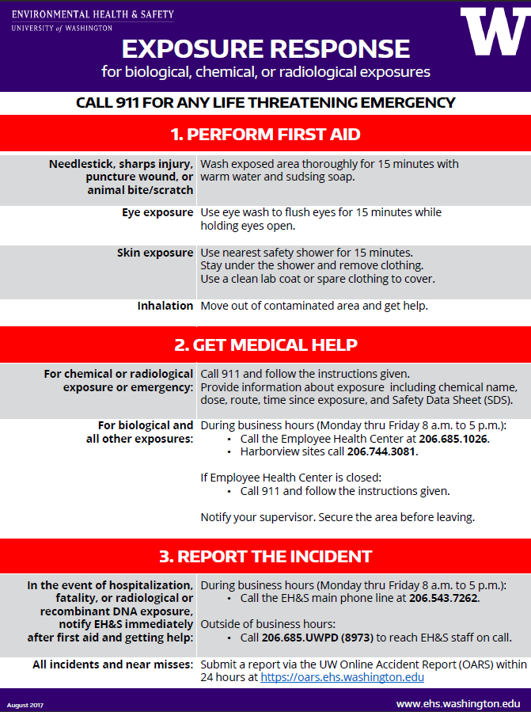
NATIONAL BIOSAFETY MONTH AT UW

Slide 8
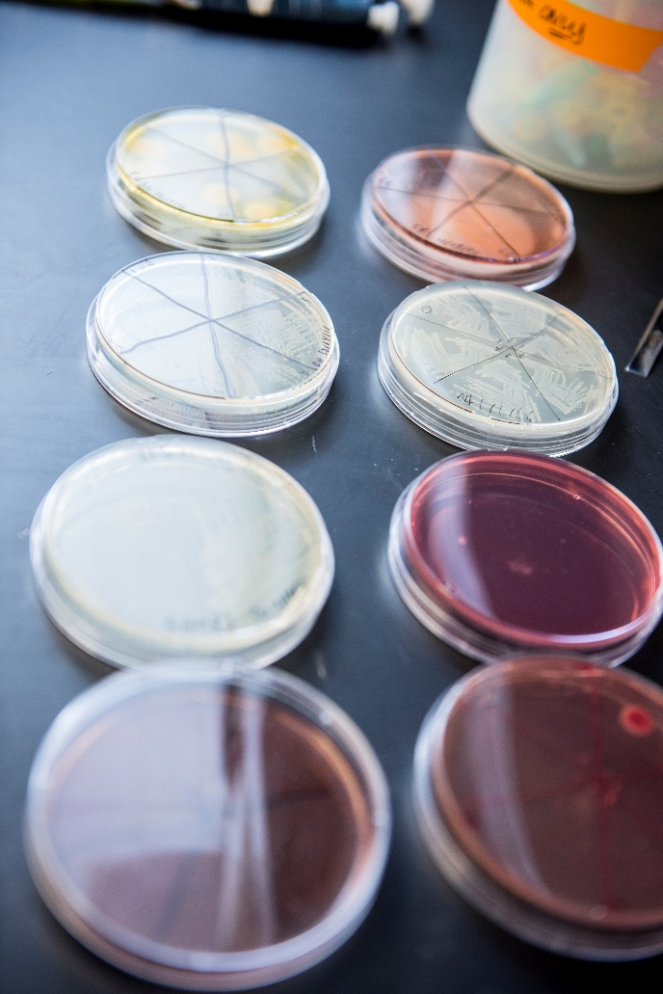
2018 – PROMOTING A CULTURE OF SAFETY
Principal Investigator responsibilities
Culture starts at the top!
Enhance biosafety training and procedures
Lab-specific training
Support researchers and highlight successes
Celebrate positive behaviors
Prevent workplace injuries and illness
Promote reporting of all incidents and near miss events
Discuss root causes and ways to prevent future incidents
Learn from mistakes
Notes:
1. PI’s responsibility to have people trained and safety in the lab. Can you discuss the new PI definition?
2. Each lab should have specific lab training for the types of work they are doing and the types of biohazards they work with.
3. National Biosafety month is a great opportunity in addition to always to provide positive feedback and celebrate positive safety working environment.
3a. Incidents and accidents can occur and it is important that people do report these issues so that we can all learn from mistakes.

Slide 9
ACHIEVING A CULTURE OF SAFETY
“Safety is shared by Everyone”
Increasingly Trustful
5. Safety is inherent
EHS is fully integrated into the business
“I say something when I see unsafe behaviours or conditions”
“I know what to do and have resources to keep myself safe”
4. Safety is a Value
We work proactively on the problems that we still find
“I know what to do to keep safe but do not have resources or safety is the Safety Officer’s job”
Act
3. Safety is a Priority
We have systems in place to manage EHS risks
“I do not know how to keep myself safe at work”
Check
2. Safety is Important
Compliance is important
Programs are Compliant
7 elements
Do
1. No Formal Safety Framework
Safety is not integrated into business
Plan
Increasingly Accountable
Notes:
A culture of safety is achieved through establish an EHS framework and maturing the framework until safety becomes a value and ultimately inherent in the way that we operate. Currently, EH&S is at level 3 – maturing our programs to a compliant state, laying the foundation to shift the culture to value safety

Slide 10
HELP PROMOTE BIOSAFETY MONTH
Email to PIs and lab managers who work with biological agents
Discuss biosafety in your departments and labs
Share article “promote a culture of safety in your lab” on EH&S website
Link to the article on Office of Research
website

Slide 11
2018 EH&S AND IBC BIOSAFETY UPDATES
New EH&S website
Online biological waste training
Sharps safety guidance
New IBC Coordinator and Biosafety Officer

Slide 12
HAPPY BIOSAFETY MONTH!!
Promoting a Culture
of Safety!!
Notes:
All of our responsibility to promote and provide a safety of culture. We are here to help.

Slide 13
RESOURCES
EH&S website: www.ehs.washington.edu
Biological Safety and Biohazardous Waste
Exposure Response Poster
Sharps Safety in Research
IBC webpage
EH&S Guide for Principal Investigators
NIH Office of Science Policy: https://osp.od.nih.gov/
EH&S Biosafety Contacts
ehsbio@uw.edu or 206-221-5524

