Slide 1
SAGE Budget Sync
Release: 11/27/2018
MRAM
November 8, 2018
Judy Chung, SAGE Product Manager, ORIS
jachung@uw.edu
Notes:
Excited to share information with you on an upcoming feature addition to SAGE called Budget Sync. This is a feature specific to Grant Runner application, so I’m going to start with a few brief reminders of what Grant Runner is all about

Slide 2
Intro
What is Grant Runner?
Grant Runner is a SAGE feature that allows users to populate the NIH sponsor forms within the eGC1.
Advantages of Use:
Fewer systems to interact with
Sponsor forms are pre-populated with eGC1 data, which ensures data accuracy & consistency, and reduces effort
Submission happens directly from SPAERC by OSP
Reduced training and support needs for sponsor systems
Coming in November! Flow SAGE Budget to RR Detailed Budget

Slide 3
Grant Runner Mission
Deliver high impact, streamlining features that reduce the overall time spent on preparing, reviewing, and submitting federal proposals.
Features added since 2017:
Single PDF of full application (all sponsor forms)
NIH validations included in eGC1 Check for Errors
Career Development and Fellowship grants support
Human Subjects & Clinical Trials (HSCT) Form support
Import of ClinicalTrials.gov data into HSCT form

Slide 4
NIH Opportunities Supported in Grant Runner
NIH Single Project, 5 year budget for:
Basic Research
Career Development
Fellowships
Endowment Programs
Shared Instrumentation
Director Awards
Targeted Research
Pre-Applications
Resource Awards
List by Activity Code

Slide 5
New Feature: Budget Sync
Budget Sync is a new Grant Runner feature that allows you to auto-populate the federal RR Detailed Budget form from a connected SAGE Budget.
Connect a SAGE Budget to an eGC1
Current State:
Future State:
SAGE Budget
eGC1 Budget
eGC1 Budget
SAGE Budget
RR Detailed Budget
If Grant Runner
Notes:
On to our new feature – Budget Sync!
Builds off the existing “connect budget” feature on the eGC1

Slide 6
Summary of Budget Sync Benefits
Why Use Budget Sync and Grant Runner?
Saves time
No more copying budget data into sponsor form
Expense amounts are changed in a single place SAGE Budget
Much less cross-checking between budgets
Improves accuracy
Single source for budget data
Easier on reviewers
Reviewers no longer need to cross-check multiple budgets
Easy to trace where an expense sourced from

Slide 7
How It Will Work
Steps:
Create a SAGE Budget
Connect your budget to a Grant Runner eGC1
Review results in RR Detailed Budget form
Make adjustments as necessary
Adjust amounts & expenses in SAGE Budget
Adjust where expenses appear in the RR Detailed Budget form from the new Sponsor Budget Map page

Slide 8
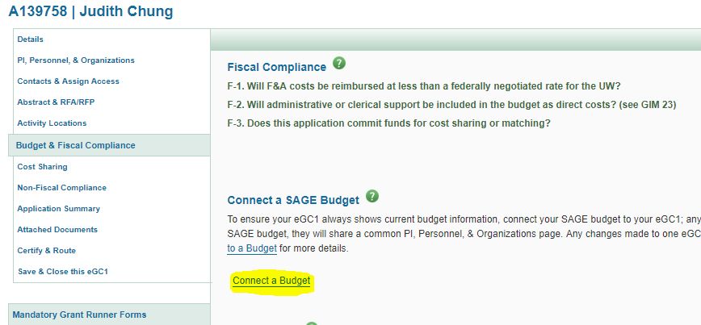
Connecting a SAGE Budget
From Budget & Fiscal Compliance Page of your eGC1, click “Connect a Budget” link.
Can be done at anytime after budget creation
Notes:
For those of you who may never have connected a SAGE Budget to an eGC1 before, you do so from …

Slide 9
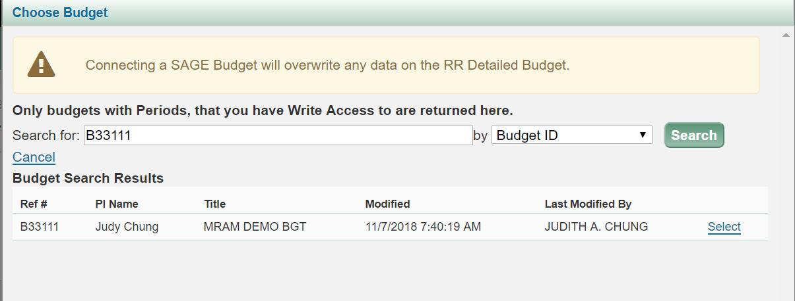
Connecting: Select your Budget
Notice the yellow warning at top, that RR Detailed Budget will be cleared on connect of Grant Runner applications

Slide 10
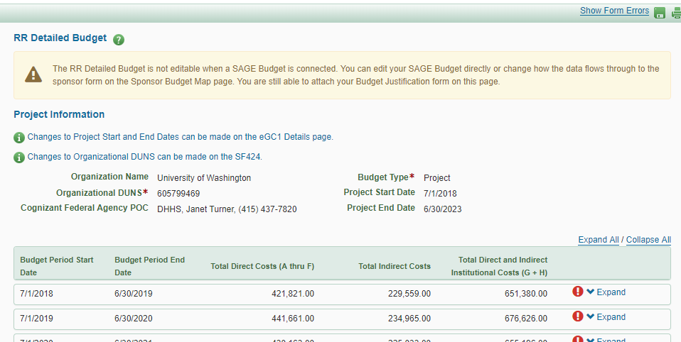
RR Detailed Budget View When Connected
RR Detailed Budget data will be read-only, as long as it’s connected
Exception: Budget Justification attachment is still uploaded from the link on the RR Detailed Budget
Expenses will flow to default categories on RR Budget, based on object code mapping rules established in collaboration with OSP & GCA, with campus input. Many defaults can be changed.
Notes:
Remember to discuss default categories!

Slide 11
Where to Make Changes, once Connected
Changes are made in 2 places, depending on the type
Use SAGE Budget To:
Add/remove expenses
Change expense descriptions or amounts
Change personnel roles
Use the New Sponsor Budget Map To:
Change where you want the expense to show up on the RR Detailed Budget form
Change order of the personnel on RR Budget
Create custom sub-categories for the RR Budget “other direct costs” or “other personnel”

Slide 12
When Will I See My Changes?
As soon as the change is saved!
Just refresh the RR Detailed Budget form to see the change.
What do we mean by refresh?
Click the SAVE icon on the eGC1 toolbar
Click the RR Detailed Budget link in left navigation
Move around the eGC1 in any way
Can I have multiple browsers open & still see changes?
YES! Just refresh the RR Detailed Budget

Slide 13
What is Budget Mapping?
Defines how SAGE Budget expenses will flow through to the RR Detailed Budget categories
SAGE BUDGET
RR DETAILED BUDGET
Object Code
Category
Object Code
Category
Object Code
Category
Notes:
What do we mean by Budget Mapping? It’s the rules for how the SAGE Budget expenses will flow to RR
For example – object code 01 Salary & Wages in SB will map to RR Budget Personnel section A, if they have a role considered to be key personnel or section B if not key personnel.
SAGE creates the default mapping for you, but many expense categories can be changed to flow the data from SAGE Budget to an alternate category on the RR Detailed budget.
04 Travel will map to section D Travel in RR, but then the user might want to switch that to section E PSC travel

Slide 14
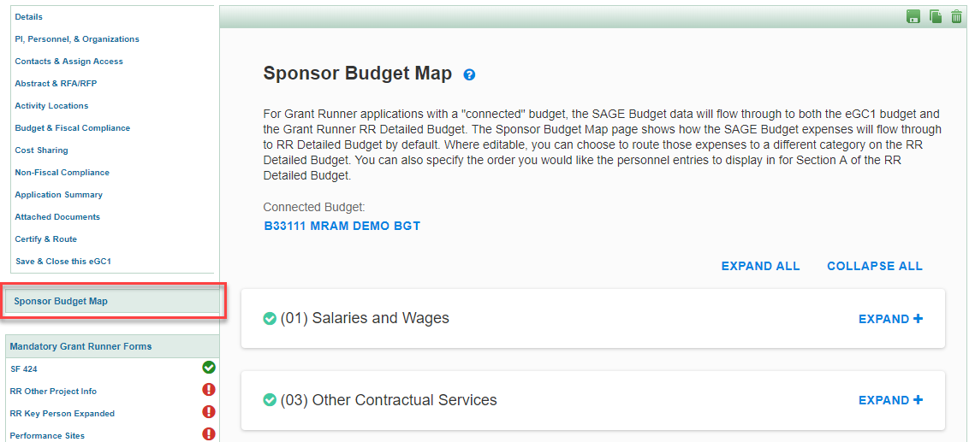
Sponsor Budget Map Page
The Sponsor Budget Map appears in left navigation when a SAGE budget is connected to a Grant Runner application with an RR Budget
Notes:
In order to give transparency to the default mappings as well as allow users to change the mappings, we are introducing the Sponsor Budget Map page.
When you first enter the page, you will see the SAGE Budget object codes used in your particular budget.

Slide 15
Sponsor Budget Map Page (cont.)
Expanding an object code allows you to
View where an expense flows to RR Budget by default
Change the RR Detailed Budget category when necessary

Slide 16
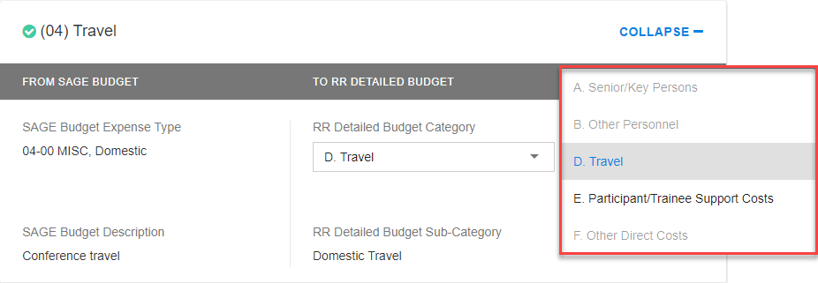
Example of a Mapping Change Option
(04) Travel flows to RR Budget section D. Travel by default
Users may want to change that to section E. Participant/Trainee Support Costs -- Travel

Slide 17
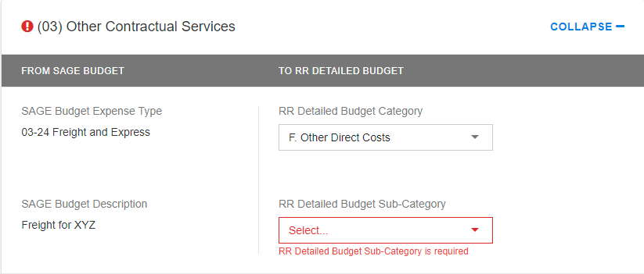
Validation Errors on Sponsor Budget Map
If you see a red exclamation or highlighting, this indicates something needs to be addressed
If it is an other expense, you can select “other” from the drop down and create your own custom sub-category
Personnel role may also require mapping when “other” role is selected in SAGE Budget
Notes:
After initial connection of your budget, I would suggest to go to Sponsor Budget Map and scan to see if you have any red exclamation points – these represent issue to address. Example: You’ve selected a personnel role of “other” in SAGE Budget. You’ll need to create a custom role in Map for that.

Slide 18
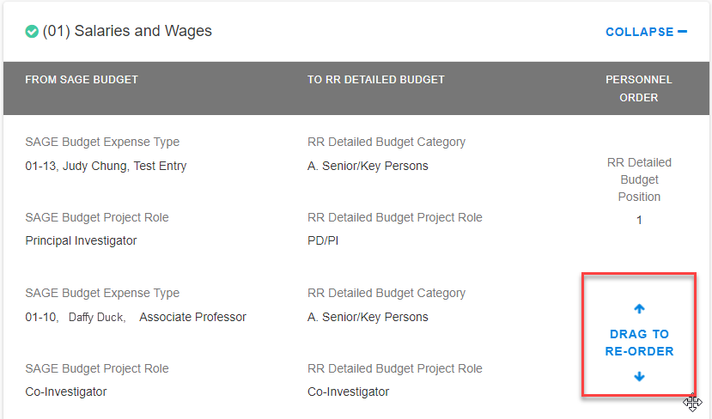
Personnel Options on Sponsor Budget Map
The Sponsor Budget Map also allows you to set a specific order for your key personnel or define a custom role for other personnel.

Slide 19
Sponsor Budget Map -- In Summary
The Sponsor Budget Map page allows users to
View the default mappings for expenses
Redirect where expenses flow to on RR Budget
Define custom sub-categories for “other expenses”
Define custom personnel roles
Re-order personnel
Red alerts will indicate actions needed
All other changes are made in SAGE Budget and will auto-update on the RR Detailed Budget

Slide 20
What Happens to Existing Applications?
At time of release, if you have an existing Grant Runner application, connected to a SAGE Budget, your RR Detailed Budget will not be affected.
Your RR Budget will remain editable and no sync occurs.
If you would like to take advantage of the Budget Sync feature on an existing application, disconnect & reconnect your SAGE budget, and sync will occur from that point forward.

Slide 21
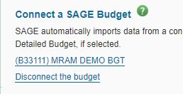
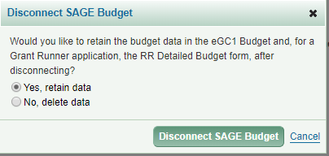
What If I Change My Mind on Sync?
No problem, just “disconnect” your budget
You will be given the option to retain or delete the data that has been sync’d

Slide 22
Outstanding Issues, Features Coming
Please Note for November Release:
You may notice minor discrepancies between your SAGE Budget totals and RR Budget totals, due to rounding approach differences. These minor differences are acceptable, per OSP, and need not hold up completion. Rounding differences will be fully resolved in the follow-on release below.
December Maintenance Enhancements Will Include:
New rounding approach for SAGE Budget
Prefix, suffix added to SAGE Budget personnel section, use in Budget Sync
Budget Sync to Modular Budgets

Slide 23
Resources, Support
The following classes will include content and training on Budget Sync:
Grant Runner 102 - December 11, 2018 1:00-3:30 pm
SAGE Budget 103 - January 2019, TBD
A job aid is coming soon, and will be made available at time of release
Systems help or suggestions
sagehelp@uw.edu

Slide 24
SAGE Budget Improvements Coming Next!
In 2019 ORIS will invest in SAGE Budget improvements!
Survey Results will inform prioritization of work
Keep the feedback coming!
Help us shape SAGE Budget and Grant Runner to bring improvements your way that are most impactful to you and your research teams!

Slide 25
In Closing
Release Date: November 27, 5:30 pm
Huge thanks to all those who contributed to
requirements gathering
review of prototypes
user testing for this feature!
Your input is critical to advancing SAGE to better meet your needs, and is much appreciated!
Give it a try, and give us your feedback!

