Slide 1
COMPLIANCE CORNER
MRAM
November, 2018
Matt Gardner & Andra Sawyer
Post Award Fiscal Compliance

Slide 2
NIH and NSF Release Updated Policy Statements
NIH Grants Policy Statement (GPS)
Applies to all grants and cooperative agreements with budget periods beginning on or after October 1, 2018
Incorporates NIH Notices since October 2017
Does not introduce any new policies or materials for the first time
Supersedes, in its entirety, the NIH GPS published in October 2017
MRAM – Matt Gardner - PAFC

Slide 3
NIH and NSF Release Updated Policy Statements
NSF Proposal & Award Policies & Procedure Guide (PAPPG)
Effective for proposals submitted or due on or after January 28, 2019, and awards made on or after January 28, 2019
Significant Changes:
Conferences (Chapter II.E.7)
Speakers and trainers are not considered participants
Participant Support (Chapter II.C.2.g(v))
May not be budgeted for room rental fees, catering costs, and supplies
Human subject payments are considered “Other Direct Costs” and should include applicable F&A
MRAM – Matt Gardner - PAFC

Slide 4
NIH and NSF Release Updated Policy Statements
References
NIH GPS:
https://grants.nih.gov/policy/nihgps/index.htm
NSF PAPPG:
https://www.nsf.gov/pubs/policydocs/pappg19_1/index.jsp
MRAM – Matt Gardner - PAFC

Slide 5
Food!
PAFC’s Data Analytics Dashboard
Provides transaction information on food purchases on sponsored awards; please obtain access and review this data because…
Auditors love to review food purchases
For more information PAFC’s Data Analytics:
https://finance.uw.edu/pafc/data-analytics

Slide 6
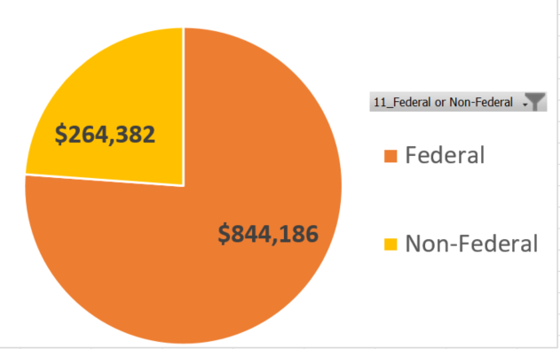
All Sponsored Award Food Purchases
Oct 2017 – Sept 2018

Slide 7
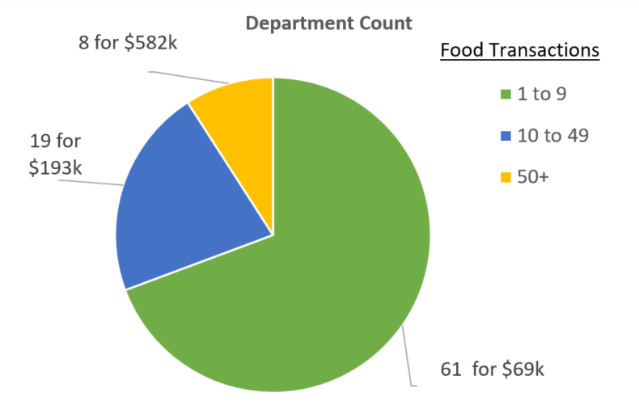
Food Purchases Federal Awards

Slide 8
Food Purchases on Federally Sponsored Awards
Requires written sponsor approval
Ideally purchase of food is itemized in the proposal
If not, then need to obtain written sponsor approval
Completion of the UW “Food Form” is not approval
More information:
Sponsored Awards: https://finance.uw.edu/pafc/food
Non-Sponsored Awards: https://finance.uw.edu/food-approval

Slide 9
Questions?
gcafco@uw.edu
https://finance.uw.edu/pafc/
Matt Gardner
mgard4@uw.edu
206-543-2610
Andra Sawyer
andra2@uw.edu
206-685-8902

