Slide 1
MRAM | Monthly Research Administration Meeting
DECEMBER 13, 2018 9:00 AM – 10:00 AM UW TOWER AUDITORIUM
TOPIC | PRESENTER | EMAIL | MIN
Welcome | Kirsten DeFries Research Compliance & Operations | kirsten5@uw.edu | 2
Revised Common Rule | Karen Moe Human Subjects Division | kemoe@uw.edu | 5
OSP Contracts Team | Cathy Cottle Office of Sponsored Programs | cottlec@uw.edu | 5
NIH and NSF sexual harassment policies | Carol Rhodes Office of Sponsored Programs | carhodes@uw.edu | 10
NSF PAPPG updates - proposal considerations | Tim Mhyre Office of Sponsored Programs | tmhyre@uw.edu | 10
Ariba Open Balances on Purged Budgets | Vince Gonzalez Grant & Contract Accounting | gcahelp@uw.edu | 10
Compliance Corner | Matt Gardner Post Award Financial Compliance | gcafco@uw.edu | 10
CORE Update | Laurie Stephan Collaborative On Research Education (CORE) | corehelp@uw.ed | 2
NEXT MEETING JANUARY 10, 2019 UW TOWER AUDITORIUM

Slide 2
The Revised Common Rule Regulations Karen Moe, Human Subjects Division
MRAM Meeting
December 13, 2018

Slide 3
The Common Rule is being revised for the first time in its history, on January 21, 2019.
The human subjects regulations required by federal agencies that fund human subjects research
Affects almost all UW human subjects research

Slide 4
The major changes
Revised and expanded categories for “exempt” status
Eliminates continuing review (“Status Reports”) for minimal risk research
Adds several required elements of consent and a Key Information section to consent forms

Slide 5
Impact on researcher workload
Change | Research workload
More studies qualify for exempt status
No continuing review
New consent elements & Key Information

Slide 6
Use these revised forms, NOW
IRB Protocol form revised Nov 30
Consent form template revised Oct 30

Slide 7
For more information
Revised Common Rule webpage
https://www.washington.edu/research/hsd/revised-common-rule/
Q and A
Which studies and when
3-minute videos explaining the changes

Slide 8
Office of Sponsored Programs: Contracts Team
December 2018 MRAM
Cathy Cottle
Associate Director, Contracts & Grants
Office of Sponsored Programs

Slide 9
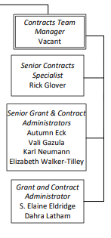
Who?
Notes:
With the exception of its manager, the newly expanded contracts team is now in place. They are Autumn Eck; Elaine Eldridge; Vali Gazula; Richard Glover; Dhara Latham; Karl Neumann; Elizabeth Walker-Tilley.

Slide 10
What?
Industry Clinical Trials and Clinical studies
All Non-award agreements (NAAs):
Affiliation Agreements
CDA/NDAs
Data Use Agreements (DUAs)
Letters of Indemnification
Master Agreements
Material Transfer Agreements (MTAs)
Memoranda of Understanding (MOUs)
Unfunded Collaborative Agreements
Notes:
Effective this week, all new NAAs will be reassigned to Contracts team members. Team will also handle Government contracts and clinical studies in addition to the industry clinical trials already part of their scope

Slide 11
Why?
Our goal is to distribute OSP’s workload more equitably, work more efficiently, and improve our Campus partners’ customer experience.

Slide 12
How do I find out who has my NAA?
NAA eGC1s will be re-assigned to a contracts team member. Re-assignment will happen within one business day.
Use Status Checker to find out which OSP Reviewer has a particular Non-Award Agreement (NAA). Currently, MyResearch Portal pulls status and assignment information from the associated eGC1 instead of the NAA itself. The original eGC1 request for NAA review will appear “approved” in MyResearch, while the NAA itself may still be under review.
12.17.18 CORRECTION - slide updated to reflect accurate guidance. MyResearch does not currently indicate the OSP reviewer of an NAA. Stay tuned for an upcoming MyResearch release next quarter.

Slide 13
Questions?
email: cottlec@uw.edu

Slide 14
NIH and NSF Sexual Harassment Policies
December 2018
Carol Rhodes

Slide 15
NIH Statement on Harassment
NIH-supported research and training must occur in a civil, safe, and respectful environment, free from discrimination and unlawful harassment, sexual or otherwise.
NIH does not tolerate harassment of any kind, including sexual harassment, at institutions that receive NIH funding, or anywhere that NIH-funded activities are conducted.

Slide 16
NOT-OD-19-029:
Institutional Letter of Support Requirements
Institution:
will ensure that proper policies, procedures, and oversight are in place.
will respond appropriately to allegations of discriminatory practices, including any required notifications.
has adopted procedures for requesting NIH prior approval of a change in the status of the PI or other senior/key personnel if administrative or disciplinary action will impact the ability of that individual to continue his/her role on the NIH award.

Slide 17
Updated UW Institutional Support Letter for T-series grant applications available
Describes University policy, including Executive Order 31
Identifies University’s Title IX Coordinator and Title IX Steering Committee’s oversight role
Informs on University’s Complaint Investigation and Resolution (UCIRO) role in investigating complaints
Explains prior approval/notification process when PI/key personnel change is needed
To obtain letter, contact research@uw.edu
Notes:
University Complaint Investigation and Resolution Office

Slide 18
NSF Sexual Harassment Policy - Reporting
Effective in October, 2018, NSF requires awardee organization to notify NSF of:
Any findings or determinations that an NSF-funded PI or Co-PI committed harassment, including sexual harassment or sexual assault.
The placement of the PI or co-PI on administrative leave, or of the imposition of any administrative action relating to a harassment or sexual assault finding or investigation.

Slide 19
Reporting Process
If there is a finding of harassment or PI/co-PI placed on leave, AOR to report using online NSF form.
AOR notified of circumstance if there is a finding or leave imposed
AOR fills out form and submits
NSF may coordinate with UW on next steps
Notes:
Form is a secure web mechanism
OSP Director notified via OR, in enough detail to meet NSF reqt

Slide 20
NSF Policy Resources
Term and Condition: Sexual Harassment, Other Forms of Harassment, or Sexual Assault
NSF FAQs:
Notification Requirements Regarding Findings of Sexual Harassment, Other Forms of Harassment, or Sexual Assault FAQs

Slide 21
University Process/Resources
If aware of or subject to sexual harassment:
Inform supervisor, department chair, unit administrator, or HR/AHR consultant
SafeCampus: 206-685-SAFE (7233)
University Complaint Investigation and Resolution Office (UCIRO): uciro@uw.edu
Title IX Coordinator: titleix@uw.edu

Slide 22
NSF: PAPPG Proposal Considerations
December 2018 MRAM
Tim Mhyre
Manager Team B
Office of Sponsored Programs

Slide 23
NSF: Proposal & Award Policies & Procedures Guide (PAPPG) 2019
Effective for proposals submitted or due on or after January 28, 2019, and awards made on or after January 28, 2019.
https://www.nsf.gov/pubs/policydocs/pappg19_1/sigchanges.jsp

Slide 24
NSF PAPPG:
Significant Changes (1 of 5)
NSF Proposal Preparation and Submission
Follow on-screen Research.gov instructions
Dear Colleague Letters
Expanded use to now included NSF’s interests in RAPID, EAGER, RAISE, & Conference proposals
Full Proposals
Reminders on the importance of proper scholarship/attribution thru proposal & award life cycle
Unaffiliated Individuals
Ineligible to receive direct NSF funding (unless authorized in solicitation)
https://www.nsf.gov/pubs/policydocs/pappg19_1/sigchanges.jsp

Slide 25
NSF PAPPG:
Significant Changes (2 of 5)
Subawards
Include description of the work in project description
Types of Proposals
“RAPID”, “EAGER”, & “RAISE” must be included in the project title
Conference
Sexual Harassment policy code-of-conduct dissemination prior to attendance & made available at conference
Conference proposals >$50K must include Collaborators & Other Affiliations (note: speakers/trainers are not Participants & should not be budgeted in Participant Support Costs)
https://www.nsf.gov/pubs/policydocs/pappg19_1/sigchanges.jsp

Slide 26
NSF PAPPG:
Significant Changes (3 of 5)
Equipment Proposals
Must include Collaborators & Other Affiliations
Resubmission
Some NSF programs that have rolling submissions may restrict eligibility for resubmission for certain period of time
Grantee Notifications to NSF (New)
Includes required notifications to implement NSF’s Harassment policy in instances where there has been a finding/determination of violation or placement of PI/PD (co-PI/co-PD) on administrative leave or other administrative action
https://www.nsf.gov/pubs/policydocs/pappg19_1/sigchanges.jsp

Slide 27
NSF PAPPG:
Significant Changes (4 of 5)
Changes in PI/PD, co-PI/co-PD or Person-Months Devoted to the Project (New)
Process for dealing with PI/PD (co-PI/co-PD) if finding or determination of harassment or placement on administrative leave or other administrative action
Responsible Conduct of Research
Encourages training of faculty in responsible/ethical conduct of research
NSF Policy on Harassment
Supplemented to stress NSF policy on sexual harassment, other forms of harassment, and sexual assault
https://www.nsf.gov/pubs/policydocs/pappg19_1/sigchanges.jsp

Slide 28
NSF PAPPG:
Significant Changes (5 of 5)
Intellectual Property
Incorporates existing patent policy (implemented via 45 CFR 650)
https://www.nsf.gov/pubs/policydocs/pappg19_1/sigchanges.jsp

Slide 29
NSF PAPPG:
Clarifications/Other Changes (1 of 4)
Foreign Organizations
Involvement of foreign org(s) justified in project description, check Cover Sheet box “Funding of a Foreign Organization”
Proposal Font, Spacing and Margin Requirements
Fonts not listed may be used for math formulas, equations, or for Greek/other special characters (“text must still be readable”; OSP doesn’t check)
Biographical Sketches
Single PDF (or other NSF-approved template) for each Senior Personnel; Synergistic Activities is list of up to 5 distinct examples
NSF PAPPG: Significant Changes & Clarifications
GIM 1: Review and Submission Requirements for Proposals

Slide 30
NSF PAPPG:
Clarifications/Other Changes (2 of 4)
Participant Support
Clarifies when an individual is a participant or speaker at a conference; participant support costs cannot cover room rental fees, catering costs, supplies, etc.
Human subject payments are to be included on line G6 as “Other Direct Costs” with applicable F&A
Subawards
Clarifies that subawards/transfers requires prior written approval
NSF PAPPG: Significant Changes & Clarifications
GIM 1: Review and Submission Requirements for Proposals

Slide 31
NSF PAPPG:
Clarifications/Other Changes (3 of 4)
Current & Pending Support
Single PDF file (or other NSF-approved template) for each individual Senior Personnel
Submission of a collaborative proposal from multiple organizations
Only the organization proposing foreign involvement must check the appropriate cover sheet box
Technical Reporting Requirements
Submission of Final Project Report and Project Outcomes Report for the General Public indicates that research is completed
NSF PAPPG: Significant Changes & Clarifications
GIM 1: Review and Submission Requirements for Proposals

Slide 32
NSF PAPPG:
Clarifications/Other Changes (4 of 4)
Definitions
“Unexpended balance” (new) - sum of the unobligated and obligated balances
“Unobligated balance” - cumulative amount of the budget authority that remains available for obligation under law in unexpired amounts
Responsible Conduct of Research
Supplements NSF’s responsibility in ensuring RCR, including taking of appropriate actions upon findings of research misconduct
NSF PAPPG: Significant Changes & Clarifications
GIM 1: Review and Submission Requirements for Proposals

Slide 33
Questions?
PAPPG: Significant Changes & Clarifications
PAPPG Effective 1/29/18
PAPPG Webinar (starts @ 10:05 mark)
GIM 1: Review and Submission Requirements for Proposals

Slide 34
Ariba Open Balances on Purged Budgets
Vince Gonzalez
Grant Manager, GCA

Slide 35
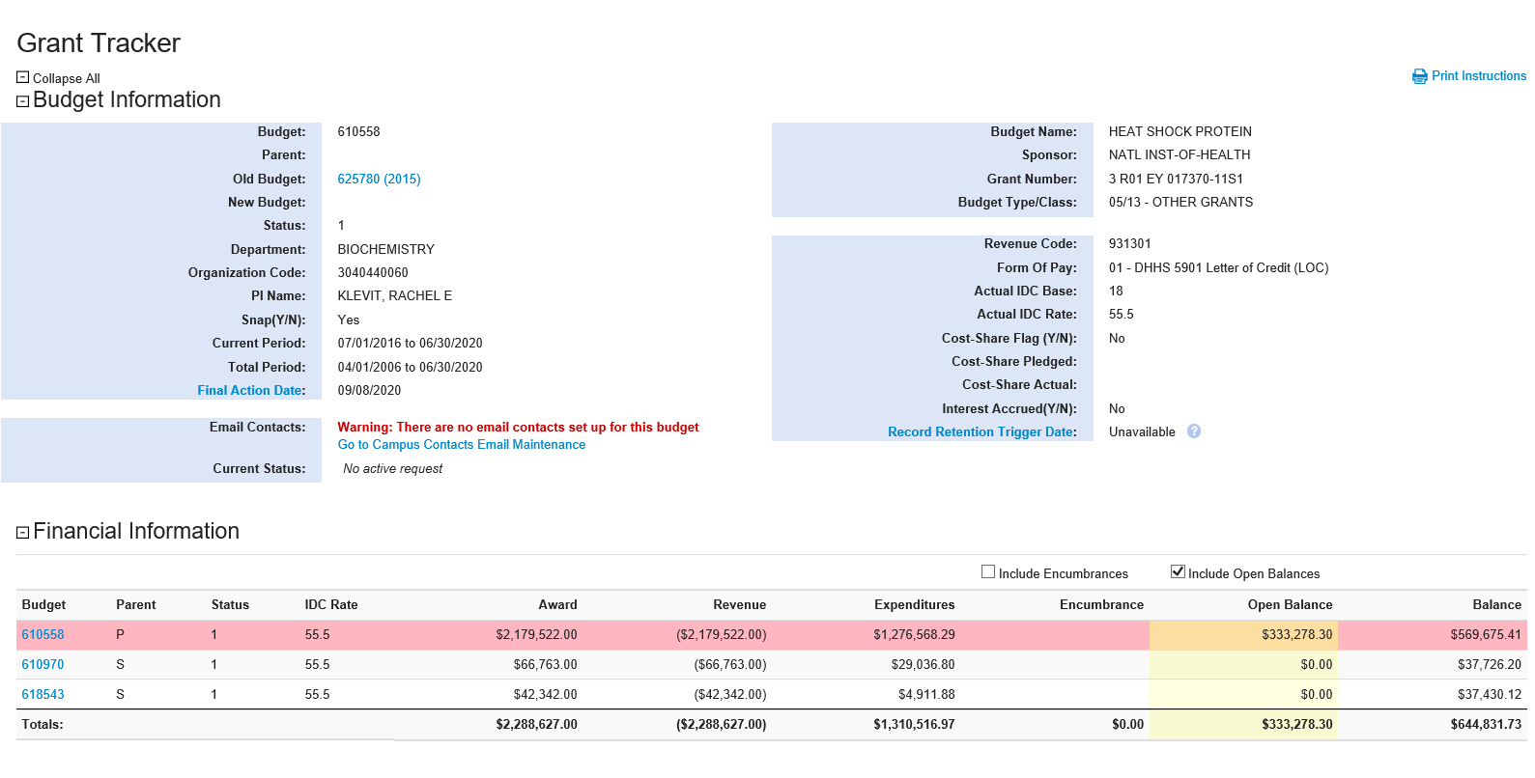
Ariba Open Balances on Purged Budgets

Slide 36
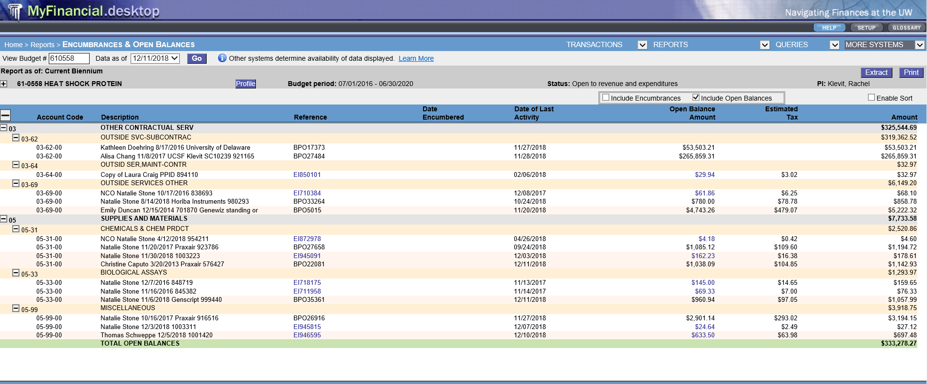
Ariba Open Balances on Purged Budgets

Slide 37
Ariba Open Balances on Purged Budgets
The Issue:
Ariba Open Balances DO NOT PURGE after a budget is purged in the accounting system and re-surface when a budget number is recycled
What to Expect:
GCA Newsletter Update
Communication from GCA via GT requesting the closeout of open balances starting in January 2019
Closeout of all Ariba Open Balances associated with purged budgets by April 2019
The Solution:
GCA & Procurement Services are joining forces to:
Eliminate Ariba Open Balances associated with purged budgets
Streamline the communication related to the closeout of Ariba Purchase Orders

Slide 38
Questions?
Contact GCA Help at:
GCAHelp@uw.edu
206-616-9995

Slide 39
COMPLIANCE CORNER
MRAM
December, 2018
Matt Gardner
Post Award Fiscal Compliance

Slide 40
Academic Student Employee (“ASE”)
Lump Sum Payments
UW-UAW contract (6/3/18 – 4/30/21)
Under the contract:
Lump sum payment of $100
ASEs with a 50% FTE appointment
Paid during the first quarter of employment during each year of the contract starting with the 2018/2019 academic year
Payments are being charged under object code 01-80 on some sponsored awards
MRAM – Matt Gardner – Post Award Fiscal Compliance

Slide 41
Are ASE payments allowable on sponsored awards?
ASE payments are unallowable on NRSA Training Grants and Fellowships
Any ASE charges to NRSA Training Grants or Fellowships must be removed and charged to a non-sponsored award
ASE payments are generally allowable on other sponsored awards
See the PAFC FAQ on Compensation for additional information
https://finance.uw.edu/pafc/faq?term_node_tid_depth=Compensation
MRAM – Matt Gardner – Post Award Fiscal Compliance

Slide 42
New NRSA Budgetary Levels for
Federal Fiscal Year 2019
NOT-OD-19-036 (issued 11/27/2018)
Applies to all NRSA awards made with Federal FY 2019 funds
Awarded on or after 10/1/2018
Previous FY 2019 Awards issued under the old levels “will be revised to adjust funding to the FY 2019 levels”
No retroactive adjustments for Awards made prior to 10/1/2018
MRAM – Matt Gardner – Post Award Fiscal Compliance

Slide 43
New NRSA Budgetary Levels for
Federal Fiscal Year 2019
Predocs
Stipend increase of $492/year
Training Related Expenses and Institutional Allowance levels remain the same as FY 2018
Postdocs
Stipend increase of $1,572/year at all levels
Training Related Expenses and Institutional Allowance levels increase of $1,000/year
Tuition levels remain the same
MRAM – Matt Gardner – Post Award Fiscal Compliance

Slide 44
NRSA Training Grant Tools
Long-term goal to develop tools to help campus manage NRSA Training Grants
Tracking Trainee Appointments
Reconciling Stipend payments
Calculating Obligations and Balances/Deficits
Interested in providing input, ideas or feedback? Email Matt or Andra
MRAM – Matt Gardner – Post Award Fiscal Compliance

Slide 45
Questions
Post Award Fiscal Compliance (PAFC)
gcafco@uw.edu
https://finance.uw.edu/pafc/
Matt Gardner
mgard4@uw.edu
206-543-2610
Andra Sawyer
andra2@uw.edu
206-685-8902
MRAM – Matt Gardner – Post Award Fiscal Compliance

Slide 46
UPCOMING COURSES IN
RESEARCH ADMINISTRATION
 | Jan 8 | OSP 101 | Introduction to Research Administration
 | Jan 10 | RAA 100 | Grant and Contract Fiscal Administration: Compliance
 | Jan 15 | MAA 100 | Introduction to Grant and Contract Certification (GCCR)
 | Jan 22 | RAA 206 | Managing Cost Share at the UW
 | Jan 23 | ORIS 103 | SAGE Budget
 | Jan 23 | OSP 145 | Subaward Fundamentals
 | Jan 29 | MAA 101 | Introduction to Faculty Effort Certification
ONLINE |  | Introduction to Sponsored Project Budgets
Currently scheduled courses and registration: https://uwresearch.gosignmeup.com/public/course/browse
CORE homepage:
https://www.washington.edu/research/training/core//

