Slide 1
Ariba Open Balances on Purged Budgets
Vince Gonzalez
Grant Manager, GCA

Slide 2
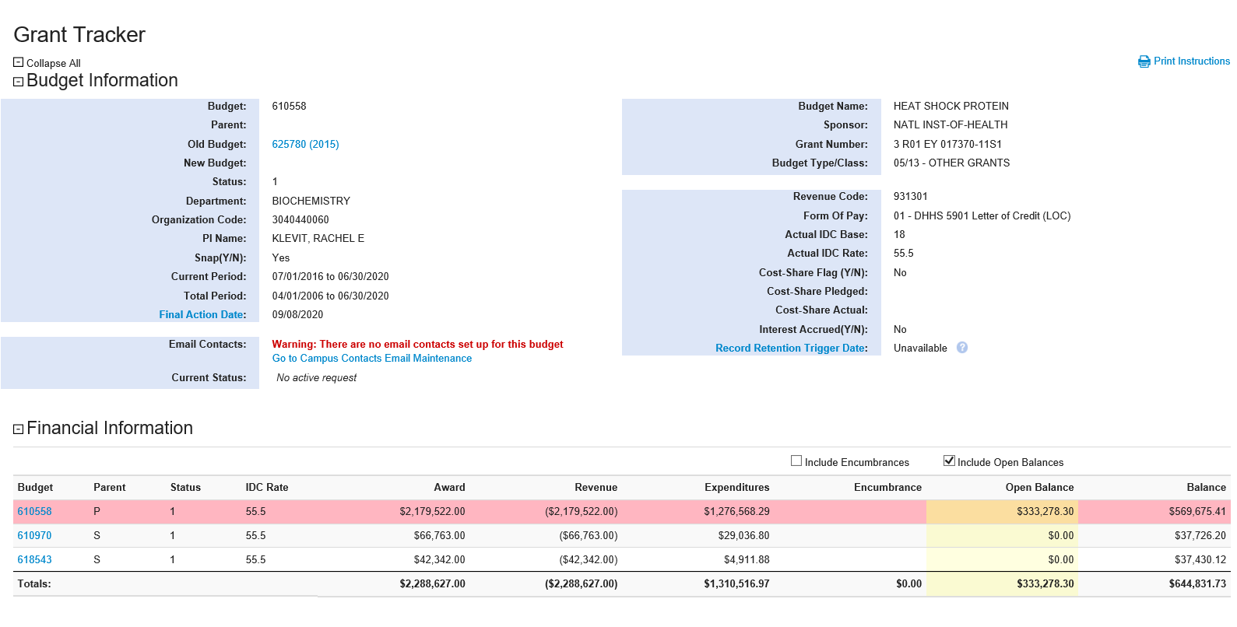
Ariba Open Balances on Purged Budgets

Slide 3
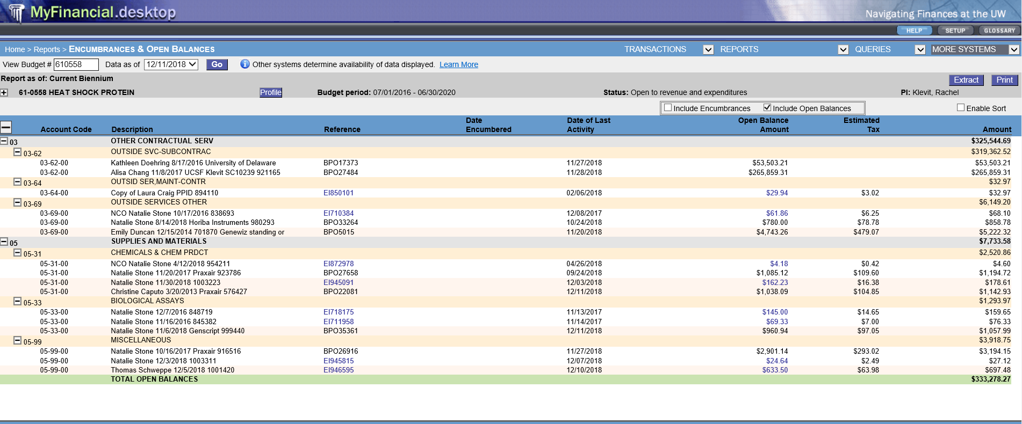
Ariba Open Balances on Purged Budgets

Slide 4
Ariba Open Balances on Purged Budgets
The Issue:
Ariba Open Balances DO NOT PURGE after a budget is purged in the accounting system and re-surface when a budget number is recycled
What to Expect:
GCA Newsletter Update
Communication from GCA via GT requesting the closeout of open balances starting in January 2019
Closeout of all Ariba Open Balances associated with purged budgets by April 2019
The Solution:
GCA & Procurement Services are joining forces to:
Eliminate Ariba Open Balances associated with purged budgets
Streamline the communication related to the closeout of Ariba Purchase Orders

Slide 5
Questions?
Contact GCA Help at:
GCAHelp@uw.edu
206-616-9995

