Slide 1
Contract Team Update
February, 2019 MRAM
Cathy Cottle
Office of Sponsored Programs

Slide 2
Current news...
Some Automated routing coming…
next SAGE release
Who has my stuff?
Use Status Checker
Contracts Manager position?
Interviews being conducted
Early positive feedback on restructure
Notes:
NAA, ATF Industry

Slide 3
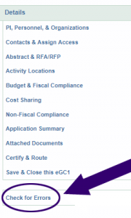
Non-Award Agreement eGC1 Instructions
Required fields
System required
OSP required
Use Check for Errors in SAGE for visibility into these system required fields
Instructions for completing an NAA eGC1 available on Research website:
https://www.washington.edu/research/faq/naa-egc1-instructions/

Slide 4
Questions

