Slide 1
Compliance
Corner
February 2019
Andra Sawyer & Matt Gardner
Post Award Fiscal Compliance
gcafco@uw.edu

Slide 2
NSF’s 2-Month Rule
Cliff Notes Version:
Salary compensation (IBS) for Senior Personnel (named in the Award) is limited to two months of their IBS in one UW Fiscal Year (July-June) for all NSF Awards.

Slide 3
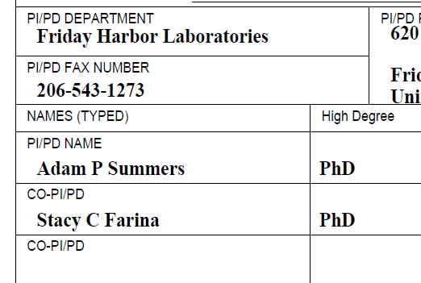
Identification of “Senior Personnel”
Proposal:
Award:

Slide 4
Exceptions to the NSF 2-Month Rule
Obtain NSF Approval at the Time of Proposal:
Include statement that proposed Senior Personnel will exceed the 2-month limit; we assume NSF approval if Award is issued at proposed budget amount.
Post-Award Re-budgeting:
Document that the Senior Personnel will exceed the 2-month limit; NSF approval not required.

Slide 5
NSF 2-Month Rule Math Monthly IBS = $15,000 & Date is 2/12/2019
Description | Subtotal | Total
Two Months IBS |  | $30,000
Less
1. IBS Paid to Date (July 2018 – January 2019) | $21,000
2. Estimated IBS to be paid on all NSF Current Awards Feb 2019 to July 2019 | $7,000
3. Estimated IBS to be paid on all NSF Pending Awards date of award to July 2019 | $2,000
4. Proposed IBS to be paid on this proposal date of award to July 2019 | $3,000
Subtotal |  | $33,000
Total = exceeds 2 months so need to request sponsor approval |  | -$3,000

Slide 6
NSF 2-Month Rule – New Resources
1. PAFC webpage
https://finance.uw.edu/pafc/nsf-2month-rule-regulation-and-resources
2. EDW Report: NSF Compensation Paid by FY
3. NSF 2-Month Rule Worksheet & User Guide

Slide 7
NSF 2-Month Rule - Resource Information
Use the IBS rate at the time of the calculation.
Use of the Worksheet is optional - responsibility for compliance is with the PI
There is no requirement to submit the Worksheet to OSP/attach to the eGC-1
Worksheet is managed and supported by PAFC; any comments/questions ask PAFC gcafco@uw.edu
Due diligence matters in an audit

Slide 8
Cost Share – New/Updated Resources
Updated Cost Share Addendum. xlsx on GCA webpage; Added linked to Object Code and instructions https://finance.uw.edu/gca/GCA_Cost_Share_Addendum
Guideline: Calculating Cost Share on Multi-Year Award https://finance.uw.edu/gca/cost-share#Multi_Year
Guideline: Cost Share F&A Rate on Awards with a split Standard F&A Rate https://finance.uw.edu/gca/cost-share#Split_F&A_Rate

Slide 9
Charging Tuition to a Federal Award - Requirements
Two instances when tuition is an allowable charge on a Federal Award:
The purpose of the Award is to provide training [2 CFR 200.466]
NRSA Training Grants
NRSA Fellowships… and
Any other Federal agency Award in which the purpose is considered “training” or a “fellowship”

Slide 10
Charging Tuition to a Federal Award - Requirements
2. The tuition is paid as a fringe benefit for working on an Award [2 CFR 200.431(j)]
Must be in accordance with the established policies of the institution, and
Must be distributed to all non-Federal activities on an equitable basis.
What does that mean?

Slide 11
Charging Tuition to a Federal Award – What does this mean?
In order to charge tuition to a Federal Award, must follow the UW policies for waiving tuition
[Executive Order #28 – Graduate Student Service Appointments]
Must apply those policies to all activities, both Federal and non-Federal
Can’t charge the Federal government for a cost that isn’t charged to non-Federal sponsors, or which the University would not cover itself

Slide 12
Charging Tuition to a Federal Award: References
Uniform Guidance
2 CFR 200.431(j) Compensation – Fringe Benefits 2 CFR 200.466 Scholarships & Student Aid Costs
Executive Order #28
http://www.washington.edu/admin/rules/policies/PO/EO28.html
Post Award Fiscal Compliance Website: Tuition
https://finance.uw.edu/pafc/tuition

Slide 13
Questions?
Post Award Fiscal Compliance
gcafco@uw.edu
https://finance.uw.edu/pafc/
Andra Sawyer
andra2@uw.edu
206-685-8902
Matt Gardner
mgard4@uw.edu
206-543-2610

