Slide 1
MRAM | Monthly Research Administration Meeting
APRIL 18, 2019 9:00 AM – 10:00 AM UW TOWER AUDITORIUM
TOPIC | PRESENTER | EMAIL | MIN
Welcome | Kirsten DeFries Research Compliance & Operations | kirsten5@uw.edu | 2
Ariba Open Balances Project | John Whitney Procurement Services | jbwhit@uw.edu | 5
Foreign Influence | Joe Giffels Associate Vice Provost for Research Administration & Integrity | jgiffels@uw.edu | 10
Sponsor Activities in Response to Foreign Influence Concerns | Carol Rhodes Office of Sponsored Programs | carhodes@uw.edu | 10
Compliance Corner | Andra Sawyer Post Award Financial Compliance | gcafco@uw.edu | 10
NIH: Human Subjects System & RPPRs - Update | Amanda Snyder Office of Sponsored Programs | acs229@uw.edu | 5
Local Professional Development Opportunities | Amanda Snyder Office of Sponsored Programs | acs229@uw.edu | 2
CORE Update | Laurie Stephan Collaborative On Research Education (CORE) | corehelp@uw.edu | 2
NEXT MEETING MAY 9, 2019 9 am - 10 am UW TOWER AUDITORIUM

Slide 2
Ariba Open Balances Project
MRAM
April, 2019
John Whitney
Procurement Services

Slide 3
Ariba Open Balances Project
MRAM Communication sent to campus in December 2018. More communication in January/February.
GCA and Procurement Services joined forces in January to close 6,517 eProcurement (EI) Purchase Orders and BPO’s with remaining open balance amounts from Ariba.
Some of the Purchase Orders dated back as far as the 2009 Biennium.
The goal was to have all Orders closed by April 2019. We completed the project in early March!
MRAM – John Whitney – Procurement Services

Slide 4
What you can do to help going forward?
If a Purchase Order in Ariba (Catalog and Non-Catalog) is incomplete or shows an open balance, contact the supplier to verify the order is canceled or closed, and that no further shipments or invoices are due.
Orders should only be closed when all items are received and all invoices have been paid.
Submit a Purchase Order close request per the instructions on the Procurement Services website:
https://finance.uw.edu/ps/change-close
Future communication efforts from Procurement Services and GCA.
MRAM – John Whitney – Procurement Services

Slide 5
Enhanced Scrutiny of International Research Collaborations
Office of Research

Slide 6
How Did We Get Here?
Research at U S universities is open and collaborative
U S government is reacting to apparent threats
Congress charges U S Dept of Ed to act
Huawei indictments
Chinese student and scholar visa restrictions
Questioning undisclosed collaborations
Research at U S universities is open and collaborative
Office of Research

Slide 7
Where Are We Now?
U S Dept of Defense
U S Dept of Energy
NIH
NSF
Office of Research

Slide 8
Where Are We Headed?
Further federal agency guidances
Voluntary university guidelines
MIT’s new process
Recommendations for UW researchers
Moratorium on gifts from indicted foreign entities
Peer review
Other support & biosketches
Intellectual property
Stay tuned
Web resources are being developed
Office of Research

Slide 9
Sponsor Activities in Response to Foreign Influence Concerns
April, 2019 MRAM
Carol Rhodes
Office of Sponsored Programs

Slide 10
National Institutes of Health (NIH)
Dr. Collins Aug 2018 Letter to research community
Advisory Committee to Director (ACD) recommendations:
Communication and awareness
Risk Mitigation
Monitoring, Action and Consequences
Review of current policies including:
Other Support requirements
SFI Disclosure requirements
Definition of “foreign component” which requires prior approval
Progress report requirements
Notes:
ACD balances recommendations with need to continue to have strong foreign collaborations

Slide 11
National Science Foundation (NSF)
Engagement of JASON
Group of scientists that advise U.S. national security & intelligence community on emerging technologies
Restricted pool of rotators
Closer look at:
Current and Pending Support requirements
Biographical Sketch(es) – Synergistic Activities
Collaborations and Other Affiliations
Notes:
Rotators: Those who take leave of absence to serve as NSF Program Managers

Slide 12
Department of Defense (DOD)
NEW - Current and Pending support requirement for all key personnel at time of proposal.
Further study of foreign talent recruitment programs and the development of relevant regulations.
Notes:
HB would have banned being part of talent program and receiving DOD funding

Slide 13
Department of Energy (DOE) - Memos
Dec 2018 - Foreign Collaboration Ban:
Restricts DOE researchers in “emerging research areas & technologies” from collaborating with colleagues from “sensitive” countries.
Central DOE oversight body to maintain sensitive nations list & research areas, can approve exemptions.
Jan 2019 - Foreign Recruitment Ban:
Prohibits DOE researchers from participating in foreign talent recruitment programs.
Directives & Risk matrix still being developed.

Slide 14
Takeaway for PIs
With or Applying to Sponsored Programs:
Disclose all financial conflict of interests.
Include all financial interests from foreign Institutions of higher education or foreign government.
Applications & Progress Reports:
Include all sources of research support, including relevant (foreign) affiliations.
Review sponsor requirements with your PI carefully and interpret with this in mind.

Slide 15
Takeaway for PIs
Applying for DOE Funding:
PIs:
Cannot be in a foreign talent program at same time.
May not be able to collaborate with foreign colleagues if project is related to “sensitive” technologies.

Slide 16
Sponsor Requirements
Watch for emerging, new, or changed requirements.
Current:
NIH - Other Support
NIH - SFI Disclosure Reminder
NSF - Current/Pending Support
UW Foreign Influence on Federally Sponsored Research

Slide 17
Compliance Corner
MRAM
April 2019
Matt Gardner & Andra Sawyer
Post Award Fiscal Compliance (PAFC)

Slide 18
Biennium Closeout –
Tagging Cost Share Contributions
Tagging Cost Share Contributions on a Biennium-based Budget
Start/End Dates: 7/1/17 – 6/30/19
Tends to be a lot of activity transferring costs on/off Biennium-based Budgets this time of year
Can be challenging to identify which transactions are available to tag in the tagging system
Tag early – don’t wait!
Good advice for all Cost Share but especially if the contributions are coming from a Biennium-based Budget
MRAM – Matt Gardner – PAFC

Slide 19
Cost Share Tagging Resources
GCA Website
https://finance.uw.edu/gca/cost-share/ste-by-step-instructions-non-fec-contributions
https://finance.uw.edu/gca/sites/default/files/Cost_Share_Tagging_Negative_Balance.pdf
GCA: gcahelp@uw.edu
MRAM – Matt Gardner – PAFC

Slide 20
Data Analytics Dashboard
Provide high risk transactions sortable by Org Codes & Award PI
Enables compliance review and trend analysis
Access must be granted by School/College Director of Finance
For more information: https://finance.uw.edu/pafc/data-analytics

Slide 21
Airfare on Federal Awards
Federal requirements on Airfare more restrictive than UW policy:
Travel in coach/economy
Comply with the Fly America Act
Exceptions exist however, sponsor approval is not an exception
For more information: https://finance.uw.edu/pafc/travel

Slide 22
Data Analytics – Airfare Purchases on Federal Awards
Filtered to federal awards and flow thru
Object Codes:
04-11: In State Airfare
04-21: Out of State Airfare
04-31: Foreign Airfare
Transactions over $500

Slide 23
Airfare Purchase Transaction Review
Actions that may need to be taken:
Expense may require additional supporting documentation
Expense may need to be moved from the federal award
None, airfare purchase is compliant with federal regulations

Slide 24
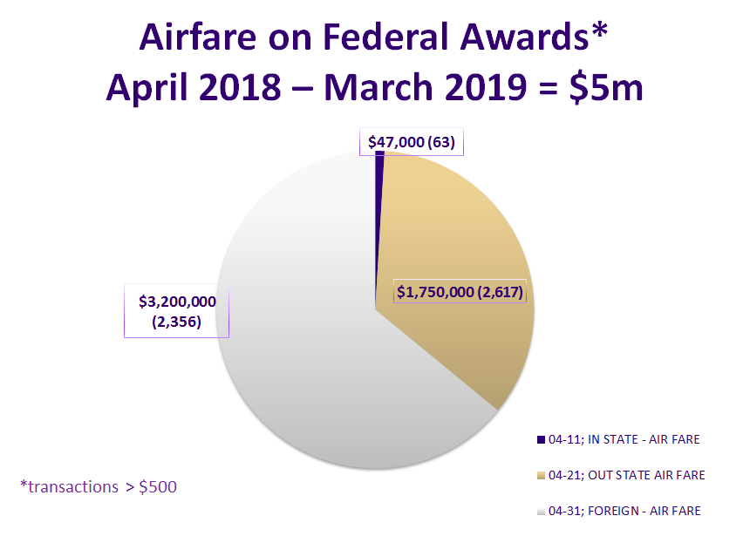
Notes:
In state average cost per ticket = $750

Slide 25
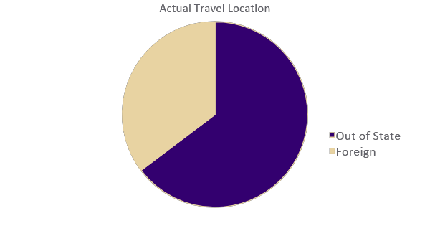
In State Travel (04-11) October 2018 – March 2019

Slide 26
DEMO

Slide 27
Questions?
PAFC Website: https://finance.uw.edu/pafc/
Email: gcahelp@uw.edu
Andra Sawyer
andra2@uw.edu
Matt Gardner
mgard4@uw.edu
MRAM – Matt Gardner – PAFC

Slide 28
NIH:
Human Subjects System and RPPRs
Update
April, 2019 MRAM
Amanda Snyder
Office of Sponsored Programs

Slide 29
RPPRs and the Human Subjects System (HSS)
NIH’s HSS is how we update Human Subjects & Clinical Trials info throughout life of an NIH grant.
Includes Enrollment Forms submitted as part of annual progress report (RPPR).
Notes:
PIs all have an eRA Commons PI account but not necessarily NIH funding

Slide 30
Human Subjects System Update
Use Human Subjects System (HSS), when applicable:
Complete HSS records & mark ‘Ready for Submission’
If the Submit button is active for the PI, PI submits the HSS record
If Submit button is not active for the PI
Twice a week (Tues & Thurs) OSP will submit all HSS records ‘Ready for Submission’.
UW Guidance RPPR NIH Submission

Slide 31
Local Professional Development Opportunities
April, 2019 MRAM
Amanda Snyder
Office of Sponsored Programs

Slide 32
Society for Research Administrators (SRA)
Pacific Northwest Chapter Meeting
Friday, July 19 @ Seattle Children’s Research Institute
Register Now!
https://www.srainternational.org/meetings/sections-chapters/pacific-northwest-meeting
Questions?
Josy Combs, SRA PNW Chapter President, combsj3@uw.edu

Slide 33
NCURA Region 6 & 7 Meeting
October 27 - 30, 2019 @ Motif Hotel, Downtown Seattle
Sunday, workshop day
Monday - Wednesday @ noon, full meeting
Research Administration Meets Bigfoot: Confronting mysteries and challenges in our changing environment
https://www.ncuraregionvii.org/regional-meeting
Questions? Want to volunteer?
Amanda Snyder, Region 6 Chair, acs229@uw.edu

Slide 34
UPCOMING COURSES IN
RESEARCH ADMINISTRATION
Apr 23 | Grant and Contract Certification Reports
Apr 25 | SAGE: Creating NIH Proposals in Grant Runner
Apr 30 | Introduction to Faculty Effort Certification
May 1 | Workshop: Preparing Sponsored Project Budgets. *Prerequisite Introduction to Sponsored Project Budgets (online)
May 7 | Research Administration Data: Visualizations and Reports
May 16 | eFEC for FEC Coordinators
May 21 | Research Administration Data Cube
May 23 | Understanding Cost Share at the UW –when is it really cost share?
CORE homepage:
https://www.washington.edu/research/training/core//
Currently scheduled courses and registration: https://uwresearch.gosignmeup.com/public/course/browse

