Slide 1
Compliance Corner
MRAM
April 2019
Matt Gardner & Andra Sawyer
Post Award Fiscal Compliance (PAFC)

Slide 2
Biennium Closeout –
Tagging Cost Share Contributions
Tagging Cost Share Contributions on a Biennium-based Budget
Start/End Dates: 7/1/17 – 6/30/19
Tends to be a lot of activity transferring costs on/off Biennium-based Budgets this time of year
Can be challenging to identify which transactions are available to tag in the tagging system
Tag early – don’t wait!
Good advice for all Cost Share but especially if the contributions are coming from a Biennium-based Budget
MRAM – Matt Gardner – PAFC

Slide 3
Cost Share Tagging Resources
GCA Website
https://finance.uw.edu/gca/cost-share/ste-by-step-instructions-non-fec-contributions
https://finance.uw.edu/gca/sites/default/files/Cost_Share_Tagging_Negative_Balance.pdf
GCA: gcahelp@uw.edu
MRAM – Matt Gardner – PAFC

Slide 4
Data Analytics Dashboard
Provide high risk transactions sortable by Org Codes & Award PI
Enables compliance review and trend analysis
Access must be granted by School/College Director of Finance
For more information: https://finance.uw.edu/pafc/data-analytics

Slide 5
Airfare on Federal Awards
Federal requirements on Airfare more restrictive than UW policy:
Travel in coach/economy
Comply with the Fly America Act
Exceptions exist however, sponsor approval is not an exception
For more information: https://finance.uw.edu/pafc/travel

Slide 6
Data Analytics – Airfare Purchases on Federal Awards
Filtered to federal awards and flow thru
Object Codes:
04-11: In State Airfare
04-21: Out of State Airfare
04-31: Foreign Airfare
Transactions over $500

Slide 7
Airfare Purchase Transaction Review
Actions that may need to be taken:
Expense may require additional supporting documentation
Expense may need to be moved from the federal award
None, airfare purchase is compliant with federal regulations

Slide 8
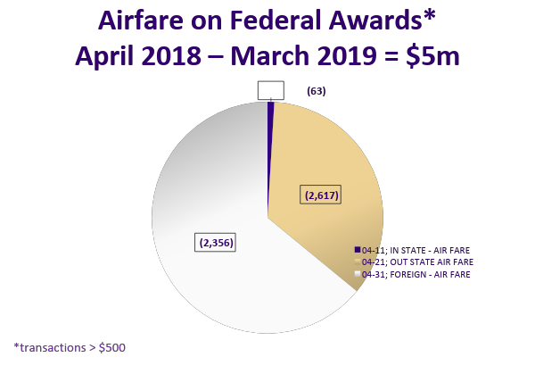
Notes:
In state average cost per ticket = $750

Slide 9
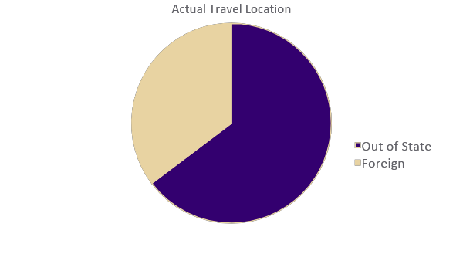
In State Travel (04-11) October 2018 – March 2019

Slide 10
DEMO

Slide 11
Questions?
PAFC Website: https://finance.uw.edu/pafc/
Email: gcahelp@uw.edu
Andra Sawyer
andra2@uw.edu
Matt Gardner
mgard4@uw.edu
MRAM – Matt Gardner – PAFC

