Slide 1
MRAM | Monthly Research Administration Meeting
MAY 9, 2019 9:00 AM – 10:00 AM UW TOWER AUDITORIUM
TOPIC | PRESENTER | EMAIL | MIN
Welcome | Kirsten DeFries Research Compliance & Operations | kirsten5@uw.edu | 2
UWFT Update | Jenn Dickey Finance Transformation | UWFTAsk@uw.edu | 20
Advance Budget Follow-Up | Lily Gebrenegus Grant & Contract Accounting | lgebren@uw.edu | 5
Compliance Corner | Matt Gardner Post Award Financial Compliance | gcafco@uw.edu | 10
Faculty Grants Management Online Refresher | Laurie Stephan Collaborative On Research Education (CORE) | corehelp@uw.ed | 15
CORE Update | Laurie Stephan Collaborative On Research Education (CORE) | corehelp@uw.ed | 2
NEXT MEETING JUNE 13, 2019 9:00 AM - 10:00 AM UW TOWER AUDITORIUM

Slide 2
OVERVIEW OF UWFT
MRAM May 2019

Slide 3
BUILDING TOWARDS FINANCIAL TRANSFORMATION
Since the Roadmap for Administrative Systems Modernization in 2008, UW has been on a path towards Financial Transformation, which each stepping stone building on the last
Finance Transformation Design, Implementation &
“Go Live”
Present
2014-2017
Finance Transformation Readiness
Regents approval of scope, schedule and budget
System Configuration
Data Conversion
Integration and Reports Development
Business Processes and Roles
Operating Model deployed
Unit Readiness confirmed
IT support model
Training & Testing
Finance Systems Strategy and Readiness
Benchmarking and Data Gathering
Operating Model Design
Foundation Data Model and Prototyping
IT System design
2010-2013
Finance Systems Needs Assessment
Visioning Workshop
ERP Sourcing Strategy – Maturity Model Workshops
Gartner Assessment
HCM Workday Go-Live
Workday Selected for Finance
Deloitte TCO
2008
Roadmap for Administrative System Modernization
ARIBA Extension
HRP Modernization
Initial Hackett Benchmarking (Procurement)
Notes:
JEANNE MARIE
Started out with a roadmap for administrative systems which included HRP, Finance, Research and Student – have been executing on that Roadmap
FSNA did requirements gathering for Finance; due to compliance issues determined we should do HRP Modernization first
Have now implemented HRP; benefit of that program going first
Deloitte – additional requirements gathering and maturity model workshops about a year ago; fit gap related to Workday and Workday selected for Finance
Integrated platform is key
Over summer completed largest BM&DG effort and now moving into Readiness – operating model, Foundation Data model, prototyping

Slide 4
TRANSFORMATION MATURITY
Risk Mitigation
Technology Enabled Improvements
Business Transformation
4
Degrees of Transformation Examples
Automation and Complete Consolidation of Services
1. ERP System Replacement
Low degree of transformation. Lift and shift existing technology. Limited redesign of existing processes. Operating model remains intact.
3
2. ERP Impacted Process Redesign
Medium degree of transformation. Cloud capability leveraged. ERP-impacted processes standardized, with corresponding change to operating model.
End-to-End Process Redesign
Value to Organization
3. End-to-End Process Redesign
Medium – High degree of transformation. All Supply Chain and Finance processes standardized. New operating model established with ERP enablement.
2
ERP Impacted Process Redesign
1
4. Automation and Complete Consolidation of Services
High degree of transformation. All Supply Chain and Finance redesigned to leverage a leading operating model for transaction processing. Unified shared service(s), irrespective of ERP.
ERP System Replacement
Digital Technology Enabler
Focus on Transformation and Innovation
Notes:
Ed
Started out with a roadmap for administrative systems which included HRP, Finance, Research and Student – have been executing on that Roadmap
FSNA did requirements gathering for Finance; due to compliance issues determined we should do HRP Modernization first
Have now implemented HRP; benefit of that program going first
Deloitte – additional requirements gathering and maturity model workshops about a year ago; fit gap related to Workday and Workday selected for Finance
Integrated platform is key
Over summer completed largest BM&DG effort and now moving into Readiness – operating model, Foundation Data model, prototyping

Slide 5
UWFT GOVERNANCE STRUCTURE
= Current
= Future
Sponsor Team
Board of Deans & Chancellors
UW Medicine Advisory
Program Leadership Team
Accounting Advisory
Technical Advisory
Core Transformation
Team
Technical Leadership Team
Process Transformation Teams
Faculty Advisory
Program Team
*Administrative leadership for program team is VP Finance
Notes:
Ed – call out how grants and research experts are involved in almost every single group, with
Mary Lidstrom on Sponsors
Jim Kresl on PLT and Core
Sue Camber on PLT
Kirsten DeFries on Core, Lily Gebrenegus on op model working group

Slide 6
TOP AREAS OF OPPORTUNITY IN FINANCE/ POST-AWARD GRANTS MANAGEMENT
Travel and expenses
Budget reconciliations and journal entries
Annual planning and forecasting
Business performance reporting and analysis
Notes:
Nicole/Jenn

Slide 7
A DESIGN PARTNERSHIP WITH WORKDAY GRANTS
UW hosted a 2-day series of working meetings with Workday’s Grants product managers and customer success leadership team
Workday recognizes UW is the leading R1 institution (in terms of grants volume)
We have already begun to engage with Workday to formalize a regular rhythm for collaborating on current and future state design needs
In the coming months and years, the UWFT program will continue engaging with UW’s research SMEs to inform and shape this part of UWFT
Notes:
Nicole

Slide 8
UPCOMING OPPORTUNITIES FOR PARTICIPATION
Provide and encourage Subject Matter Experts to support workshops, decision making, review of decisions
Resources to review outputs of each of the 9 end-to-end processes and the Foundation Data Model; smaller units need to rely on others for input
Business and IT owners for each system will also be required to provide input to the system inventory analysis and support analysis for the system remediation/retirement strategy
Faculty participating in faculty focus groups
Additional effort is also being scoped for activities that each unit will need to prepare for Implementation
Notes:
Jenn

Slide 9
THANK YOU!

Slide 10
PROCESS TRANSFORMATION TEAMS
Manage Cash and Financial Assets
User Task Group around specific need
User Task Group around specific need
Customer Req. to Payment
Hire to Retire
(TBD)
User Task Group around specific need
Record to Report
Core Transformation
Team
Project Inception to Close
Grant Award to Close
Asset Acquire to Retire
Procurement & Supply Chain
Plan and Manage the Business
Notes:
Liz – question about participation – reminds me that she was often frustrated during HRPM – how can we involve her more?
8-12 people
Provide detailed subject matter expertise on systems, reports, and sub processes.
Document high level current state processes, policies and roles
Support data gathering for process area side systems, reports inventory and detailed use cases, side system analysis, report analysis, change management, security requirements, communication, training, etc.
Change Agents
Become super users in Workday
Late spring/early summer

Slide 11
UWFT READINESS TIMELINE
June | July | Aug
Sept | Oct | Nov | Dec | Jan | Feb | Mar | Apr | May | Jun
Readiness Phase
Operating Model
Benchmarking & Data Gathering
Current State Understanding
High Level Future State Operating Model Direction
Conceptual Operating Model Structure
Unit Readiness / Stakeholder Engagement
Governance & Decision Rights
Leadership Alignment, Governance, and Change & Comms Strategy
Leadership Alignment, Governance, and Change & Comms Execution
Technical
System and Integrations Inventory
IT Landscape
Inventory and Requirements
Future State Strategy
Foundation Data Model
Review of COAs and Reports Inventory
FDM Kickoff and Current State
FDM Discovery Workshops and Blueprint
Blueprint Refinement
HRP Remediation
Review Production
HRP Solution Catalog and Stakeholder Working Group Engagement
End-to-End Process Design
Process Maps / Inventory
Plan and Execute Workday Demo/Deep Dive Sessions
AMU Prototype Prep
Program Management
Program Processes and Structure
Program Management Activities
Design Plans
On-track

Slide 12
ADVANCE BUDGET FOLLOW-UP
MRAM
May 2019
Lily Gebrenegus
Grant & Contract Accounting

Slide 13
OVERVIEW
By the numbers:
211 active advance budget numbers
8% have budget periods greater than 12 months
10% are expired
28% are sub budgets
$5.8M of expenses charged to advance budgets
Tools for campus
Related policy is in GIM 9
Advance Budget Number Report in BI Portal
MRAM – Lily Gebrenegus – Grant & Contract Accounting

Slide 14
WHAT CAN YOU DO?
Got an advance sub budget? If the parent budget has received its award, send us a Transpasu in GT!
Check your expired advances and request an extension if budget period is under 12 months
Take a close look at advances with budget periods greater than 12 months-can be a sign of increased compliance/financial risk
MRAM – Lily Gebrenegus – Grant & Contract Accounting

Slide 15
QUESTIONS?
Contact Lily Gebrenegus
lgebren@uw.edu
MRAM – Lily Gebrenegus – Grant & Contract Accounting

Slide 16
COMPLIANCE CORNER
MRAM
May 2019
Matt Gardner
Post Award Fiscal Compliance

Slide 17
RECENT AUDIT FINDINGS –
PARTICIPANT SUPPORT
Travel
Budget justification indicated reimbursement for actual travel expenses incurred for participants
Recipient provided “lump sum” payments to participants for travel, regardless of the actual cost of the travel
Recipient could not provide detailed support for actual expenses incurred
All costs were questioned
MRAM – Matt Gardner – PAFC

Slide 18
RECENT AUDIT FINDINGS –
PARTICIPANT SUPPORT
Stipends
Recipient budgeted for “Stipends” under Participant Support Costs and then charged individual costs for:
Parking
Scholarships
Course Fees
Lab Fees
NSF disallowed the costs as unallowable Participant Support expenses
MRAM – Matt Gardner – PAFC

Slide 19
ALL ABOUT STIPENDS
Stipends are:
Lump sum payments to defray living expenses
Not compensation in exchange for effort
Not a condition of employment
Not subject to Federal Withholding but may be taxable income
If a cost is directly paid by the Award for a Participant (travel, food, lodging) - it is not a stipend.
Stipends are lump sum payments to individuals
Stipend payments must be processed by the appropriate UW central office
MRAM – Matt Gardner – PAFC

Slide 20
RECENT AUDIT FINDINGS –
PARTICIPANT SUPPORT
Employee Costs
Recipient charged payroll expenses to Participant Support budgets
Recipient charged airline tickets for employees to travel to a conference as Participant Support
Audit findings have varied from questioned costs to noting a compliance exception
Per NSF policy, re-budgeting from Participant Support to other direct cost categories requires prior approval
MRAM – Matt Gardner – PAFC

Slide 21
PARTICIPANT SUPPORT ON NSF BUDGETS
Salaries and Wages for UW employees are unallowable as Participant Support Costs
A UW employee that is paid on an NSF award cannot also be a “Participant”
Best Practice if you have NSF Participant Support
Review the Budget Summary in MyFD; there should be not be any 01-xx charges on the Participant Support sub budget
Allocable 01-xx Salaries & Wages should be charged to the parent budget
MRAM – Matt Gardner – PAFC

Slide 22
RECENT AUDIT FINDINGS –
F&A RATES
Recipient applied an F&A Rate lower than their negotiated rate on 17 NSF Awards
NSF: “Inappropriate application of proposed indirect costs…”
Recipient: “It’s okay… we can apply a lower rate if we chose.”
NSF: “No, you can’t.”
From the PAPPG: “Use of an indirect cost rate lower than the organizations’ current negotiated indirect cost rate is considered a violation of NSF’s cost sharing policy.” [NSF PAPPG 17-1, Part I, Chapter II, Section C.2.g.(viii)]
MRAM – Matt Gardner – PAFC

Slide 23
REFERENCES
NSF PAPPG
Participant Support: https://www.nsf.gov/pubs/policydocs/pappg19_1/pappg_2.jsp#IIC2gv
Indirect Costs: https://www.nsf.gov/pubs/policydocs/pappg19_1/pappg_2.jsp#IIC2gviii
Research Terms & Conditions – Prior Approval Matrix
https://www.nsf.gov/bfa/dias/policy/fedrtc/appendix_a.pdf
Uniform Guidance
2 CFR 200.75 (Participant Support Costs)
2 CFR 200.456 (Use of Participant Support Costs)
Stipends – UW Policy
https://finance.uw.edu/tax/departments/fed-taxes/stipend-payments
MRAM – Matt Gardner – PAFC

Slide 24
QUESTIONS?
Post Award Fiscal Compliance
Web: https://finance.uw.edu/pafc/
Email: gcafco@uw.edu
Andra Sawyer (on vacation)
andra2@uw.edu
206-685-8902
Matt Gardner (not on vacation)
mgard4@uw.edu
206-543-2610
MRAM – Matt Gardner – PAFC

Slide 25
Faculty Grants Management Online Refresher
MRAM
May, 2019
Laurie Stephan
Office of Research
Notes:
Good morning. I am Laurie Stephan, with the Office of Research and lead for the CORE research administration learning program.
As most of you know, all Pis on all UW campuses are required to complete a faculty grants management course and then renew that training every 4 years. The initial training must be completed in the classroom but the renewal can be met by completing the online course. We have recently updated this online offering and launched the updated course at the end of April.
Today I am going to give you a quick tour of what is included in the course.

Slide 26
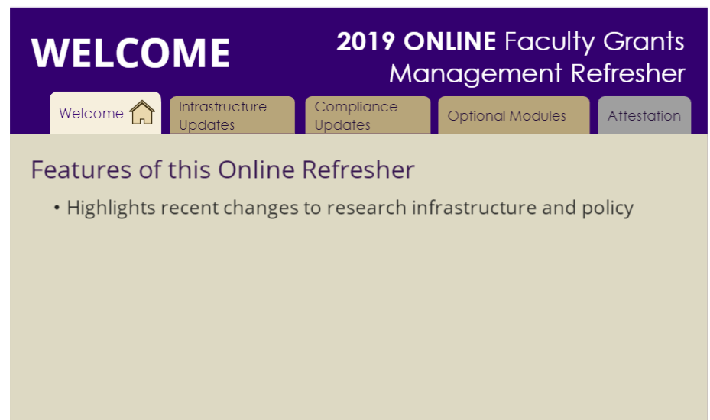
New Approach
Short modules
Required Core topics
What’s New –current relevant updates
Customized content (electives)
Notes:
The old online refresher was retired a year ago due to outdated content and links and because there was no efficient way for us to update the content on an as needed basis. We needed to produce a refresher that could be easily updated, contained brief information that could point Pis to other resources that are kept up-to-date by the units responsible for that information. Furthermore, we wanted to provide current information –updates in key areas that are impacting how research administration is practiced at the UW.
In thinking through our needs we wanted a training that met 4 goals:
Minimize faculty time –communicate only the most significant information in an efficient way with resources they can use later
Focus on core topics that everybody needs to remember
Focus on new issues that are changing the way research administration is practiced at the UW
Provide customized content for faculty who need specific info such as in Human Subjects, Animal Welfare of Lab Safety.

Slide 27
FGM Online Refresher Modules
Research Infrastructure
MyResearch Lifecycle
MyResearch Portal
Financial Processes
Proposal and Grant Status Tools
Shared Research Facilities & Resources
Compliance Updates
Open Access
Conflict of Interest
Sexual Harassment
Foreign Influence
Electives
Lab Safety
Human Subjects Updates (Common Rule)
Working with Animals
What’s New
Notes:
The content modules are divided into three areas—
Research Infrastructure
Compliance Updates and
Electives

Slide 28
Research Infrastructure Topics
Notes:
Each 3-4 minute module provides a narrated presentation of only the high level details in
MyResearch Portal
Working with OSP
How GCA supports research projects
Newly launched Shared Research Facilities and Resources website

Slide 29
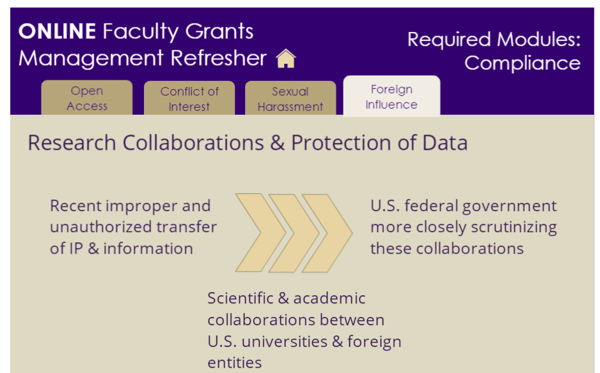
Compliance Updates
Notes:
Very brief overviews of significant compliance trends and changes that are impacting how investigators much manage aspects of their sponsored projects including
Open Access
Conflict of Interest
Sexual Harassment and
Foreign Influence

Slide 30
Electives
Notes:
Finally, electives modules specifically targeting investigators who conduct research that require compliance focus in these particular areas
Human Subjects had a timely update about a change in administration of human subjects research
Lab Safety
Working with Animals

Slide 31
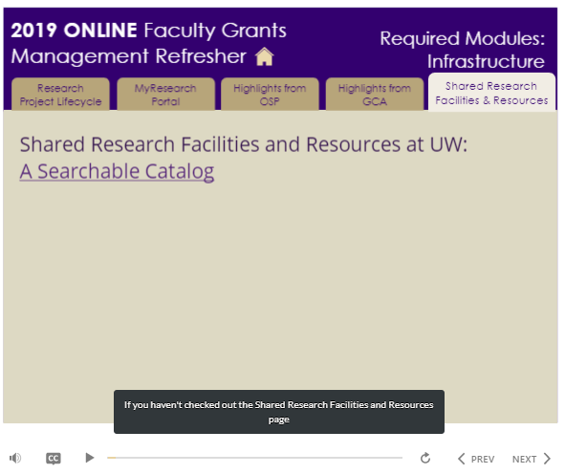
Preview
Notes:
Here’s an example of how the training is delivered and the focus on new developments in resources to support UW research activities.

Slide 32
Feedback Results
54 completers/30 feedback surveys
90% agree it contains valuable content
96% agree it’s easy to use
83% agree it’s about the right length,10% neither agree/nor disagree with that statement
71% agree the training provides resources they will use later, 18% neither agree nor disagree with that statement
http://www.washington.edu/research/learning/online/index.php/lessons/uw-faculty-grants-management-refresher/
Notes:
Overall the feedback is positive. We will release an updated version annually and will continue to refine the offering based on the feedback we receive. Anybody with a UW NetID can access the course so feel welcome to login at this URL and find out what your Pis are being told.

Slide 33
UPCOMING COURSES IN
RESEARCH ADMINISTRATION
May 21 | Research Administration Data Cube
May 23 | Electronic Faculty Effort Certification (eFECS) for FEC Coordinators
May 23 | Understanding Cost Share at the UW: When is it Really Cost Share?
May 30 | Tools and Calculators for Monitoring Effort and Adjusting FECs
June 4 | Managing Cost Share at the UW
June 11 | Managing NRSA Training Grant Budgets at the UW
June 13 | Salary Limitations – Salary Cap
June 25 | Subawards in SAGE
CORE homepage:
https://www.washington.edu/research/training/core//
Currently scheduled courses and registration: https://uwresearch.gosignmeup.com/public/course/browse

Slide 34
ONLINE COURSES IN
RESEARCH ADMINISTRATION
Direct Billing of F&A Type Costs
Timing of Expenditures and Benefit to Award
Internal Controls: Basic Concepts
Introduction to Sponsored Project Budgets
Post Award Food Purchases and Compliance
Salary and Cost Transfers
CORE homepage:
https://www.washington.edu/research/training/core//
Currently scheduled courses and registration: https://uwresearch.gosignmeup.com/public/course/browse

