Slide 1
Faculty Grants Management Online Refresher
MRAM
May, 2019
Laurie Stephan
Office of Research
Notes:
Good morning. I am Laurie Stephan, with the Office of Research and lead for the CORE research administration learning program.
As most of you know, all Pis on all UW campuses are required to complete a faculty grants management course and then renew that training every 4 years. The initial training must be completed in the classroom but the renewal can be met by completing the online course. We have recently updated this online offering and launched the updated course at the end of April.
Today I am going to give you a quick tour of what is included in the course.

Slide 2
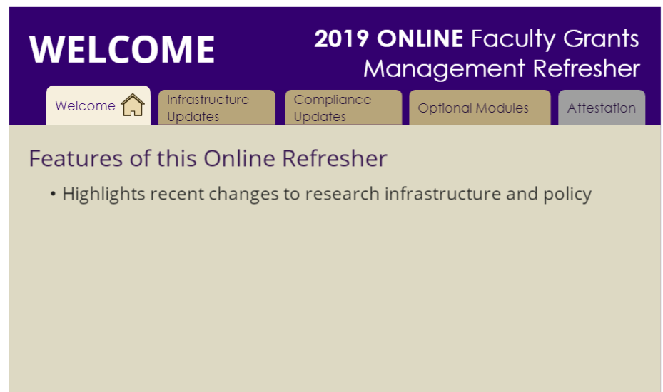
New Approach
Short modules
Required Core topics
What’s New –current relevant updates
Customized content (electives)
Notes:
The old online refresher was retired a year ago due to outdated content and links and because there was no efficient way for us to update the content on an as needed basis. We needed to produce a refresher that could be easily updated, contained brief information that could point Pis to other resources that are kept up-to-date by the units responsible for that information. Furthermore, we wanted to provide current information –updates in key areas that are impacting how research administration is practiced at the UW.
In thinking through our needs we wanted a training that met 4 goals:
Minimize faculty time –communicate only the most significant information in an efficient way with resources they can use later
Focus on core topics that everybody needs to remember
Focus on new issues that are changing the way research administration is practiced at the UW
Provide customized content for faculty who need specific info such as in Human Subjects, Animal Welfare of Lab Safety.

Slide 3
FGM Online Refresher Modules
Research Infrastructure
MyResearch Lifecycle
MyResearch Portal
Financial Processes
Proposal and Grant Status Tools
Shared Research Facilities & Resources
Compliance Updates
Open Access
Conflict of Interest
Sexual Harassment
Foreign Influence
Electives
Lab Safety
Human Subjects Updates (Common Rule)
Working with Animals
What’s New
Notes:
The content modules are divided into three areas—
Research Infrastructure
Compliance Updates and
Electives

Slide 4
Research Infrastructure Topics
Notes:
Each 3-4 minute module provides a narrated presentation of only the high level details in
MyResearch Portal
Working with OSP
How GCA supports research projects
Newly launched Shared Research Facilities and Resources website

Slide 5
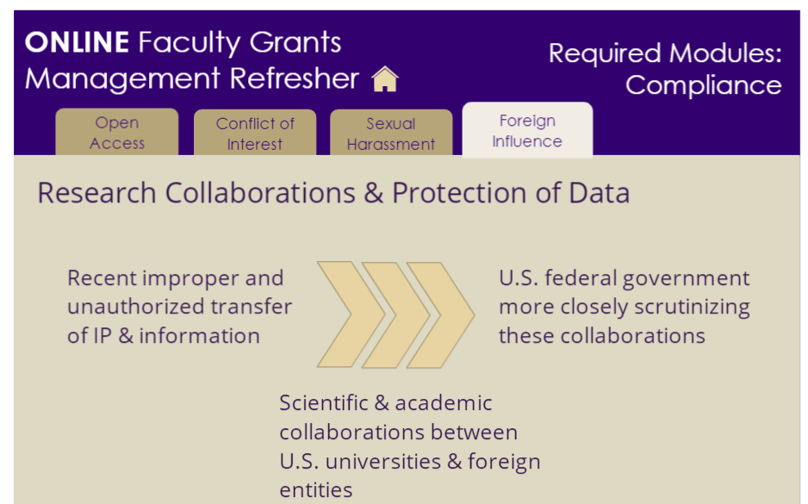
Compliance Updates
Notes:
Very brief overviews of significant compliance trends and changes that are impacting how investigators much manage aspects of their sponsored projects including
Open Access
Conflict of Interest
Sexual Harassment and
Foreign Influence

Slide 6
Electives
Notes:
Finally, electives modules specifically targeting investigators who conduct research that require compliance focus in these particular areas
Human Subjects had a timely update about a change in administration of human subjects research
Lab Safety
Working with Animals

Slide 7
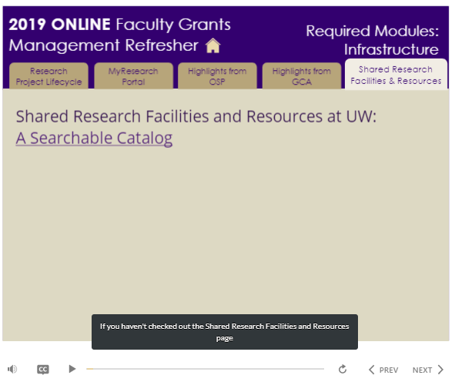
Preview
Notes:
Here’s an example of how the training is delivered and the focus on new developments in resources to support UW research activities.

Slide 8
Feedback Results
54 completers/30 feedback surveys
90% agree it contains valuable content
96% agree it’s easy to use
83% agree it’s about the right length,10% neither agree/nor disagree with that statement
71% agree the training provides resources they will use later, 18% neither agree nor disagree with that statement
http://www.washington.edu/research/learning/online/index.php/lessons/uw-faculty-grants-management-refresher/
Notes:
Overall the feedback is positive. We will release an updated version annually and will continue to refine the offering based on the feedback we receive. Anybody with a UW NetID can access the course so feel welcome to login at this URL and find out what your Pis are being told.

