Slide 1
MRAM | Monthly Research Administration Meeting
JUNE 13, 2019 9:00 AM – 10:00 AM UW TOWER AUDITORIUM
TOPIC | PRESENTER | EMAIL | MIN
Welcome | Kirsten DeFries Research Compliance & Operations | kirsten5@uw.edu | 2
Business Continuity Planning for Research | Joe Giffels Office of Research | jgiffels@uw.edu | 10
NSF Updates | Tim Mhyre Office of Sponsored Programs | tmhyre@uw.edu | 10
Biennium Close Update | Susan Wilbanks Grant and Contract Accounting | gcahelp@uw.ed | 10
Compliance Corner | Andra Sawyer Post Award Financial Compliance | gcafco@uw.edu | 10
Local Professional Development Opportunities | Amanda Snyder Office of Sponsored Programs | acs229@uw.edu | 2
CORE Update | Amanda Snyder Collaborative On Research Education (CORE) | corehelp@uw.ed | 2
NEXT MEETING JULY 11, 2019 9:00 AM - 10:00 AM UW TOWER AUDITORIUM

Slide 2
Business Continuity Planning for Research
MRAM - June 13 2019
Office of Research

Slide 3
An Approach to Planning
Consider a spectrum of scenarios
Plan for short-, medium-, and long-term interruptions
Know who is doing what, where by
Department
Lab
Building
Plan for access to
Data, computer programs
Samples
Equipment
Animals
Develop and follow a communications plan
Office of Research

Slide 4
Some Strategies
(Helpful Hint: Do these in advance of the emergency)
Categorize/prioritize core/key
Operations
Experiments
Geographically diversify
Storage of data, samples
Equipment
Locations of operations
Develop reciprocal partner labs (ie, “buddy up”)
Office of Research
Notes:
UW Emergency Management (UWEM) is a department in UW Facilities (https://www.washington.edu/uwem/).

Slide 5
A Resource: UWEM (UW Emergency Management – a department of UW Facilities)
Megan Levy
BARC Program Manager
levym2@uw.edu
https://www.washington.edu/uwem/
Support in developing continuity plans
Facilitated discussions
Research and experience based recommendations
Support throughout the planning process
Presentations and continuity training
Facilitated after action reviews
Detailed review of continuity plans for content and best practices
Exercises, drills, and other continuity practice
Support during disaster response and recovery
Supporting your planning in other ways as requested
Office of Research

Slide 6
NSF Updates
June, 2019 MRAM
Tim Mhyre
Office of Sponsored Programs

Slide 7
NSF Updates
Implications of 2019 Government Shutdown
NSF will be especially busy at the end of this fiscal year due to shutdown earlier this year.
Will need quick turnaround times on administrative requests.
Get annual reports in on time!

Slide 8
NSF 2020 PAPPG DRAFT - Open for Comment
Effective for proposals submitted or due on or after February 25, 2019, & awards made on/after this date
Most changes involve additions/deletions to provide clarity
Biographical Sketches - required to use NSF- approved format
Additional explanatory text regarding Responsible & Ethical Conduct of Research

Slide 9
NSF 2020 PAPPG DRAFT - Open for Comment
Current and Pending Support Changes
Clarifying “longstanding requirements” (not new policy)
NSF anticipates an electronic format for submission of this info in the future
Draft Proposal & Award Policies & Procedures Guide (PAPPG) (NSF 20-1)
Can send comments to research@uw.edu with Subject line: NSF PAPPG Proposed Changes - Comments

Slide 10
NSF 2020 PAPPG DRAFT - Open for Comment
NSF comments regarding Current and Pending Support Changes
“This section has been revised to clarify NSF’s longstanding requirements regarding submission of current and pending support information.
Information must be provided for all current and pending support irrespective of whether such support is provided through the proposing organization or directly to the individual.
Examples of current and pending support have been expanded to include non-profit organizations and consulting agreements.
All projects and activities that require a time commitment must be reported (no minimum has been established), even if the support received is only in-kind.
NSF does not consider these clarifications to be changes in policy.
New electronic format (or formats) will be implemented to collect current and pending information. Upload of pdf will no longer be permitted.”

Slide 11
My NSF Biographical Sketch in SciENcv
Step-by-step instructions for creating NSF-compliant Biosketch
NSF recommends using optional ORCID ID link (Open Researcher & Contributor ID)
Can be uploaded into FastLane or Research.gov as PDF
See NSF Update from May, 2019, FDP Meeting

Slide 12
Biennium Crossover impacts on grant budgets
MRAM
June 2019
Susan Wilbanks
Grant & Contract Accounting

Slide 13
OVERVIEW
Non-FEC cost sharing
Interim reports and invoices
Month 25 impacts
Using the B.I. Portal
Deficit transfers
MRAM – Susan Wilbanks – Grant & Contract Accounting

Slide 14
NON-FEC COST SHARE CONTRIBUTIONS
Transactions on biennium-based budgets will no longer be available for tagging as non-FEC cost share contributions once the biennium has closed
All eFECS cost sharing systems will be down for ~10 days at the beginning of July
Tag transactions in the Non-FEC Cost Share Tagging Application ASAP, no later than June 28
MRAM – Susan Wilbanks – Grant & Contract Accounting

Slide 15
INTERIM REPORTING AND INVOICING
Month 25 – final month of the expiring biennium, allowing departments to post trailing costs to it after June 30
The month of June cannot close in FIN/MyFD until Month 25 is complete
Interim reports and invoices for periods ending June 30 are typically due before Month 25 (and therefore June itself) closes
MRAM – Susan Wilbanks – Grant & Contract Accounting

Slide 16
INTERIM REPORTING AND INVOICING CONTINUED
In order to meet sponsor deadlines, GCA only reports or invoices through Month 24 (calendar June)
GCA will include Month 25 transactions in the report or invoice for the budget period beginning July 1
Since MyFD/FIN includes Month 25 charges in June, our invoices and reports will be out of sync with these systems
MRAM – Susan Wilbanks – Grant & Contract Accounting

Slide 17
INTERIM REPORTING AND INVOICING CONTINUED
We will calculate our reporting/invoicing totals by treating 7/5/19 as the last day of June—our goal is to capture all Month 24 charges, but none from Month 25 or Month 1
Departments needing to provide backup for an invoice or report should use 7/5/19 as well
Use the Variable Reporting Period Transaction summary report from the B.I. Portal
MRAM – Susan Wilbanks – Grant & Contract Accounting

Slide 18
DEFICIT TRANSFERS
When using the Deficit Transfer tool on the GrantTracker website in July, check the GCA website for the date these transfers will switch from the 2017 to the 2019 biennium.
If you want to request a 2019 biennium transfer before that date, do NOT use the Deficit Transfer tool. Instead, email gcahelp@uw.edu or submit a GrantTracker request under the Closing topic.
Deadline to submit JV requests to GCA: 7/15
MRAM – Susan Wilbanks – Grant & Contract Accounting

Slide 19
QUESTIONS?
Resources
MyFD biennium page: https://finance.uw.edu/ps/reports-reconciliation/bienniumclose
GCA biennium page: https://finance.uw.edu/gca/resources/biennium-crossover-2019-grant-and-contract-budgets
Contact GCA Help
gcahelp@uw.edu
MRAM – Susan Wilbanks – Grant & Contract Accounting

Slide 20
Compliance Corner
MRAM
June 2019
Andra Sawyer
Post Award Fiscal Compliance (PAFC)

Slide 21
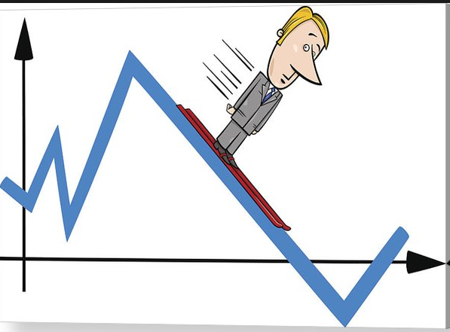
Office of the Controller
Data Analytics Dashboard
Auditors use data analytics to identify high risk transactions
Dashboard presents these high risk transactions to campus for their routine review
Access to the Dashboard is by approval
For access, contact your school/college administrator or ask PAFC for help (gcafco@uw.edu)
Information on the data analytics program:
https://finance.uw.edu/pafc/data-analytics

Slide 22
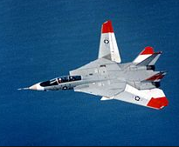
All Travel Transactions are High Risk
Can be difficult to prove how travel is allocable (beneficial) to a Sponsored Award
Can be seen as a benefit to the Traveler
There are many rules about per diem, lodging, class of airfare/Fly America Act
Federal travel requirements are much more stringent than UW requirements
UW Travel:
https://finance.uw.edu/travel/
Sponsored Award travel:
https://finance.uw.edu/pafc/travel

Slide 23
Audit Risk:
Travel Budget < Actual Travel Expenditures
Auditors look for:
Unplanned or unnecessary travel
Excess travel expenditures
Additional travelers
Travel costs higher than budgeted

Slide 24
Travel Approval
On Federal Awards, unless stated otherwise, Travel does not require Sponsor approval; this makes Travel expenditures an increased audit risk.
Auditors will question when Travel Budget < Travel Expenses and look for “proof” that the excess travel is allocable to the Award:
Written notification to the Program Officer
Documented benefit of travel in
progress/programmatic reports

Slide 25
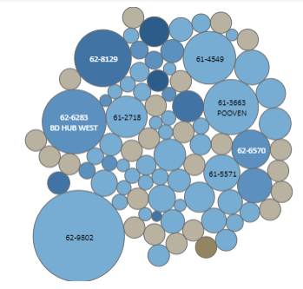
New Dashboard Visualization:
Travel Budget < Actual Expenditures
Identify all Sponsored Awards where Travel Budget < Travel Expenditures to date
Displays at the Parent Budget level (includes any sub-budget)
Displays data to highlight an auditor’s indicators:
amount (%) Travel expenses are over-budget
total amount of Travel expenses

Slide 26
Questions?
Post Award Fiscal Compliance
Matt Gardner
Andra Sawyer
gcafco@uw.edu
https://finance.uw.edu/pafc/

Slide 27
Local Professional Development Opportunities
June, 2019 MRAM
Amanda Snyder
Office of Sponsored Programs

Slide 28
Society for Research Administrators (SRA)
Pacific Northwest Chapter Meeting
Friday, July 19, 8:00 am - 4:00 pm
Seattle Children’s Research Institute (Downtown)
Pre-registration ends July 8!
https://www.srainternational.org/meetings/sections-chapters/pacific-northwest-meeting
Questions?
Josy Combs, SRA PNW Chapter President, combsj3@uw.edu

Slide 29
NCURA Region 6 & 7 Meeting
October 27 - 30, 2019 @ Motif Hotel, Downtown Seattle
Sunday, workshop day
Monday - Wednesday, full meeting
Research Administration Meets Bigfoot: Confronting mysteries and challenges in our changing environment
Registration Opening in June
https://www.ncuraregionvii.org/regional-meeting
Questions?
Amanda Snyder, Region 6 Chair, acs229@uw.edu

Slide 30
UPCOMING COURSES IN
RESEARCH ADMINISTRATION
June 25 | Subawards in SAGE
September 10 | Introduction to Research Administration
CORE homepage:
https://www.washington.edu/research/training/core//
Currently scheduled courses and registration: https://uwresearch.gosignmeup.com/public/course/browse

Slide 31
ONLINE COURSES IN
RESEARCH ADMINISTRATION
Direct Billing of F&A Type Costs
Timing of Expenditures and Benefit to Award
Internal Controls: Basic Concepts
Introduction to Sponsored Project Budgets
Post Award Food Purchases and Compliance
Salary and Cost Transfers
CORE homepage:
https://www.washington.edu/research/training/core//
Currently scheduled courses and registration: https://uwresearch.gosignmeup.com/public/course/browse

