Slide 1
Compliance Corner
MRAM
June 2019
Andra Sawyer
Post Award Fiscal Compliance (PAFC)

Slide 2
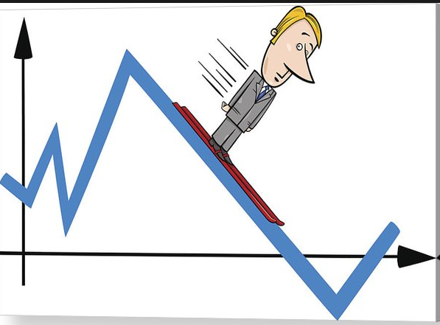
Office of the Controller
Data Analytics Dashboard
Auditors use data analytics to identify high risk transactions
Dashboard presents these high risk transactions to campus for their routine review
Access to the Dashboard is by approval
For access, contact your school/college administrator or ask PAFC for help (gcafco@uw.edu)
Information on the data analytics program:
https://finance.uw.edu/pafc/data-analytics

Slide 3
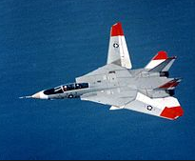
All Travel Transactions are High Risk
Can be difficult to prove how travel is allocable (beneficial) to a Sponsored Award
Can be seen as a benefit to the Traveler
There are many rules about per diem, lodging, class of airfare/Fly America Act
Federal travel requirements are much more stringent than UW requirements
UW Travel:
https://finance.uw.edu/travel/
Sponsored Award travel:
https://finance.uw.edu/pafc/travel

Slide 4
Audit Risk:
Travel Budget < Actual Travel Expenditures
Auditors look for:
Unplanned or unnecessary travel
Excess travel expenditures
Additional travelers
Travel costs higher than budgeted

Slide 5
Travel Approval
On Federal Awards, unless stated otherwise, Travel does not require Sponsor approval; this makes Travel expenditures an increased audit risk.
Auditors will question when Travel Budget < Travel Expenses and look for “proof” that the excess travel is allocable to the Award:
Written notification to the Program Officer
Documented benefit of travel in
progress/programmatic reports

Slide 6
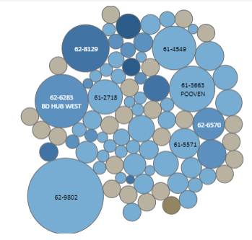
New Dashboard Visualization:
Travel Budget < Actual Expenditures
Identify all Sponsored Awards where Travel Budget < Travel Expenditures to date
Displays at the Parent Budget level (includes any sub-budget)
Displays data to highlight an auditor’s indicators:
amount (%) Travel expenses are over-budget
total amount of Travel expenses

Slide 7
Questions?
Post Award Fiscal Compliance
Matt Gardner
Andra Sawyer
gcafco@uw.edu
https://finance.uw.edu/pafc/

