Slide 1
MRAM | Monthly Research Administration Meeting
SEPTEMBER 12, 2019 9:00 AM – 10:30 AM UW TOWER AUDITORIUM
TOPIC | PRESENTER | EMAIL | MIN
Welcome | Kirsten DeFries Research Compliance & Operations | kirsten5@uw.edu | 2
UW Finance Transformation - Program Update | Ed Loftus Erick Winger Nicole Flagg UW Finance Transformation | ejloftus@uw.edu erickw@uw.edu nicole@uw.edu | 15
Updates: Foreign and Significant Financial Interests | Melissa Petersen Office of Research | petermm@uw.edu | 7
Sponsor Updates | Carol Rhodes Director, Office of Sponsored Programs | carhodes@uw.edu | 10
NIH - ORCID ID requirement | Amanda Snyder Associate Director, Office of Sponsored Programs | acs229@uw.edu | 5
Training Grants | Doug Pistoresi Grant & Contract Accounting | gcahelp@uw.edu | 5
MyFinancial Desktop JV’s | Lily Gebrenegus Grant & Contract Accounting | gcahelp@uw.edu | 5
Internal Audit Update | Richard Cordova Internal Audit | rcordova@uw.edu | 10
Compliance Corner | Matt Gardner Post Award Fiscal Compliance | gcafco@uw.edu | 10
CORE - Certificate in Research Administration | Laurie Stephan Collaborative On Research Education (CORE) Amanda Snyder Office of Sponsored Programs (OSP) | corehelp@uw.ed | 10
NEXT MEETING OCTOBER 10, 2019 9:00 AM - 10:00 AM UW TOWER AUDITORIUM

Slide 2
UWFT UPDATE 9/12/2019 MRAM

Slide 3
uw finance transformation is an OPPORTUNITY to reimagine and streamline our finance-related policies and processes, with the help of new technology

Slide 4
SINCE WE LAST MET…
In early summer, leadership from UWFT, UW-IT, UW Finance and UW Medicine went before the Board of Regents twice to review the work completed in Readiness, and secure approval to proceed to Design
The Design Phase is a 6-month period of time devoted to firming up this multi-year program’s scope, schedule and budget
UWFT will go before the Board of Regents in December to ask for Stage 2 funding. At that time, we’ll also have a definitive go-live date
Engagement with stakeholders so far has been steady, but will grow significantly in frequency, and broaden in reach, beginning in 2020
New members of the UWFT Sponsor team include Mary Lidstrom, Mia Tuan and Bob Stacey
Notes:
Benchmarking & Data Gathering (BM&DG): Achieved 100 percent, on time participation from hundreds of experts in every unit across the University to establish a detailed understanding of current state
UWFT Newsletter & Website: Launched a website and regular program newsletter to a growing audience of recipients, totaling 4,000 UW employees
Leadership & Advisory Groups: Met regularly (monthly, quarterly, semi-annually and annually) with a wide variety of leadership groups, ranging from Board of Deans and Chancellors to Faculty Senate. Also established and regularly engaged with advisory groups within UW Medicine
Unit Profiles and Engagement: Following the BM&DG effort, prepared unit-specific profiles and met with over 20 units to share findings and provide programmatic updates
Faculty Focus Groups: Launched and will continue to engage throughout Implementation
Workshops: Over 50 workshops have engaged roughly 300 stakeholders across UW Academy and UWM, providing critical inputs
Working Groups: Several working groups were launched with key stakeholders, including FDM Design, Op Model, HRP and Technical

Slide 5
ENVISIONING WHAT COULD BE
AMU Prototype Session | Date | Status
Asset Acquire to Retire AMU Prototype | Wednesday, July 10 | Complete
Plan and Manage the Business AMU Prototype | Thursday, July 11 | Complete
Procure to Pay AMU Prototype | Wednesday, July 17 | Complete
Customer Requisition to Payment AMU Prototype | Thursday, July 18 | Complete
Travel & Expense AMU Prototype | Wednesday, July 24 | Complete
Record to Report AMU Prototype | Thursday, July 25 | Complete
Manage Cash and Financial Assets AMU Prototype | Tuesday, July 30 | Complete
Project Inception to Close AMU Prototype | Tuesday, August 6 | Complete
Gifts and Endowments AMU Prototype | Thursday, August 8 | Complete
Inventory and Supply Chain AMU Prototype | Thursday, August 8 | Complete
Grant Award to Close AMU Prototype | Wednesday, August 14 | Complete
Business Process Design Wrap Up | Thursday, August 22 | Complete

Slide 6
GRANT AWARD TO CLOSE: SESSION TAKEAWAYS
AREAS OF EXCITEMENT Expanded award attribute functionality! Ability to configure and use Grant worktag and award attributes to drive workflow approvals, notifications, and to support a variety of downstream processing, such as award setup, expenditure date validations, and spend transaction approval workflows Dates matter! Ability to configure and use dates to accept pre- and post-award expenses while maintaining actual contractual start and end dates AREAS FOR FURTHER EXPLORATION Multidimensional considerations! Multiple Cost Centers sharing a single Grant versus one Cost Center to one Grant Cost share process! Significant change in how to think about and manage cost share; frequency of multiple funding sources used for cost share
Notes:
Award attribute functionality - Easier to do it right and harder to do it wrong! Example, Award Special Conditions - IRB fee, e-verify, carryover terms
Multidimensional consideration – Working with the data in a new way – greater flexibility
Cost share process – shift to companion Grant, impacts on timing, tracking, funding sources

Slide 7
END-TO-END PROCESS TRANSFORMATION GOALS
GRANT AWARD TO CLOSE
Sponsor data that automatically flows through the system from pre- to post-award
Streamline grant/contract set up process
Streamline and standardize subcontract process
Provide ability to apply rules/workflows consistently across all awards based on grant attributes like sponsor type
Streamline documents management processes
Implement a solution that provides robust grant tracking
Improve reporting (including projections)
Consolidate post-award grants management in Workday
Increase granular tracking of expenditure types within a grant
Establish automated reconciliation between Grants Ledger & General Ledger
Provide automated exception reporting
Provide more timely, transparent, and accurate grant accounting and effort certification including enterprise reporting for PIs and leadership
DRAFT FOR DISCUSSION

Slide 8
FDM DESIGN PHASE OUTREACH OBJECTIVES
Begin education of FDM and what it means for the enterprise's transition to Workday
Pilot our outreach with units represented in Core Team
Participants would include each unit's primary fiscal agent and one to two other designated colleagues
Brainstorm/whiteboard initial fiscal structure with pilot units
Share results and key learnings with Core Team
Include how outreach approach may need adjusted when working with more units

Slide 9
QUESTIONS? COMMENTS? SUGGESTIONS?
Please email additional questions and feedback to:
UWFT Finance Transformation: uwftask@uw.edu

Slide 10
Updates: Foreign and Significant Financial Interests
Melissa Petersen - Office of Research
petermm@uw.edu, 206-616-2120

Slide 11
NIH Reminders
Other Support
Foreign Components
Financial Conflicts of Interest

Slide 12
Other Support & Foreign Components
No UW impact on reporting or approval requirements related to Financial Conflict of Interest policy, GIM 10 or Outside Professional Work policy Executive Order No. 57 (Administrative Policy Statement 47.3 for staff)

Slide 13
Financial Conflicts of Interest (FCOI)
Reminder that NIH Investigators are required to disclose gifts in accordance with their institution’s Financial Conflict of Interest policy
UW employees are not permitted to accept gifts valued >$50
Gifts received by the UW (Advancement) are not SFI and do not require disclosure

Slide 14
Financial Conflicts of Interest (FCOI)
Reminder that the compensation (honoraria) received for institutional responsibilities performed at other domestic institutes of higher education is excluded from the FCOI regulation
This exclusion does not apply to compensation received from foreign governments or foreign institutes of higher education

Slide 15
Examples
UW Researcher travels to The Hong Kong University of Science and Technology to present on their UW research activities
Honoraria and travel expenses combined total $5,050
Outside Work?
No
SFI?
Yes (compensation is >$5,000)

Slide 16
Examples
UW Researcher has a Courtesy Affiliate Professor appointment at University of London
No compensation is received related to this appointment
Other Support?
Yes
Outside Work?
Maybe
SFI?
No

Slide 17
Examples
UW Researcher travels to The University of British Columbia to present on their UW research activities
Honoraria and travel expenses combined total $1,080
Outside Work?
No
SFI?
No, because the compensation is <$5,000, but like the NIH we encourage erring on the side of disclosure

Slide 18
Sponsor Updates
September, 2019 MRAM
Carol Rhodes
Office of Sponsored Programs

Slide 19
Reminder
Federal Fiscal Year End 9.30.19
Expect requests for quick turn around times from federal agencies - NSF in particular.
Proposals, awards, admin actions etc.
The University must be prompt in its response to federal agencies. If you receive federal sponsor requests directly, please forward the requested information to OSP asap.

Slide 20
NIH: Human Fetal Tissue (HFT) Research Effective 9.25.19
HFT research must be addressed in the budget, budget justification, the cover letter, research plan, and applicants
must also:
Include two attachments in the "Other Attachments" section of the R&R Other Project Information form
HFT Sample IRB Consent Form
Forms & Templates: TEMPLATE: Consent Form, Fetal Tissue Research
HFT Compliance Assurance (letter from PI)
Include specific info in the Research Strategy attachment regardless of whether Human Subjects research is proposed.
NIH will NOT review applications that do not address all
required information, including the detailed budget.
Notes:
Human Fetal Tissue from elective abortions
HFT Sample IRB Consent Form:https://www.washington.edu/research/forms-and-templates/template-consent-form-standard/
Search for consent in Forms and Templates. The new consent form will be called TEMPLATE: Consent Form, Fetal Tissue Research.
HFT Compliance Assurance: letter signed by PI attesting to compliance w/specific consent-related requirements outlined in NIH policy.

Slide 21
NIH: HFT Guidance
Working on a proposal with HFT research on or after 9.25.19?
Please follow the NIH guidance.
NOT-OD-19-128 - Requirements Regarding Proposed Human Fetal Tissue Research
NOT-OD-19-137 -HFT Clarification & FAQs published
HFT FAQs
NIH Grants Policy Statement Human Fetal Tissue Research 4.1.14
NIH: NOT-OD-16-033 - Informed Consent for Human Fetal Tissue Research
HHS June 5, 2019 Statement

Slide 22
NIH xTRACT Requirement - 10.01.19
xTRACT is a module within the eRA Commons that creates research training tables for inclusion in progress reports & Training Grant applications.
NOT-OD-19-108:
Use of the xTRACT has been optional but NOW it is required for NIH and AHRQ T15, T32, T90/R90, and TL1 progress report (RPPR) data tables due on or after 10.01.19.
NOT-OD-18-133
Anticipates that T32, TL1, T90/R90, and T15 applications submitted for due dates on or after 1.25.20, would also be required to use xTRACT.
Notes:
Notice does not address competing renewals

Slide 23
Sponsor Updates:
NIMH Data Sharing Requirement (1 of 2)
NIMH Requirements NOT-MH-19-033: Data sharing change: genomic data & data related to biosamples and genomic data
NIMH Data Archive (NDA)=repository for NIMH funded genomic data
Awardees measuring human genomic data register with dbGaP
After registration, all data deposited in the NDA. Link to NDA collection will be added to dbGaP registration.
Applies to ALL NIMH grant applications & awards that involve human subject research submitted after January 1, 2020
Applies to all NIMH FOAs
Notes:
NIH Genome Data Sharing Policy NOT-OD-14-124 still applies
Unless stated otherwise in negotiation terms & conditions
Excluded applications types: Fellowship (F), Research Career Development (K), Training (T), Small Business (SBIR/STTR), Small Grants (R03), Education (R25), Awards related to AIDS applications

Slide 24
Sponsor Updates:
NIMH Data Sharing Requirement (2 of 2)
All NIMH applications with Human Subjects Research are expected to include a Resource Sharing Plan
The data section must include:
1) a summary of the data that will be shared
2) a description of the standard(s) and/or data dictionaries that will be used to describe the data set, and
3) the proposed schedule to validate that the data are compliant with the data dictionary that is being used.
NOAs will include compliance with this data sharing plan as a special term and condition.
Notes:
NIH Genome Data Sharing Policy NOT-OD-14-124 still applies
Unless stated otherwise in negotiation terms & conditions
Excluded applications types: Fellowship (F), Research Career Development (K), Training (T), Small Business (SBIR/STTR), Small Grants (R03), Education (R25), Awards related to AIDS applications

Slide 25
NIH Other Support
NOT-OD-19-114
Other Support definition
Resources and/or financial support from foreign and domestic entities must be reported as Other Support. This includes all resources made available to a researcher in support of, and/or related to, all of their research endeavors, including:
appointments (e.g. at foreign university) whether or not remuneration is received
resources provided directly to senior/key personnel
in-kind support
research collaborations that directly benefit the research endeavors of the senior/key personnel.
Please review the FAQs that accompany NOT-OD-19-114.
Notes:
FAQs dropped start-up packages and outside consulting but we are not confident that NIH does NOT consider those other support

Slide 26
NIH Foreign Components
NOT-OD-19-114
Foreign Components definition
Any significant scientific element or segment of a project conducted outside of the U.S. is considered a foreign component. For example:
Involvement of humans or animals at a foreign site
Extensive foreign travel by grantee project staff for activities that support the project such as collecting data, surveys, samples or similar activities
Any activity of the grantee or foreign researcher affiliated with the project that may have an impact on U.S. foreign policy through involvement in the affairs or environment of a foreign country
Collaborations with investigators at a foreign site anticipated to result in co-authorship
Use of facilities or instrumentation at a foreign site; or receipt of financial support or resources from a foreign entity
Adding a foreign component requires prior approval. As with any other significant change to a project, please send your request to add
a foreign component via OSP as a concurrence request.

Slide 27
NSF: Research.gov for Proposals
Research.gov
Now allows prep & submission of full collaborative research proposals with subawards
Will eventually replace FastLane
More info: Research.gov for proposal prep
Research.gov Feedback

Slide 28
Foreign Influence Information
NIH NOT-OD-19-114
Research announcements July 17th MRAM
Foreign Interest web page (list by sponsor)

Slide 29
NSF: PAPPG - Proposed Current & Pending Support Requirements
PAPPG DRAFT
Current & Pending Support clarifications / FAQs questioned by research community
Areas addressed:
requirement to list involvement with activities outside scope of investigator’s institutional appointment (e.g. consulting during summer months)
in-kind support
wording of the certification required by the AOR on the proposal
PAPPG DRAFT 20-1
Notes:
Ae

Slide 30
Read Sponsor Updates & Guidance!
While we try to highlight sponsor updates and announcements which may impact our research community we encourage our audience to follow links provided and read the full guidance from our Sponsors.

Slide 31
Questions

Slide 32
NIH: ORCID iD Requirement
September, 2019 MRAM
Amanda Snyder
Office of Sponsored Programs

Slide 33
ORCID iD
Unique identifiers that follow individual investigators throughout their careers
Free
Assigned & maintained by non-profit org called ORCID
Use is expanding:
Some scientific journals use ORCID iDs
Can link ORCID accounts with SciENcv to aid in biosketch prep
NIH began option for users to associate ORCID iD with eRA Commons Personal Profile in 2017
Notes:
We recommend:
Prospective applicants for Individual Fellowship and Career Development Awards follow the Create or Connect your ORCID ID link in eRA Commons and link their eRA profiles to existing ORCID accounts or create ORCID profiles and link them back to the eRA Commons.
PD/PIs for Institutional Research Training, Career Development and Research Education Awards should alert potential appointees to do the same.
Requirement Deadlines:
October 2019 - ORCID ID Required for Appointees

Slide 34
NIH: ORCID iD Requirement 10.01.19
Research Training, Fellowship, Research Education, and Career Development Awards
Individuals supported by research training, fellowship, research education, and career development to have ORCID iDs linked to their eRA Commons Personal Profile in FY 2020 beginning with Oct. 2019 appointees and January 2020 with K & F applications.
NOTE: Confirming ORCID iDs are linked to an eRA profile is not part of OSP review.
eRA Validations should catch this.
Notes:
We recommend:
Prospective applicants for Individual Fellowship and Career Development Awards follow the Create or Connect your ORCID ID link in eRA Commons and link their eRA profiles to existing ORCID accounts or create ORCID profiles and link them back to the eRA Commons.
PD/PIs for Institutional Research Training, Career Development and Research Education Awards should alert potential appointees to do the same.
Requirement Deadlines:
October 2019 - ORCID ID Required for Appointees

Slide 35
ORCID iD Update
NIH confirmed:
This requirement only applies to new appointments and applications.
Reappointments and amendments submitted in xTrain will receive a “warning message” if trainees are lacking an ORCID iD, but will be allowed to proceed.
Notes:
NIH recognizes there are occasions when institutions need to submit such appointments after the trainee has left the institution and is no longer available."

Slide 36
ORCID iD Resources
UW Health Sciences: ORCID Library Guide
NOT-OD-19-109
Create ORCID profile
eRA Commons User Guide: ORCID ID
eRA Commons User Guide: Personal Profile
UW NIH Systems: ORCID IDs and the eRA Commons Personal Profile Requirement

Slide 37
Questions

Slide 38
Training Grants
MRAM
September 2019
Doug Pistoresi
Grant and Contract Accounting (GCA)

Slide 39
Reconciliation - Reports Due September 2019
GCA reconciliation of training grants to include:
Reviewing appointments, termination notices
Analyzing trainee stipends in MyFD
Checking for over/underpayments
Creating draft Outstanding Trainee Obligation (OTO)
(NIH term for OTO: Unliquidated Obligation)
Calculating funds eligible to be obligated toward tuition

Slide 40
What Departments Receive From GCA
Communication via GrantTracker covering:
Any discrepancies requiring corrections
i.e. over/underpayments, incorrect object codes
Draft OTO form for review
Balance of funds available for tuition obligation
Deficit balance and transfer options

Slide 41
Department Action Required
Review OTO form
Identify tuition amounts to obligate for continuation year
Correct stipend payments and/or remove unallowable expenditures
Supply budget number to transfer deficit
Continuation budget, if applicable, or allowable non-federal budget
Submit OTO form to GCA via GrantTracker

Slide 42
Final Steps GCA Will Take
Update OTO form with any tuition obligations provided
Prepare/submit Federal Financial Report (FFR) to NIH
Send copy of FFR/final OTO to department via GrantTracker
Early review of trainee stipend payments is highly recommended
Allows more time for making corrections
Ensures timely and accurate submission of FFR

Slide 43
Resources
Post-Award Fiscal Compliance:
https://finance.uw.edu/pafc/nrsa-nih-training-grants
UW Office of Research:
https://www.washington.edu/research/collaboration/guidance-for-nih-institutional-training-grants/
https://www.washington.edu/research/collaboration/guidance-for-nih-institutional-training-grants/managing-the-institutional-training-grant-award-budget/
NIH :
Grants Policy Statement:
https://grants.nih.gov/policy/nihgps/index.htm
Training Grant/Fellowship FAQs:
https://researchtraining.nih.gov/resources/faq
Stipend/Tuition Levels:
https://grants.nih.gov/grants/guide/notice-files/NOT-OD-18-175.html
Contact GCA
gcahelp@uw.edu

Slide 44
GCA and MyFD JVs
MRAM
September 2019
Lily Gebrenegus
Grant & Contract Accounting

Slide 45
CURRENT PROCESS
GCA creates a variety of journal vouchers using Excel and FASTRANS, including indirect cost adjustment JVs
GCA’s current process is paper-based, manual, time-consuming and subject to error
MyFD JV Tool offers a web-based, automated, compliant solution

Slide 46
NEW PROCESS
This month, GCA will transition to MyFD JV!
Campus will have access to the completed JV form, attachments and audit trail information via MyFD
No more GrantTracker notifications for indirect cost adjustments-notification will happen via the tool’s distribution list for those listed in GT as a campus contact
Tip: Get MyFD access by requesting the Inquiry access from your ASTRA authorizer to review the JVs in MyFD

Slide 47
OTHER
Please do not use the tool to:
Transfer revenue between grants and gifts (budget types 05 and 06, respectively)
Transfer revenue between grants and fixed price surplus accounts (budget type/class 05/34)

Slide 48
QUESTIONS?
Contact Lily Gebrenegus
lgebren@uw.edu

Slide 49
Internal Audit Update
MRAM
September, 2019
Richard Cordova
Internal Audit

Slide 50
Internal Audit Update
Risk Assessment for 2020 Audit Plan - on-going
State Auditor – Single Audit Procedures resulted in No Findings! - Well Done
Equipment Inventory Audit of Federal Government Owned Equipment – Fair Results – But need for Improvement
Location Location Location
Tagging Tagging Tagging
MRAM - Richard Cordova - Internal Audit

Slide 51
Internal Audit Update
Current Internal Audit Focus
Grant Compliance
Grant vs. Gift Evaluation
MRAM - Richard Cordova - Internal Audit

Slide 52
COMPLIANCE CORNER
MRAM
September 2019
Matt Gardner
Post Award Fiscal Compliance

Slide 53
NON-FEC COST SHARE CONTRIBUTIONS
Scenario
Non-FEC Cost Share expenditures are tagged on budget 75-xxxx, an RCR budget. One year later, those same expenditures are transferred from 75-xxxx to 61-xxxx, a Sponsored Award. Are there any problem with this action?
Cost Share contributions must be made from non-Sponsored funds (with rare exceptions). Transferring the cost to a Sponsored Award makes the expenditures unallowable as Cost Share.
MRAM – Matt Gardner - PAFC

Slide 54
NON-FEC COST SHARE CONTRIBUTIONS
PAFC periodically reviews all cost transfers involving expenditures previously tagged as Cost Share contributions.
You will receive a communication from PAFC if a transfer moves an expenditure tagged as Cost Share to a Sponsored Award.
If the transfer to a Sponsored Award is correct, then the cost would need to be “un-tagged” as a Cost Share contribution. (Rare exception: prior written approval obtained from both the benefiting and the contributing Award sponsors.)
MRAM – Matt Gardner - PAFC

Slide 55
NON-FEC COST SHARE CONTRIBUTIONS
Tips & Things to Consider
Keep a record of which expenditures were tagged as Cost Share (leverage the non-FEC Cost Share Tagging Report sent to GCA).
Transfers from one non-Sponsored Award to another are allowable (RCR 🡪 Gift Budget, etc.)
If a benefiting budget is closed, do not move expenses tagged as cost share to a Sponsored Award.
MRAM – Matt Gardner - PAFC

Slide 56
NON-FEC COST SHARE CONTRIBUTIONS
More Information
Cost Share Contributions: https://finance.uw.edu/gca/cost-share#Cost_Share_Contributions
Non-FEC Cost Share Tagging https://finance.uw.edu/gca/cost-share/ste-by-step-instructions-non-fec-contributions
GIM 21: Cost Share on Sponsored Programs https://www.washington.edu/research/policies/gim-21-cost-share-on-sponsored-programs/
MRAM – Matt Gardner - PAFC

Slide 57
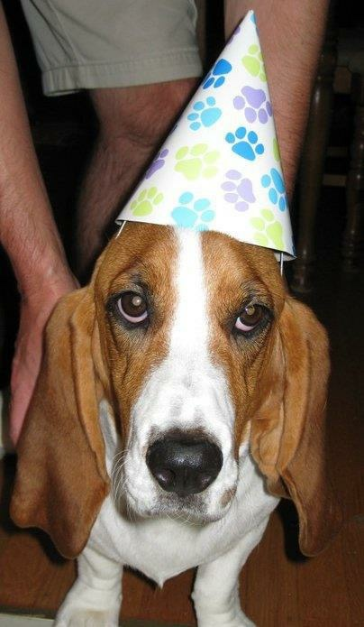
NEW COST SHARE REPORT!
Celebrate!
A new Cost Share report on the B.I. Portal will allow users to extract and view the Cost Share commitments and contributions in eFECS.

Slide 58
COST SHARE COMMITMENTS & CONTRIBUTIONS REPORT
Why the need for this report?
eFECS only displays Cost Share data for a single budget number
Wanted a report that allowed users to look at Cost Share on at a much higher level
No easy way to extract eFECS data on a School, Department, or PI level
No way to view Cost Share data on a large scale by commitment type or sponsor
MRAM – Matt Gardner – PAFC

Slide 59
COST SHARE COMMITMENTS & CONTRIBUTIONS REPORT
New report summarizes Cost Share on all active Sponsored Awards (Status 1, 2, or 3)
The data pulled from eFECS Cost Share Summary system – if it’s in eFECS, it’s in the Report
Data can be filtered by:
Four levels of Org Code
Award PI
Days until Award end date
Single budget number
MRAM – Matt Gardner – PAFC

Slide 60
COST SHARE COMMITMENTS & CONTRIBUTIONS REPORT
Question the new report can help to answer:
How much Cost Share has a specific PI committed to across all of their Awards?
How much Cost Share has the Department committed to across all Awards?
What are the outstanding Cost Share commitments for Awards that expire in the next 90 days? 30 days? Already expired?
How much [FEC, 3rd Party, Equipment, Travel, etc.) has a School/Dept./PI committed to?
MRAM – Matt Gardner – PAFC

Slide 61
COST SHARE COMMITMENTS & CONTRIBUTIONS REPORT
Where to find the report…
Linked on the GCA website
https://finance.uw.edu/gca/Cost_Share_Report
Website also contains information on using the report
On the B.I. Portal
Home 🡪 Financial 🡪 Cost Share Commitments & Contributions
https://edw.washington.edu/Reports/report/Financial/Cost%20Share%20Commitments%20and%20Contributions
MRAM – Matt Gardner – PAFC

Slide 62
COST SHARE COMMITMENTS & CONTRIBUTIONS REPORT

Slide 63
DATA FROM THE REPORT –
COST SHARE COMMITMENTS BY TYPE
*As of 8/15/2019
Commitment Type | Amount | % Share
3rd Party/Subawards | $35,111,851 | 36%
Non-FEC S/W | $19,619,142 | 20%
Faculty Effort | $19,458,081 | 20%
UIDC | $6,887,678 | 7%
Equipment | $5,471,509 | 6%
Services | $4,359,473 | 4%
Tuition | $2,596,210 | 3%
Supplies/Materials | $1,821,573 | 2%
Other (Travel, Stipends, Benefits, etc.) | $3,014,766 | 4%
Total | $98,340,283 | 100%
MRAM – Matt Gardner – PAFC

Slide 64
COST SHARE COMMITMENTS & CONTRIBUTIONS REPORT
Special “Thank you” to UW IT for all of their help the last six months!
Robert McLaughlin, Nina Velkin, Kyle Kingma, Keith Van Eaton, Tracy Fisher, Ed Razon, Mary Friedmar, Matt Portwood
MRAM – Matt Gardner – PAFC

Slide 65
QUESTIONS?
Post Award Fiscal Compliance
Web: https://finance.uw.edu/pafc/
Email: gcafco@uw.edu
Andra Sawyer
andra2@uw.edu
206-685-8902
Matt Gardner
mgard4@uw.edu
206-543-2610
MRAM – Matt Gardner – PAFC

Slide 66
CORE Certificate in Research Administration
MRAM
September, 2019
Laurie Stephan, Office of Research
Amanda Snyder, Office of Sponsored Programs

Slide 67
Purpose and Audience
To provide:
Resources for campus staff to become more knowledgeable about research administration at the UW
Professional development opportunities for staff new to this field
Opportunities for more advanced research administrators to refresh their knowledge while gaining a credential
MRAM – Stephan/Snyder – Office of Research

Slide 68
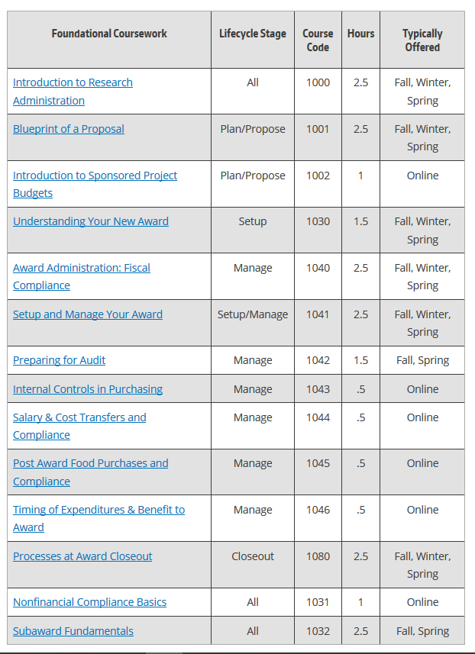
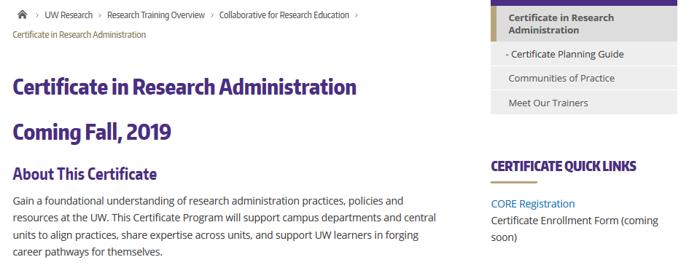
Courses and Hours
22 hours required coursework
11 hours electives
MRAM – Stephan/Snyder – Office of Research

Slide 69
Tracking Learning
MRAM – Stephan/Snyder – Office of Research

Slide 70
Launch Date: 9/25/2019
Questions?
corehelp@uw.edu

Slide 71
UPCOMING COURSES IN
RESEARCH ADMINISTRATION
 | Sep 17 | SAGE: Creating and Submitting eGC1s
 | Sep 24 | Preparing Sponsored Project Budgets Workshop
 | Sep 26 | SAGE Budget
 | Oct 2 | Understanding Your New Award
 | Oct 3 | SAGE: Creating NIH Proposals in Grant Runner
 | Oct 15 | Award Administration: Fiscal Compliance
 | Online | Internal Controls in Purchasing
 | Online | Introduction to Sponsored Project Budgets
 | Online | Post Award Food Purchases and Compliance
 | Online | Salary & Cost Transfers and Compliance
 | Online | Direct Billing of F&A Type Costs
 | Online | Timing of Expenditures & Benefit to Award
To see a full list of courses and to register, visit: https://uwresearch.gosignmeup.com/public/course/browse
For information on CORE, visit our homepage:
https://www.washington.edu/research/training/core//

