Slide 1
COMPLIANCE CORNER
MRAM
September 2019
Matt Gardner
Post Award Fiscal Compliance

Slide 2
NON-FEC COST SHARE CONTRIBUTIONS
Scenario
Non-FEC Cost Share expenditures are tagged on budget 75-xxxx, an RCR budget. One year later, those same expenditures are transferred from 75-xxxx to 61-xxxx, a Sponsored Award. Are there any problem with this action?
Cost Share contributions must be made from non-Sponsored funds (with rare exceptions). Transferring the cost to a Sponsored Award makes the expenditures unallowable as Cost Share.
MRAM – Matt Gardner - PAFC

Slide 3
NON-FEC COST SHARE CONTRIBUTIONS
PAFC periodically reviews all cost transfers involving expenditures previously tagged as Cost Share contributions.
You will receive a communication from PAFC if a transfer moves an expenditure tagged as Cost Share to a Sponsored Award.
If the transfer to a Sponsored Award is correct, then the cost would need to be “un-tagged” as a Cost Share contribution. (Rare exception: prior written approval obtained from both the benefiting and the contributing Award sponsors.)
MRAM – Matt Gardner - PAFC

Slide 4
NON-FEC COST SHARE CONTRIBUTIONS
Tips & Things to Consider
Keep a record of which expenditures were tagged as Cost Share (leverage the non-FEC Cost Share Tagging Report sent to GCA).
Transfers from one non-Sponsored Award to another are allowable (RCR 🡪 Gift Budget, etc.)
If a benefiting budget is closed, do not move expenses tagged as cost share to a Sponsored Award.
MRAM – Matt Gardner - PAFC

Slide 5
NON-FEC COST SHARE CONTRIBUTIONS
More Information
Cost Share Contributions: https://finance.uw.edu/gca/cost-share#Cost_Share_Contributions
Non-FEC Cost Share Tagging https://finance.uw.edu/gca/cost-share/ste-by-step-instructions-non-fec-contributions
GIM 21: Cost Share on Sponsored Programs https://www.washington.edu/research/policies/gim-21-cost-share-on-sponsored-programs/
MRAM – Matt Gardner - PAFC

Slide 6
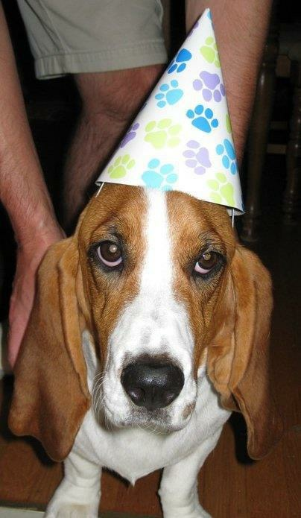
NEW COST SHARE REPORT!
Celebrate!
A new Cost Share report on the B.I. Portal will allow users to extract and view the Cost Share commitments and contributions in eFECS.

Slide 7
COST SHARE COMMITMENTS & CONTRIBUTIONS REPORT
Why the need for this report?
eFECS only displays Cost Share data for a single budget number
Wanted a report that allowed users to look at Cost Share on at a much higher level
No easy way to extract eFECS data on a School, Department, or PI level
No way to view Cost Share data on a large scale by commitment type or sponsor
MRAM – Matt Gardner – PAFC

Slide 8
COST SHARE COMMITMENTS & CONTRIBUTIONS REPORT
New report summarizes Cost Share on all active Sponsored Awards (Status 1, 2, or 3)
The data pulled from eFECS Cost Share Summary system – if it’s in eFECS, it’s in the Report
Data can be filtered by:
Four levels of Org Code
Award PI
Days until Award end date
Single budget number
MRAM – Matt Gardner – PAFC

Slide 9
COST SHARE COMMITMENTS & CONTRIBUTIONS REPORT
Question the new report can help to answer:
How much Cost Share has a specific PI committed to across all of their Awards?
How much Cost Share has the Department committed to across all Awards?
What are the outstanding Cost Share commitments for Awards that expire in the next 90 days? 30 days? Already expired?
How much [FEC, 3rd Party, Equipment, Travel, etc.) has a School/Dept./PI committed to?
MRAM – Matt Gardner – PAFC

Slide 10
COST SHARE COMMITMENTS & CONTRIBUTIONS REPORT
Where to find the report…
Linked on the GCA website
https://finance.uw.edu/gca/Cost_Share_Report
Website also contains information on using the report
On the B.I. Portal
Home 🡪 Financial 🡪 Cost Share Commitments & Contributions
https://edw.washington.edu/Reports/report/Financial/Cost%20Share%20Commitments%20and%20Contributions
MRAM – Matt Gardner – PAFC

Slide 11
COST SHARE COMMITMENTS & CONTRIBUTIONS REPORT

Slide 12
DATA FROM THE REPORT –
COST SHARE COMMITMENTS BY TYPE
*As of 8/15/2019
Commitment Type | Amount | % Share
3rd Party/Subawards | $35,111,851 | 36%
Non-FEC S/W | $19,619,142 | 20%
Faculty Effort | $19,458,081 | 20%
UIDC | $6,887,678 | 7%
Equipment | $5,471,509 | 6%
Services | $4,359,473 | 4%
Tuition | $2,596,210 | 3%
Supplies/Materials | $1,821,573 | 2%
Other (Travel, Stipends, Benefits, etc.) | $3,014,766 | 4%
Total | $98,340,283 | 100%
MRAM – Matt Gardner – PAFC

Slide 13
COST SHARE COMMITMENTS & CONTRIBUTIONS REPORT
Special “Thank you” to UW IT for all of their help the last six months!
Robert McLaughlin, Nina Velkin, Kyle Kingma, Keith Van Eaton, Tracy Fisher, Ed Razon, Mary Friedmar, Matt Portwood
MRAM – Matt Gardner – PAFC

Slide 14
QUESTIONS?
Post Award Fiscal Compliance
Web: https://finance.uw.edu/pafc/
Email: gcafco@uw.edu
Andra Sawyer
andra2@uw.edu
206-685-8902
Matt Gardner
mgard4@uw.edu
206-543-2610
MRAM – Matt Gardner – PAFC

