Slide 1
CORE Certificate in Research Administration
MRAM
September, 2019
Laurie Stephan, Office of Research
Amanda Snyder, Office of Sponsored Programs

Slide 2
Purpose and Audience
To provide:
Resources for campus staff to become more knowledgeable about research administration at the UW
Professional development opportunities for staff new to this field
Opportunities for more advanced research administrators to refresh their knowledge while gaining a credential
MRAM – Stephan/Snyder – Office of Research

Slide 3
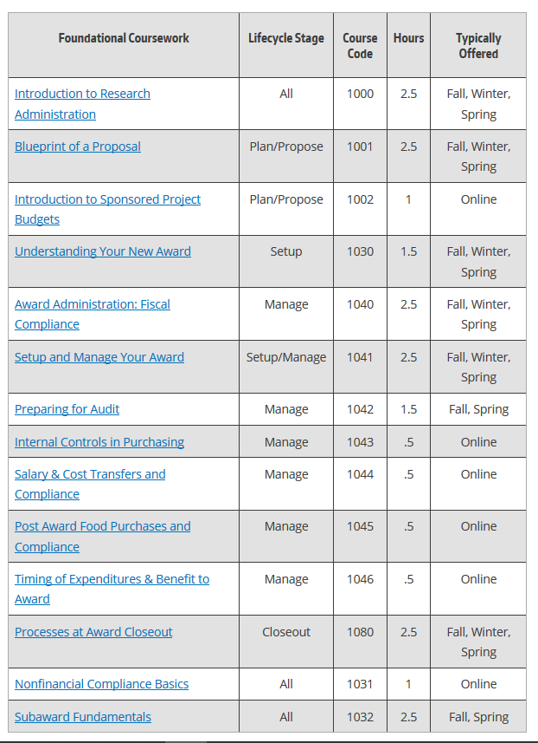
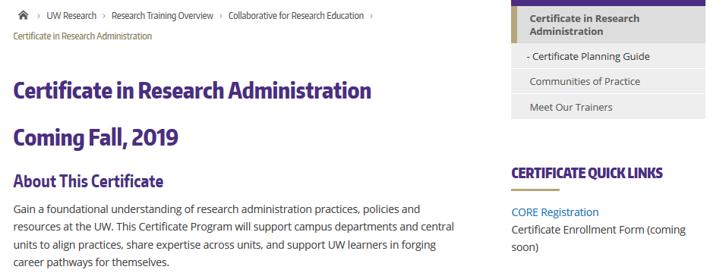
Courses and Hours
22 hours required coursework
11 hours electives
MRAM – Stephan/Snyder – Office of Research

Slide 4
Tracking Learning
MRAM – Stephan/Snyder – Office of Research

Slide 5
Launch Date: 9/25/2019
Questions?
corehelp@uw.edu

Slide 6
UPCOMING COURSES IN
RESEARCH ADMINISTRATION
 | Sep 17 | SAGE: Creating and Submitting eGC1s
 | Sep 24 | Preparing Sponsored Project Budgets Workshop
 | Sep 26 | SAGE Budget
 | Oct 2 | Understanding Your New Award
 | Oct 3 | SAGE: Creating NIH Proposals in Grant Runner
 | Oct 15 | Award Administration: Fiscal Compliance
 | Online | Internal Controls in Purchasing
 | Online | Introduction to Sponsored Project Budgets
 | Online | Post Award Food Purchases and Compliance
 | Online | Salary & Cost Transfers and Compliance
 | Online | Direct Billing of F&A Type Costs
 | Online | Timing of Expenditures & Benefit to Award
To see a full list of courses and to register, visit: https://uwresearch.gosignmeup.com/public/course/browse
For information on CORE, visit our homepage:
https://www.washington.edu/research/training/core//

