Slide 1
MRAM | Monthly Research Administration Meeting
NOVEMBER 14, 2019 9:00 AM – 10:00 AM UW TOWER AUDITORIUM
TOPIC | PRESENTER | EMAIL | MIN
Welcome | Kirsten DeFries Research Compliance & Operations | kirsten5@uw.edu | 2
OSP Contracts Team and Agreement Types | Jesse Kindra Manager, Contracts Team, Office of Sponsored Programs | jkindra@uw.edu | 10
Foreign Influence and Export Controls | Mark Stomski Assistant Vice Provost, Export Controls | stomski@uw.edu | 10
Single IRB Requirements | Karen Moe Director, Human Subjects Division & Asst Vice Provost for Research | kemoe@uw.edu | 15
Progress Reports: Timeliness is Important | Carol Rhodes Director, Office of Sponsored Programs | carhodes@uw.edu | 5
Compliance Corner | Andra Sawyer & Matt Gardner Post Award Fiscal Compliance | gcafco@uw.edu | 10
CORE Update | Laurie Stephan Collaborative On Research Education (CORE) | corehelp@uw.edu | 2
NEXT MEETING DECEMBER 5, 2019 9:00 AM – 10:00 AM UW TOWER AUDITORIUM

Slide 2
Office of Sponsored Programs: Contracts Team
November, 2019 MRAM
Jesse Kindra
Contracts Team Manager
Office of Sponsored Programs

Slide 3
Who? and Why?
Name | Title | Email | Phone
Jesse Kindra | Manager, Contracts Team | jkindra@uw.edu | 206.685.5425
Richard Glover | Senior Contracts Specialist | rglover@uw.edu | 206.543.7581
Autumn Eck | Senior Grant & Contract Administrator | afe@uw.edu | 206.543.4838
Karl Neumann | Senior Grant & Contract Administrator | neumannk@uw.edu | 206.685.7117
Vali Gazula | Senior Grant & Contract Administrator | vrg2@uw.edu | 206.685.7119
Elizabeth Walker-Tilley | Senior Grant & Contract Administrator | ewtilley@uw.edu | 206.616.1343
S. Elaine Eldridge | Grant & Contract Administrator | see4@uw.edu | 206.543.2081
Dahra Latham | Grant & Contract Administrator | dahra@uw.edu | 206.685.0338
Notes:
RA landscape evolving, the UW and our peer institutions are seeing an increase in Non-Award Agreements - reflection of expanding collaborations.
Changes to team structure to focus on these agreements

Slide 4
What does the Contracts Team handle?
Industry Clinical Trials and Clinical Studies
Industry Sponsored Research Agreements
Other Complex Agreements As May Be Assigned
All Non-Award Agreements (NAAs) related to Sponsored Programs:
Affiliation Agreements
Confidentiality / Non-Disclosure Agreements (CDA / NDA)
Data Use / Transfer Agreements (DUA / DTUA)
Master Agreement
Material Transfer Agreements (MTAs)
Memorandum of Understanding (MOUs)
Unfunded Collaborative Research Agreements

Slide 5
Process Improvements underway...
Research Website & UW Approved Templates
CDAs
DUAs
MTAs
https://www.washington.edu/research/myresearch-lifecycle/setup/collaborations/agreement-types/

Slide 6
Sharing Information and Data
Confidentiality / Non-Disclosure Agreements
Process information updated
UW Approved NDA Template published
Using UW Approved templates speeds up OSP review
https://www.washington.edu/research/myresearch-lifecycle/setup/collaborations/sharing-information-and-data/
Notes:
Updates to web guidance provide more direct information on what to do for signature and who to contact
AKA Proprietary Information Agreements (PIA)
CDA/NDAs - Restricts disclosure use of proprietary or protected information

Slide 7
Sharing Information and Data
Data Use / Data Transfer Agreements
DUA process steps online
Need a DUA?
Federal Demonstration Partnership (FDP) Templates
Complete DTUA Face Page, Attachments 1 and 3, relevant attachment 2
Upon receipt of Non-Award Agreement (NAA) eGC1 with complete FDP templates, OSP can review and sign
Using FDP DUA template speeds up OSP process
Have a Data Sharer’s DUA?
Review FDP templates - this is info OSP needs in NAA eGC1
Less predictable timeline
Who reviews a DUA? 1.5min process flow video
Notes:
DUAs: used for transferring collected or developed data (data sets, raw data, personal health info, student info, etc.)

Slide 8
Sharing Materials:
Material Transfer Agreement
OSP and CoMotion handle MTAs
Where do you send an MTA? It depends…
Improved guidance on where to send your MTA
Quick 1.5min MTA flowchart video
https://www.washington.edu/research/myresearch-lifecycle/setup/collaborations/sharing-material/
Notes:
Different criteria, different processes

Slide 9
Non-Award Agreement (NAA) eGC1 Instructions
What to include:
Sponsor contacts name & email/phone
Related eGC1 #
A detailed description of what agreement is trying to accomplish
Editable agreement attached or indicate OSP to issue template
https://washington.edu/research/faq/naa-egc1-instructions/

Slide 10
NAA Approval Process
After eGC1 routed to OSP, reviewer assigned who confirms required info is included.
Once info is confirmed, OSP reviewer:
Reviews & Approves eGC1
eGC1 approval does not imply approval or acceptance of agreement
Creates related Non-Award Agreement admin action (NAA)
Reviews and negotiates agreement
Fully Executed Agreement attached
Approve Non-Award Agreement admin action
https://washington.edu/research/faq/naa-egc1-instructions/
Notes:
Status Checker

Slide 11
Agreement Types Table Updates
Content links to specific process guidance
Confidentiality Agreements
Data Use Agreements
Material Transfer Agreements
References updated
Links and resources
Sponsored Research Agreement
Reorganized columns & format
Header titles updated
Alphabetical
Column flow
https://www.washington.edu/research/myresearch-lifecycle/setup/collaborations/agreement-types/
Notes:
will go over a few examples - check out updates on your own -let ospweb@uw.edu know if you have questions

Slide 12
Agreement Types Table BEFORE
Confidentiality / Non-Disclosure Agreement
What transaction is contemplated? | UW Office Contact Instructions | Agreement Type
Restrict the further disclosure and potential use by a recipient of non-tangible information. These agreements are often presented for signature in order for parties to share information with each other when considering a grantor/grantee relationship. | Does it also relate to an existing sponsored program or specifically intended to result in a sponsored program? Contact OSP, or the investigator may sign strictly in their own capacity. Is the information to be shared a potential UW innovation? Or related to the activities of CoMotion? Contact CoMotion. NOT for research or other sponsored program? Contact your Departmental Chair or department authorized signing authority. | Confidential Disclosure Agreement/ Non-Disclosure Agreement (CDA/NDA) Also can be called a Proprietary Information Agreement (PIA)

Slide 13
Agreement Types Table AFTER
Confidentiality / Non-Disclosure Agreement
Agreement Type | Agreement Purpose | Contact Instructions
Confidential Disclosure Agreement (CDA) Non-Disclosure Agreement (NDA) Proprietary Information Agreement (PIA) | Restrict disclosure & use of proprietary or protected info. | Related to or in anticipation of a sponsored program? Route a Non-award Agreement (NAA) eGC1 with agreement attached. Related to an innovation you have disclosed? Contact CoMotion. Neither? Contact your Dean or Director
https://www.washington.edu/research/myresearch-lifecycle/setup/collaborations/agreement-types/

Slide 14
Contract Team Volumes
Description | 2017 | 2018
CDAs | 400 | 550
DUAs | 125 | 158
MTAs | 31 | 53
Total | 556 | 761

Slide 15
Resources
Agreement Types
Sharing Information & Data
UW Approved NDA Template
FDP Templates
Who reviews a DUA? video
Sharing Materials
MTA Process Flow video
Agreement Considerations
Non-Award Agreement eGC1 Instructions
Questions? Suggestions?
email : jkindra@uw.edu

Slide 16
Export Controls and Foreign Influence

Slide 17
What is generally not subject to export controls?
Public Domain Information
Information that is generally accessible to the public through: periodicals, books, print, or electronic media.
Includes information that is readily available at libraries, in patents, or through an “open” conference.
Academic Catalog Courses

Slide 18
What is excluded from Export Controls?
Fundamental Research Results
Basic and applied research in science or engineering; and
Intention is to publish the research results and there are no restrictions or approvals required on the publishing of the research results; and
No restrictions on the access to the research results (including foreign national restrictions or approvals)

Slide 19
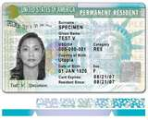
What is an Export?
“’Export’ means an actual shipment or transmission of items … out of the United States, or release of technology or software, … to a foreign national in the United States”
Export Administration Regulations (EAR)
Not Foreign Nationals

Slide 20
Why Export Controls at a University?
Private and government equipment and technology can remain export controlled even in the course of academic education and research
Exports do not have to be shipments of goods
Providing goods, technology, or software to a foreign national in the United States is still considered to be an export – a.k.a. “deemed export”
E-mailing technical data or a software program
Technology has enabled research and education to become increasingly global and “hands-on”
J. Reece Roth
Export Controls does not cover FISMA, Personal Identifiable Information, or Confidential Unclassified Information, or Foreign Influence, but they are related

Slide 21
Foreign Influence
Agreements and arrangements to transfer intellectual property, technology, and know-how to a foreign country, openly or covertly
Comingling of domestic and foreign sources of funding for the same field of study
End-Use of technology
Foreign Talent Recruitment Programs
Defense Services

Slide 22
Foreign Influence & Export Controls
Intellectual Property/Technology Transfer – export
Sending unlicensed technologies to foreign countries
Trade Secrets
Comingling domestic and foreign research funding
Domestic funding may be fundamental research
Foreign funding may not be fundamental research
Some research results not export controlled, some are
End-Use in foreign country
Military/Space/Human Rights Violations
Diversion to a Debarred Party
May Require an Export License

Slide 23
Foreign Influence & Export Controls
Foreign Talent Recruitment Programs
Motivation
Free technology advancements and time savings
Leap Frog – Use American knowledge to create own more advanced technologies that can be used against the United States
“Sea Turtle” effect
Elements (one or all)
Compensation
Recruitment to prestigious events/sites
Temporary relocation to foreign site
Defense Services
Military applications
Space applications
Sample Names of Foreign Talent Recruitment Programs
100 Talents Program
1,000 Talents Program
111 Plan
555 Program
National Experts Contribution Program
National Science Fund for Outstanding Scholars
New Century Project
Provincial Extraordinary Experts
Yellow Crane Talent Plan
Shenzhen Peacock Plan
Changjiang Scholars Program

Slide 24
Defense Service
The only export that can be done with public domain information, courses, or fundamental research results
Furnishing assistance (including training) on defense articles to foreign persons
Includes design, development, engineering, manufacture, production, assembly, testing, repair, maintenance, modification, operation, demilitarization, destruction, processing or use of defense articles
Training of foreign units/forces, including through the use of educational or informational publications
What does this mean?
Any activity with a foreign government’s military or space programs should be brought to the Office of Research’s attention

Slide 25
What to be on the look out for?
Foreign Intent – Technology Transfer
Are all the participants identified? Obscure references to other parties should be flagged for review
Goals/objectives should be clear
Trial periods not consistent with normal agreements
Researchers to live or work for significant amounts of time at a sponsor’s location
Benefit/Risk to University
Agreements where the University has no benefit should be reviewed
Foreign funding for the same research funded by US government
Defense Services
Military applications
Space applications
When in doubt, forward to Robert Conley or Mark Stomski for review

Slide 26
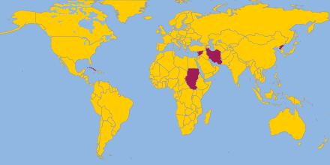
Sanctions and Embargoes
Office of Foreign Assets Controls (OFAC)
CUBA
IRAN
NORTH KOREA
SUDAN
SYRIA
Belarus
Cote d’Ivoire (Ivory Coast)
Congo
Liberia
Lebanon
Libya
Somalia
Zimbabwe

Slide 27
Questions?
Mark Stomski: 206-616-8741
stomski@uw.edu

Slide 28
MRAM Meeting November 14, 2019
Karen Moe, Human Subjects Division

Slide 29
Single IRB One IRB reviews all domestic institutions in a study

Slide 31
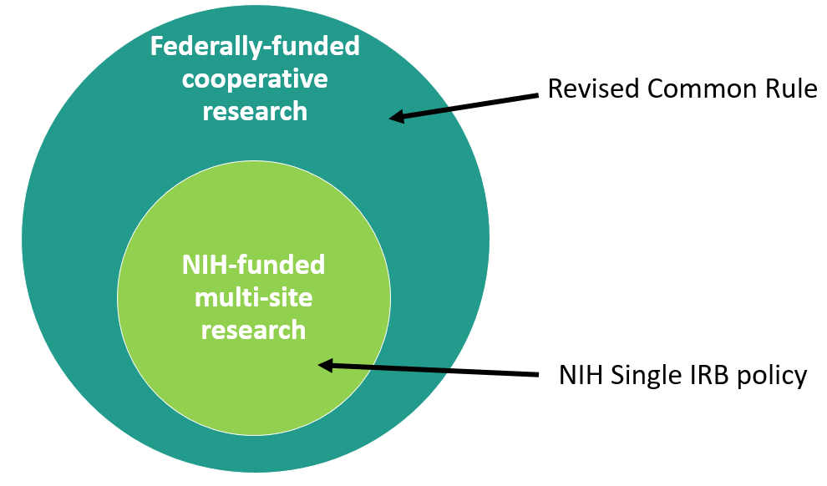
Many more studies will now be affected by this new model of IRB review

Slide 32
NIH sIRB
Common Rule sIRB
Only NIH-funded
Only multi-site [each site is doing the same thing; not collaborations]
New requirement for grant applications (sIRB plan)
Lots of guidance from NIH
Ongoing studies: NIH requires transition to sIRB with competitive renewal
All federal funding (except DOJ)
Multi-site or collaborative
No known grant requirements from other federal agencies
No guidance from other federal agencies
Unclear how ongoing studies are affected

Slide 33
What this means
HSD

Slide 34
Beginning January 20, 2020
HSD will assess each new application for the need to comply with this new Common Rule requirement.
If yes, we will work closely with the PI to implement it in the most efficient way possible.

Slide 35
When will the UW IRB be the Single IRB?
In general, the UW IRB is willing to be the sIRB when the UW is the primary awardee and/or the lead PI for the overall study.
Exceptions
Federal agency requires a different IRB
PI prefers another IRB (if acceptable to HSD)
Existing coop agreement requires a different IRB (e.g., use of Hutch IRB)
(rare) UW IRB doesn’t have the capacity for the specific study (very large; lack of IRB expertise)

Slide 36
What PIs should do
Knowledge | Types of studies affected by new requirement HSD eNews; HSD Single IRB webpages New responsibilities of lead study PI/team How to obtain help hsdrely@uw.edu
Grant application | Consult HSD before saying UW is the single IRB Identify any budget implications (IRB fees; additional staffing). HSD can help with this.
Study start-up | Different type of IRB application process (overall study, and then the sites)

Slide 37
What Administrators should do
Knowledge | Types of studies affected by new requirement HSD eNews; HSD Single IRB webpages New responsibilities of lead study PI/team How to obtain help hsdrely@uw.edu
Inform PIs | About what they need to know
Grant application | IDEAL Assess it: Single IRB required or mentioned? If yes: Staffing and budget impact? If UW IRB: Has HSD been consulted first?

Slide 38
What about those IRB fees?
Reviewing for other sites involves additional costs
HSD staff time and UW IRB time
Can be significant (e.g., a few hundred hours for a HSD staff person)
Not covered by indirect costs to UW
NIH allows IRBs to recover these extra costs by charging a fee
https://grants.nih.gov/grants/guide/notice-files/NOT-OD-16-109.html
https://osp.od.nih.gov/clinical-research/nih-policy-on-the-use-of-a-single-irb-for-multi-site-research-faqs-on-costs/

Slide 39
HSD will charge a fee for some Single IRB studies
Which studies will be charged
Where the cost is significant. We are not going to try to recover every extra dollar of cost. We will absorb as much as we can.
How much
The fee will be a small %FTE for a specific period of time. We are still determining actual costs so that we can create a fee sheet based on type of study and number of sites. There will be faculty consultation as part of this process.
Why not an actual fee instead of FTE
The extra cost is personnel time, so FTE is appropriate. FTE is easier for everyone administratively (vs. invoicing & cost centers).

Slide 40
HSD will charge a fee for some Single IRB studies
When will this start?
Probably in 5-6 months, for new grants being submitted.
What is the faculty consultation process?
HSD is seeking discussions with:
Established faculty leadership groups e.g., Faculty Council on Research
Faculty groups/depts likely to have many Single IRB studies
Any faculty member who wants to be involved

Slide 41
The take-aways
A new federal requirement
Requires additional planning by PIs
May affect research costs
Consult HSD

Slide 42
Progress Reports
Timeliness is Important!
Carol Rhodes
Director, Office of Sponsored Programs
November 2019 MRAM

Slide 43
Progress Reports and Federal Sponsors
Submission is required no less than annually.
Can be more often - check award terms
PI & collaborators responsible for preparing content
PI submits directly in sponsor’s research administration system e.g. eRA Commons, Research.gov - Exceptions:
Award terms and conditions dictate another method
NIH non-SNAP eligible awards route through OSP

Slide 44
Recent Concern Communicated from NSF
NSF expressed concern over volume of the UW’s
late reports.
NSF Chief Financial Officer in Finance and Award Management Division provided a list of delinquent progress reports:
89 late annual reports
25 late final reports

Slide 45
Special Reminder & Possible Escalation
For these delinquent NSF reports OSP will send a reminder to PI with a cc to dept. contact on eGC1:
NSF requires submission within 90 days prior to the next budget period
Requirement of award
NSF may sanction PI (and Co-PIs) if submissions are not timely:
Inability for PI to obtain additional NSF funding
Inability to receive NSF approval on any affected award OR associated awards
If not resolved by 11.30.19, OSP will apply escalation path in
GIM 39 (typically for late final reports) to late annual reports
Notes:
Remember: NSF often awards multi-year awards upfront; incremental funding is NOT contingent on submission of report
PI should have already received notices from NSF

Slide 46
Resources
NSF report submission instructions
Research.gov
Manage Reporting
Closeout Reporting
GIM 39: Closeout of Sponsored Programs

Slide 47
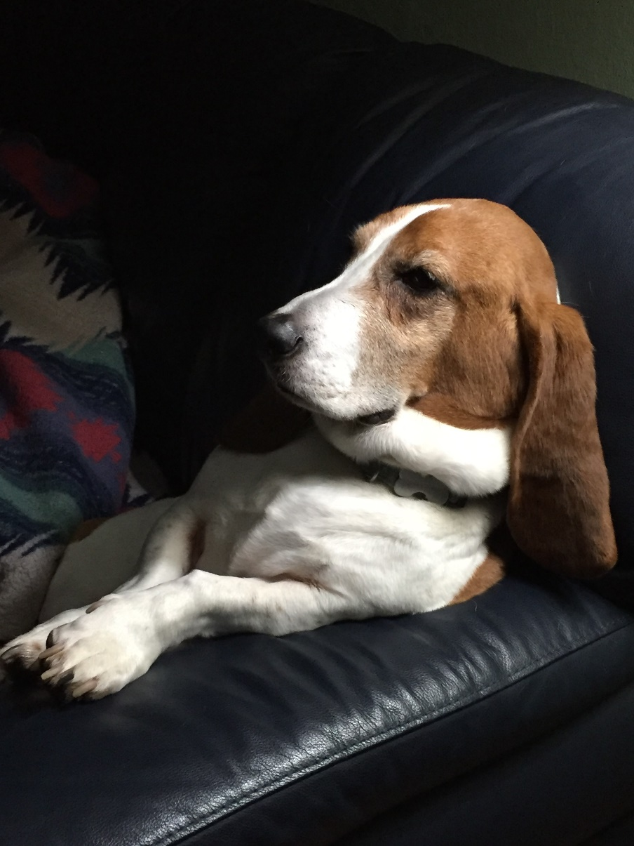
Compliance Corner
Post Award Fiscal Compliance
Andra Sawyer
Matt Gardner
gcafco@uw.edu

Slide 48
Data! Tools!
Manage Awards & Stay out of Trouble
Data Analytics Dashboard
Review high risk transactions (before the auditors)
PAFC web has link & supporting information
https://finance.uw.edu/pafc/data-analytics
Cost Share Report
GCA web has link & supporting information
https://finance.uw.edu/gca/Cost_Share_Report
No longer on the MAA webpage

Slide 49
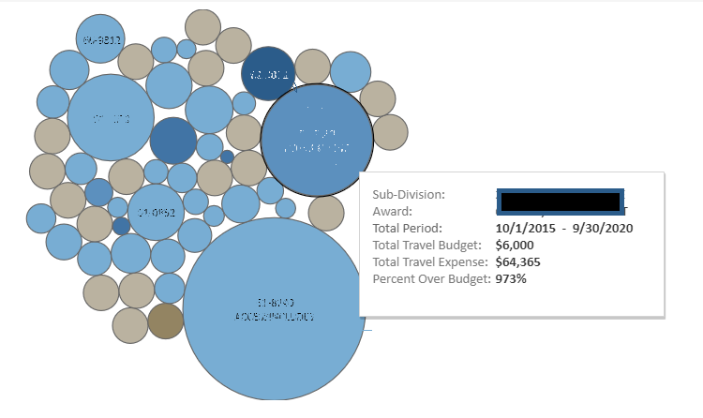
Travel: Expenses > Budget
Bubble Size: Difference between Budget and Expenditure Amount
Bubble Color: Amount of Travel Expenses

Slide 50
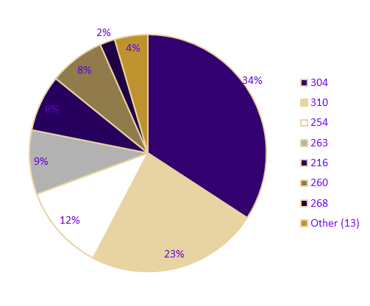
International Airfare on Federal Awards
Fly America Act
Last 12 months:
Total Expenses: $2.9m
Total Transactions: 2,323
Schools/Colleges: 22
Award PI’s: 432
Coding Errors: ??

Slide 51
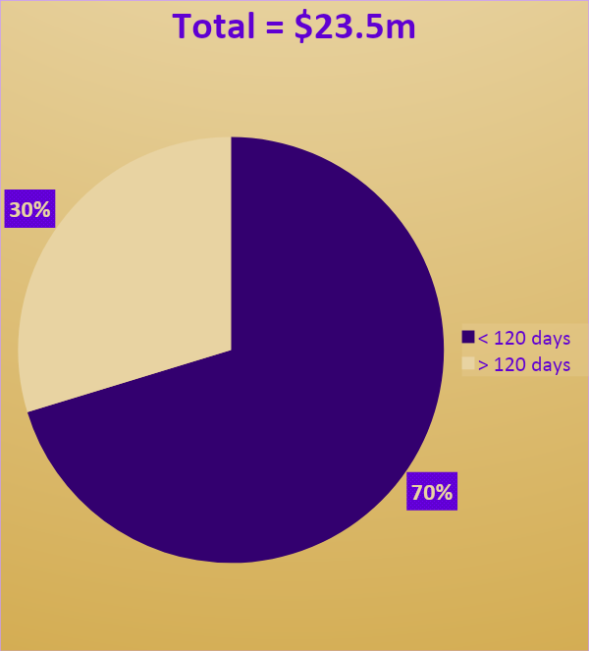
Cost Transfers on Sponsored Awards
Last 12 Months:
Total Transactions:
21,823

Slide 52
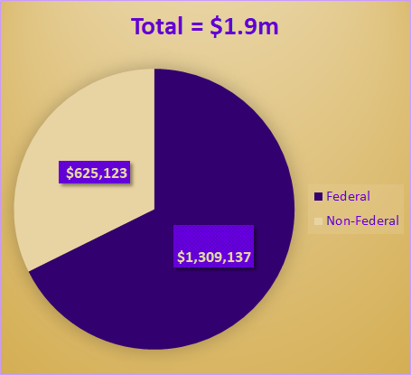
Food Purchases on Sponsored Awards
All Food purchases require Sponsor approval
In last 12 months:
Total Transactions: 7,048
Total Value: $1.9m

Slide 53
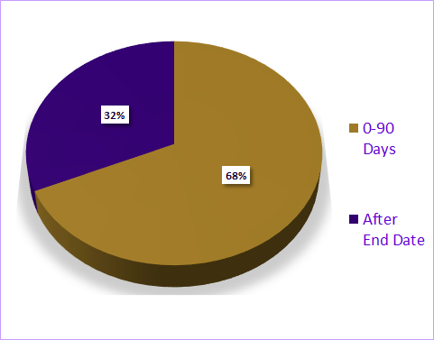
Equipment Purchased in the Last 90 Days of an Award
Over the last 12 months:
123 transactions occurring in the last 90 days of an Award
$923,858
39 transactions after the Award end date
$715,229

Slide 54
Tuition Paid on Sponsored Awards
Tuition Dashboard identifies tuition transactions on Awards:
>Which are not identified as “Training” in the UW financial system, and
>In which there are no expenditures in object code 01-40 (Graduate Student Appointments)
Over the last 12 months:
>Federal Awards: 266 transactions ($633,244)
>Non-Federal: 122 transactions ($197,862)

Slide 55
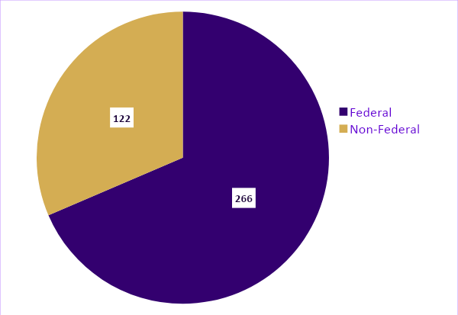
Tuition Dashboard Data
Award Type | Trans. | Amount
Federal | 266 | $633,244
Non-Federal | 122 | $197,862

Slide 56
Cost Share by Commitment Type
Commitment Type | Amount | % Share
3rd Party / Subawards | $47,885,764 | 44%
Salaries & Wages (FEC and non-FEC) | $40,680,672 | 37%
Non-Salaries & Wages (Supplies, Equipment, etc.) | $10,398,813 | 10%
Tuition and Stipends | $2,986,589 | 3%
Unrecovered Indirect Costs (UIDC) | $602,280 | 6%
Total | $108,654,118 | 100%

Slide 57
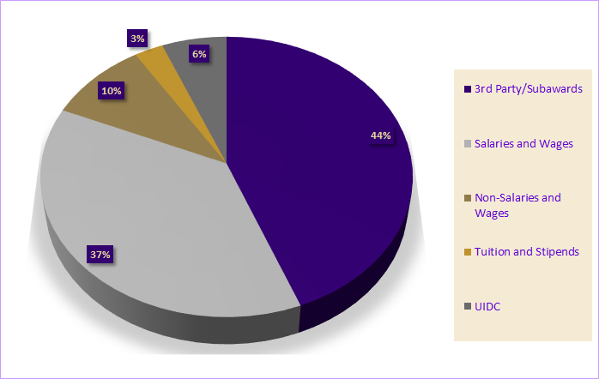
Cost Share by Commitment Type

Slide 58
Cost Share Commitments:
Federal vs. Non-Federal
Commitment Type | Federal | Non-Federal
3rd Party / Subawards | $41,027,707 | $6,858,057
Salaries & Wages | $33,137,181 | $7,543,491
Non-Salaries & Wages | $5,101,840 | $5,296,973
UIDC | $6,212,965 | $803,137
Tuition and Stipends | $2,183,452 | $489,315
Total | $87,663,145 | $20,990,973

Slide 59
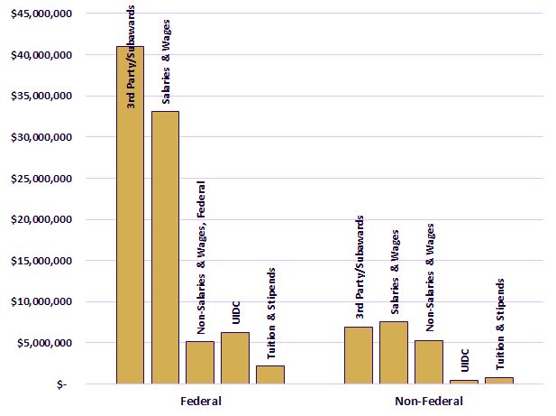
Cost Share Commitments:
Federal vs. Non-Federal

Slide 60
Questions?
Post Award Fiscal Compliance
Web: https://finance.uw.edu/pafc/
Email: gcafco@uw.edu
Andra Sawyer
andra2@uw.edu
206-685-8902
Matt Gardner
mgard4@uw.edu
206-543-2610

Slide 61
UPDATES
Certificate Enrollment at 136. Several enrollees are very close to done. Recognition event September 2020.
Enrollment very high this quarter. Thank you to everyone who cancelled their registration ahead of time to make space available for those on the waitlist
 | Nov 21 | Understanding Cost Share at the UW: When is it really cost share?
 | Dec 3 | Managing Cost Share at the UW
 | Dec 10 | Managing NRSA Training Grants at the UW
 | Online | Internal Controls in Purchasing
 | Online | Introduction to Sponsored Project Budgets
 | Online | Post Award Food Purchases and Compliance
 | Online | Salary & Cost Transfers and Compliance
 | Online | Direct Billing of F&A Type Costs
 | Online | Timing of Expenditures & Benefit to Award
Certificate in Research Administration Required Courses Winter 2020 Schedule
Jan 9 | Introduction to Research Administration
Jan 16 | Blueprint of a Proposal
Jan 22 | Understanding Your New Award
Jan 28 | Award Administration: Fiscal Compliance
Feb 4 | Set up and Manage Your Award
Feb 12 | Preparing for Audit
Feb 20 | Processes at Award Closeout
CORE homepage:
https://www.washington.edu/research/training/core//
Full list of courses and registration: https://uwresearch.gosignmeup.com/public/course/browse

Slide 62
UPDATES
 | Nov 21 | Understanding Cost Share at the UW: When is it really cost share?
 | Dec 3 | Managing Cost Share at the UW
 | Dec 10 | Managing NRSA Training Grants at the UW
 | Online | Internal Controls in Purchasing
 | Online | Introduction to Sponsored Project Budgets
 | Online | Post Award Food Purchases and Compliance
 | Online | Salary & Cost Transfers and Compliance
 | Online | Direct Billing of F&A Type Costs
 | Online | Timing of Expenditures & Benefit to Award
CORE homepage:
https://www.washington.edu/research/training/core//
Full list of courses and registration: https://uwresearch.gosignmeup.com/public/course/browse

