Slide 1
Export Controls and Foreign Influence

Slide 2
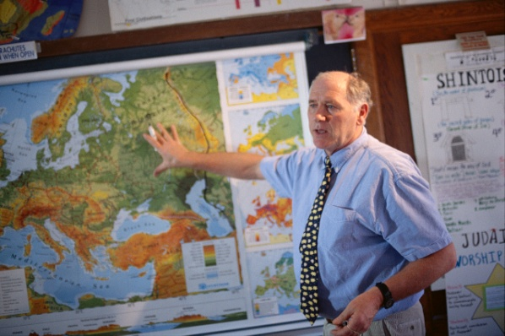
What is generally not subject to export controls?
Public Domain Information
Information that is generally accessible to the public through: periodicals, books, print, or electronic media.
Includes information that is readily available at libraries, in patents, or through an “open” conference.
Academic Catalog Courses

Slide 3
What is excluded from Export Controls?
Fundamental Research Results
Basic and applied research in science or engineering; and
Intention is to publish the research results and there are no restrictions or approvals required on the publishing of the research results; and
No restrictions on the access to the research results (including foreign national restrictions or approvals)

Slide 4
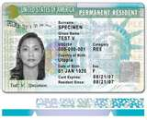
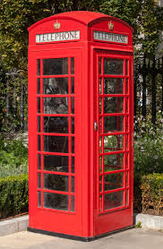
What is an Export?
“’Export’ means an actual shipment or transmission of items … out of the United States, or release of technology or software, … to a foreign national in the United States”
Export Administration Regulations (EAR)
Not Foreign Nationals

Slide 5
Why Export Controls at a University?
Private and government equipment and technology can remain export controlled even in the course of academic education and research
Exports do not have to be shipments of goods
Providing goods, technology, or software to a foreign national in the United States is still considered to be an export – a.k.a. “deemed export”
E-mailing technical data or a software program
Technology has enabled research and education to become increasingly global and “hands-on”
J. Reece Roth
Export Controls does not cover FISMA, Personal Identifiable Information, or Confidential Unclassified Information, or Foreign Influence, but they are related

Slide 6
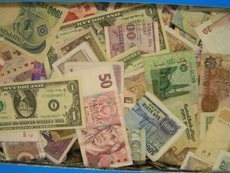
Foreign Influence
Agreements and arrangements to transfer intellectual property, technology, and know-how to a foreign country, openly or covertly
Comingling of domestic and foreign sources of funding for the same field of study
End-Use of technology
Foreign Talent Recruitment Programs
Defense Services

Slide 7
Foreign Influence & Export Controls
Intellectual Property/Technology Transfer – export
Sending unlicensed technologies to foreign countries
Trade Secrets
Comingling domestic and foreign research funding
Domestic funding may be fundamental research
Foreign funding may not be fundamental research
Some research results not export controlled, some are
End-Use in foreign country
Military/Space/Human Rights Violations
Diversion to a Debarred Party
May Require an Export License
Slide ‹#›

Slide 8
Foreign Influence & Export Controls
Foreign Talent Recruitment Programs
Motivation
Free technology advancements and time savings
Leap Frog – Use American knowledge to create own more advanced technologies that can be used against the United States
“Sea Turtle” effect
Elements (one or all)
Compensation
Recruitment to prestigious events/sites
Temporary relocation to foreign site
Defense Services
Military applications
Space applications
Sample Names of Foreign Talent Recruitment Programs
100 Talents Program
1,000 Talents Program
111 Plan
555 Program
National Experts Contribution Program
National Science Fund for Outstanding Scholars
New Century Project
Provincial Extraordinary Experts
Yellow Crane Talent Plan
Shenzhen Peacock Plan
Changjiang Scholars Program

Slide 9
Defense Service
The only export that can be done with public domain information, courses, or fundamental research results
Furnishing assistance (including training) on defense articles to foreign persons
Includes design, development, engineering, manufacture, production, assembly, testing, repair, maintenance, modification, operation, demilitarization, destruction, processing or use of defense articles
Training of foreign units/forces, including through the use of educational or informational publications
What does this mean?
Any activity with a foreign government’s military or space programs should be brought to the Office of Research’s attention

Slide 10
What to be on the look out for?
Foreign Intent – Technology Transfer
Are all the participants identified? Obscure references to other parties should be flagged for review
Goals/objectives should be clear
Trial periods not consistent with normal agreements
Researchers to live or work for significant amounts of time at a sponsor’s location
Benefit/Risk to University
Agreements where the University has no benefit should be reviewed
Foreign funding for the same research funded by US government
Defense Services
Military applications
Space applications
When in doubt, forward to Robert Conley or Mark Stomski for review

Slide 11
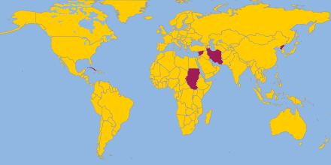
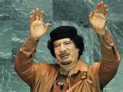
Sanctions and Embargoes
Office of Foreign Assets Controls (OFAC)
CUBA
IRAN
NORTH KOREA
SUDAN
SYRIA
Belarus
Cote d’Ivoire (Ivory Coast)
Congo
Liberia
Lebanon
Libya
Somalia
Zimbabwe

Slide 12
Questions?
Mark Stomski: 206-616-8741
stomski@uw.edu

