Slide 1
MRAM Meeting November 14, 2019
Karen Moe, Human Subjects Division

Slide 2
Single IRB One IRB reviews all domestic institutions in a study

Slide 3
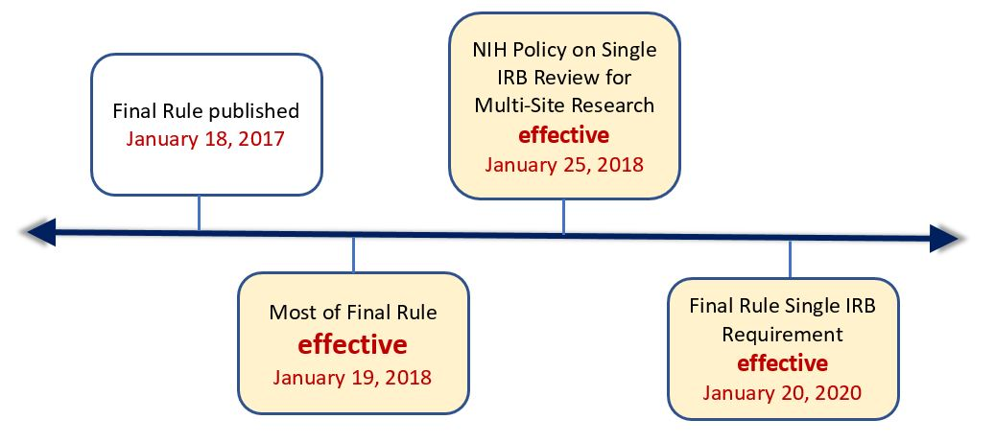

Slide 4
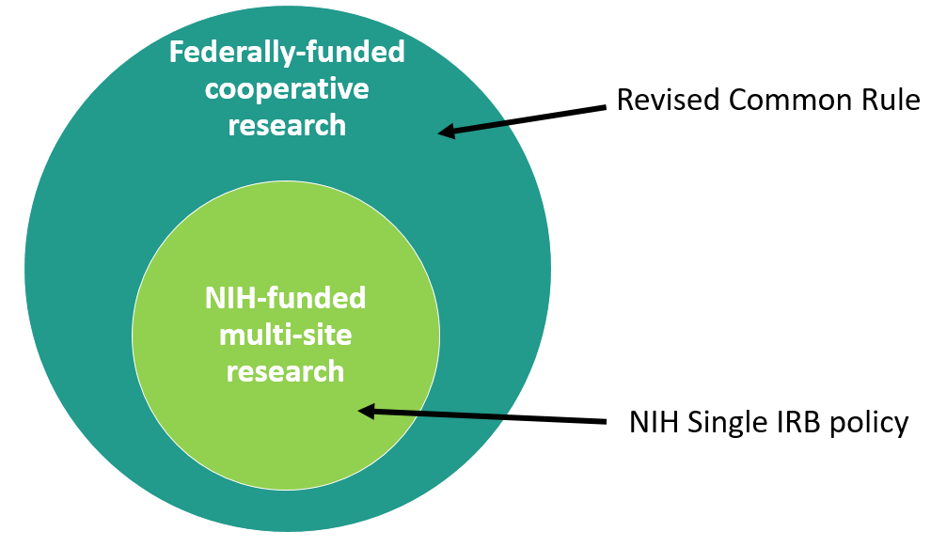
Many more studies will now be affected by this new model of IRB review

Slide 5
NIH sIRB
Common Rule sIRB
Only NIH-funded
Only multi-site [each site is doing the same thing; not collaborations]
New requirement for grant applications (sIRB plan)
Lots of guidance from NIH
Ongoing studies: NIH requires transition to sIRB with competitive renewal
All federal funding (except DOJ)
Multi-site or collaborative
No known grant requirements from other federal agencies
No guidance from other federal agencies
Unclear how ongoing studies are affected

Slide 6
What this means
HSD

Slide 7
Beginning January 20, 2020
HSD will assess each new application for the need to comply with this new Common Rule requirement.
If yes, we will work closely with the PI to implement it in the most efficient way possible.

Slide 8
When will the UW IRB be the Single IRB?
In general, the UW IRB is willing to be the sIRB when the UW is the primary awardee and/or the lead PI for the overall study.
Exceptions
Federal agency requires a different IRB
PI prefers another IRB (if acceptable to HSD)
Existing coop agreement requires a different IRB (e.g., use of Hutch IRB)
(rare) UW IRB doesn’t have the capacity for the specific study (very large; lack of IRB expertise)

Slide 9
What PIs should do
Knowledge | Types of studies affected by new requirement HSD eNews; HSD Single IRB webpages New responsibilities of lead study PI/team How to obtain help hsdrely@uw.edu
Grant application | Consult HSD before saying UW is the single IRB Identify any budget implications (IRB fees; additional staffing). HSD can help with this.
Study start-up | Different type of IRB application process (overall study, and then the sites)

Slide 10
What Administrators should do
Knowledge | Types of studies affected by new requirement HSD eNews; HSD Single IRB webpages New responsibilities of lead study PI/team How to obtain help hsdrely@uw.edu
Inform PIs | About what they need to know
Grant application | IDEAL Assess it: Single IRB required or mentioned? If yes: Staffing and budget impact? If UW IRB: Has HSD been consulted first?

Slide 11
What about those IRB fees?
Reviewing for other sites involves additional costs
HSD staff time and UW IRB time
Can be significant (e.g., a few hundred hours for a HSD staff person)
Not covered by indirect costs to UW
NIH allows IRBs to recover these extra costs by charging a fee
https://grants.nih.gov/grants/guide/notice-files/NOT-OD-16-109.html
https://osp.od.nih.gov/clinical-research/nih-policy-on-the-use-of-a-single-irb-for-multi-site-research-faqs-on-costs/

Slide 12
HSD will charge a fee for some Single IRB studies
Which studies will be charged
Where the cost is significant. We are not going to try to recover every extra dollar of cost. We will absorb as much as we can.
How much
The fee will be a small %FTE for a specific period of time. We are still determining actual costs so that we can create a fee sheet based on type of study and number of sites. There will be faculty consultation as part of this process.
Why not an actual fee instead of FTE
The extra cost is personnel time, so FTE is appropriate. FTE is easier for everyone administratively (vs. invoicing & cost centers).

Slide 13
HSD will charge a fee for some Single IRB studies
When will this start?
Probably in 5-6 months, for new grants being submitted.
What is the faculty consultation process?
HSD is seeking discussions with:
Established faculty leadership groups e.g., Faculty Council on Research
Faculty groups/depts likely to have many Single IRB studies
Any faculty member who wants to be involved

Slide 14
The take-aways
A new federal requirement
Requires additional planning by PIs
May affect research costs
Consult HSD

