Slide 1
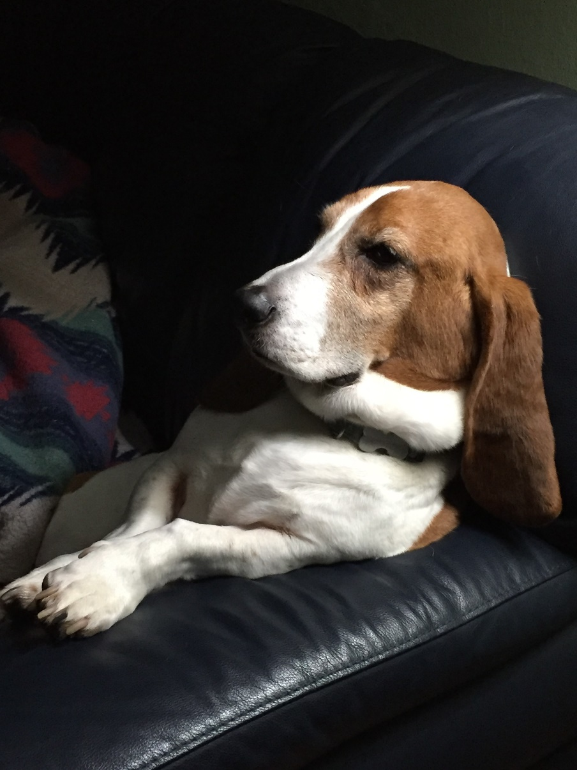
Compliance Corner
Post Award Fiscal Compliance
Andra Sawyer
Matt Gardner
gcafco@uw.edu

Slide 2
Data! Tools!
Manage Awards & Stay out of Trouble
Data Analytics Dashboard
Review high risk transactions (before the auditors)
PAFC web has link & supporting information
https://finance.uw.edu/pafc/data-analytics
Cost Share Report
GCA web has link & supporting information
https://finance.uw.edu/gca/Cost_Share_Report
No longer on the MAA webpage

Slide 3
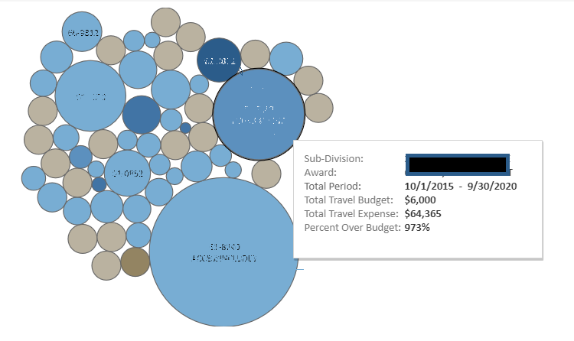
Travel: Expenses > Budget
Bubble Size: Difference between Budget and Expenditure Amount
Bubble Color: Amount of Travel Expenses

Slide 4
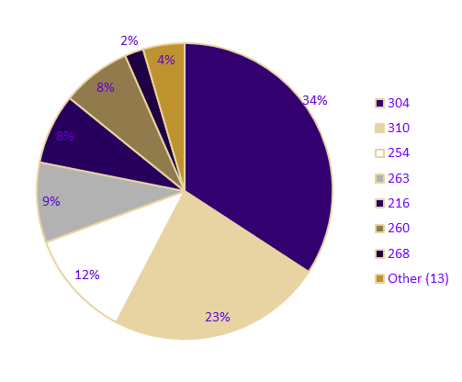
International Airfare on Federal Awards
Fly America Act
Last 12 months:
Total Expenses: $2.9m
Total Transactions: 2,323
Schools/Colleges: 22
Award PI’s: 432
Coding Errors: ??

Slide 5
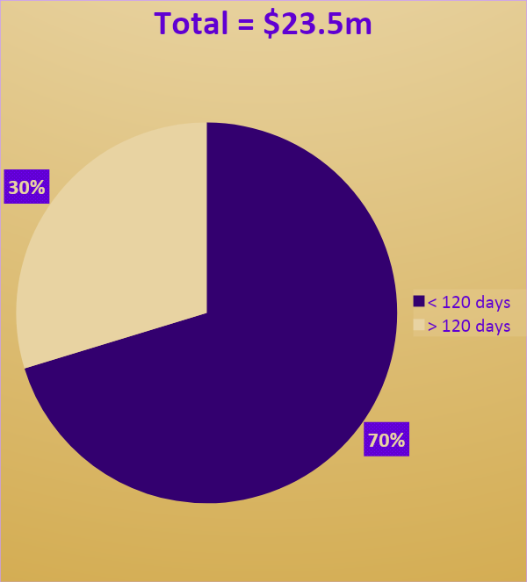
Cost Transfers on Sponsored Awards
Last 12 Months:
Total Transactions:
21,823

Slide 6
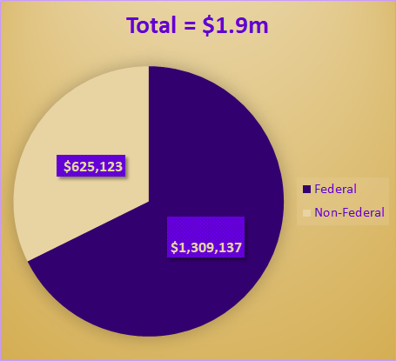
Food Purchases on Sponsored Awards
All Food purchases require Sponsor approval
In last 12 months:
Total Transactions: 7,048
Total Value: $1.9m

Slide 7
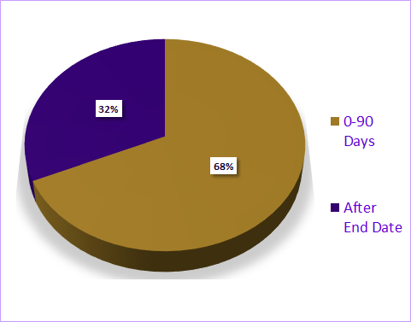
Equipment Purchased in the Last 90 Days of an Award
Over the last 12 months:
123 transactions occurring in the last 90 days of an Award
$923,858
39 transactions after the Award end date
$715,229

Slide 8
Tuition Paid on Sponsored Awards
Tuition Dashboard identifies tuition transactions on Awards:
>Which are not identified as “Training” in the UW financial system, and
>In which there are no expenditures in object code 01-40 (Graduate Student Appointments)
Over the last 12 months:
>Federal Awards: 266 transactions ($633,244)
>Non-Federal: 122 transactions ($197,862)

Slide 9
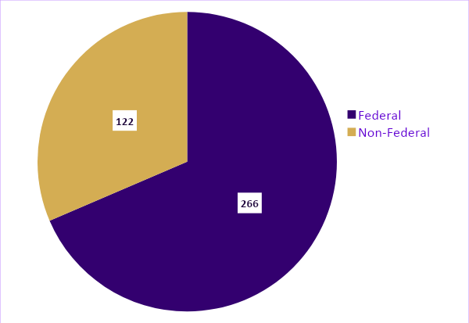
Tuition Dashboard Data
Award Type | Trans. | Amount
Federal | 266 | $633,244
Non-Federal | 122 | $197,862

Slide 10
Cost Share by Commitment Type
Commitment Type | Amount | % Share
3rd Party / Subawards | $47,885,764 | 44%
Salaries & Wages (FEC and non-FEC) | $40,680,672 | 37%
Non-Salaries & Wages (Supplies, Equipment, etc.) | $10,398,813 | 10%
Tuition and Stipends | $2,986,589 | 3%
Unrecovered Indirect Costs (UIDC) | $602,280 | 6%
Total | $108,654,118 | 100%

Slide 11
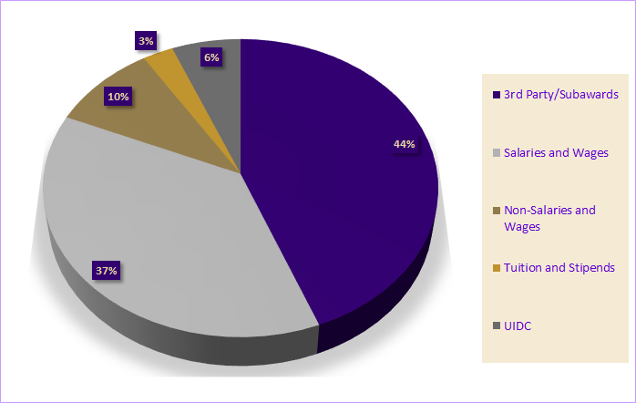
Cost Share by Commitment Type

Slide 12
Cost Share Commitments:
Federal vs. Non-Federal
Commitment Type | Federal | Non-Federal
3rd Party / Subawards | $41,027,707 | $6,858,057
Salaries & Wages | $33,137,181 | $7,543,491
Non-Salaries & Wages | $5,101,840 | $5,296,973
UIDC | $6,212,965 | $803,137
Tuition and Stipends | $2,183,452 | $489,315
Total | $87,663,145 | $20,990,973

Slide 13
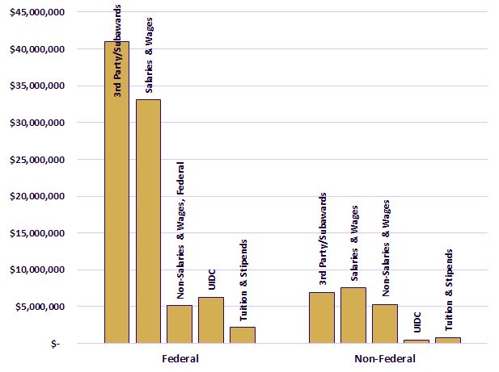
Cost Share Commitments:
Federal vs. Non-Federal

Slide 14
Questions?
Post Award Fiscal Compliance
Web: https://finance.uw.edu/pafc/
Email: gcafco@uw.edu
Andra Sawyer
andra2@uw.edu
206-685-8902
Matt Gardner
mgard4@uw.edu
206-543-2610

