Slide 1
MRAM | Monthly Research Administration Meeting
January 9, 2020 9:00 AM – 10:00 AM UW TOWER AUDITORIUM
TOPIC | PRESENTER | EMAIL | MIN
Welcome | Kirsten DeFries Research Compliance & Operations | kirsten5@uw.edu | 2
Lab Safety Program Updates | Katia Harb Environmental Health & Safety | kharb@uw.edu | 10
Human Subjects Division & eSignatures | Karen Moe Director & Assistant Vice Provost for Research Human Subjects Division | kemoe@uw.edu | 5
Sexual Harassment: Reporting | Joe Giffels Associate Vice Provost for Research Administration and Integrity | jgiffels@uw.edu | 10
Compliance Corner | Andra Sawyer Post Award Fiscal Compliance | gcafco@uw.edu | 10
CORE Update | Laurie Stephan Collaborative On Research Education (CORE) | corehelp@uw.edu | 2
NEXT MEETING February 13, 2020 9:00 AM - 10:00 AM UW TOWER AUDITORIUM

Slide 2
EH&S UPDATE
LAB SAFETY PROGRAM
Katia Harb, Senior Director, Environmental Health & Safety
MRAM
January 9, 2020
kharb@uw.edu, 206.616.4146

Slide 3
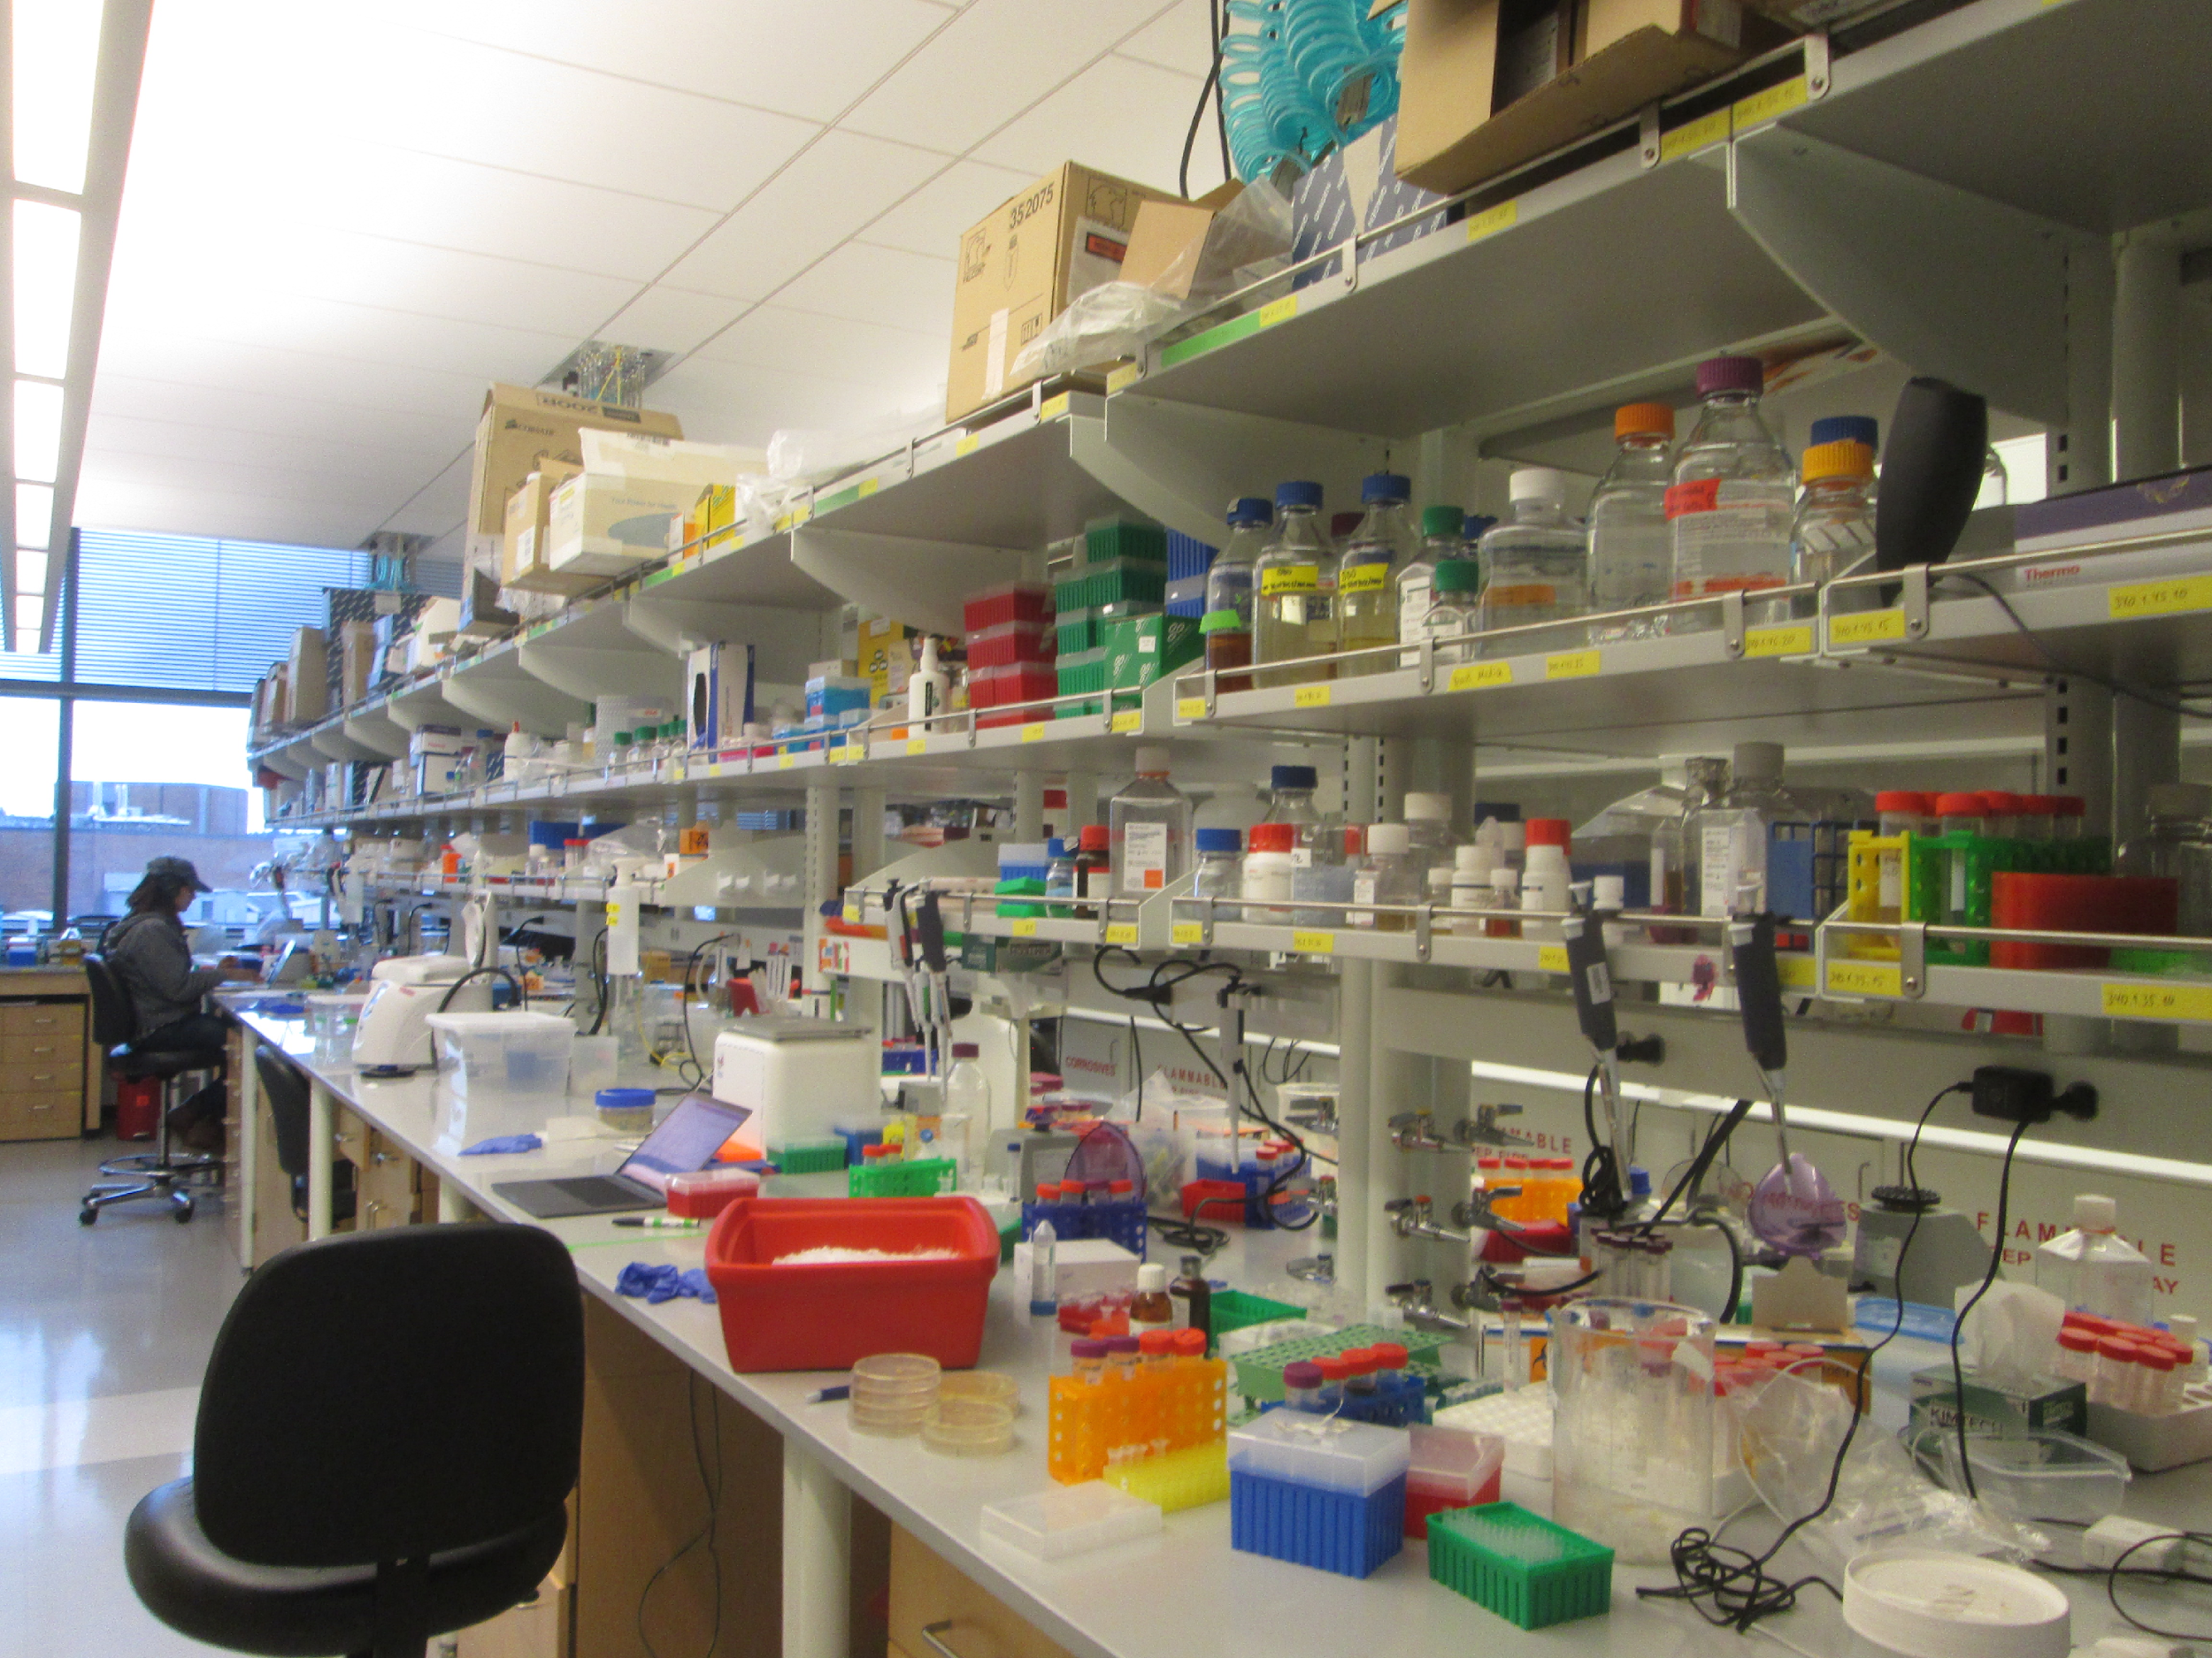
LABORATORY SAFETY SURVEY PROGRAM
Approximately 950 Investigator groups
Over 4,400 laboratory spaces
60% Investigators have biological use authorization
12% have radiological use authorization
Each lab surveyed every 14 months
Laboratory safety initiative pilot project 2016-2018
Notes:
Two new research buildings opened in 2018 (include ~48,000 sq. ft of lab space)
Buildings included 39 new fume hoods and 81 new biological safety cabinets
Amount of research spaces included in 2018 survey visits increased by ~25,000 sq. ft.
Surveys currently cover 1.5 million sq. ft of research spaces
Number of PIs with RUA
110 PIs, which includes clinical, oncology, gamma knife, sealed source, sea vessel, broad, etc
235 if you include human subjects RUAs
Number of spaces with RUAs: 317. You can use the new RAM Labs Grouped by Building report that I wrote for the DFP to find this number in the future.
Annually is kind of a hard number to quantify because people are continuously coming and going throughout the year. I can tell you that as of 6/30/2019 (the last complete quarter that we have data for), we had 1914 unique dose participants who are not area monitors, or spares.
Last year, we trained 76 people in our regular Radiation Safety Training. 13 people in the sealed source training, 6 people in the shipping radioactive materials training. For nurse and other hospital trainings, I looked at the 2018 quarterly report, added up the trainings and got 74. Jen sent me a spreadsheet of just the nurse training part way through this year that had 88 trainings on it, so it’s possible the 2018 number isn’t totally correct, but it’s the best I could come up with.
I’ve attached some metrics for the HSRAC program, which I presented at the HRPP meeting in August. If you want metrics that span over multiple years, I can work on that if you let me know what metrics you want. Or potentially Jenna can help

Slide 4
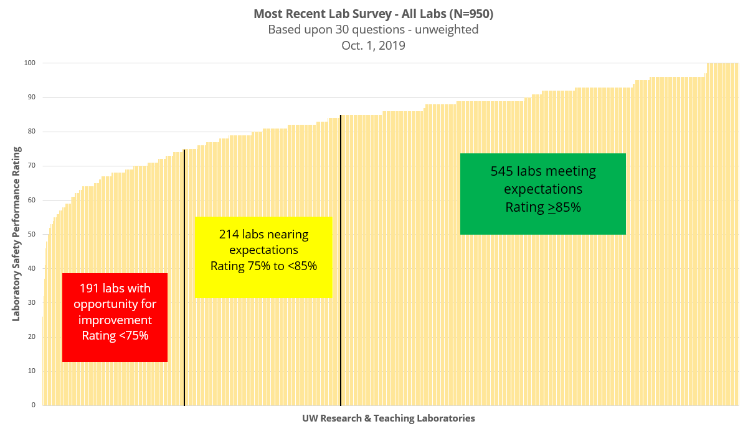
CURRENT STATE OF UW LAB SAFETY PERFORMANCE
Lab Safety Initiative (LSI):
90 pilot labs
Two-year project funded by Provost
Worked to reduce safety barriers
Unclear roles and responsibilities
Training, education, safety strategies
57%
(40% pre-LSI)
23%
(24% pre-LSI)
20%
(36% pre- LSI)
Notes:
So where are we now?
57% are meeting expectations –at the end of the LSI (62%)
We are managing to sustain t
Two year Provost funded pilot project
June 2016 - June 2018
90 labs in pilot group
$500,000 Provost investment (lab mentor, data analyst, administrative support, incentives/events)
Focus on higher risk
Engage faculty and leadership
Create a standard of performance
Develop/share best practices
Prevent accidents
Desired Results: Improve safety in high risk pilot labs - Apply learning across all campus laboratories
he progress made during the LSI, but how do we continue to improve the safety performance in labs?

Slide 5
PROVOST TASK FORCE ON LAB SAFETY RECOMMENDATIONS
Adopt policy for chemical and physical safety requirements in research
-By January 31, 2020
Constitute institutional chemical and physical safety committee
-By December 31, 2019
Expand Executive Order 55 to include all institutional safety committees
-Winter, 2020
Develop formal escalation policy for correcting lab deficiencies
-January 31, 2020
Form advisory group of institutional safety committee chairs
-Summer, 2020
Notes:
Formed in response to faculty counsel on research (FCR) formulated resolution passed by the faculty council in January 2019
Task force members: Public Health, Medicine, Arts and Sciences, Engineering, EH&S, graduate student and post doctorate representatives

Slide 6
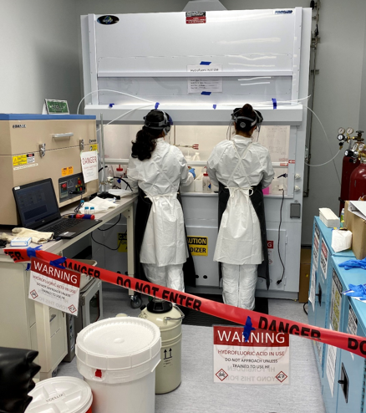
INSTITUTIONAL CHEMICAL AND PHYSICAL SAFETY COMMITTEE
Scope is research and academic labs and other research environments
Faculty led committee
Administered by EH&S
Oversight by Health Sciences Administration
Independent oversight committee supporting safety and compliance in research
Escalation procedure for lab safety findings that need attention
Notes:
Help develop, recommend and update UW research safety-related policies pertaining to chemical and physical hazards, and training and educational materials.
Review and approve major changes to the University’s Laboratory Safety Manual.
Review findings of inspection and hazard surveillance programs carried out by EH&S
Support EH&S in the escalation of outstanding laboratory deficiencies and in addressing unsafe conditions to department deans or University leadership.
Establish and review strategies to ensure ongoing and adequate surveillance, hazard identification and risk evaluation of laboratory activities.
Advise EH&S and University leadership regarding compliance with safety-related policies through general observations, review of incident reports and similar activities.
Review requests for variances from established safety policies and advise EH&S on accepting or denying these requests.
Annually review EH&S statistics on laboratory safety, including reportable accidents, compliance with safety policies and other available data to monitor trends and identify priorities for policy development, education or enforcement.

Slide 7
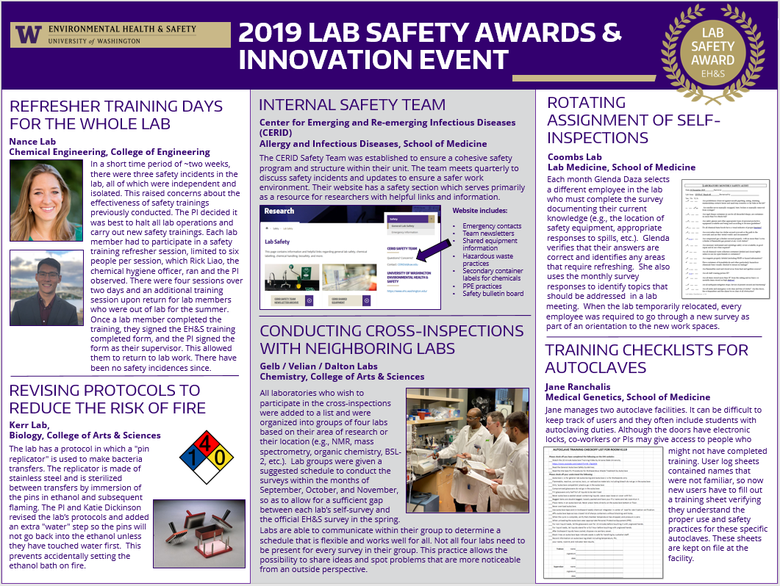
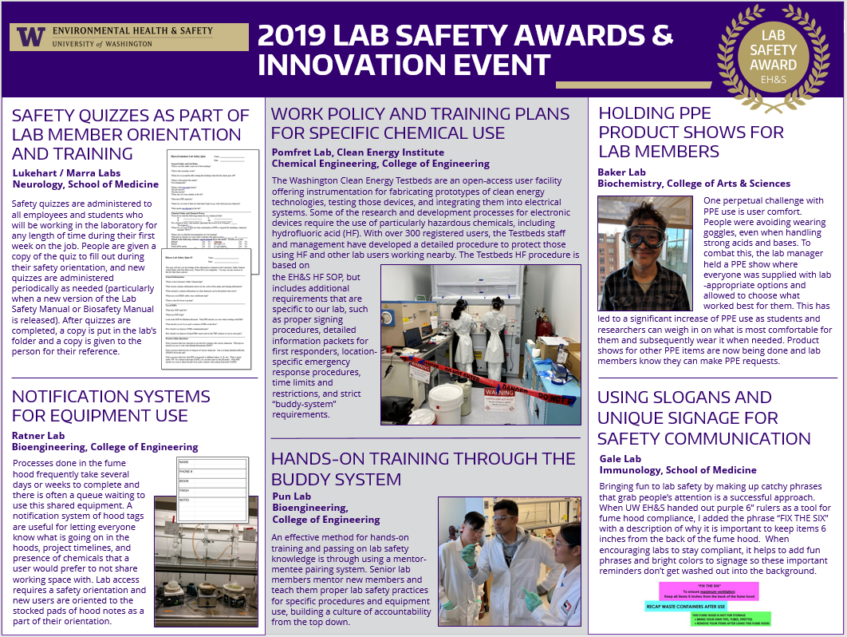
OTHER EH&S RESEARCH SAFETY PROGRAM UPDATES
Electronic Tools – reduce administrative burden
Biological safety- electronic lab survey
Radiation safety electronic lab surveys
Data consolidation and management efforts
Chemical waste collection improvements
Chemical inventory system upgrade (MyChem)
Bridge Learning Management System
Efforts enhance standardization
Strategic dashboard
Outreach projects
Lab Safety Innovation Event
Sharps Injury Reduction

Slide 8
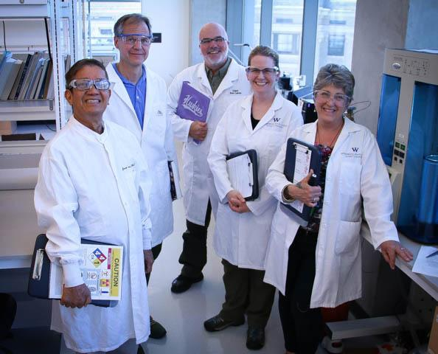
THANK YOU FOR YOUR PARTNERSHIP AND SUPPORT
Provost Richards and former Provost Baldasty
Health Sciences Administration, Dave Anderson
Faculty Senate
Office of Research
Mary Lidstrom, Joe Giffels, Jim Kresl
Deans, Directors, Chairs
Task Force on Lab Safety
EH&S Lab Safety Survey Team
Jude Van Buren, Mark Murray

Slide 9
Questions
ACHIEVING A CULTURE OF SAFETY
“Safety is shared by Everyone”
Increasingly Trustful
5. Safety is inherent
EHS is fully integrated into the business
“I say something when I see unsafe behaviors or conditions”
“I know what to do and have resources to keep myself safe”
4. Safety is a Value
We work proactively on the problems that we still find
“I know what to do to keep safe but do not have resources or safety is the Safety Officer’s job”
3. Safety is a Priority
We have systems in place to manage EHS risks
“I do not know how to keep myself safe at work”
Increasingly Accountable
2. Safety is Important
Compliance is important
1. No Formal Safety Framework
Safety is not integrated into business
Notes:
Safety Culture refers to an organization’s shared values, assumptions, and beliefs specific to workplace safety or more simply, the importance of safety within the organization relative to other priorities.
A strong, positive safety culture arises not because of a set of rules but because of a commitment to safety throughout the organization. Such a culture supports the free exchange of safety information, emphasizes learning and improvement, and assigned greater importance to identifying and solving problems rather than placing blame. High importance is assigned to safety all the time.
Continual Process Improvement: Plan-Do-Check-Act
Accountability at all levels
A culture of safety is achieved through establish an EHS framework and maturing the framework until safety becomes a value and ultimately inherent in the way that we operate. Currently, EH&S is at level 3 – maturing our programs to a compliant state, laying the foundation to shift the culture to value safety

Slide 10
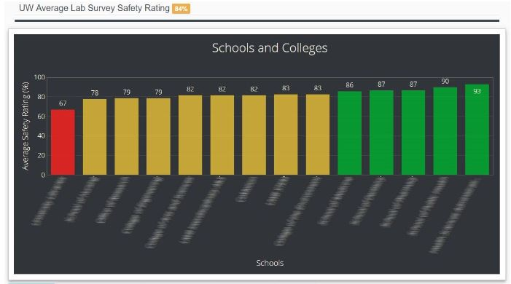
EH&S WEBSITE RESOURCES
HTTPS://WWW.EHS.WASHINGTON.EDU/
Laboratory Safety Dashboard (Executive, Chair, and PI links)
Safety Training
EH&S Guide for Investigators
Laboratory Safety Manual
Template standard operating procedures
Annual Report

Slide 11
E-CONSENT REMINDER ABOUT THE POSSIBILITIES
MRAM Meeting
January 9, 2020
Karen Moe
Human Subjects Division

Slide 12
Easier to engage with distant participants
Easier to store
Can incorporate pictures, graphic, videos, short comprehension test
E-CONSENT A USEFUL TOOL

Slide 13
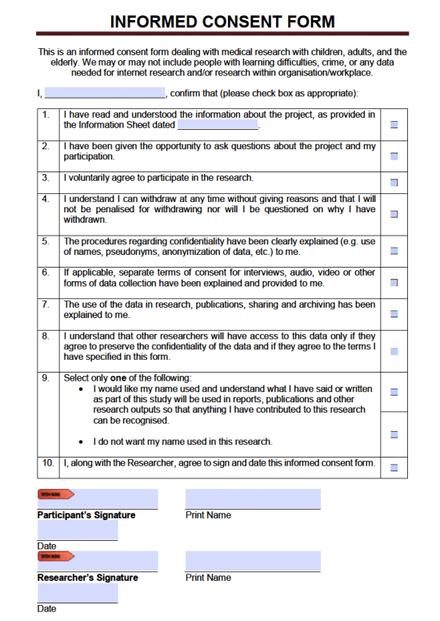
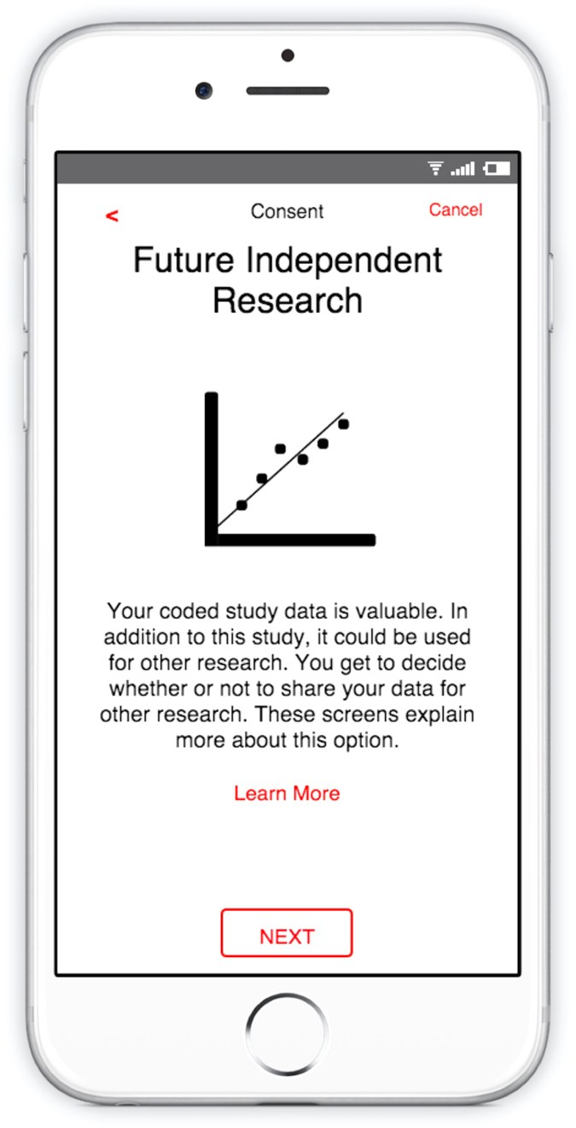
E-CONSENT MANY TYPES
Handwritten signature on a electronic tablet, laptop, or smartphone
Electronic “signature” by clicking a button or link in an email, text message, or website
May be in the presence of a study staff person, or at a separate location

Slide 14
E-CONSENT NEED FOR VALIDITY
Validity of “remote” signatures requires:
Evidence of who actually “signed”
Protection from change after signature

Slide 15
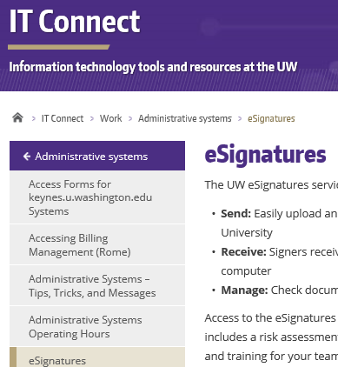
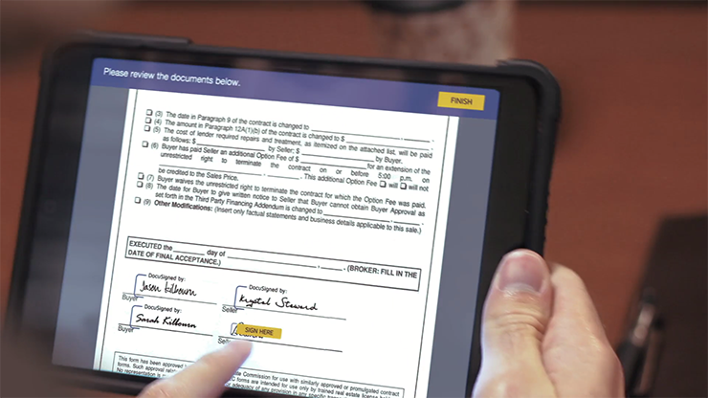
E-CONSENT ALLOWED BY UW & IRB
eSignatures (DocuSign)
Provided and supported through UW IT
https://itconnect.uw.edu/work/administrative-systems/esignatures/

Slide 16
E-CONSENT
Explore the possibilities
Ask hsdinfo@uw.edu
HSD guidance
https://www.washington.edu/research/policies/guidance-electronic-informed-consent/

Slide 17
Sexual Harassment
Regulations Affecting Research Administration
MRAM
January 9, 2020
Joe Giffels
Office of Research

Slide 18
National Science Foundation
UW is required to report when administrative action is taken
NSF may take action
For more information: https://www.nsf.gov/od/odi/harassment.jsp
MRAM – Joe Giffels – Office of Research

Slide 19
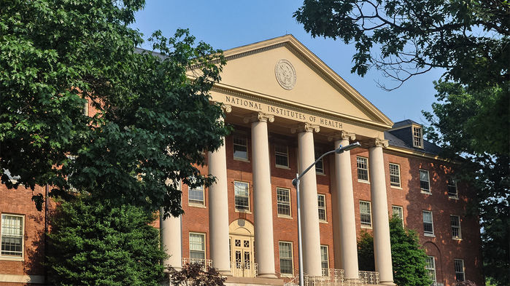
National Institutes of Health
UW is required to inform NIH of administrative actions or other circumstances that change the status of senior/key personnel on an NIH award
NIH may take action
For more information: https://www.nih.gov/anti-sexual-harassment/nih-awardee-organizations-those-who-work-there
MRAM – Joe Giffels – Office of Research

Slide 20
National Oceanic and Atmospheric Administration
Training of all personnel is required
For more information:
https://www.corporateservices.noaa.gov/ames/administrative_orders/chapter_202/202-1106.html
https://www.noaa.gov/sites/default/files/atoms/files/1330-52.222-70%20NOAA%20Sexual%20Assault%20and%20Sexual%20Harassment%20Prevention%20and%20Response%20Policy%20for%20Services%20%28except%20for%20services%20for%20the%20use%20of%20vessels%29.pdf
The contractor shall provide all contractor employees assigned to perform under this contract with mandatory sexual assault and sexual harassment prevention and response training in compliance with the requirements of NAO 202-1106, Section 5, Prevention Training and Awareness, as part of their initial in-processing and on an annual basis thereafter. The initial training shall be completed within business days [30 unless a different number is inserted] of contract award or the date a contractor employee is assigned to perform under the contract, as applicable.
MRAM – Joe Giffels – Office of Research

Slide 21
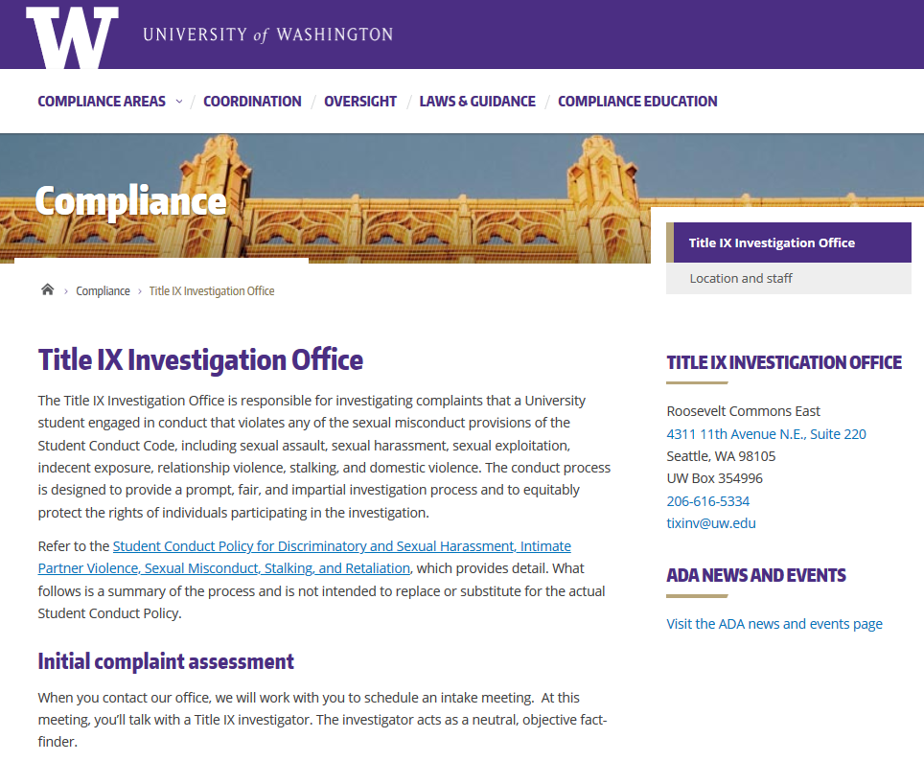
UW Title IX Office
MRAM – Joe Giffels – Office of Research

Slide 22
Assess Research Sponsor Reporting Requirement
Ask for consult…
research@uw.edu
MRAM – Joe Giffels – Office of Research

Slide 23
Questions
?
MRAM – Joe Giffels – Office of Research

Slide 24
COMPLIANCE CORNER
MRAM
January 2020
Matt Gardner & Andra Sawyer
Post Award Fiscal Compliance

Slide 25
Academic Student Employee (“ASE”)
Lump Sum Payments
UW-UAW contract (6/3/18 – 4/30/21)
Under the contract:
Lump sum payment of $100
ASEs with a 50% FTE appointment
Paid during the first quarter of employment during each year of the contract starting with the 2018/2019 academic year
Payments are being charged under object code 01-80 on some sponsored awards
MRAM – Matt Gardner – PAFC

Slide 26
Are ASE Payments Allowable on Sponsored Awards?
ASE payments are unallowable on NRSA Training Grants and Fellowships
Any ASE charges to NRSA Training Grants or Fellowships must be removed and transferred to a non-sponsored award
ASE payments are generally allowable on other sponsored awards
See the PAFC FAQ on Compensation for additional information
https://finance.uw.edu/pafc/faq?term_node_tid_depth=Compensation
MRAM – Matt Gardner – PAFC

Slide 27
NIH Grants Policy Statement
NIH published the revised Grants Policy Statement on December 10, 2019
Applies to all NIH grants and cooperative beginning on or after October 1, 2019
No significant changes with respect to post award fiscal compliance policies
Summary of the significant changes can be found at NIH: https://grants.nih.gov/grants/policy/nihgps/Significant-Changes-Table-NIHGPS-2019.pdf
MRAM – Matt Gardner - PAFC

Slide 28
NSF Proposal & Award Policies and Procedures Guide (PAPPG)
The annual PAPPG revision is delayed
Per NSF, the revised guide will be released in the “coming months”
The revised PAPPG will be effective 90 days after release
Until then… continue to follow the current PAPPG
https://www.nsf.gov/publications/pub_summ.jsp?ods_key=nsf19001
MRAM – Matt Gardner - PAFC

Slide 29
Airfare on Federal Awards: Review
Cost is NOT the primary consideration when purchasing airfare, instead it must be:
In compliance with the Fly America Act
“Basic” Class of Service
Refundable Ticket (allowable if used, unallowable if not used)
And then…
Cheapest available
https://finance.uw.edu/pafc/travel
MRAM – Andra Sawyer – PAFC

Slide 30
Travel: “Package Deals” on Federal Awards
Definition: a single vendor provides multiple travel services (e.g., airfare + lodging from Expedia)
Package Deals can only be used on Federal Awards IF the vendor provides detailed information on airfare, including:
compliance with the Fly America Act
class of service
Unused non-refundable packages cannot be charged to a Federal Award
Other considerations for Package Deals, please see the UW Travel webpage:
https://finance.uw.edu/travel/airfare#Package%20Deal
MRAM – Andra Sawyer – PAFC

Slide 31
Cost Share Update:
1. What is NOT Cost Share
Costs are being shared but not recorded as Cost Share in UW Systems:
Intramural (Sponsor-Provided)
Agreements that are not part of the Sponsored Award
Expenses incurred in support of but not charged to an NIH Training Grant
https://finance.uw.edu/gca/cost-share#Not_Cost_Share
MRAM – Andra Sawyer – PAFC

Slide 32
Cost Share Update:
2. Third (3rd) Party
If a proposed 3rd Party cannot provide the necessary Cost Share documentation, that is NOT a reason to not meet the Cost Share Commitment.
An individual within an organization can certify his/her own effort; the individual becomes the 3rd party.
https://finance.uw.edu/gca/cost-share#Cost_Share_Contributions
MRAM – Andra Sawyer – PAFC

Slide 33
Cost Share Update:
3. Subawards & 3rd Party
Subaward and 3rd Party Cost Share are two separate Cost Share Components
Subaward: contractual agreement as part of the Award
3rd Party: no contractual agreement on the Award
UW systems/policies do not make that distinction
GIM 21: under review
Cost Share Addendum.xlsx & Instructions: updated
Cost Share Summary/eFECS System: 3rd Party category used for both, can include name of entity
https://finance.uw.edu/gca/cost-share#Cost_Share_Components
MRAM – Andra Sawyer – PAFC

Slide 34
Questions?
Post Award Fiscal Compliance (PAFC)
gcafco@uw.edu
https://finance.uw.edu/pafc/
Andra Sawyer
andra2@uw.edu
206-685-8902
Matt Gardner
mgard4@uw.edu
206-543-2610
MRAM – Post Award Fiscal Compliance

Slide 35
UPDATES
Certificate Enrollment: 178
CORE homepage:
https://www.washington.edu/research/training/core//
Existing eLearning updated to address user feedback, and better meet accessibility standards
New eLearning coming soon –Nonfinancial Compliance Basics
Registration: https://uwresearch.gosignmeup.com/public/course/browse
Late Arrival Policy: No credit for arrivals later than 15 minutes
Course Enrollments: Larger rooms used this quarter for most classes to accommodate the demand

Slide 36
UPCOMING COURSES IN
RESEARCH ADMINISTRATION
Jan 14 | 1011 | SAGE: Creating and Submitting eGC1s (FULL)
Jan 16 | 1001 | Blueprint of a Proposal
Jan 22 | 1030 | Understanding Your New Award
Jan 23 | 1014 | SAGE: Budget (FULL)
Jan 28 | 1040 | Award Administration: Fiscal Compliance
Jan 30 | 1012 | SAGE: Creating NIH Proposals in Grant Runner (FULL)
Feb 4 | 1041 | Set Up and Manage Your Award
Feb 11 | 1090 | Research Administration Data: Visualizations and Reports
Feb 12 | 1042 | Preparing for Audit
Feb 20 | 1080 | Processes at Award Closeout
Feb 25 | 2090 | Research Administration Data Cube
Currently scheduled courses & registration: https://uwresearch.gosignmeup.com/public/course/browse

