Slide 1
EH&S UPDATE
LAB SAFETY PROGRAM
Katia Harb, Senior Director, Environmental Health & Safety
MRAM
January 9, 2020
kharb@uw.edu, 206.616.4146

Slide 2
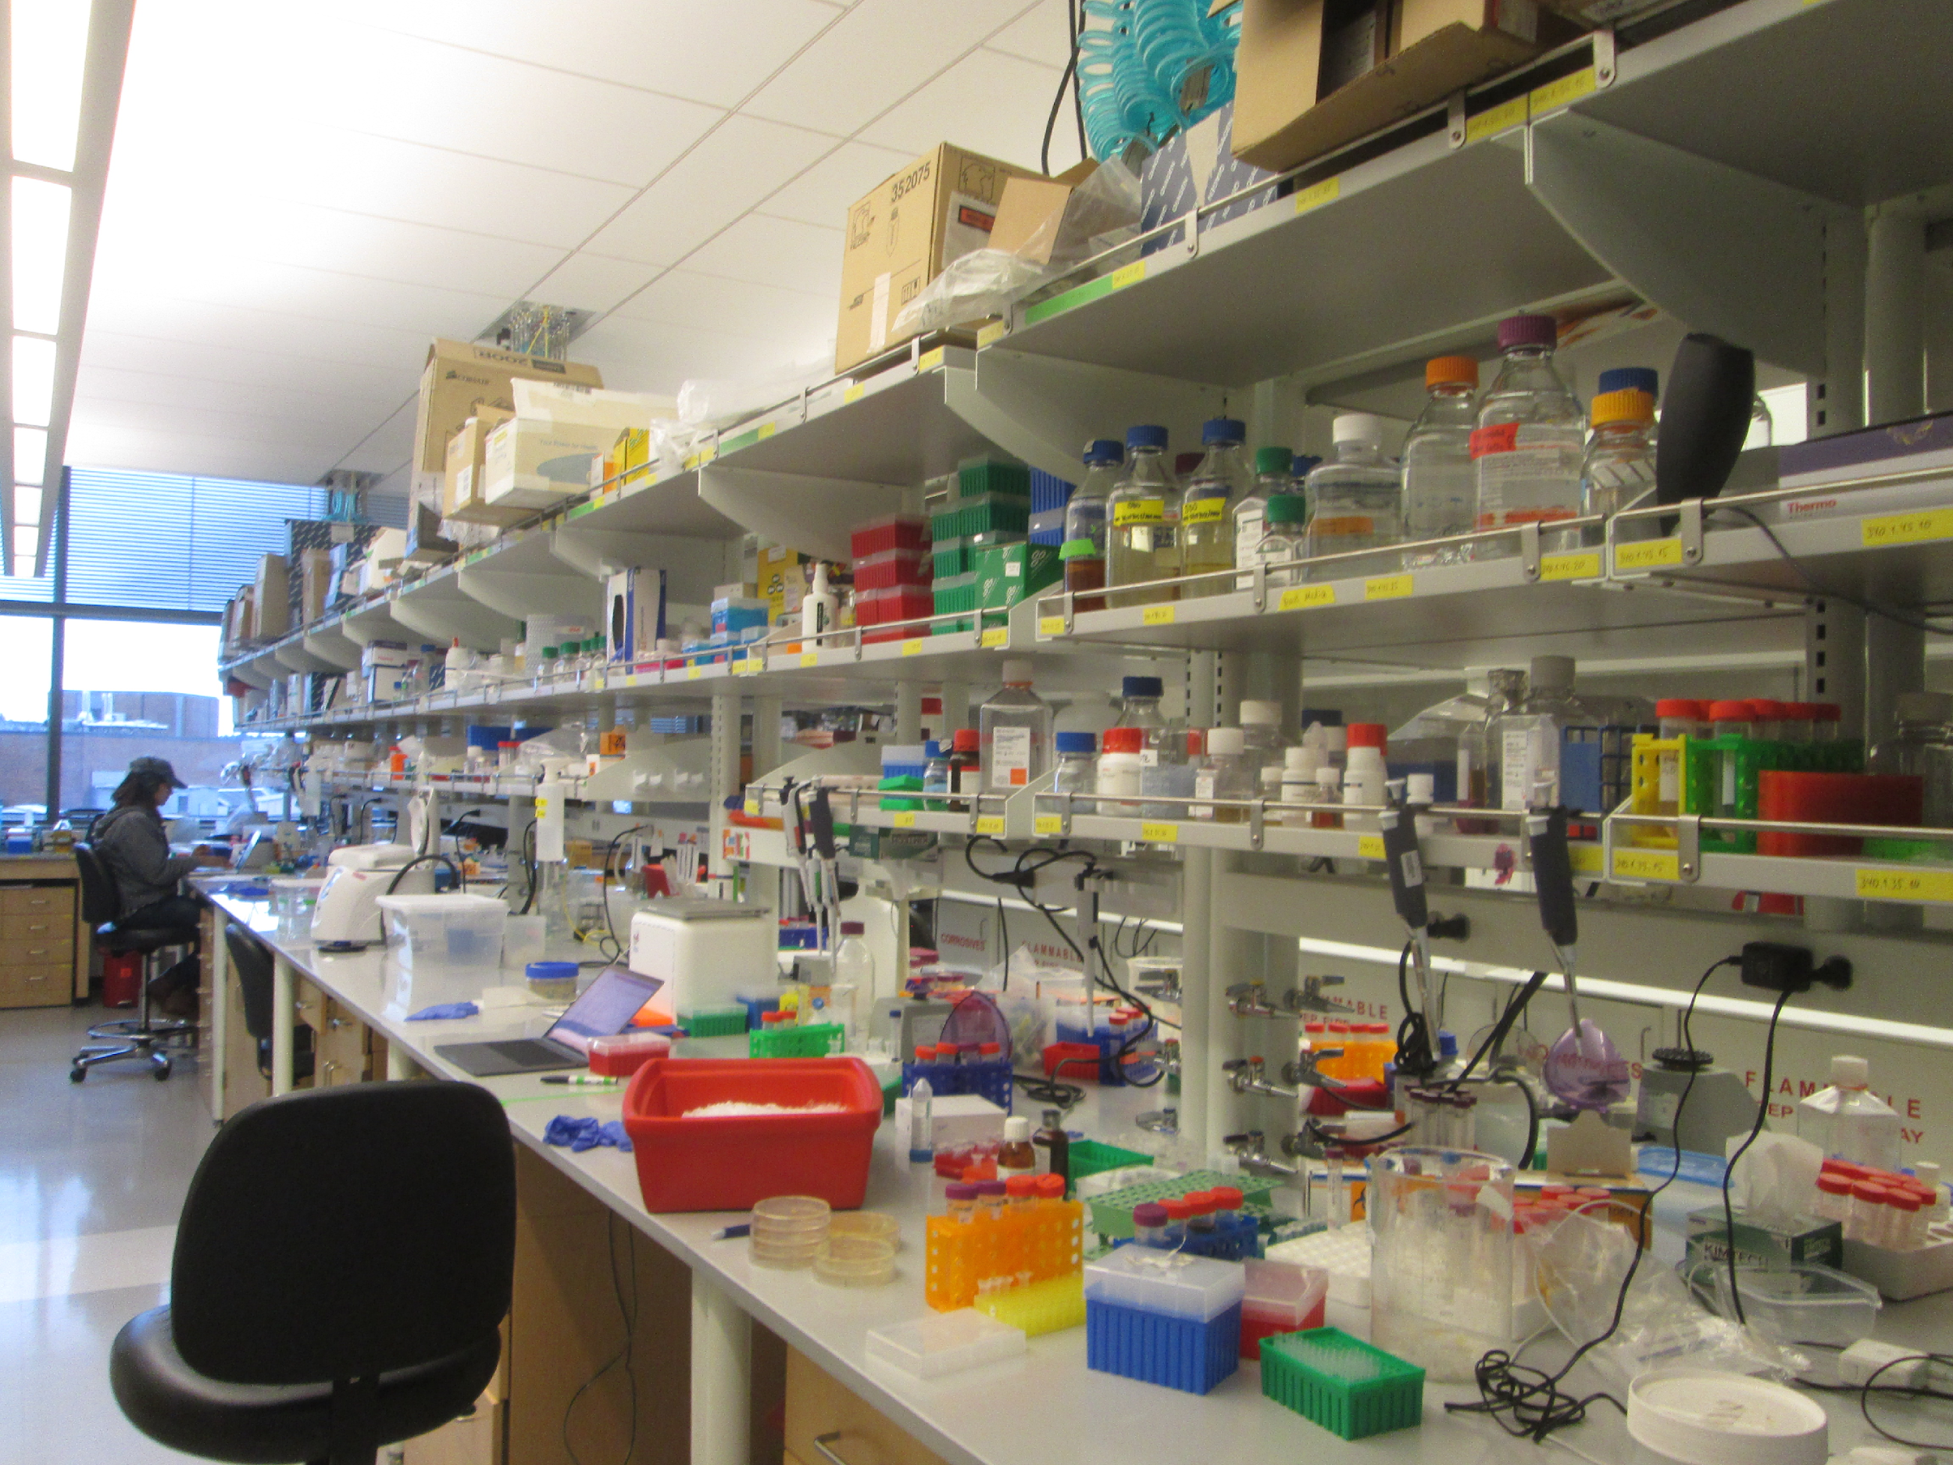
LABORATORY SAFETY SURVEY PROGRAM
Approximately 950 Investigator groups
Over 4,400 laboratory spaces
60% Investigators have biological use authorization
12% have radiological use authorization
Each lab surveyed every 14 months
Laboratory safety initiative pilot project 2016-2018
Notes:
Two new research buildings opened in 2018 (include ~48,000 sq. ft of lab space)
Buildings included 39 new fume hoods and 81 new biological safety cabinets
Amount of research spaces included in 2018 survey visits increased by ~25,000 sq. ft.
Surveys currently cover 1.5 million sq. ft of research spaces
Number of PIs with RUA
110 PIs, which includes clinical, oncology, gamma knife, sealed source, sea vessel, broad, etc
235 if you include human subjects RUAs
Number of spaces with RUAs: 317. You can use the new RAM Labs Grouped by Building report that I wrote for the DFP to find this number in the future.
Annually is kind of a hard number to quantify because people are continuously coming and going throughout the year. I can tell you that as of 6/30/2019 (the last complete quarter that we have data for), we had 1914 unique dose participants who are not area monitors, or spares.
Last year, we trained 76 people in our regular Radiation Safety Training. 13 people in the sealed source training, 6 people in the shipping radioactive materials training. For nurse and other hospital trainings, I looked at the 2018 quarterly report, added up the trainings and got 74. Jen sent me a spreadsheet of just the nurse training part way through this year that had 88 trainings on it, so it’s possible the 2018 number isn’t totally correct, but it’s the best I could come up with.
I’ve attached some metrics for the HSRAC program, which I presented at the HRPP meeting in August. If you want metrics that span over multiple years, I can work on that if you let me know what metrics you want. Or potentially Jenna can help

Slide 3
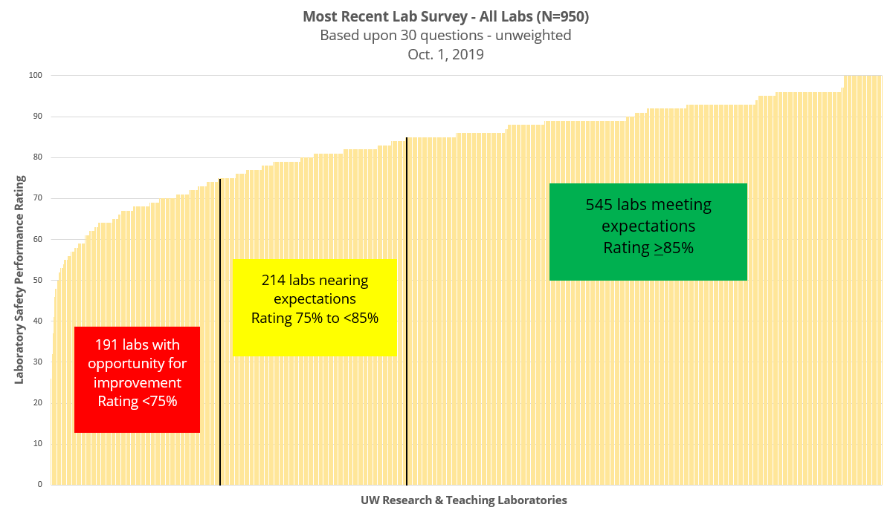
CURRENT STATE OF UW LAB SAFETY PERFORMANCE
Lab Safety Initiative (LSI):
90 pilot labs
Two-year project funded by Provost
Worked to reduce safety barriers
Unclear roles and responsibilities
Training, education, safety strategies
57%
(40% pre-LSI)
23%
(24% pre-LSI)
20%
(36% pre- LSI)
Notes:
So where are we now?
57% are meeting expectations –at the end of the LSI (62%)
We are managing to sustain t
Two year Provost funded pilot project
June 2016 - June 2018
90 labs in pilot group
$500,000 Provost investment (lab mentor, data analyst, administrative support, incentives/events)
Focus on higher risk
Engage faculty and leadership
Create a standard of performance
Develop/share best practices
Prevent accidents
Desired Results: Improve safety in high risk pilot labs - Apply learning across all campus laboratories
he progress made during the LSI, but how do we continue to improve the safety performance in labs?

Slide 4
PROVOST TASK FORCE ON LAB SAFETY RECOMMENDATIONS
Adopt policy for chemical and physical safety requirements in research
-By January 31, 2020
Constitute institutional chemical and physical safety committee
-By December 31, 2019
Expand Executive Order 55 to include all institutional safety committees
-Winter, 2020
Develop formal escalation policy for correcting lab deficiencies
-January 31, 2020
Form advisory group of institutional safety committee chairs
-Summer, 2020
Notes:
Formed in response to faculty counsel on research (FCR) formulated resolution passed by the faculty council in January 2019
Task force members: Public Health, Medicine, Arts and Sciences, Engineering, EH&S, graduate student and post doctorate representatives

Slide 5
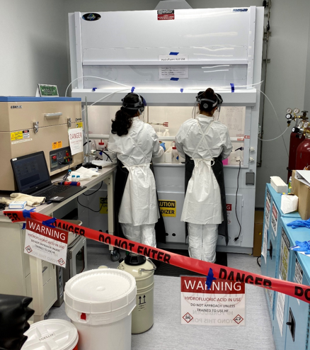
INSTITUTIONAL CHEMICAL AND PHYSICAL SAFETY COMMITTEE
Scope is research and academic labs and other research environments
Faculty led committee
Administered by EH&S
Oversight by Health Sciences Administration
Independent oversight committee supporting safety and compliance in research
Escalation procedure for lab safety findings that need attention
Notes:
Help develop, recommend and update UW research safety-related policies pertaining to chemical and physical hazards, and training and educational materials.
Review and approve major changes to the University’s Laboratory Safety Manual.
Review findings of inspection and hazard surveillance programs carried out by EH&S
Support EH&S in the escalation of outstanding laboratory deficiencies and in addressing unsafe conditions to department deans or University leadership.
Establish and review strategies to ensure ongoing and adequate surveillance, hazard identification and risk evaluation of laboratory activities.
Advise EH&S and University leadership regarding compliance with safety-related policies through general observations, review of incident reports and similar activities.
Review requests for variances from established safety policies and advise EH&S on accepting or denying these requests.
Annually review EH&S statistics on laboratory safety, including reportable accidents, compliance with safety policies and other available data to monitor trends and identify priorities for policy development, education or enforcement.

Slide 6
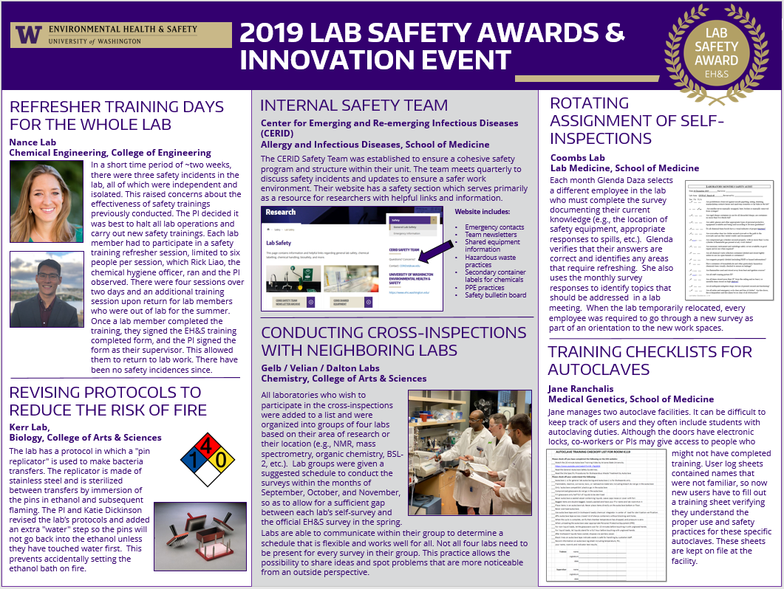
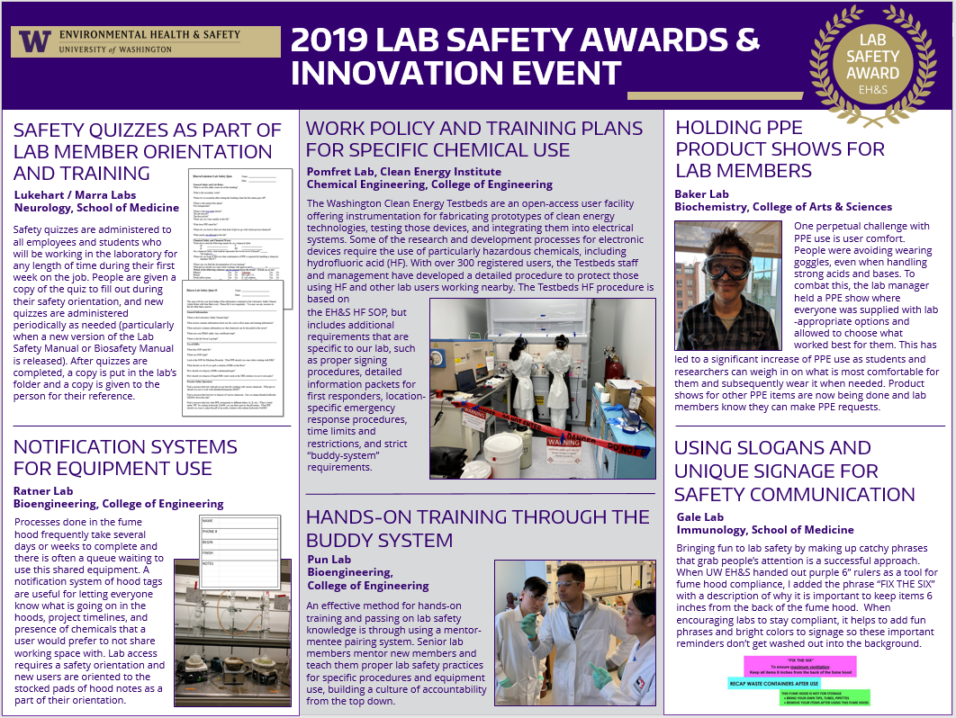
OTHER EH&S RESEARCH SAFETY PROGRAM UPDATES
Electronic Tools – reduce administrative burden
Biological safety- electronic lab survey
Radiation safety electronic lab surveys
Data consolidation and management efforts
Chemical waste collection improvements
Chemical inventory system upgrade (MyChem)
Bridge Learning Management System
Efforts enhance standardization
Strategic dashboard
Outreach projects
Lab Safety Innovation Event
Sharps Injury Reduction

Slide 7
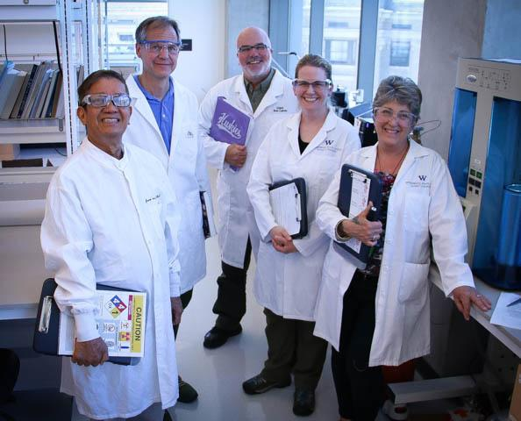
THANK YOU FOR YOUR PARTNERSHIP AND SUPPORT
Provost Richards and former Provost Baldasty
Health Sciences Administration, Dave Anderson
Faculty Senate
Office of Research
Mary Lidstrom, Joe Giffels, Jim Kresl
Deans, Directors, Chairs
Task Force on Lab Safety
EH&S Lab Safety Survey Team
Jude Van Buren, Mark Murray

Slide 8
Questions
ACHIEVING A CULTURE OF SAFETY
“Safety is shared by Everyone”
Increasingly Trustful
5. Safety is inherent
EHS is fully integrated into the business
“I say something when I see unsafe behaviors or conditions”
“I know what to do and have resources to keep myself safe”
4. Safety is a Value
We work proactively on the problems that we still find
“I know what to do to keep safe but do not have resources or safety is the Safety Officer’s job”
3. Safety is a Priority
We have systems in place to manage EHS risks
“I do not know how to keep myself safe at work”
Increasingly Accountable
2. Safety is Important
Compliance is important
1. No Formal Safety Framework
Safety is not integrated into business
Notes:
Safety Culture refers to an organization’s shared values, assumptions, and beliefs specific to workplace safety or more simply, the importance of safety within the organization relative to other priorities.
A strong, positive safety culture arises not because of a set of rules but because of a commitment to safety throughout the organization. Such a culture supports the free exchange of safety information, emphasizes learning and improvement, and assigned greater importance to identifying and solving problems rather than placing blame. High importance is assigned to safety all the time.
Continual Process Improvement: Plan-Do-Check-Act
Accountability at all levels
A culture of safety is achieved through establish an EHS framework and maturing the framework until safety becomes a value and ultimately inherent in the way that we operate. Currently, EH&S is at level 3 – maturing our programs to a compliant state, laying the foundation to shift the culture to value safety

Slide 9
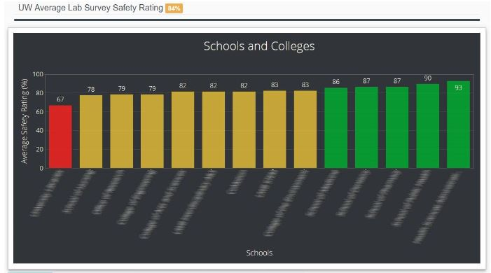
EH&S WEBSITE RESOURCES
HTTPS://WWW.EHS.WASHINGTON.EDU/
Laboratory Safety Dashboard (Executive, Chair, and PI links)
Safety Training
EH&S Guide for Investigators
Laboratory Safety Manual
Template standard operating procedures
Annual Report

