Slide 1
E-CONSENT REMINDER ABOUT THE POSSIBILITIES
MRAM Meeting
January 9, 2020
Karen Moe
Human Subjects Division

Slide 2
Easier to engage with distant participants
Easier to store
Can incorporate pictures, graphic, videos, short comprehension test
E-CONSENT A USEFUL TOOL

Slide 3
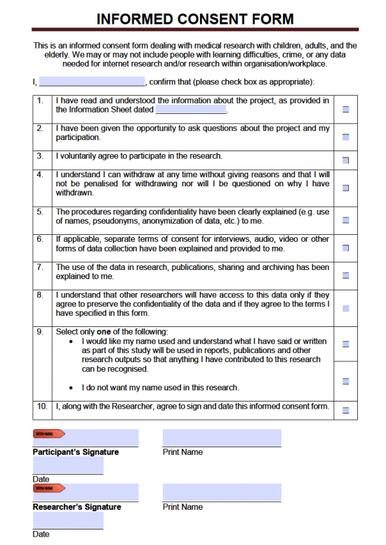
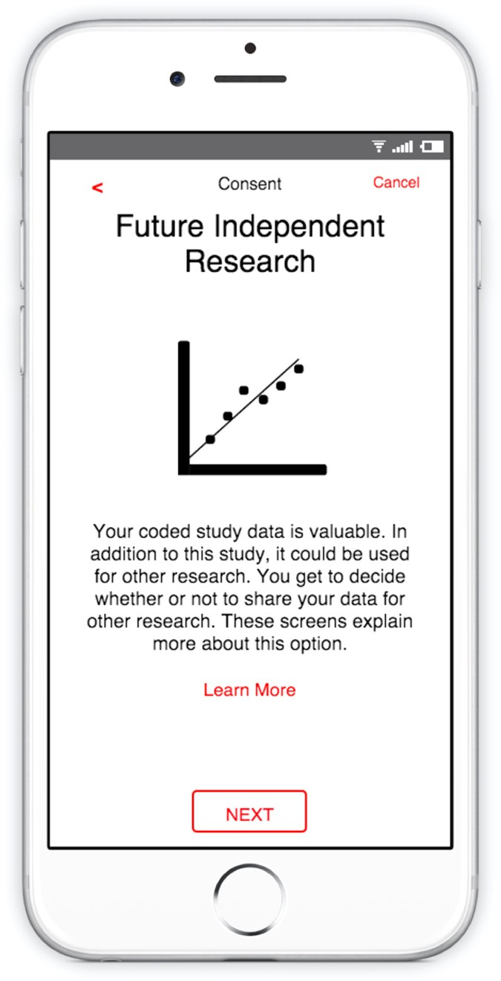
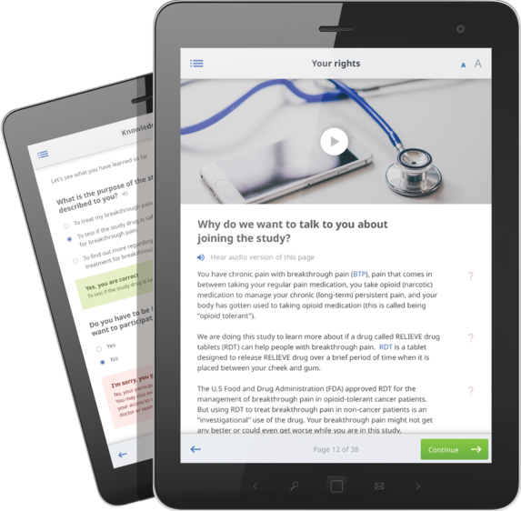
E-CONSENT MANY TYPES
Handwritten signature on a electronic tablet, laptop, or smartphone
Electronic “signature” by clicking a button or link in an email, text message, or website
May be in the presence of a study staff person, or at a separate location

Slide 4
E-CONSENT NEED FOR VALIDITY
Validity of “remote” signatures requires:
Evidence of who actually “signed”
Protection from change after signature

Slide 5
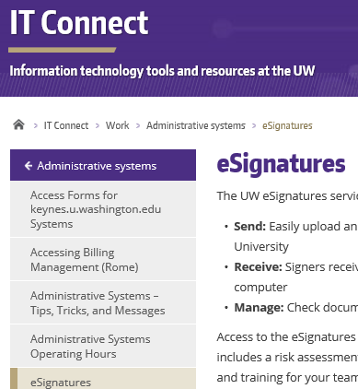
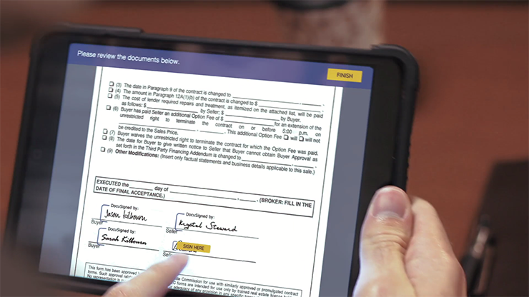
E-CONSENT ALLOWED BY UW & IRB
eSignatures (DocuSign)
Provided and supported through UW IT
https://itconnect.uw.edu/work/administrative-systems/esignatures/

Slide 6
E-CONSENT
Explore the possibilities
Ask hsdinfo@uw.edu
HSD guidance
https://www.washington.edu/research/policies/guidance-electronic-informed-consent/

