Slide 1
Sexual Harassment
Regulations Affecting Research Administration
MRAM
January 9, 2020
Joe Giffels
Office of Research

Slide 2
National Science Foundation
UW is required to report when administrative action is taken
NSF may take action
For more information: https://www.nsf.gov/od/odi/harassment.jsp
MRAM – Joe Giffels – Office of Research

Slide 3
National Institutes of Health
UW is required to inform NIH of administrative actions or other circumstances that change the status of senior/key personnel on an NIH award
NIH may take action
For more information: https://www.nih.gov/anti-sexual-harassment/nih-awardee-organizations-those-who-work-there
MRAM – Joe Giffels – Office of Research

Slide 4
National Oceanic and Atmospheric Administration
Training of all personnel is required
For more information:
https://www.corporateservices.noaa.gov/ames/administrative_orders/chapter_202/202-1106.html
https://www.noaa.gov/sites/default/files/atoms/files/1330-52.222-70%20NOAA%20Sexual%20Assault%20and%20Sexual%20Harassment%20Prevention%20and%20Response%20Policy%20for%20Services%20%28except%20for%20services%20for%20the%20use%20of%20vessels%29.pdf
The contractor shall provide all contractor employees assigned to perform under this contract with mandatory sexual assault and sexual harassment prevention and response training in compliance with the requirements of NAO 202-1106, Section 5, Prevention Training and Awareness, as part of their initial in-processing and on an annual basis thereafter. The initial training shall be completed within business days [30 unless a different number is inserted] of contract award or the date a contractor employee is assigned to perform under the contract, as applicable.
MRAM – Joe Giffels – Office of Research

Slide 5
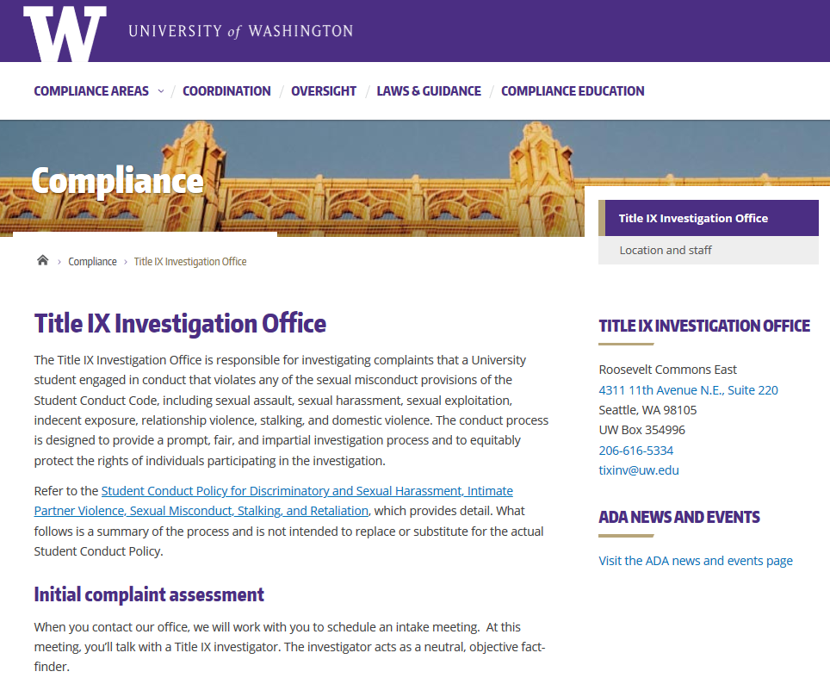
UW Title IX Office
MRAM – Joe Giffels – Office of Research

Slide 6
Assess Research Sponsor Reporting Requirement
Ask for consult…
research@uw.edu
MRAM – Joe Giffels – Office of Research

Slide 7
Questions
?
MRAM – Joe Giffels – Office of Research

