Slide 1
COMPLIANCE CORNER
MRAM
February 2020
Matt Gardner
Post Award Fiscal Compliance

Slide 2
Revised NSF PAPPG
Released on January 24th, 2020
Effective June 1, 2020
“For proposals submitted or due, and awards made, on or after June 1st, 2020.”
Link:
https://www.nsf.gov/pubs/policydocs/pappg20_1/index.jsp
MRAM – Matt Gardner – PAFC

Slide 3
Revised NSF PAPPG –
Participant Support (Chapter II.C.2.g.)
Old: “Participant support costs may not be budgeted to cover room rental fees, catering costs, supplies, etc., related to an NSF-sponsored conference.”
New: “Costs related to an NSF-sponsored conference … venue rental fees, catering costs, supplies … that will be secured through a service agreement/contract should be budgeted on line G.6. Other Direct Costs …”
MRAM – Matt Gardner – PAFC

Slide 4
Revised NSF PAPPG –
Participant Support (Chapter II.C.2.g.)
What’s the difference?
Room rental fees, catering fees, and supplies CAN be considered Participant Support if not paid through a service agreement/contract.
If the costs are procured through a service agreement/contract, they are not considered Participant Support and F&A should be applied.
MRAM – Matt Gardner – PAFC

Slide 5
Revised NSF PAPPG –
Participant Support (Chapter II.C.2.g.)
What hasn’t changed?
The following costs are still not allowed as Participant Support:
Employee costs
Travel
Food
Registration Fees
Speaker Fees (unless the primary purpose of the Speaker’s attendance is learning)
Incentive payments to research subjects
MRAM – Matt Gardner – PAFC

Slide 6
2 CFR 200 – Uniform Guidance:
Proposed Changes
OMB released proposed revisions on January 21, 2020.
Comment period open from January 22 through March 23, 2020.
The current Uniform Guidance is still applicable until the revisions are finalized.
UW is gathering feedback/comments in coordination with the Office of Research
Link:
https://www.federalregister.gov/documents/2020/01/22/2019-28524/guidance-for-grants-and-agreements?utm_medium=email&utm_campaign=subscription+mailing+list&utm_source=federalregister.gov
MRAM – Matt Gardner – PAFC

Slide 7
Revised NIH Grants Policy Statement
Released: December 10, 2019
Effective: For all NIH grants and cooperative agreements beginning on or after October 1, 2019
No major post award fiscal compliance impacts
Link:
https://grants.nih.gov/grants/policy/nihgps/index.htm
MRAM – Matt Gardner – PAFC

Slide 8
New NRSA Budget Levels
Establishes Stipend, Training Related Expenses, and Institutional Allowance levels for NRSA Training Grants & Fellowships
Levels apply to NRSA Awards made with FY2020 funds
Awards beginning on or after October 1, 2019
Awards beginning before October 1, 2019 do not receive an increase
MRAM – Matt Gardner – PAFC

Slide 9
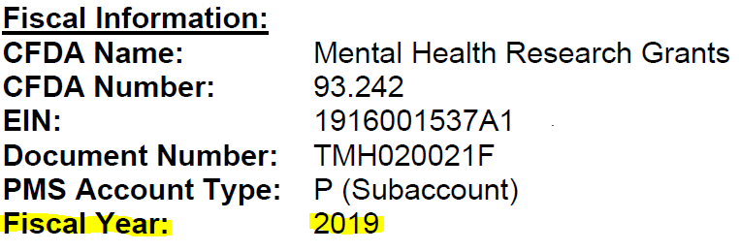
NRSA Budget Levels –
Which year is my Award?
The NIH Notice of Award states under which fiscal year the Award was issued.

Slide 10
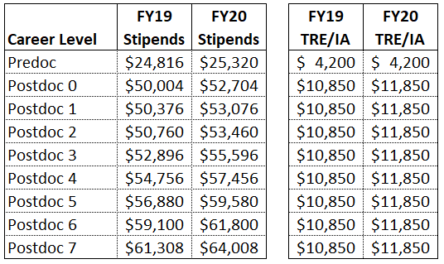
New NRSA Budget Levels –
What’s Changed?
See NOT-OD-20-070 for more information:
https://grants.nih.gov/grants/guide/notice-files/NOT-OD-20-070.html

Slide 11
Questions?
Post Award Fiscal Compliance (PAFC)
gcafco@uw.edu
https://finance.uw.edu/pafc/
Andra Sawyer, Assistant Director
andra2@uw.edu
206-685-8902
Matt Gardner, Compliance Analyst
mgard4@uw.edu
206-543-2610
MRAM – Matt Gardner – PAFC

