Slide 1
MRAM | Monthly Research Administration Meeting
March 12, 2020 9:00 AM – 10:00 AM Hosted Remotely Join the LIVE Webinar - https://washington.zoom.us/j/346891888
TOPIC | PRESENTER | EMAIL | MIN
Welcome | Kirsten DeFries Research Compliance & Operations | kirsten5@uw.edu | 2
Update on research administration and compliance preparedness for COVID-19 impacts | Joe Giffels, Carol Rhodes, Zara Llewellyn, Katia Harb, Andra Sawyer, Karen Moe OR, OSP, EH&S, PAFC, HSD | jgiffels@uw.edu carhodes@uw.edu zaral@uw.edu kharb@uw.edu gcafco@uw.edu kemoe@uw.edu | 40
SciENcv: NSF Biosketch & Current and Pending Support | Carol Rhodes Office of Sponsored Programs | carhodes@uw.edu | 5
External Funding: Gift or Sponsored Program | Carol Rhodes Director, Office of Sponsored Programs Tobin Eckholt Director, Gift Services | carhodes@uw.edu teckholt@uw.edu | 10
External Funding: Provision of Services or Sponsored Program Business Considerations | Carol Rhodes Director, Office of Sponsored Programs Fuchi Obioha Director, UW Tax Office | carhodes@uw.edu fobioha@uw.edu | 10
NEXT MEETING April 9, 2020 9:00 AM - 10:00 AM SAVE THE DATE FOR A SPECIAL SAGE BUDGET SESSION FOLLOWING APRIL MRAM

Slide 2
MRAM: Coronavirus Edition
MRAM
March, 2020
Joe Giffels
Office of Research

Slide 3
“Coronavirus” =
SARS-CoV-2 (the virus) = COVID-19 (the disease)
MRAM – Joe Giffels – Office of Research

Slide 4
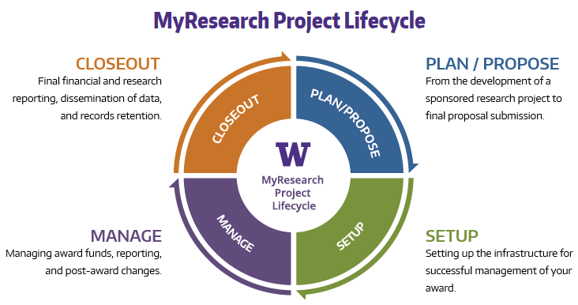
Text
MRAM – Joe Giffels – Office of Research

Slide 5
Operations – our research is not “closed”
Business, Academic and Research Continuity Plan

Slide 6
Text
MRAM – Joe Giffels – Office of Research

Slide 7
Carol Rhodes
Director, Office of Sponsored Programs
Katia Harb
Senior Director, Environmental Health and Safety
Andra Sawyer
Assistant Director, Research Compliance and Operations
Karen Moe
Director, Human Subjects Division

Slide 8
COVID-19 and
Sponsored Programs
Office of Sponsored Programs

Slide 9
Threefold focus for OSP
OSP business continuity in light of local/regional public health communications
COVID-19 research efforts exception/acceleration paths
Sponsor policies, guidance or funding opportunities specific to the novel coronavirus outbreak

Slide 10
OSP Business Continuity
Remote access is cornerstone of continuity to support social distance recommendation
OSP staff have access to all UW and sponsor systems to access proposals, awards, pre- and post-award activity, and issuance of subawards.
OSP has modified front desk operations:
Main phone line voicemail checked every half hour
We discourage hard copy documents; electronic preferred
Make an appointment in order to meet in-person
If sponsor requires an ink signature, please indicate in the eGC1

Slide 11
COVID-19 Research:
Exception/Accelerated Paths
OSP proposal reviewers have limited GIM 19 waiver authority for COVID-19 research proposals.
Proposal preparation impacted by COVID-19, e.g.:
PI or other key personnel illness
School closure
Bypass needing unit Chair or unit Director concurrence.
Pre- and post-award items for COVID-19 research are being prioritized over non-COVID-19 items

Slide 12
Sponsor announcements and guidelines related to COVID-19
Sponsor are beginning to issue specific guidance:
MRAM- NSF FAQ and Dear Colleague Letter
Some sponsors are announcing funding opportunities related to coronavirus; we will post such information.
Research Website:
Mitigating Impacts to Research Activities Due to COVID-19

Slide 13
EH&S UPDATE:
COVID-19 PLANNING RESPONSE
Katia Harb
Director
Environmental Health & Safety
MRAM
March 2020

Slide 14
EH&S OPERATIONS
EH&S department is fully operational at this time
Combination of remote and in-person staffing
Business continuity plan reviews taking place
Institutional Biosafety Committee (IBC), Radiation Safety Committee, University-Wide Safety Committee, and others meeting via Zoom.
EH&S Training: In-person classes, where possible are being transitioned to Zoom or other methods that support social distancing.
Supporting University’s Advisory Committee on Communicable Diseases and COVID-19 response planning
Resources to support research continuity planning

Slide 15
COVID-19 GUIDANCE
Visit the Novel Coronavirus Page:
www.washington.edu/coronavirus
What to do if you are sick
Procedures for being in contact with COVID-19 case
Events guidance
Travel advisories
Information and guidance is rapidly changing
General Questions, send to ehsdept@uw.edu, 206-543-7262

Slide 16
COVID-19: Cancelled Travel Expenditures GCA/PAFC Operations CORE Training
Andra Sawyer
Assistant Director, Post Award Fiscal Compliance

Slide 17
Cancelled Travel due to COVID
There is no change in any UW or Federal Government Travel policies as a result of COVID-19.
For non-Sponsored Award travel, consult the UW Travel webpage on travel cancellation.

Slide 18
Cancelled Travel due to COVID – Sponsored Award Travel:
Award and Sponsor-specific requirements should be followed.
In the absence of Award or Sponsor requirements then the UW Travel Policies apply.
Summary of Sponsored Award Travel under COVID-19: https://finance.uw.edu/pafc/Travel_COVID-19.
PAFC is monitoring the federal government websites and listservs. Updated information will be added to this webpage.
Latest from NSF: https://www.nsf.gov/pubs/2020/nsf20053/nsf20053.jsp
Latest from NIH: https://grants.nih.gov/grants/guide/notice-files/NOT-OD-20-083.html

Slide 19
UW Travel Policies – Cancelled Travel
Every effort should be made to obtain a full or partial refund from the vendor (airline, hotel, conference organizer, car rental, etc.).
Any refunds should be refunded to the same budget that the expense was paid from.
If a refund cannot be obtained, then per UW Policy the unrefundable amount can be charged to the Sponsored Award for the following reasons:
Cancelled conference/meeting
Airline cancelled flight
Death of a family member
Traveler’s illness
Department determination that the health/safety of the traveler is at risk and the travel should thus be cancelled. Concerns about traveling due to the COVID-19 virus would fall under this category.

Slide 20
UW Travel Policies… continued
Supporting documentation should be added to the transaction and should include the following:
Efforts made to obtain a full refund
The reason, from the list provided above, for the cancellation. For health/safety reasons:
if the Department, School or College has cancelled all travel, then attach a copy of the cancellation notification. Please do not just include a link to a webpage as web pages may be removed once the health/safety situation has been resolved.
if the individual is cancelling the travel due to individual concerns, then there needs to be documented approval from the Department.

Slide 21
Airfare on Federal Awards
Unused non-refundable airfare purchases are not an allowable expense.
See PAFC: https://finance.uw.edu/pafc/travel#Commercial_Air
Change or cancellation on refundable/changeable tickets are an allowable expense.
Thus, if a cancelled trip included the purchase of non-refundable airline ticket, the cost of that non-refundable ticket is not an allowable expense on a Sponsored Award. Even for COVID-19.

Slide 22
Allowable Costs on Sponsored Awards
Please consult HR for all questions on how to handle leave, sick time, telecommuting, etc. due to COVID-19. https://hr.uw.edu/coronavirus
Please read any announcements or updates from the federal government very carefully as the language can be confusing/lack clarity.
Please consult PAFC if you have any questions on allowable costs on Sponsored Awards:
gcafco@uw.edu
Andra Sawyer: 685-8902
Matt Gardner: 543-2610

Slide 23
Research Compliance Office (RCO) Business Continuity:
PAFC and GCA staff may be working from home but will continue operations as best as possible.
GCA main phone line may be closed as we explore remote work options for incoming and outgoing calls. In lieu of a phone call….
We encourage use of GrantTracker or and email (gcahelp@uw.edu). These systems are continuously monitored throughout the workday.
Urgent requests will be triaged appropriately.
Mailing physical documents to Sponsors (e.g. financial reports and invoices) may be delayed in the event of working remotely.

Slide 24
CORE Training
Spring Quarter classes have been scheduled.
CORE team working on accommodating the current reality of encouraged telecommuting.
More information from CORE will be coming as adjustments are made.
https://www.washington.edu/research/training/core/

Slide 25
And Human Subjects Research
Karen Moe, Director
Human Subjects Division March 12, 2020

Slide 26
HSD and the IRB are fully operational
HSD Staff
Working remotely
IRB meetings
Held remotely
Change: Main phone line
Message only; forwarded to hsdinfo@uw.edu
Change: Paper applications
Send by email, not mail or drop-off

Slide 27
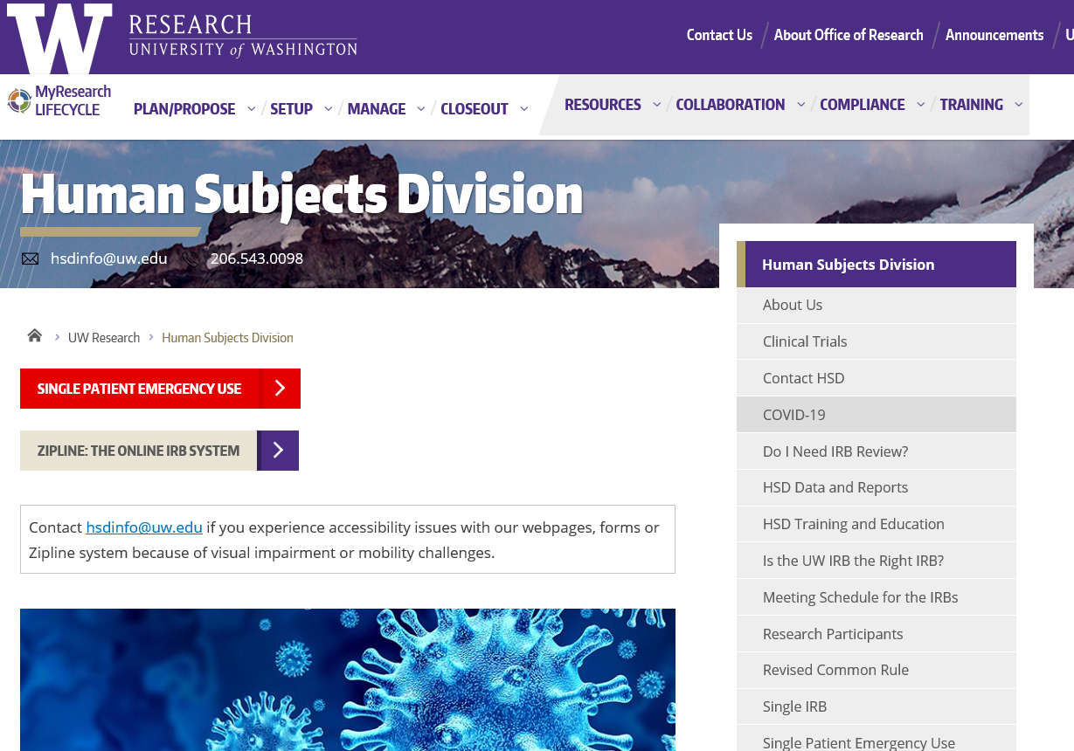
New Resource: COVID-19 webpage

Slide 28
Considerations for ongoing research
Remote procedures*
Delay, postpone
Participant safety monitoring*
*Modification required

Slide 29
HSD and IRB Priorities
Modifications to ongoing research required because of COVID-19
COVID-19 and SARS-CoV-2 research
This may mean some delay for other types of applications

Slide 30
NSF: SciENcv
Biosketches and
Current & Pending Support

Slide 31
SciENcv for Biosketches
Biosketches must be developed entirely within an NSF approved format
SciENcv provides an NSF approved format
Do NOT make any changes to PDF after download
SciENcv is easy to use and multiple training resources available from SciENcv

Slide 32
SciENcv for Current and Pending Support
NSF released: Current and Pending Support FAQs
March 2020:
SciENcv will produce an NSF-compliant PDF version of current & pending support format
NSF will also release a fillable PDF format
June 1, 2020:
NSF requires an approved format for current & pending support upon implementation of the Proposal and Award Policies and Procedures Guide (PAPPG) (NSF 20-1), for all proposals submitted or due on or after 6.01.2020.
https://www.nsf.gov/bfa/dias/policy/cps.jsp

Slide 33
Resources
YouTube Video: SciENcv Tutorial
YouTube Video: Integrating with ORCID
SciENcv Help
Current and Pending Support FAQs
PAPPG 20-1 (Effective 6.01.2020)

Slide 34
External Funding:
Gift or Sponsored Program
March, 2020 MRAM
Carol Rhodes
Director, Office of Sponsored Programs
Tobin Eckholt
Director, Gift Services

Slide 35
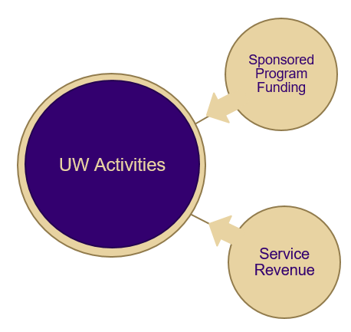
Distinguishing between Gifts and
Sponsored Programs
Sponsored Program Funding
UW Activities
Gift Funding

Slide 36
Private Gifts and Grants Acceptance
Task Force
Purpose
Scope
Participation & Subcommittees
Outcomes and Next Steps

Slide 37
Outcome: GIM 34 Updates
GIM 34 has been the policy on distinguishing external support as either a gift or sponsored program
Getting outdated as handling has changed
Updates intended to clarify distinguishing factors, and provide the correct process information for each type of funding

Slide 38
Significant Updates (1 of 2)
Changed Title from "Classification of External Support" to “Classification of External Support as either a Sponsored Program or as a Gift"
intent of GIM is to address sponsored programs and gift funding not all types of external funding
Updated information on the “hallmarks” of gift versus a sponsored program
New resources developed to help campus understand which path to follow
Updated Gift Services Website
Checklist

Slide 39
Significant Updates (2 of 2)
Reminder: compliance regulations and processes that apply to research are still relevant, even if research is carried out with gift funds.
Escalation process to address complexities that make classification of funding difficult.
Gift Funded Research: Compliance Checklist (publication on 3.20.2020)

Slide 40
GIM 34: Myths Busted
Funding determinations are not based on F&A rates (or avoidance of rates).
Final determination is not based merely on the agreement/letter itself.
Funder intent is a factor
if funder intends a gift, but includes t&c that put into “sponsored program” category
Corporate & Foundation Relations (CFR) or Advancement can work with the funder on appropriate gift letter format.
Funding made to UWF for a specific researcher’s scope of work does not, in and of itself, make it a sponsored program.
It could be a restricted gift.
Again, the terms and funder intent are factors.

Slide 41
Complex Gifts
Challenges
- Volume: 80,000+ transactions annually
- Variety: Providing proactive answers/solutions
- Veracity: Receiving full documentation
- Velocity: Streamlining check processing
(OFM 5 business day requirement)

Slide 42
Gift Acceptance
What we are screening for in Gift Services:
- Nature of Support (type, amount, restriction)
- Gift agreements or award letters
- Benefits received by funder
- Funder Stipulation
- No overhead/No indirect cost clause
5% Gift Assessment mandated by APS 36.2

Slide 43
Gift Acceptance Worksheet
A new online gift transmittal is in production:
- Built-in logic
- Adaptive form
- Approval workflows
- Maximizing efficiency/minimizing risk

Slide 44
Processing Gifts
Online Gift Transmittal:
https://gs.gifts.washington.edu/uwnetid/GiftTransmittal
PDF forms: https://depts.washington.edu/uwadv/central-resources/gproc/forms/gift-transmittal/
Campus
Send to: Gift Services, Box 359505
Medicine
Send to: UW Medicine Advancement, Box 358045

Slide 45
Questions

Slide 46
External Funding:
Provision of Services or Sponsored Program
March, 2020 MRAM
Carol Rhodes
Director, Office of Sponsored Programs
Fuchi Obioha
Director, UW Tax Office

Slide 47
Why is the Distinction Important?
Overhead structure, taxes and accounting treatment different for services, depending on type of revenue:
Department revenue
Recharge Center
Program Income
Auxiliary
Reporting and audit requirements for sponsored programs specific to funding from awards:
Schedule of Expenditures of Federal Awards
Single Audit
Higher Education Research and Development (HERD) report
UW policy on Sales of Goods and Services: Administrative Policy Statement (APS) 59.5
Notes:
Why timely? UWFT and federal GSA retirement of DUNS# identifier
HERD: The Higher Education Research and Development (HERD) Survey is the primary source of information on separately accounted for R&D expenditures

Slide 48
Guidance Development
Working group:
Management Accounting and Analysis (MAA), Office of Planning & Budgeting (OPB), Research Accounting and Analysis (RAA), and OSP

Slide 49
Results: New Web Guidance and FAQs
Sponsored Program or Service?
Sponsored Program Indicators
Service Indicators
Service Activity: Who do I contact?
Link active on: 3.20.2020

Slide 50
Sale of Goods and Services
Information for Schools/Colleges
Use guidance when deciding whether to route a contract to OSP or handle within School
Office that handle self-sustaining revenue:
Program Income: GCA sets up budget number
Service and Recharge Centers: Set rates with MAA
Govt. contract (when not sponsored program): UW Policy on Sale of Goods and Services and contact (Ann Anderson)
Dept. revenue budget establishment: Budget Office
Discussions underway on future revenue handling within UWFT-inform future system
Notes:
Hand off to Ann for the business planning aspect

Slide 51
So You Want to Sell Something – Now What?

Slide 52
Overview
Campus units endeavoring to diversify business activities and revenue by launching external sales of goods and/or services should execute from a well developed, vetted and approved business plan, that effectively addresses risks to ensure fiscal sustainability, compliance and other issues, prior to embarking on the activity. Otherwise, the effort will likely experience delays, rework and other unintended or unanticipated outcomes impacting all the parties involved.

Slide 53
Considerations
What is the service we’re being asked to perform (or that we’re selling)?
Is this a one-off or is this a planned ongoing service (could impact the level of effort needed for adequate due diligence)?
Do we have the right level and capacity of expertise to engage in the activity, both direct and indirect?
Do we have the services to sell? In other words, what isn’t being done while we’re performing this service (or are we establishing a whole new operation to provide this service)?
Is this service otherwise available in the marketplace? If so, we should ask ourselves why we’re doing it and if we still do it, it’s likely subject to Unrelated Business Income Tax (activities that are otherwise available or that don’t align with our exempt purpose).
Are there any potential reputational issues related to what we’re selling or to whom that should be identified and managed and/or communicated?

Slide 54
Considerations (con’t)
Is there a business plan?
Fiscal sustainability, including full cost recovery (including unit and institutional overhead)
Are there IP issues? Engage CoMotion
Are the data security issues? Engage UWIT/CISO
Are there HR issues?
What’s the plan for billing/ensuring the customer pays and a plan for if/when they don’t
Does the department have a role? Do they know? Are they on board? Do they have capacity?
Are there stakeholders outside the unit?
Is there an international component? Engage Office of Global Affairs
Are there legal issues? Engage Attorney General’s Office
Is there a need to “vet” customers? Who will do it and how?

Slide 55
When Is Support Needed or Approval Required?
Incidental sales of gear to alumni or supplies to students
Student services (revenue generating career fairs and interview programs)
Sponsored research and “pure” sponsorship agreements (managed by OSP)
Incidental, student focused, and otherwise addressed through other formal processes
Support likely is not required or otherwise already established
Requires borrowing or issuance of debt
Requires resources and/or approval from one or more central offices
New activity for the unit
Little specific business expertise at departmental level
Large scale, mainly commercial activities or first-time
Business Unit Requiring Assistance; Support May be Required
Something in between?
FACTORS:
Substantial revenue and expenses
Departmental business experience
Requires negotiation and execution of business instruments
Involves space, significant institutional input, resources, etc.
Lack of clarity regarding required steps
Business Unit Coordination

Slide 56
Roles and Responsibilities
 | Department/School/ College | Central Business Support | Consulting SMEs (e.g., CoMotion) | Signoffs: Dept/Dean/Chancellor, Provost (e.g., OGA), others?
Develop Idea | X
Initial and ongoing business advice and contract review |  | X
Coordinate compliance, HR, funding, tax, legal, etc. advice |  | X
Provide guidance within area of expertise |  |  | X
Due Diligence Review
Signoff (where appropriate) |  |  |  | X

Slide 57
“Real Life” Examples:
Domestic Executive Education Program
Intellectual property
Contract negotiated after performance had already begun
International Business Consulting Services
Potential employment and tax issues
Delays, rework related to central legal and other reviews
Surprise! Institutional Overhead
Leveraging research for commercial testing
Unclear approval flow and internal loans
Unanticipated taxes
Intellectual property

Slide 58
Existing Policy Guidance
https://www.washington.edu/admin/rules/policies/APS/59.05.html
https://www.washington.edu/globalaffairs/agreements/

