Slide 1
MRAM: Coronavirus Edition
MRAM
March, 2020
Joe Giffels
Office of Research

Slide 2
“Coronavirus” =
SARS-CoV-2 (the virus) = COVID-19 (the disease)
MRAM – Joe Giffels – Office of Research

Slide 3
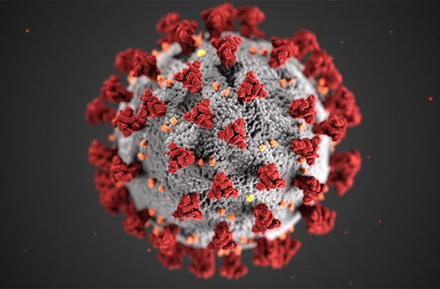
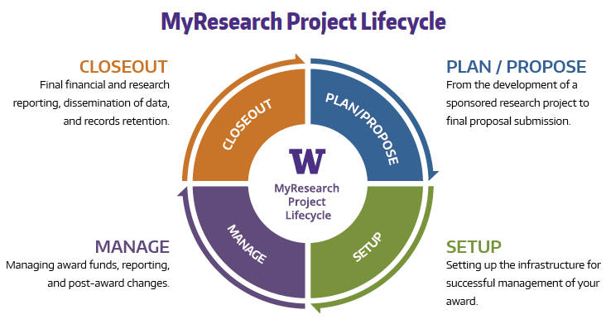
Text
MRAM – Joe Giffels – Office of Research

Slide 4
Operations – our research is not “closed”
Business, Academic and Research Continuity Plan

Slide 5
Text
MRAM – Joe Giffels – Office of Research

Slide 6
Carol Rhodes
Director, Office of Sponsored Programs
Katia Harb
Senior Director, Environmental Health and Safety
Andra Sawyer
Assistant Director, Research Compliance and Operations
Karen Moe
Director, Human Subjects Division

