Slide 1
And Human Subjects Research
Karen Moe, Director
Human Subjects Division March 12, 2020

Slide 2
HSD and the IRB are fully operational
HSD Staff
Working remotely
IRB meetings
Held remotely
Change: Main phone line
Message only; forwarded to hsdinfo@uw.edu
Change: Paper applications
Send by email, not mail or drop-off

Slide 3
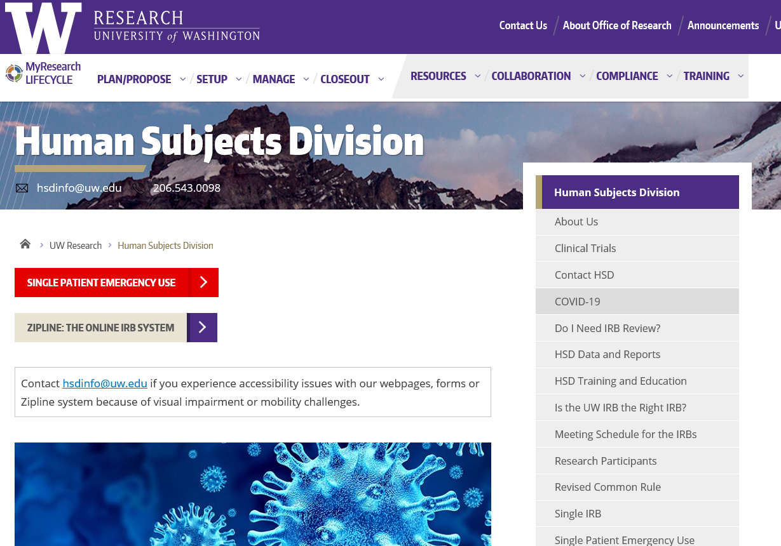
New Resource: COVID-19 webpage

Slide 4
Considerations for ongoing research
Remote procedures*
Delay, postpone
Participant safety monitoring*
*Modification required

Slide 5
HSD and IRB Priorities
Modifications to ongoing research required because of COVID-19
COVID-19 and SARS-CoV-2 research
This may mean some delay for other types of applications

