Slide 1
External Funding:
Gift or Sponsored Program
March, 2020 MRAM
Carol Rhodes
Director, Office of Sponsored Programs
Tobin Eckholt
Director, Gift Services

Slide 2
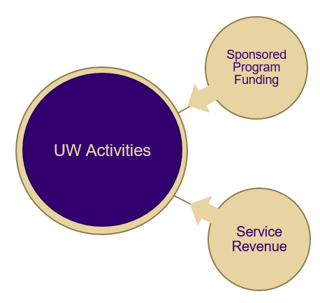
Distinguishing between Gifts and
Sponsored Programs
Sponsored Program Funding
UW Activities
Gift Funding

Slide 3
Private Gifts and Grants Acceptance
Task Force
Purpose
Scope
Participation & Subcommittees
Outcomes and Next Steps

Slide 4
Outcome: GIM 34 Updates
GIM 34 has been the policy on distinguishing external support as either a gift or sponsored program
Getting outdated as handling has changed
Updates intended to clarify distinguishing factors, and provide the correct process information for each type of funding

Slide 5
Significant Updates (1 of 2)
Changed Title from "Classification of External Support" to “Classification of External Support as either a Sponsored Program or as a Gift"
intent of GIM is to address sponsored programs and gift funding not all types of external funding
Updated information on the “hallmarks” of gift versus a sponsored program
New resources developed to help campus understand which path to follow
Updated Gift Services Website
Checklist

Slide 6
Significant Updates (2 of 2)
Reminder: compliance regulations and processes that apply to research are still relevant, even if research is carried out with gift funds.
Escalation process to address complexities that make classification of funding difficult.
Gift Funded Research: Compliance Checklist (publication on 3.20.2020)

Slide 7
GIM 34: Myths Busted
Funding determinations are not based on F&A rates (or avoidance of rates).
Final determination is not based merely on the agreement/letter itself.
Funder intent is a factor
if funder intends a gift, but includes t&c that put into “sponsored program” category
Corporate & Foundation Relations (CFR) or Advancement can work with the funder on appropriate gift letter format.
Funding made to UWF for a specific researcher’s scope of work does not, in and of itself, make it a sponsored program.
It could be a restricted gift.
Again, the terms and funder intent are factors.

Slide 8
Complex Gifts
Challenges
- Volume: 80,000+ transactions annually
- Variety: Providing proactive answers/solutions
- Veracity: Receiving full documentation
- Velocity: Streamlining check processing
(OFM 5 business day requirement)

Slide 9
Gift Acceptance
What we are screening for in Gift Services:
- Nature of Support (type, amount, restriction)
- Gift agreements or award letters
- Benefits received by funder
- Funder Stipulation
- No overhead/No indirect cost clause
5% Gift Assessment mandated by APS 36.2

Slide 10
Gift Acceptance Worksheet
A new online gift transmittal is in production:
- Built-in logic
- Adaptive form
- Approval workflows
- Maximizing efficiency/minimizing risk

Slide 11
Processing Gifts
Online Gift Transmittal:
https://gs.gifts.washington.edu/uwnetid/GiftTransmittal
PDF forms: https://depts.washington.edu/uwadv/central-resources/gproc/forms/gift-transmittal/
Campus
Send to: Gift Services, Box 359505
Medicine
Send to: UW Medicine Advancement, Box 358045

Slide 12
Questions

