Slide 1
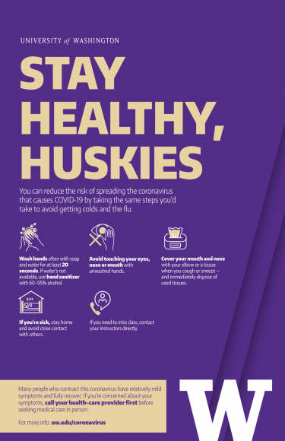
EH&S UPDATE:
COVID-19 PLANNING RESPONSE
Katia Harb
Director
Environmental Health & Safety
MRAM
April 2020

Slide 2
EH&S OPERATIONS
EH&S operations mostly remote and also on-site to support University critical operations including research, healthcare, worker health and safety, COVID-19 public health response.
Examples of on-site activities:
Biological use reviews, approvals, and biosafety cabinet certifications
Chemical waste collection
Employee health center medical exams for COVID-19 research and animal care personnel
Respirator fit testing

Slide 3
KEY POINTS FOR RESEARCH LABS FOR COVID-19 PREVENTION AND SAFETY
Maintain as few people in the lab as possible to conduct work safely.
Maintain social and physical distance (at least 6 feet).
Conduct enhanced cleaning and disinfection of high touch surfaces daily.
Follow good hygiene measures (not touching faces, wash hands frequently)
Ensure personnel stay home if they are sick, have symptoms of illness, or have had contact with someone who has COVID-19.

Slide 4
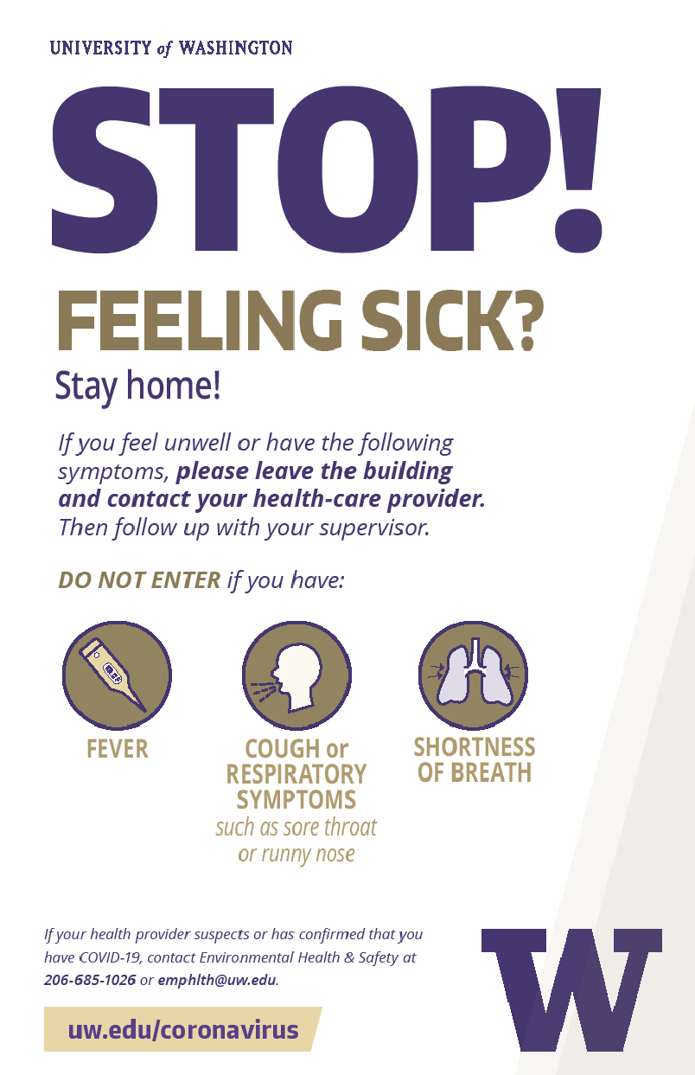
COVID-19 PUBLIC HEALTH GUIDANCE REMINDERS
Stay home if you are sick, even if symptoms are mild.
If you have symptoms related to COVID-19 infection contact your health provider:
Fever
Cough
Shortness of breath
Difficulty breathing
Respiratory symptoms
Report suspect and confirmed COVID-19 cases: Employee Health, 206-685-1026 or emphlth@uw.edu.

Slide 5
HOW THE UNIVERSITY RESPONDS TO COVID-19 CASES
Obtain details about the person’s symptoms, locations on campus, close contacts (personal information is kept private).
Conduct a risk assessment to determine an action plan.
Provide guidance to ill person for self-isolation.
Notify the school department and/or work unit.
Notify people who had close contact. Ask them to stay home for 14 days.
Evaluate spaces for enhanced cleaning and disinfection.
UW is in ongoing coordination with local health departments on COVID-19 response.
UW COVID-19 Daily Case Counts: https://www.washington.edu/coronavirus/testing-results/
Notes:
Obtain details about the person’s symptoms, locations on campus, close contacts (personal information kept private).
Conduct a risk assessment to determine an action plan.
Provide guidance to ill person for self-isolation.
Notify the school department and/or work unit.
Notify people who had close contact (within 6 feet, for more than a few minutes) with the ill person during 48 hours prior to onset of symptoms and while symptomatic. Close contacts asked to stay home and monitor health for 14 days.
Evaluate spaces for enhanced cleaning and disinfection where an ill person spent time 48 hours prior to symptoms developing through seven days after the person was in a University space.
UW is in ongoing coordination with local health departments on COVID-19 response.
UW COVID-19 Daily Case Counts : https://www.washington.edu/coronavirus/testing-results/

Slide 6
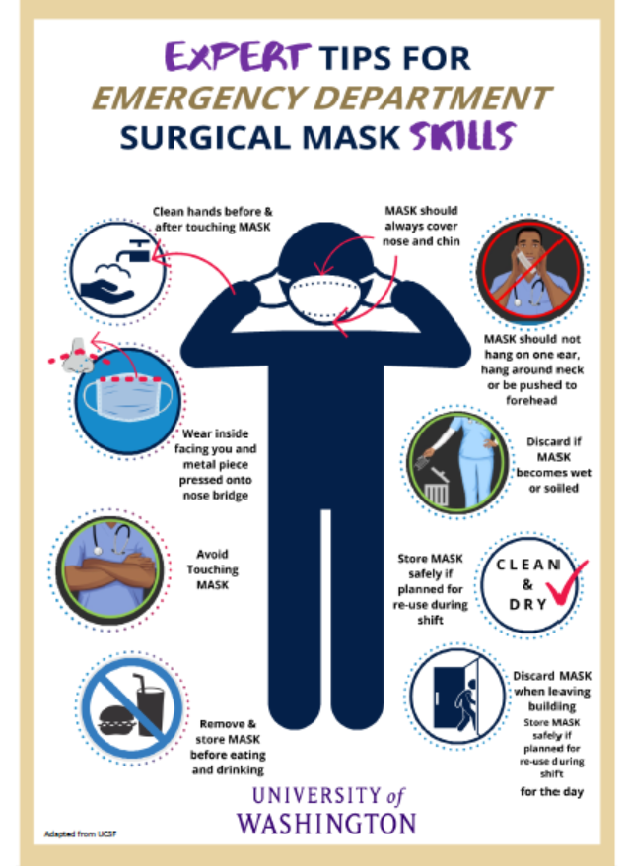
EH&S COVID-19 RESOURCES AND UPDATES
GUIDANCE UPDATED REGULARLY
EH&S COVID-19 Resources :
https://www.ehs.washington.edu/covid-19-health-and-safety-resources
Guidance on Facemask Use for COVID-19
Lab business continuity guide
Enhanced cleaning and disinfection
COVID-19 prevention for researchers (Office of Research Partnership)
Guidance for conservation of personal protective equipment
UW Novel Coronavirus Main Website: https://www.washington.edu/coronavirus/
What to do if you are sick; what to do if you have COVID-19; What to do if you are in close contact with someone with COVID-19; How the University follows up when there is a case.

Slide 7
QUESTIONS
General Questions
Contact EH&S at 206-543-7262, ehsdept@uw.edu

