Slide 1
COVID-19: OSP Update
April 2020 MRAM
Carol Rhodes
Office of Sponsored Programs

Slide 2
COVID-19: Check UW Guidance
Is the charge to my grant allowable?
Check Post Award Fiscal Compliance COVID-19 page.
If Sponsor permission is needed, follow OSP’s COVID-19 communication instructions.
Notes:
Describe the specific situation & inability to carry out specific aspects of the research, delays, etc.
OSP will document the communication in SAGE, and be available to confirm as the authorized official or help respond to follow-up questions.

Slide 3
COVID-19:
Communicating with your Sponsor & OSP
Communicate with Sponsors Early!
Delays? Changes in scope? Taking advantage of flexibilities granted?
Use: “C19” as a prefix in the subject line
CC: grant or contract administrative rep, e.g.:
Grants Management Specialist (NIH)
Grant Officer (other federal grants)
Contracting Officer (federal contracts)
CC: osp@uw.edu
Communicating with OSP?
Use “C19” as a prefix in your short titles and email subject lines to let OSP know it is COVID-19 related!
All COVID-19 items are prioritized!
Notes:
Describe the specific situation & inability to carry out specific aspects of the research, delays, etc.
OSP will document the communication in SAGE, and be available to confirm as the authorized official or help respond to follow-up questions.

Slide 4
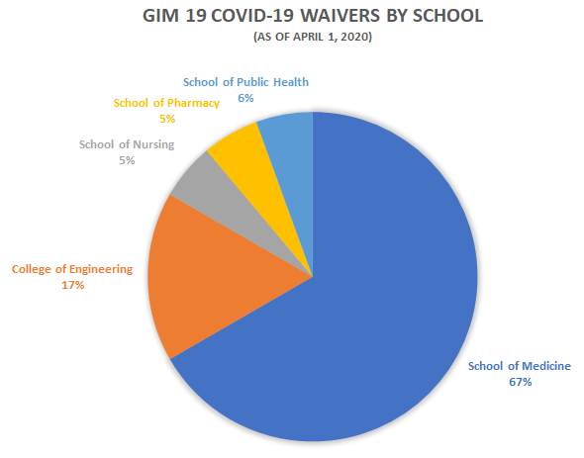
C19 by the Numbers - March 2020
GIM 19 Waivers, Proposals, & Agreements
COVID-19 Related
GIM 19 Waivers: 18
Proposals: 38
Agreements: 10

Slide 5
Outgoing Subawards & C19: Proposals and Managing the Award Impacts
Proposals:
If there will be a delay in obtaining subrecipient documents, please seek a GIM 19 waiver as early as possible.
When a subrecipient reports impacts:
Determine impacts to the overall project.
Follow the OSP instructions for communicating COVID-19 impacts to your sponsor.
Request modifications to the subaward, as appropriate.
Questions? Send an email to ospsubs@uw.edu

