Slide 1
MRAM | Monthly Research Administration Meeting
May 14, 2020 9:00 AM – 10:00 AM Hosted Remotely Join the LIVE Webinar - https://washington.zoom.us/j/346891888
TOPIC | PRESENTER | EMAIL | MIN
Welcome | Kirsten DeFries Research Compliance & Operations | kirsten5@uw.edu | 2
Return to Research | Joe Giffels Office of Research | jgiffels@uw.edu | 10
Salary Payments under COVID | Matt Gardner Post Award Fiscal Compliance | gcafco@uw.edu | 10
Compliance Corner | Andra Sawyer Post Award Fiscal Compliance | gcafco@uw.edu | 10
NEXT MEETING June 11, 2020 9:00 AM - 10:00 AM

Slide 2
RETURN TO RESEARCH
PHASE 1
MRAM
May 2020
Joe Giffels
Associate Vice Provost
Office of Research

Slide 3
Regulatory Framework
WA State Governor’s Safe Start Phase 1 Guidance
WA State Dept of Labor & Industry
Public Health – Seattle & King Co
Advisory Committee on Communicable Diseases
COVID-19 Incident Command
Environmental Health & Safety
Office of Research
UW Guidance
MRAM – Joe Giffels – Office of Research

Slide 4
First…
All research that can be done remotely should be done remotely.
No one with COVID-19 or symptomatic may do in-person research.
Researchers with COVID-19-related concerns should not be pressured to do in-person research.
For in-person research…
MRAM – Joe Giffels – Office of Research

Slide 5
Previously Allowable Research
Research that will help deal with the pandemic
Public health research
Research that has the potential to lead to therapies to treat human health problems
Research that will help the nation recover from the pandemic
Some areas of research that involve human subjects, travel, or field work that are already allowed
MRAM – Joe Giffels – Office of Research

Slide 6
Plus Newly Allowable Research
Research required to meet an upcoming deadline
Facilities that support research
MRAM – Joe Giffels – Office of Research

Slide 7
For In-Person Research…
Research/Lab Safety Plan and Training
COVID-19 Supervisor
Daily Symptom Monitoring
Observe All Safety Requirements
Physical Distancing
Face Covering / PPE
Cleaning / Disinfecting
MRAM – Joe Giffels – Office of Research

Slide 8
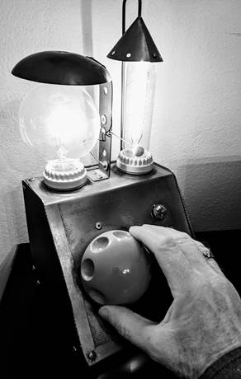
Dial, don’t flip!
MRAM – Joe Giffels – Office of Research

Slide 9
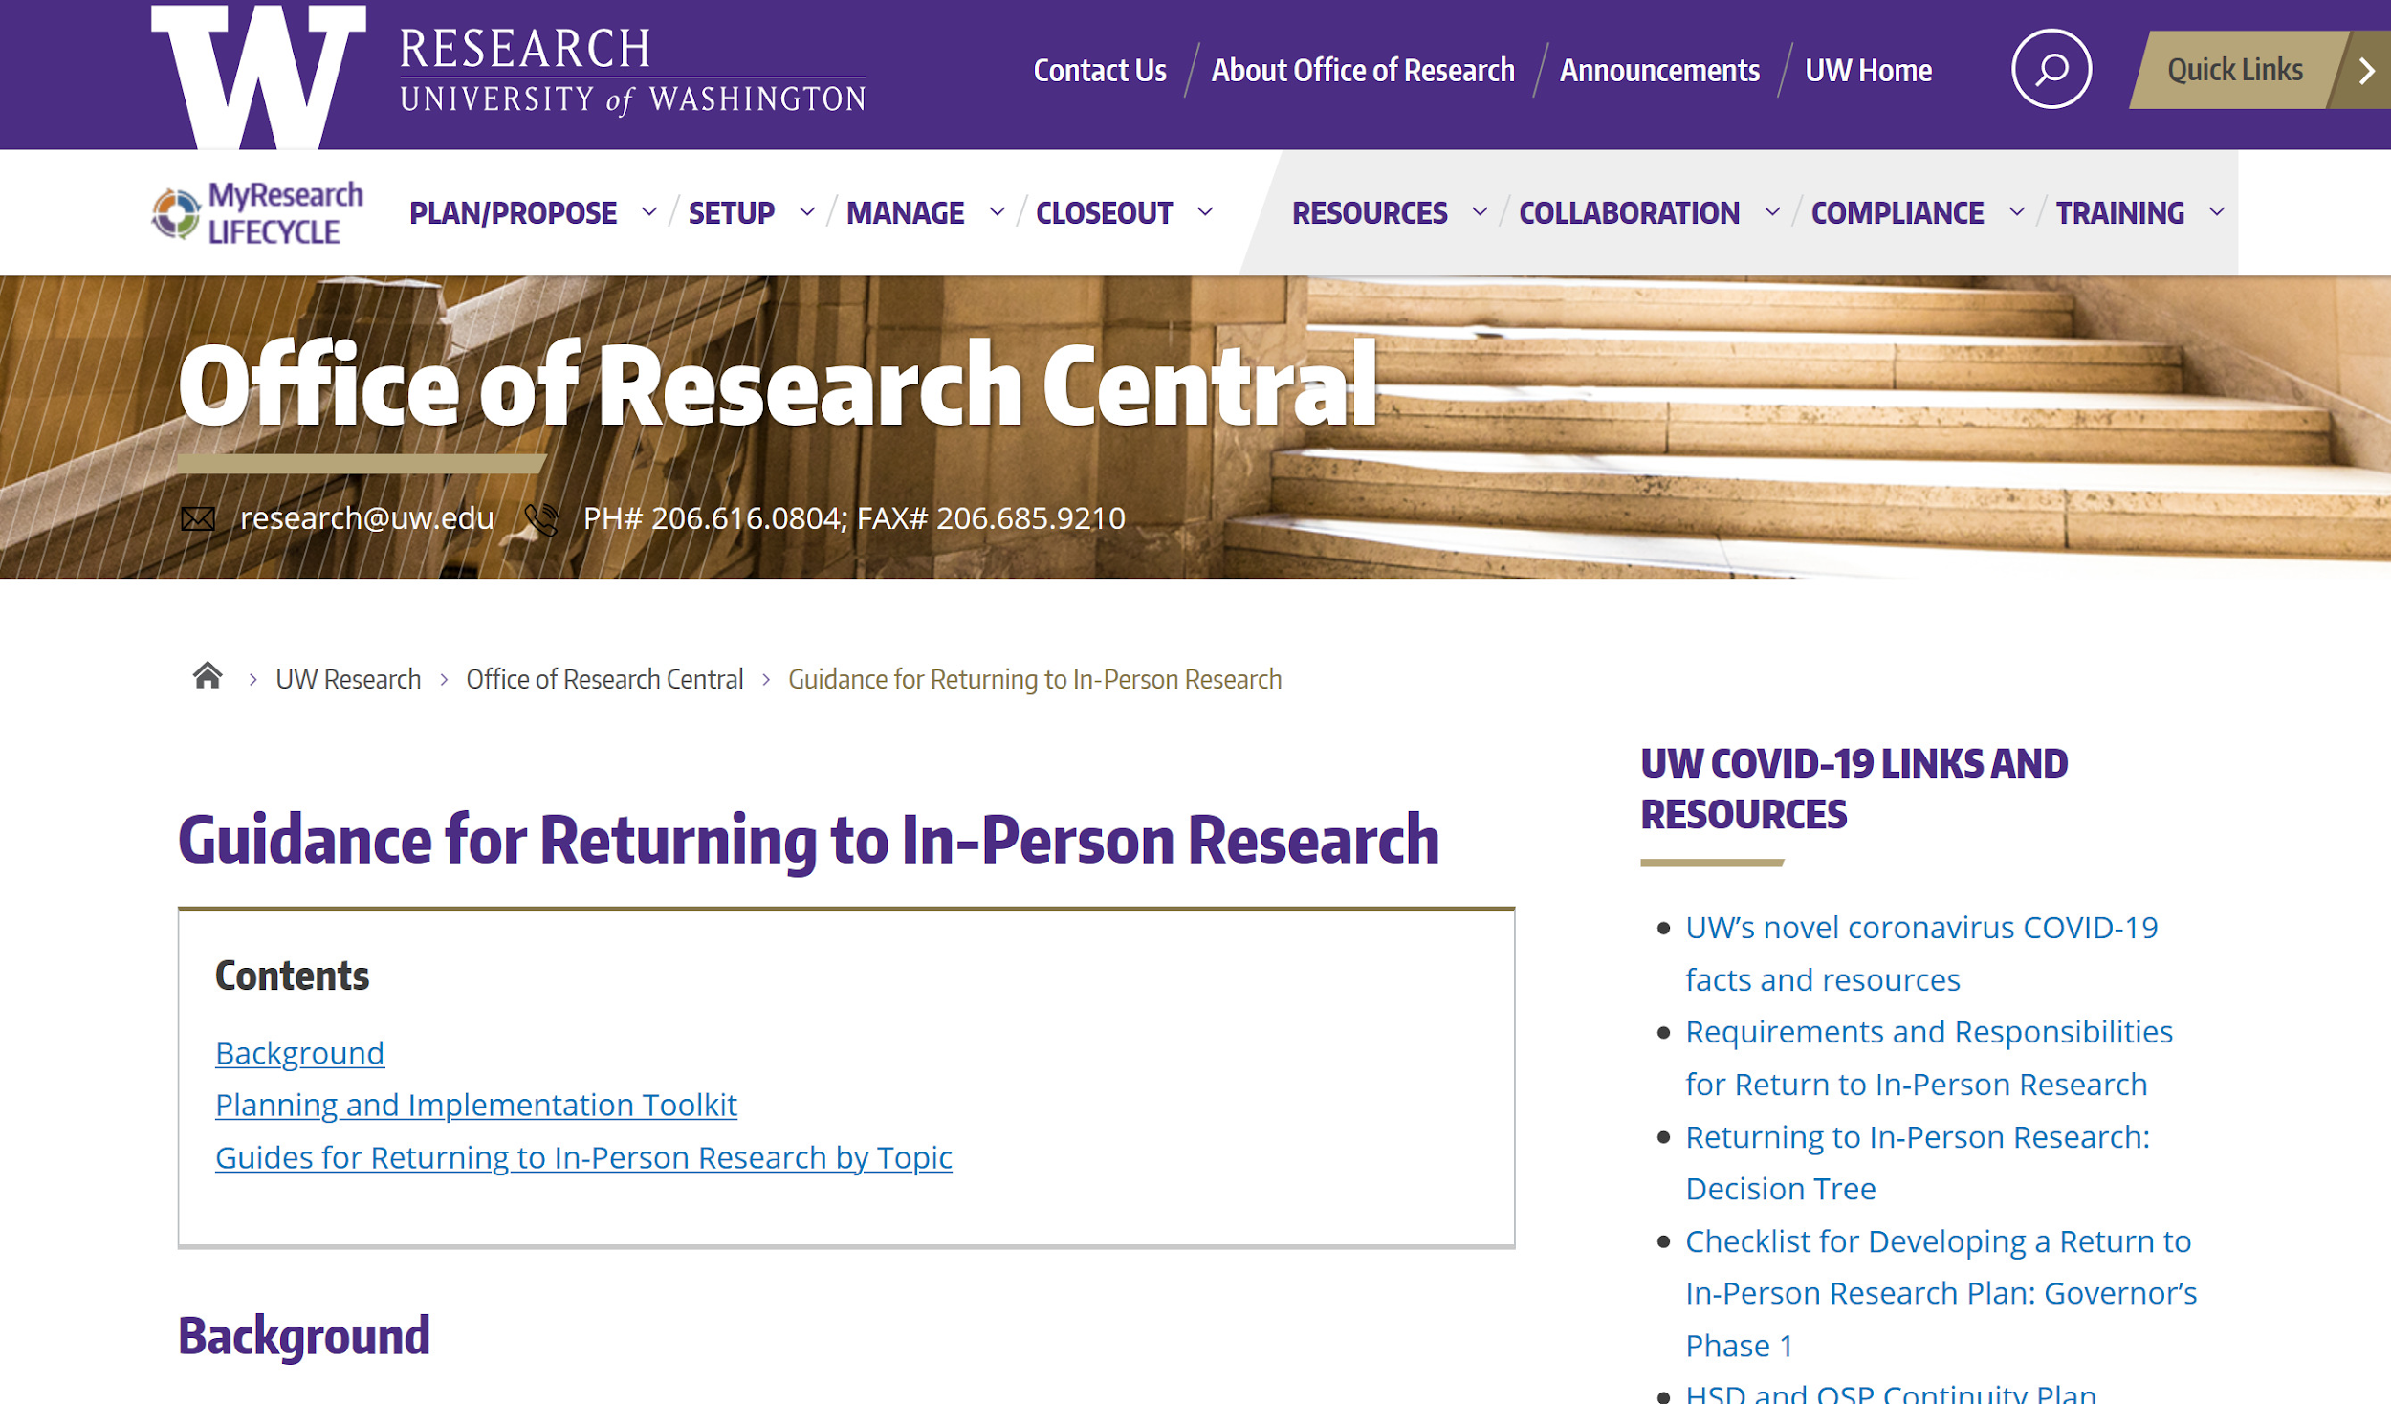
The more you know…
https://www.washington.edu/research/or/guidance-for-returning-to-in-person-research/
MRAM – Joe Giffels – Office of Research

Slide 10
Guides
MRAM – Joe Giffels – Office of Research

Slide 11
PAYMENTS UNDER COVID
MRAM
May 14, 2020
Matt Gardner
Post Award Fiscal Compliance

Slide 12
Awards Impacted by COVID-19:
Sponsor Guidance
OMB issued guidance allowing Federal agencies to provide flexibilities due to COVID-19 impacts.
Federal agencies can issue their own guidance
There is no single Federal guidance regarding COVID-19 impacts
Most Federal agencies have issued COVID guidance; check with your specific sponsor
Non-Federal Sponsors: Follow instructions from your individual sponsor.
MRAM – Matt Gardner – PAFC

Slide 13
Awards Impacted by COVID-19:
Sponsor Guidance
General Information
https://finance.uw.edu/pafc/covid19-information-sponsored-awards
Cancelled Travel
https://finance.uw.edu/pafc/Travel_COVID-19
Other Costs
https://finance.uw.edu/pafc/Other_Costs_COVID-19
MRAM – Matt Gardner – PAFC

Slide 14
Charging Salaries when Research is Disrupted by COVID-19
Scenario: Research is disrupted due to COVID-19; can salary costs be charged to Sponsored Awards even though work cannot be performed?
Some Sponsors are allowing salary charges during COVID disruptions if consistent with the institution’s own policy.
UW issued a Declaration of Extraordinary Circumstances allowing the charging of research salaries if the Sponsor permits such charging.
MRAM – Matt Gardner – PAFC

Slide 15
Charging Salaries during COVID-19 Disruptions:
Step-by-Step Guidance
Step #1: Every effort should be made to identify activities which can benefit the Award. If no activities can be identified…
Step #2: Consider reassigning researchers to other sources of funds where work is available.
If Steps #1 and #2 are unsuccessful:
Step #3: If the Sponsor has a policy to allow for charging of salaries due to COVID disruptions, allocate time to “Stay Home, Stay Healthy” pay.
MRAM – Matt Gardner – PAFC

Slide 16
Charging Salaries during COVID-19 –
Key Points
Check your Sponsor’s policies to confirm if salaries are allowed during COVID-19 disruptions. Do not assume Sponsor is allowing salary charges.
Communicate with your Sponsor if work is disrupted due to COVID-19; Sponsors should be made aware if the research is interrupted or delayed due to COVID-19.
Salary charged cannot exceed pre-COVID-19 levels
There is no guarantee that Sponsors will supplement with additional funding.
Some Sponsor’s are restricting salary charges to existing Awards only.
MRAM – Matt Gardner – PAFC

Slide 17
Charging Salaries during COVID-19 –
Resources
PAFC Webpage
https://finance.uw.edu/pafc/Salary_Expenses_COVID
FAQs
https://finance.uw.edu/pafc/Salary_Expenses_COVID#FAQ
UW HR
https://hr.uw.edu/coronavirus/policy-updates/administrative-leave-during-covid-19/
MRAM – Matt Gardner – PAFC

Slide 18
Questions
Post Award Fiscal Compliance (PAFC)
gcafco@uw.edu
https://finance.uw.edu/pafc/
Andra Sawyer
andra2@uw.edu
Matt Gardner
mgard4@uw.edu
MRAM – Matt Gardner – PAFC

Slide 19
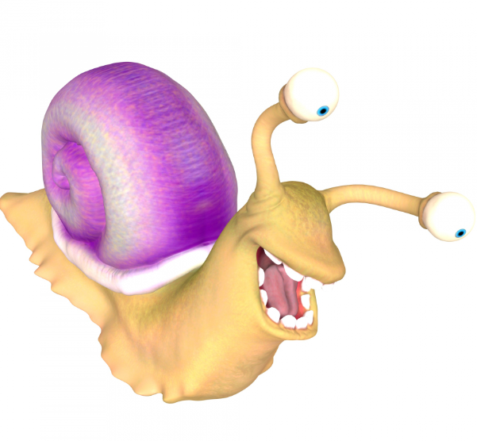
Compliance
Corner
May 2020
Andra Sawyer
Post Award Fiscal Compliance
gcafco@uw.edu

Slide 20
NSF Audit: By the Numbers
November 2015: UW position on questioned costs:
Agreed with disallowance: $71k
Disagreed: $108k
Total: $179k
February 2020: NSF final determination
Disallowed: $77k
Allowed: $102k
Total: $179k

Slide 21
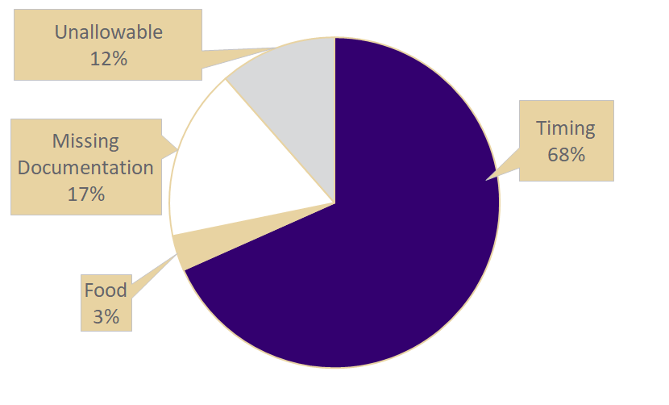
NSF Audit: Disallowed Costs $77,000

Slide 22
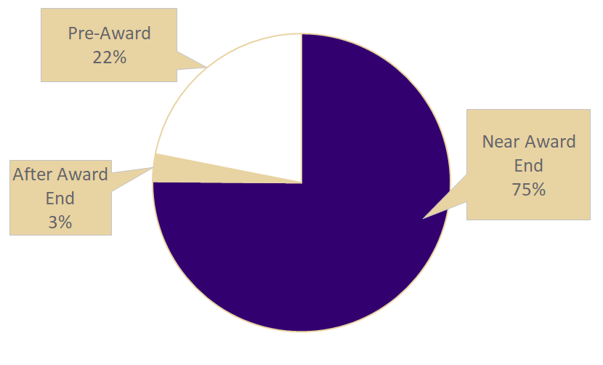
NSF Audit: Timing Disallowed Costs $52,000

Slide 23
If only there was more information on Timing…
PAFC website: https://finance.uw.edu/pafc/expenditure-timing
Data analytics dashboard (end of Award equipment): https://finance.uw.edu/pafc/Dashboard_End_of_Award_Equipment_Purchases
Timing of Expenditures eLearning: https://www.washington.edu/research/research-administration-learning/timing-of-expenditures-benefit-to-award/
CORE Fiscal Compliance Class: https://www.washington.edu/research/research-administration-learning/grant-and-contract-fiscal-administration-compliance/
CORE Preparing for Audit Class: https://www.washington.edu/research/research-administration-learning/preparing-for-audit/
In-person presentation & discussion: Happy to do it! Just ask PAFC.

Slide 24
NSF 2-Month Rule: Still in Effect
NSF’s 2-month rule: senior personnel can only expend up to two months of their Institutional Base Salary (IBS) on all NSF Awards in one UW fiscal year.
Questioned costs on UW’s compliance with NSF’s 2-month rule: $1.8m
For more information, a calculation tool & EDW report: https://finance.uw.edu/pafc/nsf-2month-rule-regulation-and-resources

Slide 25
Anticipated Questions
The answer to ALL the following questions is YES:
Did we have to refund $77,000 to NSF?
Did the PI’s, who had the Awards with disallowed costs, have to identify unrestricted funds to cover their portion of the $77,000?
Could NSF, or another federal agency, do a similar audit at the UW again?
Did the UW spend more responding to the NSF audit than the amount of the disallowed costs?
Are Matt and Andra happy to assist departments in staying out of trouble with the auditors?

Slide 26
All in-person classes have transitioned to Zoom; No impact on the Certificate in Research Administration
Please provide feedback, either class survey or to CORE (corehelp@uw.edu)
Please be sure to update your Zoom account – must be using version 5.0 by May 30
https://itconnect.uw.edu/connect/phones/conferencing/zoom-video-conferencing/updates/

Slide 27
Thank you! Next MRAM is June 11

