Slide 1
RETURN TO RESEARCH
PHASE 1
MRAM
May 2020
Joe Giffels
Associate Vice Provost
Office of Research

Slide 2
Regulatory Framework
WA State Governor’s Safe Start Phase 1 Guidance
WA State Dept of Labor & Industry
Public Health – Seattle & King Co
Advisory Committee on Communicable Diseases
COVID-19 Incident Command
Environmental Health & Safety
Office of Research
UW Guidance
MRAM – Joe Giffels – Office of Research

Slide 3
First…
All research that can be done remotely should be done remotely.
No one with COVID-19 or symptomatic may do in-person research.
Researchers with COVID-19-related concerns should not be pressured to do in-person research.
For in-person research…
MRAM – Joe Giffels – Office of Research

Slide 4
Previously Allowable Research
Research that will help deal with the pandemic
Public health research
Research that has the potential to lead to therapies to treat human health problems
Research that will help the nation recover from the pandemic
Some areas of research that involve human subjects, travel, or field work that are already allowed
MRAM – Joe Giffels – Office of Research

Slide 5
Plus Newly Allowable Research
Research required to meet an upcoming deadline
Facilities that support research
MRAM – Joe Giffels – Office of Research

Slide 6
For In-Person Research…
Research/Lab Safety Plan and Training
COVID-19 Supervisor
Daily Symptom Monitoring
Observe All Safety Requirements
Physical Distancing
Face Covering / PPE
Cleaning / Disinfecting
MRAM – Joe Giffels – Office of Research

Slide 7
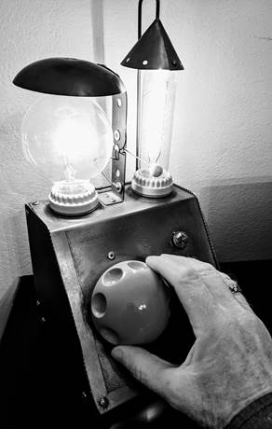
Dial, don’t flip!
MRAM – Joe Giffels – Office of Research

Slide 8
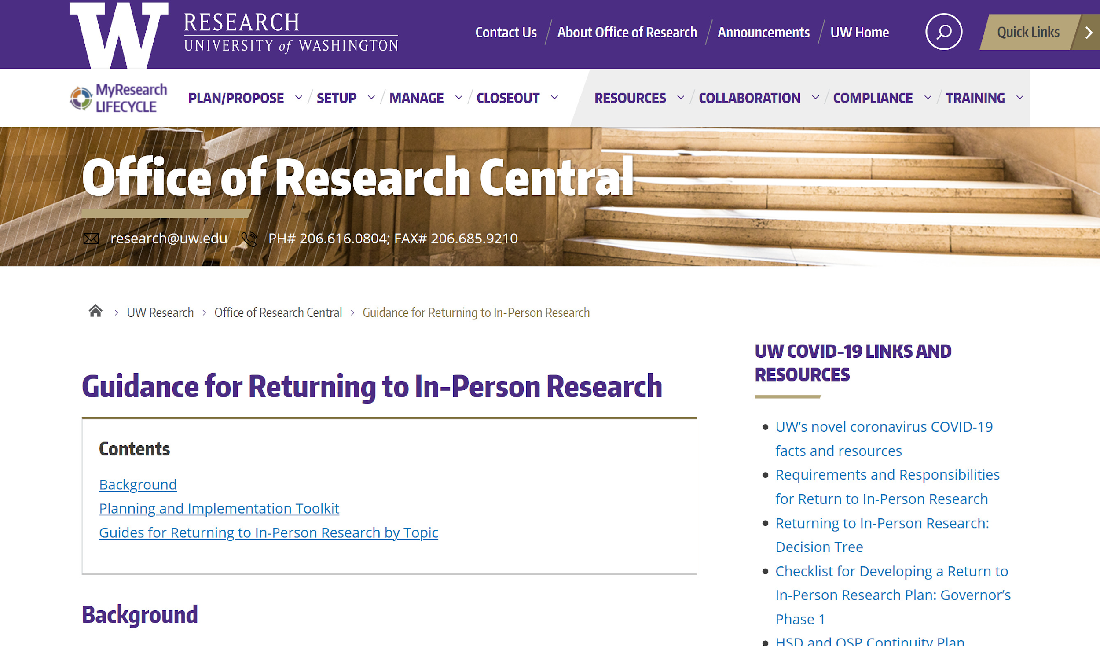
The more you know…
https://www.washington.edu/research/or/guidance-for-returning-to-in-person-research/
MRAM – Joe Giffels – Office of Research

Slide 9
Guides
MRAM – Joe Giffels – Office of Research

