Slide 1
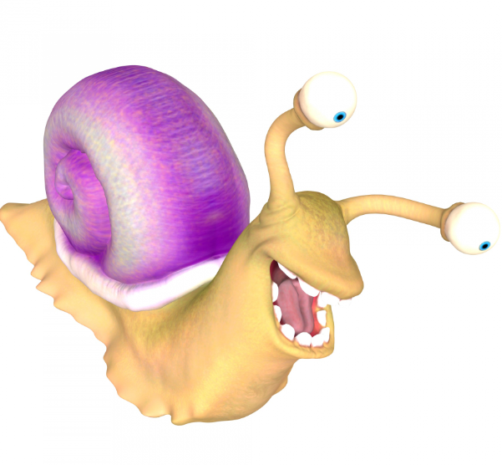
Compliance
Corner
May 2020
Andra Sawyer
Post Award Fiscal Compliance
gcafco@uw.edu

Slide 2
NSF Audit: By the Numbers
November 2015: UW position on questioned costs:
Agreed with disallowance: $71k
Disagreed: $108k
Total: $179k
February 2020: NSF final determination
Disallowed: $77k
Allowed: $102k
Total: $179k

Slide 3
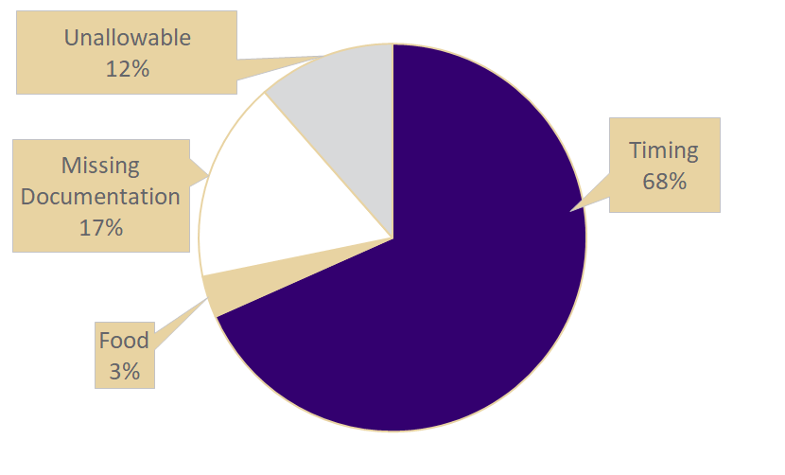
NSF Audit: Disallowed Costs $77,000

Slide 4
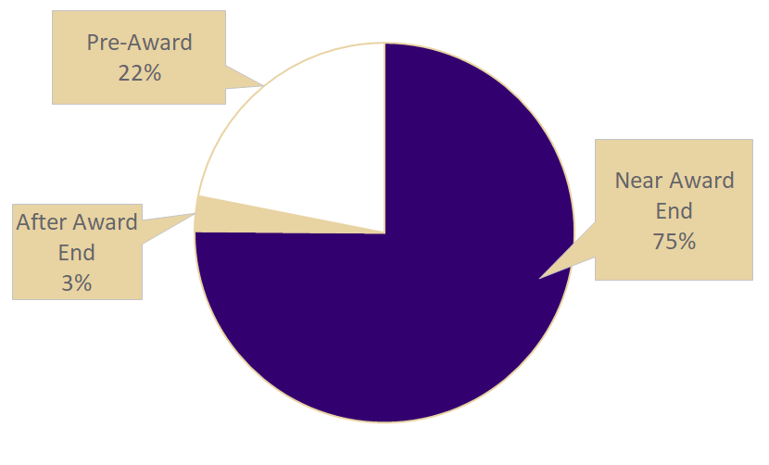
NSF Audit: Timing Disallowed Costs $52,000

Slide 5
If only there was more information on Timing…
PAFC website: https://finance.uw.edu/pafc/expenditure-timing
Data analytics dashboard (end of Award equipment): https://finance.uw.edu/pafc/Dashboard_End_of_Award_Equipment_Purchases
Timing of Expenditures eLearning: https://www.washington.edu/research/research-administration-learning/timing-of-expenditures-benefit-to-award/
CORE Fiscal Compliance Class: https://www.washington.edu/research/research-administration-learning/grant-and-contract-fiscal-administration-compliance/
CORE Preparing for Audit Class: https://www.washington.edu/research/research-administration-learning/preparing-for-audit/
In-person presentation & discussion: Happy to do it! Just ask PAFC.

Slide 6
NSF 2-Month Rule: Still in Effect
NSF’s 2-month rule: senior personnel can only expend up to two months of their Institutional Base Salary (IBS) on all NSF Awards in one UW fiscal year.
Questioned costs on UW’s compliance with NSF’s 2-month rule: $1.8m
For more information, a calculation tool & EDW report: https://finance.uw.edu/pafc/nsf-2month-rule-regulation-and-resources

Slide 7
Anticipated Questions
The answer to ALL the following questions is YES:
Did we have to refund $77,000 to NSF?
Did the PI’s, who had the Awards with disallowed costs, have to identify unrestricted funds to cover their portion of the $77,000?
Could NSF, or another federal agency, do a similar audit at the UW again?
Did the UW spend more responding to the NSF audit than the amount of the disallowed costs?
Are Matt and Andra happy to assist departments in staying out of trouble with the auditors?

Slide 8
All in-person classes have transitioned to Zoom; No impact on the Certificate in Research Administration
Please provide feedback, either class survey or to CORE (corehelp@uw.edu)
Please be sure to update your Zoom account – must be using version 5.0 by May 30
https://itconnect.uw.edu/connect/phones/conferencing/zoom-video-conferencing/updates/

Slide 9
Thank you! Next MRAM is June 11

