Slide 1
MRAM | Monthly Research Administration Meeting
June 11, 2020 9:00 AM – 10:00 AM HOSTED REMOTELY Join the LIVE Webinar: https://washington.zoom.us/j/346891888
TOPIC | PRESENTER | EMAIL | MIN
Welcome | Kirsten DeFries Research Compliance & Operations | kirsten5@uw.edu | 2
GrantTracker Enhancements | Austin Campbell Grant & Contract Accounting | gcahelp@uw.edu | 10
Royalty Research Funding | Karen Luetjen Internal Research Funding Programs | luetjen@uw.edu | 10
SAGE: Budget | Judy Chung Office of Research Information Services | jachung@uw.edu | 15
Compliance Corner | Matt Gardner Post Award Fiscal Compliance | gcafco@uw.edu | 10
NEXT MEETING July 9, 2020 9:00 AM - 10:00 AM UW TOWER AUDITORIUM

Slide 2
GrantTracker Enhancements
MRAM
June 11, 2020
Austin Campbell, Grant Analyst
Grant and Contract Accounting (GCA)

Slide 3
Agenda
View Open GrantTracker Notes for Parent and Sub Budgets in Central Location
Reports on Parent and Sub Budgets
Revised Reports on Purged budgets

Slide 4
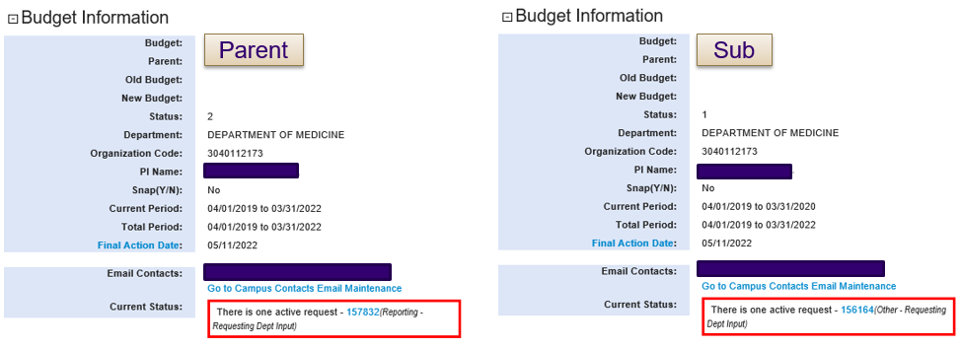
View Open GrantTracker Notes
for Parent and Sub Budgets in Central Location
Previous view – “Current Status”
Only showed open GrantTracker notes for the specific budget you were viewing
Not easy to identify all outstanding requests for one award

Slide 5
View Open GrantTracker Notes
for Parent and Sub Budgets in Central Location
Updated view – “Open GT Notes”
Parent budget view shows open notes for all budgets
Sub budget view shows open notes only for that sub budget
Ability to collapse or expand section

Slide 6
Reports on Parent and Sub Budgets
Awards requiring separate period accountability are sometimes set up with sub budgets to track expenditures for each period
Financial report schedule only visible on the parent budget GrantTracker summary page
Burdensome to navigate if a report was for a period covered only by a specific sub budget
Going forward, these sub budgets will have their own list of reports (established budgets will not be updated)
Parent budget reporting schedule will show all reports for the entire award (parent and subs)
Sub budget reporting schedule will show reports
for that specific budget

Slide 7
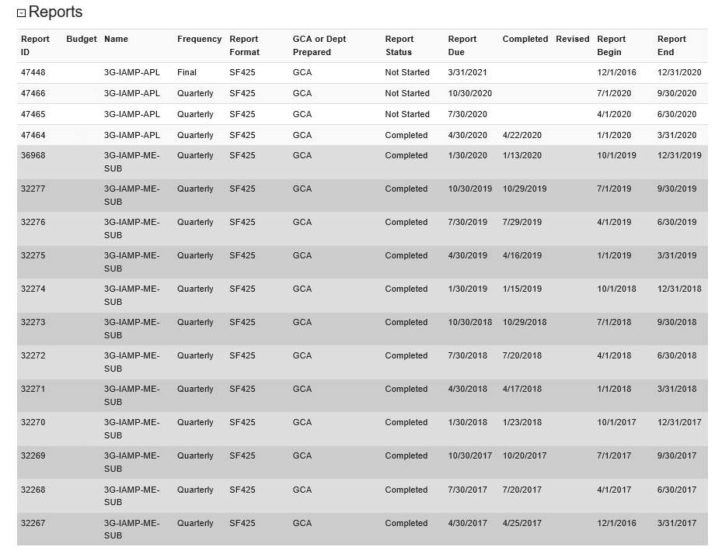
Reports on Parent and Sub Budgets
Parent
Parent view
Budget number and name now show
Sub

Slide 8
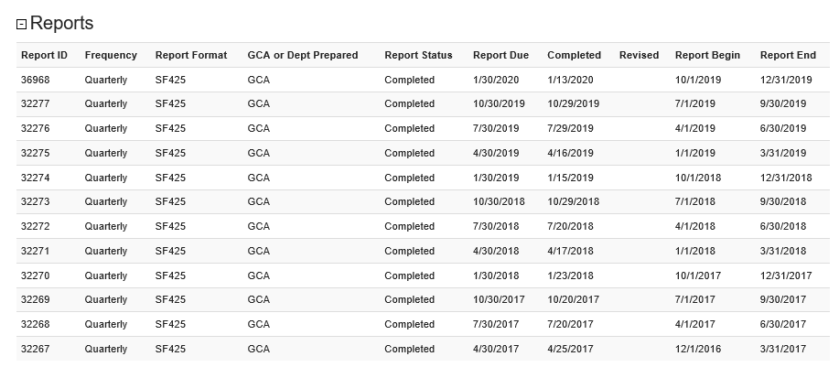
Reports on Parent and Sub Budgets
Sub budget view
Only this sub budget’s reports are listed

Slide 9
Revised Reports on Purged Budgets
Previously we couldn’t update anything in GrantTracker after a budget was purged from the Financial Accounting System (FAS)
Reports on purged budgets need to be revised occasionally
GCA can now add a revised date to reports on purged budgets in GrantTracker

Slide 10
Additional Information
Curious about other updates that have been made?
Check out the GrantTracker Release Information
https://gcaserver.finance.washington.edu/gca/GT/Release
Also accessible from any GrantTracker page if you scroll down and click on the hyperlink in the right of the footer
It should look like “ver. 4.10 6/5/2020”
This is just an example of the most recent version/update
If you have any questions or feedback regarding these updates, please contact us at gcahelp@uw.edu.

Slide 11
ROYALTY RESEARCH FUND
MRAM
June 2020
Karen Luetjen
Office of Research

Slide 12
Royalty Research Fund (RRF)
Funded from royalty and licensing fee income
Two deadlines per year – March and September
Average of 26% of applicants receive awards
Grants up to $40,000
MRAM - Luetjen – Office of Research

Slide 13
Purpose
Advance new directions in research
Opportunity for junior faculty
Increase competitiveness for subsequent funding
RRF Scholars program funds release time
MRAM - Luetjen – Office of Research

Slide 14
Process
Application is via SAGE eGC1
Components of application are typical
Projects can be 12 or 24 months in duration
Awards announced in around 4 months and PIs can select budget start date shortly thereafter
MRAM - Luetjen – Office of Research

Slide 15
Peer Review by UW Faculty
Arts, Humanities, and Social Sciences
Basic Biological and Biomedical Sciences
Physical Sciences and Engineering
MRAM - Luetjen – Office of Research

Slide 16
Impact
With RRF support, I developed a new computational approach….
RRF support has been essential to refining my ideas and realizing a book. It has also enabled me to develop material for two undergraduate courses….
This award supported development and submission of research proposals to extend this work, including the following new awards ….
MRAM - Luetjen – Office of Research

Slide 17
Next RRF deadline is September 28
https://www.washington.edu/research/or/royalty-research-fund-rrf/
MRAM - Luetjen – Office of Research

Slide 18
SAGE BUDGET REDESIGN
A LOOK AT WHAT’S COMING SOON
Judy Chung (jachung@uw.edu)

Slide 19
SAGE BUDGET REDESIGN RELEASE
June 25, 2020
5:30 pm

Slide 20
GOALS FOR TODAY
Familiarize you with the project drivers, goals, and user engagement
Preview the new layout & highlights
Share the support/change management plan
Answer questions

Slide 21
DRIVERS
Usability concerns raised by users
Overly complex
Not PI friendly
Inefficient (Excel preferred)
Gaps, needs not met
Many shadow systems and different formats
Challenging for reviewers
Calculation errors, cross-checking needed
Not leveraging institutional data
Notes:
Create a more streamlined, efficient, intuitive design
Address gaps
Upgrade infrastructure to support system integrations in the future

Slide 22
CAMPUS ENGAGEMENT
Survey - over 200 responses
Focus Groups - 3 sessions
SAGE Budget Advisory Group - met monthly
Usability Testing - 3 sessions
RAPIT, RAPN - preview & input
Notes:
Create a more streamlined, efficient, intuitive design
Address gaps
Upgrade infrastructure to support system integrations in the future

Slide 23
NEW DESIGN FEATURES

Slide 24
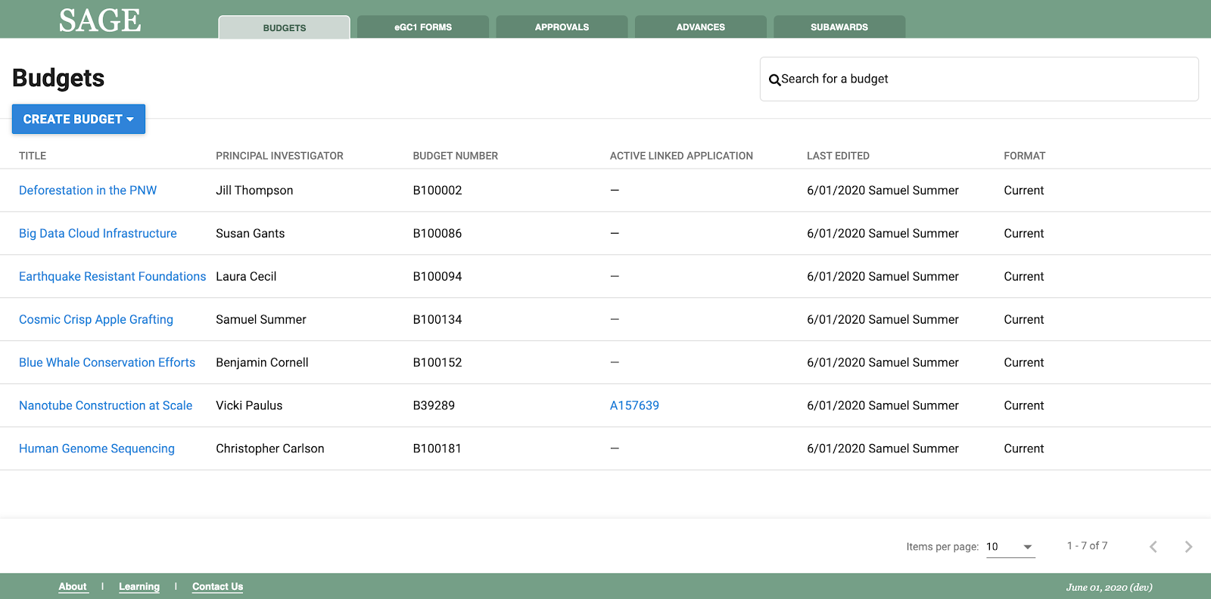
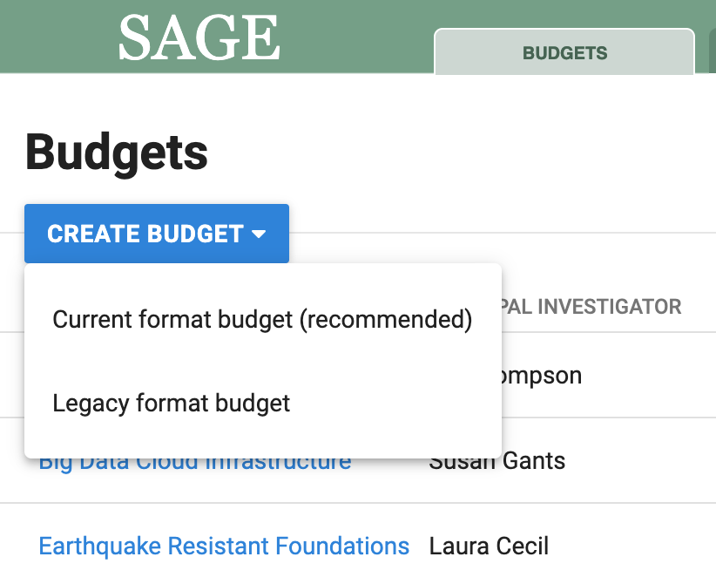
BUDGET LIST REVISIONS
For initial release, users can choose to create new budgets in “Legacy” (old SAGE) format, or use the redesigned “Current” format.
Search
Create
New Budgets
(current or
legacy)

Slide 25
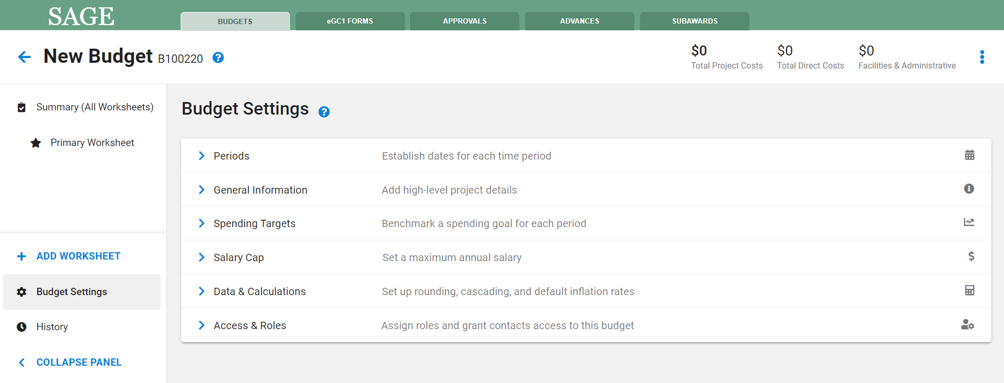
NEW BUDGET - SETTINGS
Notes:
Streamlining by only requiring entry of periods at time of create. By default, will auto-create a new Primary worksheet.

Slide 26
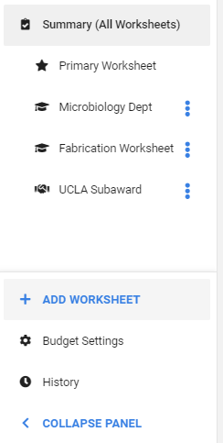
LEFT NAVIGATION WITH MULTIPLE WORKSHEETS
New more intuitive left navigation
Better view of all worksheets included in the overall project budget
Unique icons indicate type of worksheet/sub-budget
Budget Settings and History at bottom
Ability to collapse navigation panel for wider view of budget detail

Slide 27
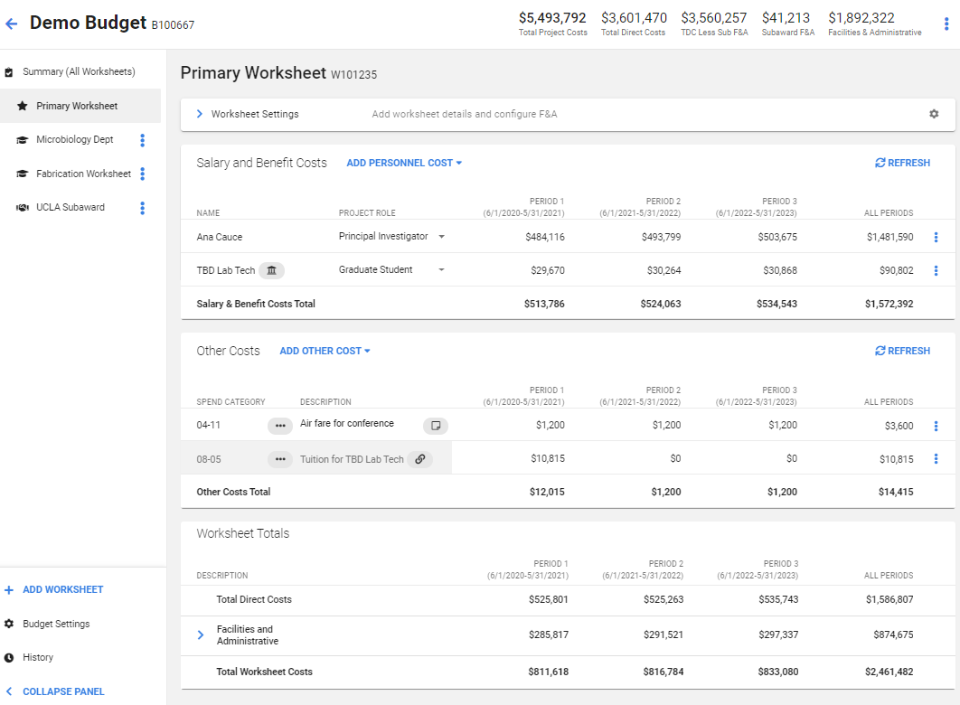
BUDGET WORKSHEETS
Project Totals
Worksheet Settings
More Actions Menu

Slide 28
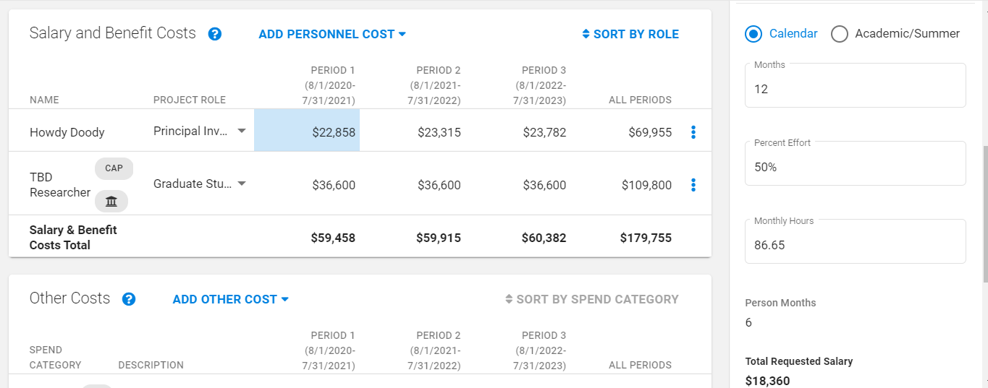
PERSONNEL ENTRY
Enter percent effort or total hours
Customize benefit rate if sponsor restricted
Salary Cap icon displays when over the cap
Click to Open
Details Panel

Slide 29
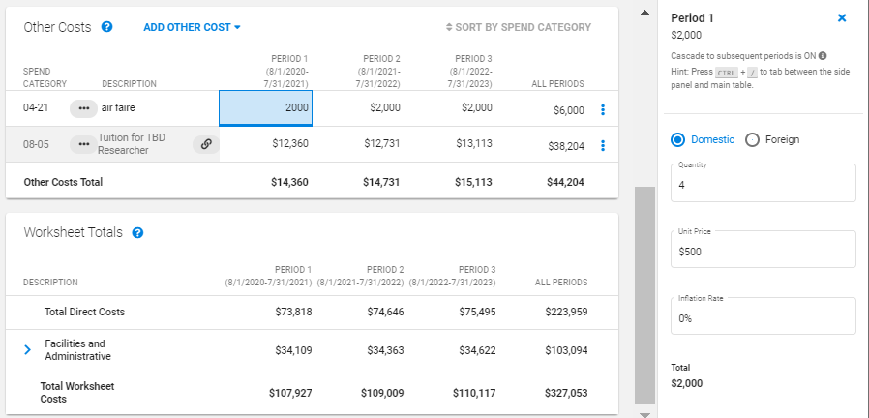
FLEXIBLE ENTRY - INLINE AMOUNT OR QTY X PRICE
Custom Entry Allows Quantity x Price and Inflation
Quick and Easy Inline Entry

Slide 30
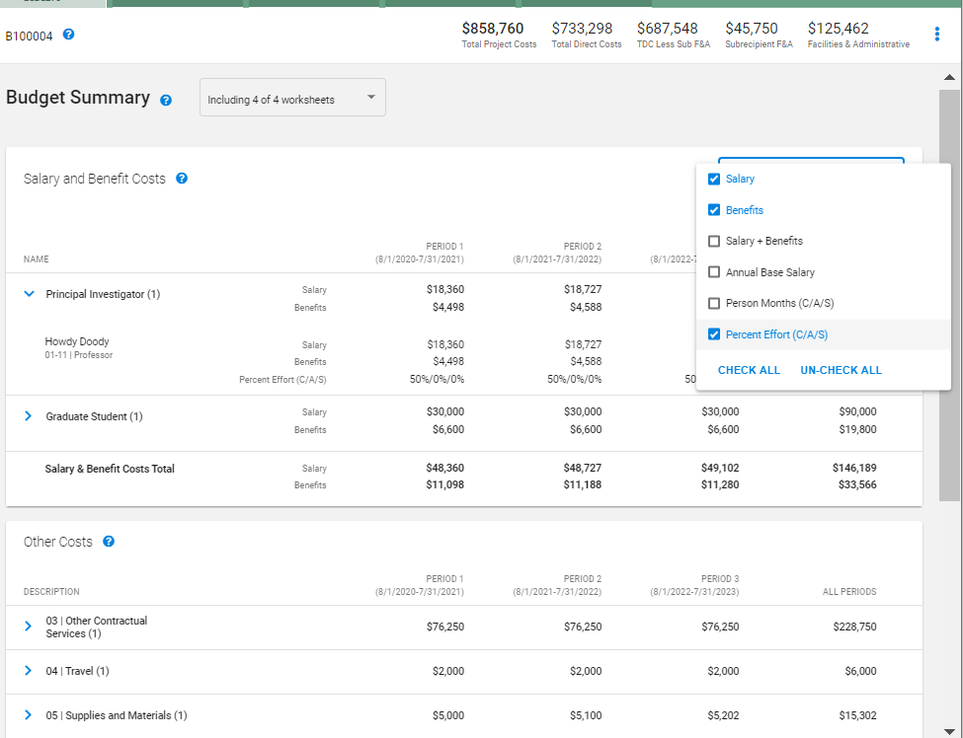
BUDGET SUMMARY
(READ ONLY ROLLUP)
Project
Totals at Top
Expand/Collapse Detailed Expense Rows
Customizable Display of Personnel Details
Notes:
This is what the reviewers would mostly work with during routing.

Slide 31
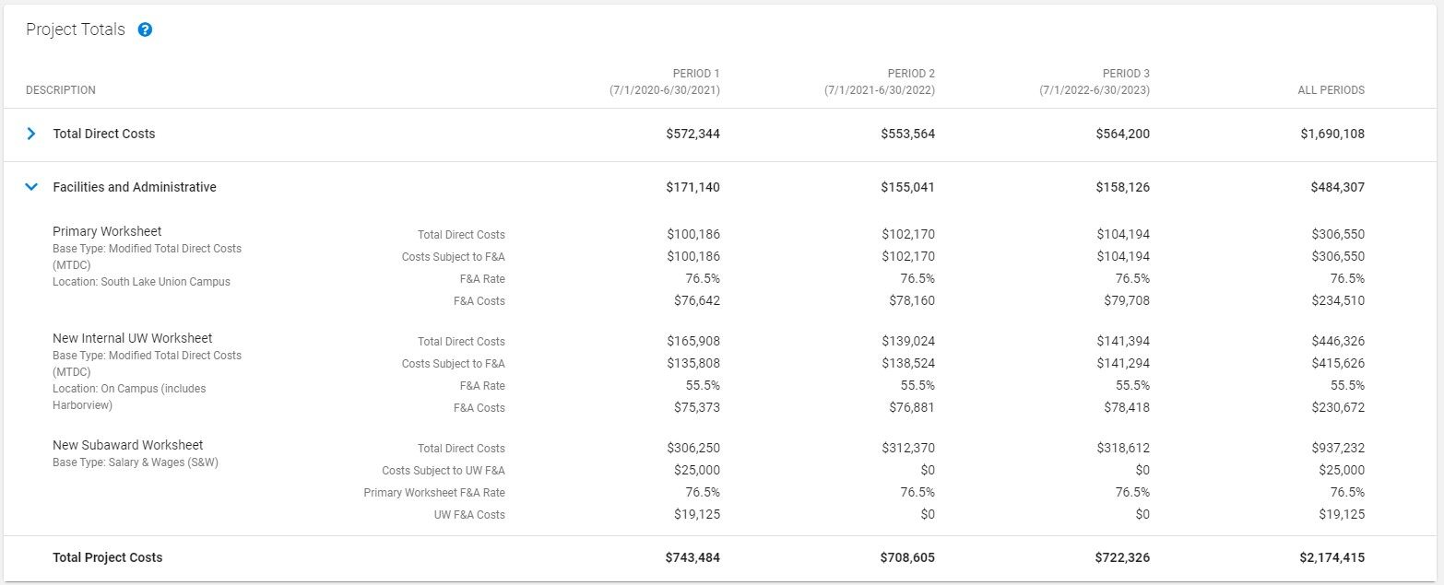
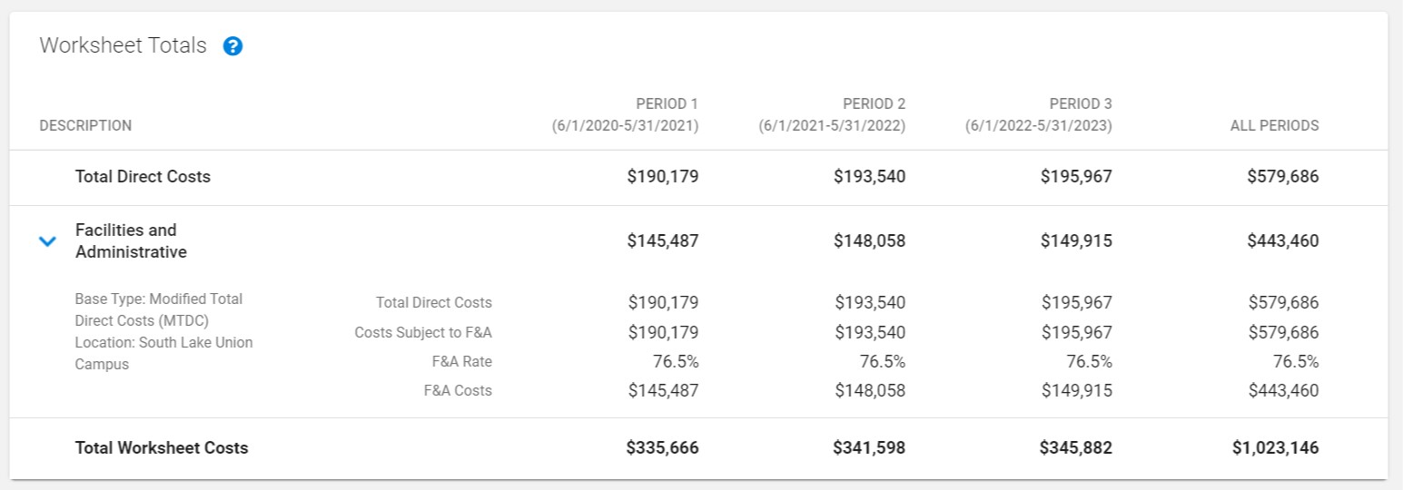
BUDGET F&A TOTALS
Add a slide focused on the Worksheet Totals, with F&A detail expanded

Slide 32
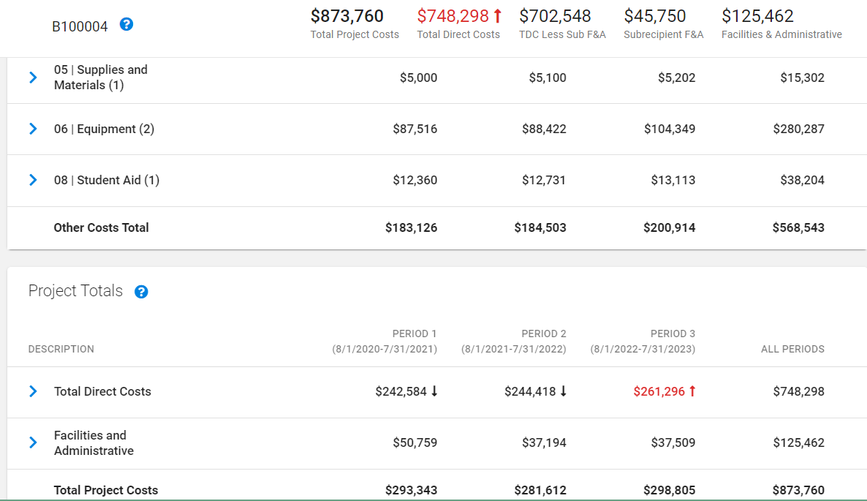
BUDGET TARGETS & LIMITS
Sample: Limit of $250,000 per period in TDC exceeded
Total Direct Costs Exceeds Limit
Period Limit Exceeded
Notes:
Can set targets & limit by period, and apply it to overall costs, TDC, or TDC less subrecipient F&A

Slide 33
EXPORT BUDGET
Export the Following to Excel (.xlsx)
> Budget Summary
> R&R Detailed Budget Format
> Individual Budget Worksheets

Slide 34
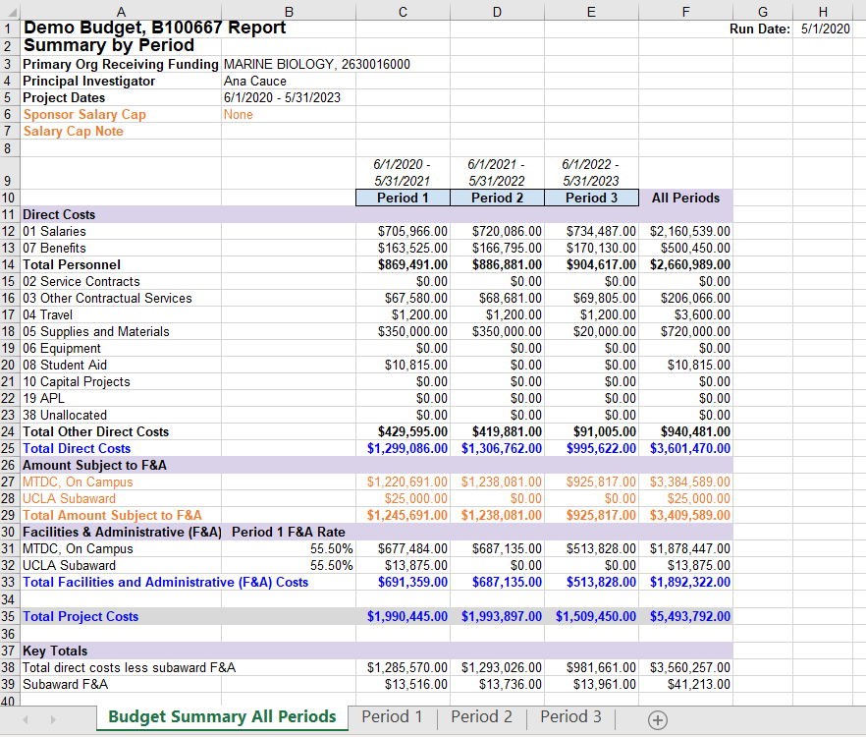
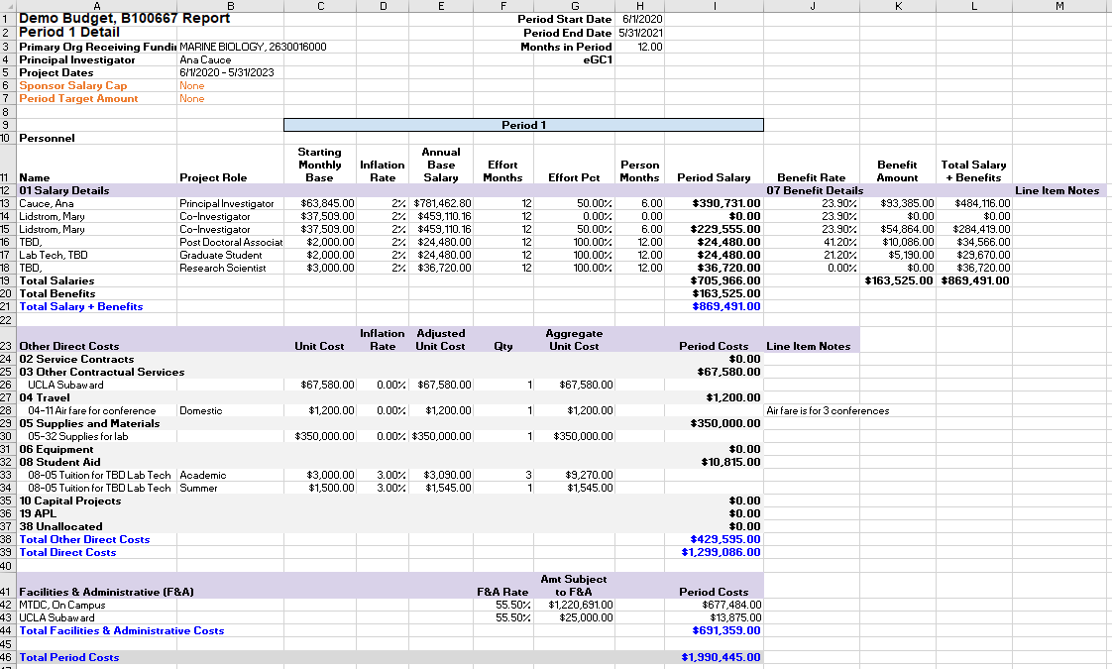
IMPROVED EXPORT LAYOUT
Budget Summary (all periods)
and period breakdown (tabs)
Notes:
Note the tabs at bottom

Slide 35
LEGACY VS CURRENT FORMAT
> Newly Created Budgets (for a limited time)
Can choose to use “legacy” (old) SAGE format or “current” (new) SAGE format
This is for the transition period only; we’ll announce in advance when full cutover will take place
> Existing Budgets
Can keep in legacy format, or upgrade to “current” (new) format
Once you upgrade a budget, you cannot revert back to legacy format

Slide 36
RESOURCES

Slide 37
RESOURCES
Date: Friday, June 26
Time: 10 am - noon AND 1 - 3 pm
Location: Zoom
https://washington.zoom.us/j/98959052578
(10 - noon) https://washington.zoom.us/j/93961983622
(1- 3)
Join us on Friday, June 26 to share your thoughts and ask questions about the redesigned SAGE Budget.
Virtual Office Hours
Demo
Date: Monday, June 29
Time: 10 - 11 am
Location: Zoom
https://washington.zoom.us/j/92856737507
Join us on Monday, June 29 for a virtual demo of the redesigned SAGE Budget.
Notes:
Links to join via Zoom will be shared in an email to MRAM next week.

Slide 38
RESOURCES
> Department Presentations
If your department is interested in a demo or focused discussion, contact us
at oris@uw.edu
SAGE Budget User Guide
New information will be published as we release the new design at the end
of June: http://www.washington.edu/research/tools/sage/guide/sage-budget/
SAGE Budget Class
Attend a SAGE Budget class offered quarterly through CORE: https://www.washington.edu/research/research-administration-learning/sage-budget/
Notes:
July 8 Budget class is currently full - looking into opening this up so more participants can attend but TBD.

Slide 39
SAGE BUDGET REDESIGN RELEASE
June 25, 2020
5:30 pm
Notes:
Reminder that this is not live yet - release date is June 25 at 5:30 pm.

Slide 40
QUESTIONS? FEEDBACK?
We encourage you to give the new
SAGE Budget revisions a try!
Send us feedback and help shape and evolve the tool further. (sagehelp@uw.edu)

Slide 41
COMPLIANCE CORNER
MRAM
June, 2020
Matt Gardner
Post Award Fiscal Compliance

Slide 42
NRSA Awards at the UW
Approximate number of active NRSA Awards at the UW:
70 – T32 Institutional Training Grants
90 – F-Series Individual Fellowships
Most of the T32 Training Grants at the UW cycle on a July 1st – June 30th budget period
GCA will perform budget reconciliations and prepare financial reports beginning in late August/September
MRAM – Matt Gardner – Compliance Corner

Slide 43
NRSA Awards Impacted by COVID-19: Scenario
“We have three training slots on our T32, but are only able to fill two slots due to impacts from COVID. What happens with the funds allocated for the third trainee slot in the subsequent budget year?”
Recipients have the discretion to carryover funds, per NIH Notice NOT-OD-20-086
Contact Sponsor to notify regarding the impacts from COVID
Contact GCA (via Grant Tracker) regarding related adjustments to the reconciliation and the financial report
MRAM – Matt Gardner – Compliance Corner

Slide 44
COVID-19 Impacts for NRSA Awards:
Odds and Ends
Recipients may continue to pay stipends to Fellows and Trainees if their training is impacted or paused due to COVID-19.
Extensions are available if COVID-19 impacted “the planned course of the research training/activities.”
Emailed Fellowship Activation Notice forms with digital signatures are sufficient for now. Hard copies with original signatures must be submitted as soon as feasible.
MRAM – Matt Gardner – Compliance Corner

Slide 45
NRSA Training Grant Resources
As with everything related to COVID-19… communicate with your sponsor if your NRSA Award has been impacted. Document everything!
NIH FAQ on NRSA Awards:
https://grants.nih.gov/faqs#/covid-19.htm
Additional NIH: https://grants.nih.gov/grants/guide/notice-files/NOT-OD-20-086.html
MRAM – Matt Gardner – Compliance Corner

Slide 46
OMB COVID-19 Flexibilities
OMB issued guidance (M-20-17) on March 19th, 2020
The memorandum provided administrative relief due to impacts from COVID-19
The flexibilities were time limited; OMB would reassess within 90 days (June 17, 2020)
Multiple entities have requested an extension of the flexibilities
OMB has yet to issue additional guidance
Updated information will be posted on the PAFC webpage: https://finance.uw.edu/pafc/covid19-information-sponsored-awards
MRAM – Matt Gardner – Compliance Corner

Slide 47
Questions
Post Award Fiscal Compliance (PAFC)
gcafco@uw.edu
https://finance.uw.edu/pafc/
https://finance.uw.edu/pafc/covid19-information-sponsored-awards
Andra Sawyer
andra2@uw.edu
Matt Gardner
mgard4@uw.edu
MRAM – Matt Gardner – Compliance Corner

